Slide 1
The role of mir-181c in blood-brain barrier destruction and brain metastasis
Fabio SUÁREZ and Irene SANZ

Slide 2
1. State of arts

Slide 3
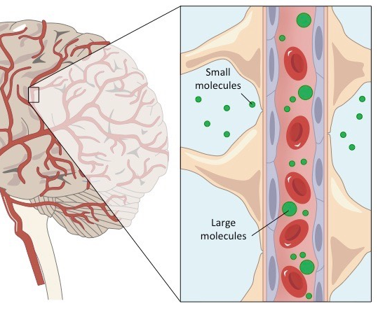
-Brain metastatic cancer cells trigger the destruction of BBB (Blood-Brain Barrier).
-Recognize and bind the endothelial cells, but the mechanisms of it are poorly known.
-Humoral factors are proposed to be the mediators between metastatic cells and the destruction of BBB.
-Extracellular vesicles are known as regulators of malignancy cells by secretory small molecules 🡪 miRNA -181c
-Downregulates the PDKP1 activity resulting in the deregulation of actin fibres.

Slide 4
2. Methods and results

Slide 5
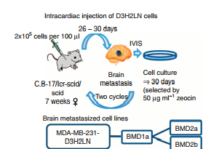
-Isolation of breast cancer cells highly metastatic (1a) were injected in inmunodepressive mice
- Metastatic brain tumors (2a) were developed, suspended in vitro and reinjected in another mice. Metastatic ratio
-From these metastatic cells (2b), extracellular vesicles were extracted.

Slide 6
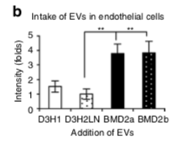
-In vitro BBB adding perycites, endothelium and astrocytes was created. The right function was tested through transendothelial electrical resistance.
-This BBB was mixed with EVs isolated from those highly metastatic brain cells.
- EVs only affected endothelial cells, not pericytes or astrocytes. This is known using EVs.
- The permeability of BBB was tested using NaF.
Cells from (1a), (2a) and (2b) populations were studied
using this method. Cells from (2a) and (2b) showed an
increased permeability ratio.

Slide 7
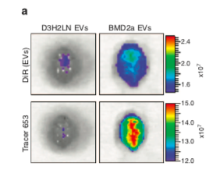
Extraction of cells 1a and 2a and they were marked with fluorescence.
After six hours and using a fluorescent dye in mouse it was observed 2a
Brain metastasis was confirmed by HE staining and immunofluorescence staining against human vimentin.
These results show that 2a cell-derived EVs promoted brain metastasis by increasing the permeability of brain blood vessels, which resulted in BBB breakdown. So EVs affected in somehow the junctions of BBB cells.

Slide 8
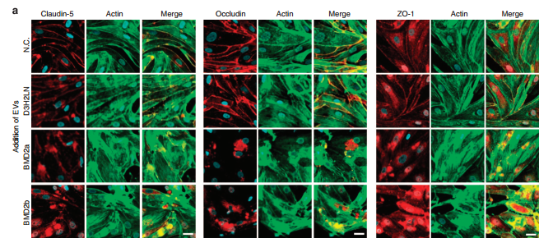
-Tight junction proteins and N-cadherin regulate cell polarity through their intimate association with the actin cytoskeletal network.
-It was observed by co-immunofluorescently that thight junction, N cadherin and actin were in the cytoplasm of endothelial cells after adding the EV of 2a and 2b.
-These proteins are involved in the breakdown of blood brain barrier.

Slide 9
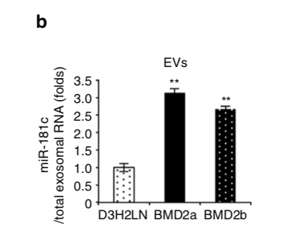
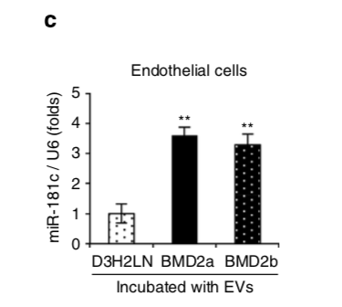
Proteomic and miRNA microarray analysis of EVs isolated from 2a, 2b and 1a cells were performed.
miR-181c was significantly upregulated
EVs from 2a and 2b were transfunded to health endothelial cells. The levels of miR-181c increased. This were also tested in BBB in vitro model.
Serum samples were extracted from patients with breast cancer and brain metastasis and they saw the leves of miR-181c were also increased.

Slide 10
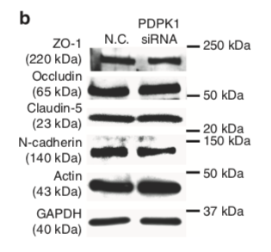
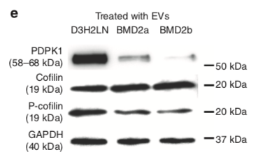
Transfection of miRNA 181c and EV of cells from 1a, 2a and 2b populations were made to endothelial cells.
They observed the downregulation of PDPK1 in transfected cells of 2a and 2b.
PDPK1 interacts with actin and its downregulation is involved in BBB’s destruction.

Slide 11
3. Discussion

Slide 12
Years ago, Zhou et al published that another miRNA, miR-105, supressed the expression of ZO-1 protein, which takes part of tight junctions in BBB. This article support those conclutions.
It’s logical to think that such a complex process, like the destruction of BBB, is not mediated just by one type of miRNA but by some.
This phenomenon, the incorporation of EVs to endothelial cells of brain, could be use to drug delivery in clinical treatments.

Slide 13
4. Open question

Slide 14
Thank you for your attention!

