Slide 1
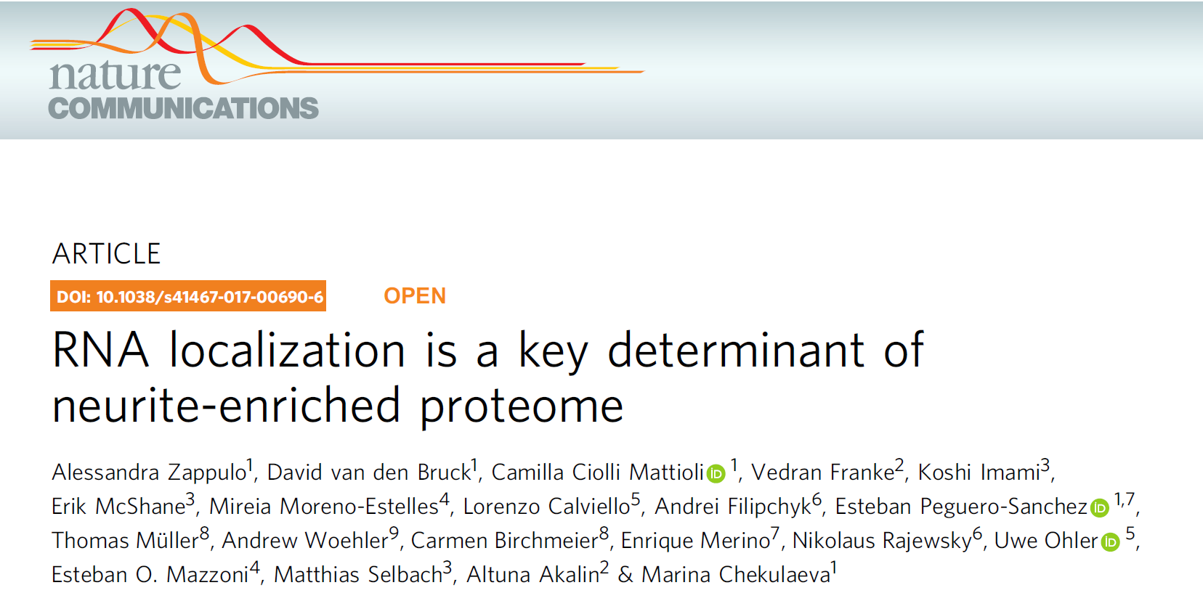

Student seminar
Topic III - Neurons: neuronal diversity, subcellular structure, and function
Emma MERLIN, Federica OLOCCO

Slide 2
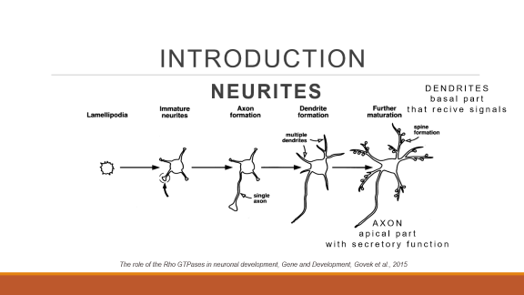
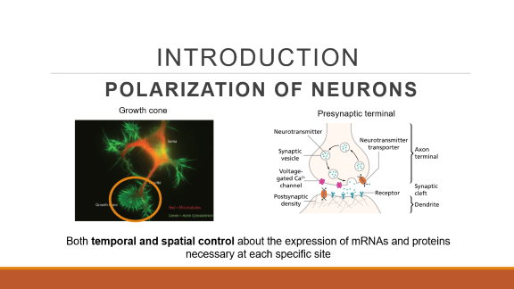
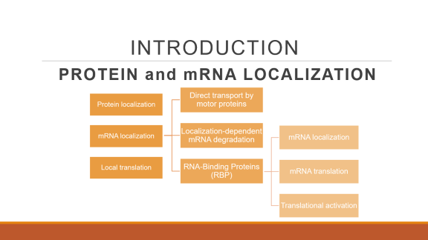
INTRODUCTION

Slide 3
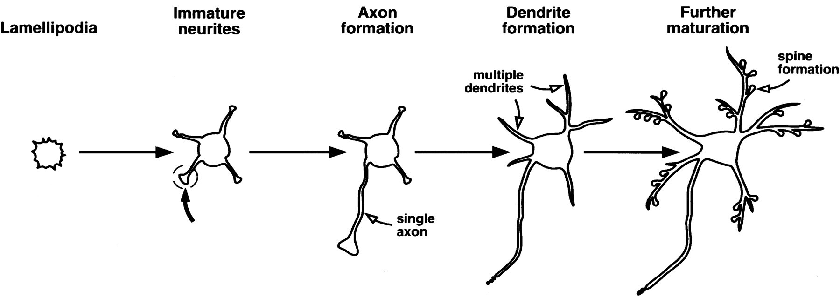
INTRODUCTION
NEURITES
DENDRITES
basal part
that recive signals
AXON
apical part
with secretory function
The role of the Rho GTPases in neuronal development, Gene and Development, Govek et al., 2015

Slide 4
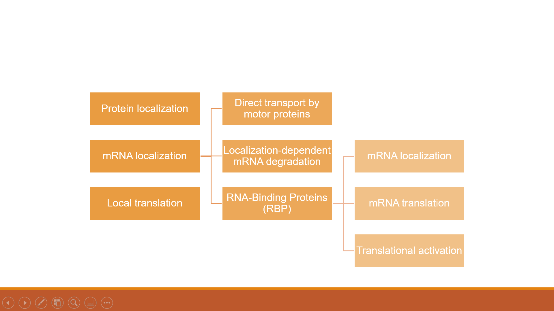
INTRODUCTION
PROTEIN and mRNA LOCALIZATION

Slide 5
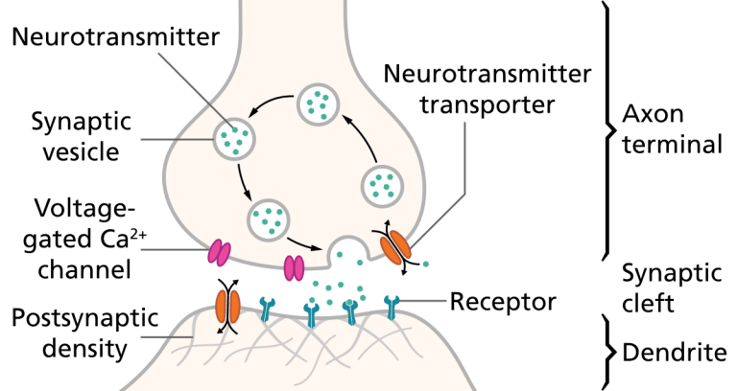
INTRODUCTION
POLARIZATION OF NEURONS
Growth cone
Presynaptic terminal
Both temporal and spatial control about the expression of mRNAs and proteins necessary at each specific site

Slide 6

SCIENTIFIC QUESTION
How and which mechanisms contribute to the general asymmetry and on the formation of a visible polarity in neurites?
The neuron family

Slide 7
MODEL IN VITRO
iNeurons cells
  Neurons differentiated from mouse Embryonic Stem Cells (mESCs) by inducible expression of ASCL1
  Highly heterogeneous
  In a large amount

Slide 8
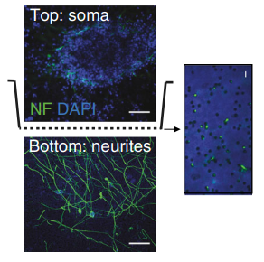
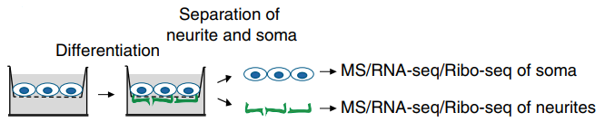
MODEL IN VITRO
iNeurons cells
Cultured on a microporous membrane
RNA localization is a key determinant of neurite-enriched proteome, Nature communications, Zappulo et al., 2019

Slide 9
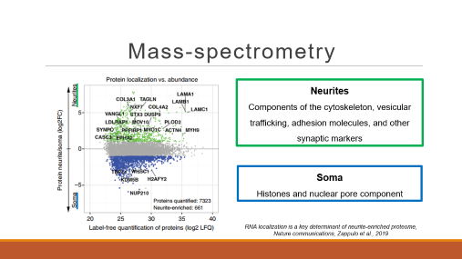
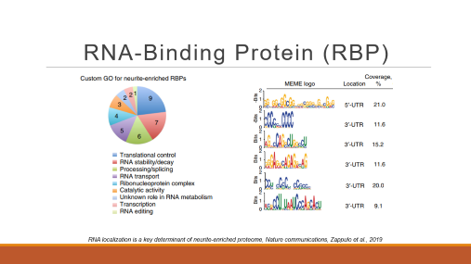
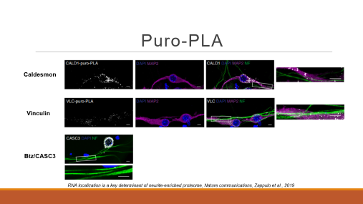
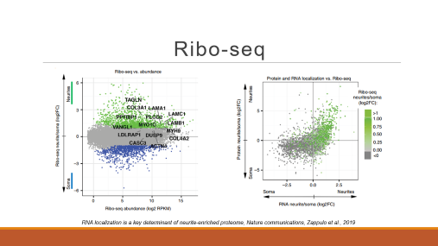
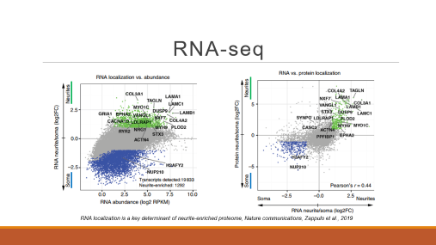
EXPERIMENTAL DATA PRESENTATION
METHODS and RESULTS

Slide 10
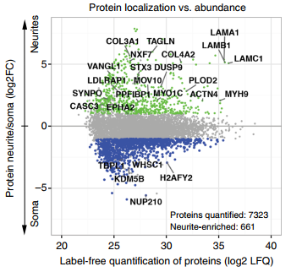
Mass-spectrometry
Neurites
Components of the cytoskeleton, vesicular trafficking, adhesion molecules, and other synaptic markers
Soma
Histones and nuclear pore component
RNA localization is a key determinant of neurite-enriched proteome, Nature communications, Zappulo et al., 2019

Slide 11
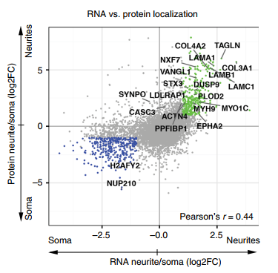
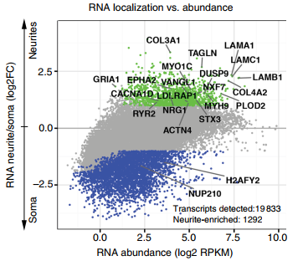
RNA-seq
RNA localization is a key determinant of neurite-enriched proteome, Nature communications, Zappulo et al., 2019

Slide 12
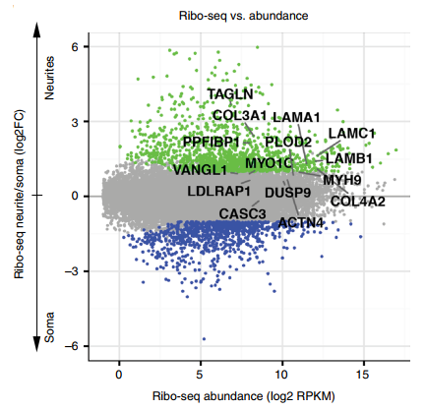
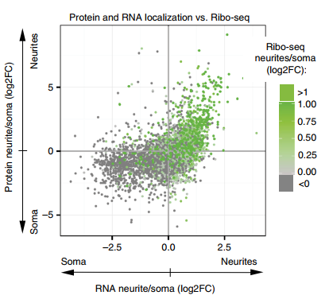
Ribo-seq
RNA localization is a key determinant of neurite-enriched proteome, Nature communications, Zappulo et al., 2019

Slide 13


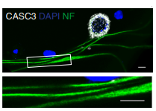
Puro-PLA
Caldesmon
Vinculin
Btz/CASC3
RNA localization is a key determinant of neurite-enriched proteome, Nature communications, Zappulo et al., 2019

Slide 14
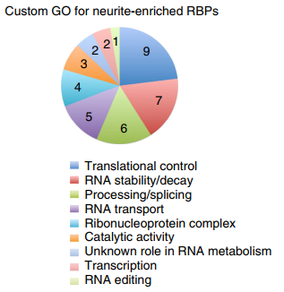
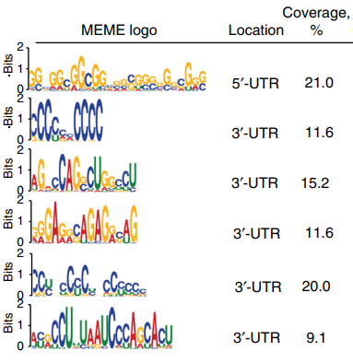
RNA-Binding Protein (RBP)
RNA localization is a key determinant of neurite-enriched proteome, Nature communications, Zappulo et al., 2019

Slide 15
DISCUSSION and CONCLUSION
  Proper sublocalization as key element for physiology and cell polarity
  Proteome and transcriptome asymmetry
  mRNA localization
  Neurite-related function of proteins
  RNA binding protein and non-coding RNA
  Determinant role of RNA establish cell polarity in developing neurons

Slide 16
OPEN QUESTIONS and PROSPECTIVE
  Specific relative contribution to neuronal polarity
  RBPs and recurring motifs
  Axon or dendrite
  Map the brain
  Is change in development also change in adult?
  In vivo model

Slide 17

Thank for the attention!
The neuron family

