Slide 1
Astrocytic neuroligins control astrocyte morphogenesis and synaptogenesis
Jeff A. Stogsdill, Juan Ramirez, Di Liu, Yong Ho Kim, Katherine T. Baldwin, Eray Enustun, Tiffany Ejikeme, Ru-Rong Ji & Cagla Eroglu
Jacopo Pinto, Paolo Piovani

Slide 2
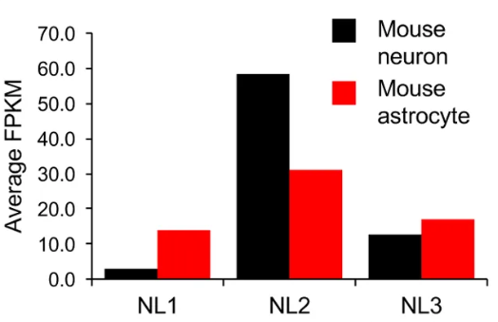
Neuroligin

Slide 3
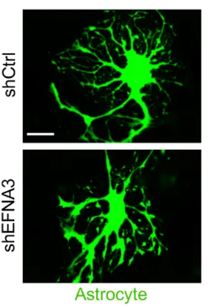
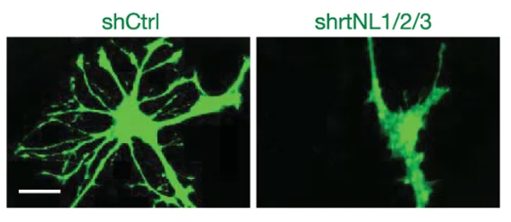
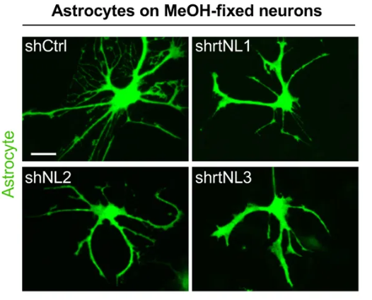
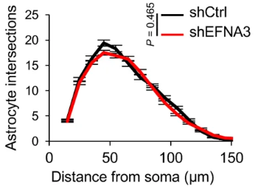
Astrocytes require Neuroligin for complexity
Notes:
Neuroligin is required for the establishment of neuronal contact-induced astrocyte morphogenesis in vitro​​
​
contacts mediated by the ChoE-like domain of NL1 are required for astrocyte morphogenesis and suggest that interactions between astrocytic neuroligins and neuronal neurexins regulate astrocyte development​

Slide 4
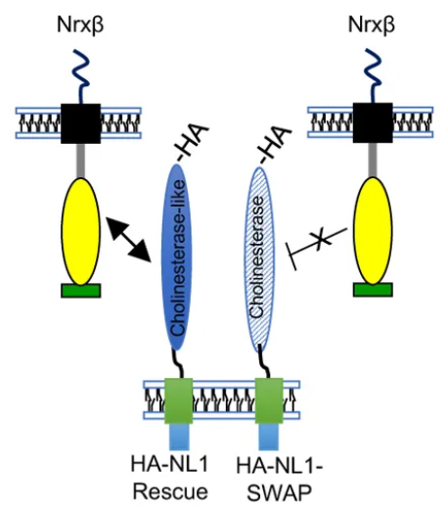
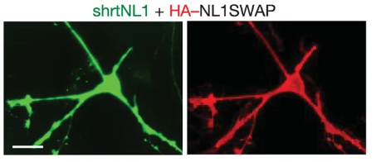
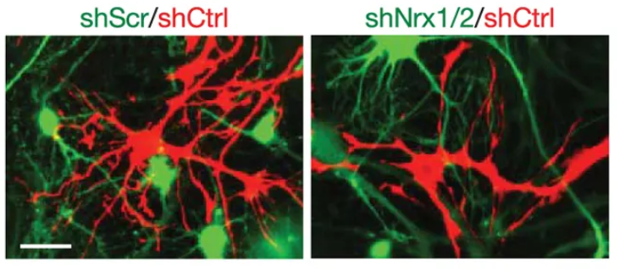
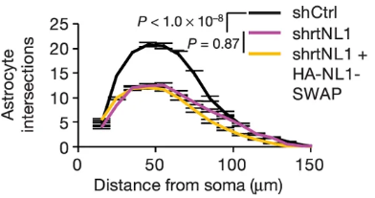
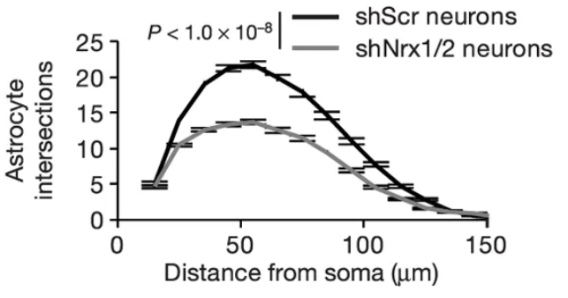
Astrocytes require Neuroligin for complexity
Notes:
Neuroligin is recuired for the establishment of neuronal contact-induced astrocyte morphogenesis in vitro​​
​
contacts mediated by the ChoE-like domain of NL1 are required for astrocyte morphogenesis and suggest that interactions between astrocytic neuroligins and neuronal neurexins regulate astrocyte development
shNL1

Slide 5
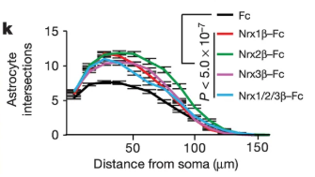
Astrocytes require Neuroligin for complexity

Slide 6
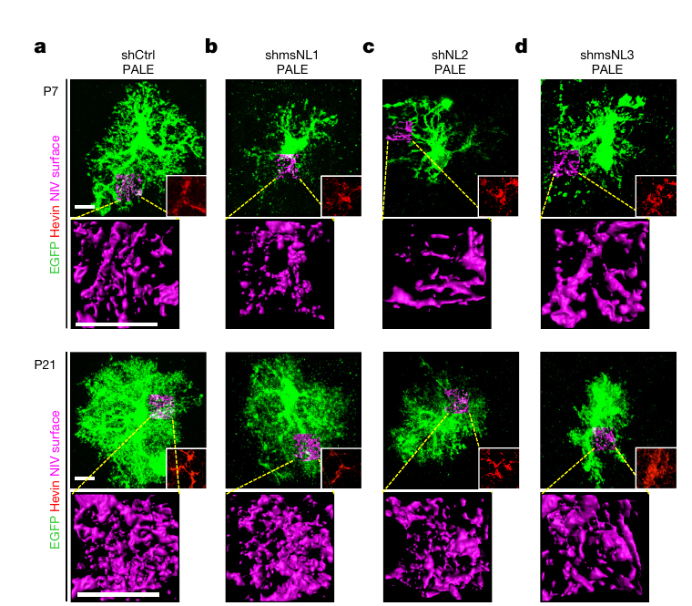
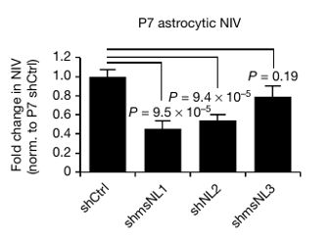
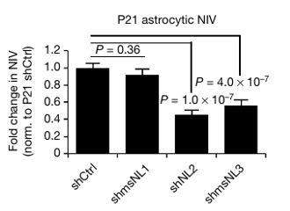
Neuroligins control astrocyte morphology in vivo
Notes:
NL1 KD-> reduce NIV at P7 but it is restored at P21
NL2 KD -> restricted NIV at both time point
NL3 KD-> does not affect the astrocyte morphogenesis at P7, but arrests their grow at P21
Neuroligins have temporal role during development

Slide 7
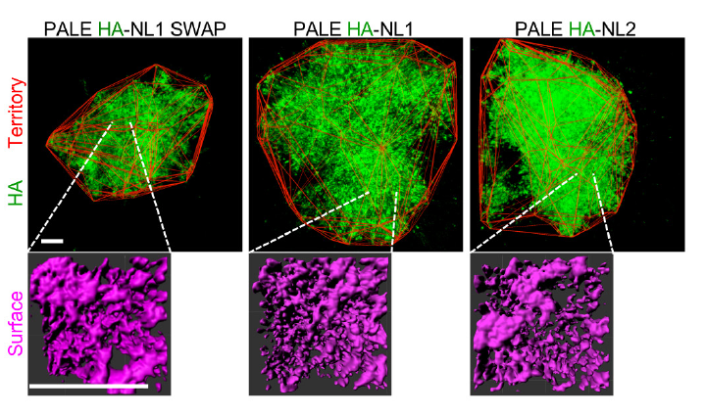
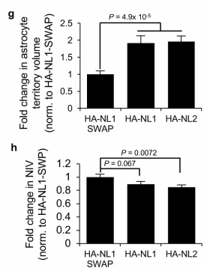
Neuroligins control astrocyte morphology in vivo
Notes:
Overexpression of NLs

Slide 8
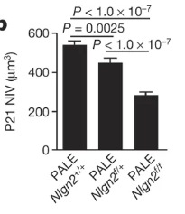
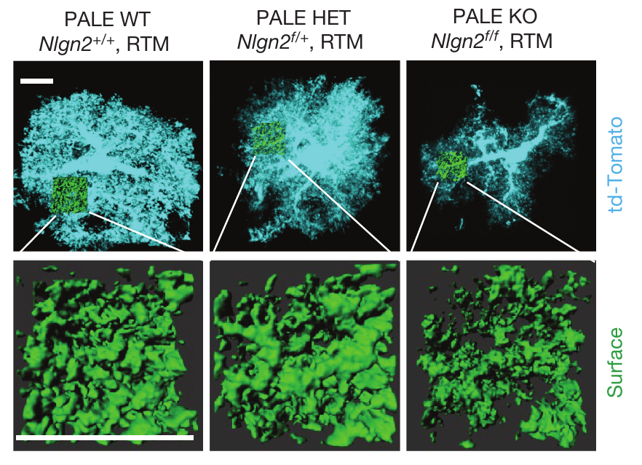
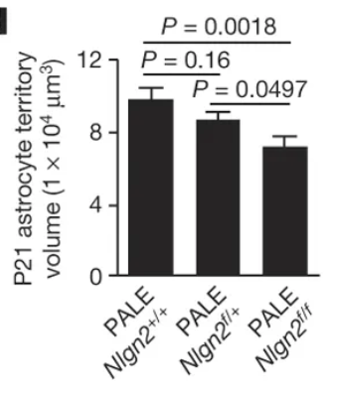
Astrocytic NL2 controls synaptogenesis
Notes:
Nlgn2-floxed mice with Gt(ROSA)26Sor^{tm14(CAG-tdTomato)Hze}

Slide 9
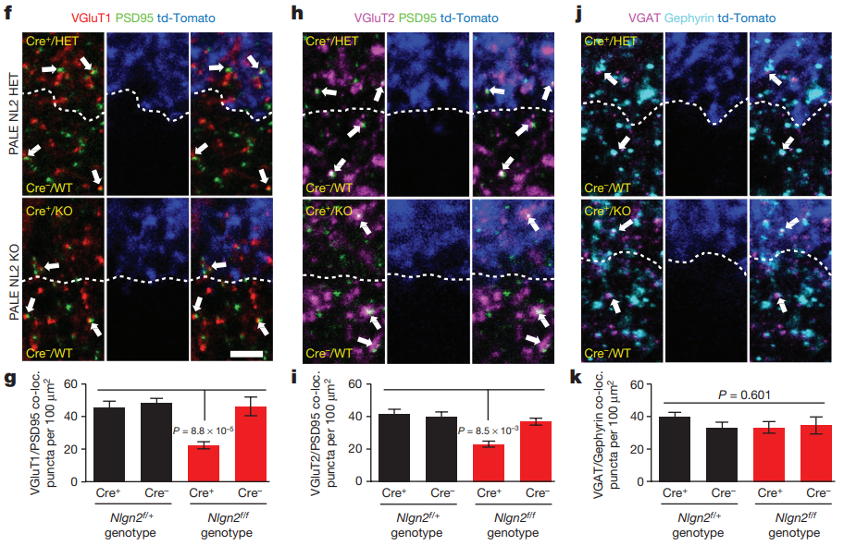
Astrocytic NL2 controls synaptogenesis

Slide 10
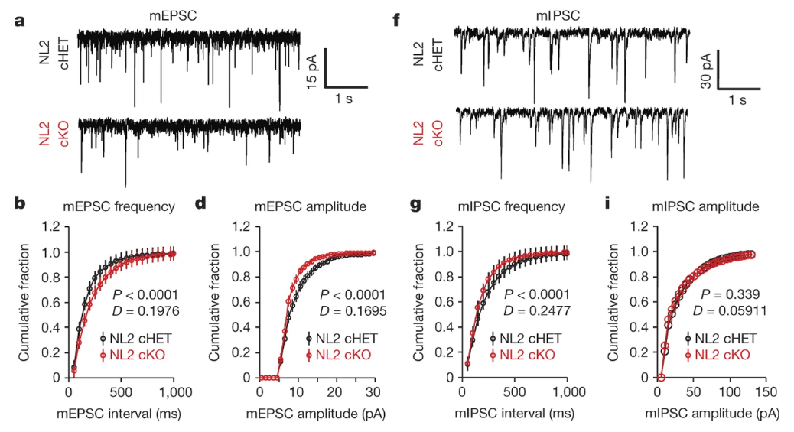
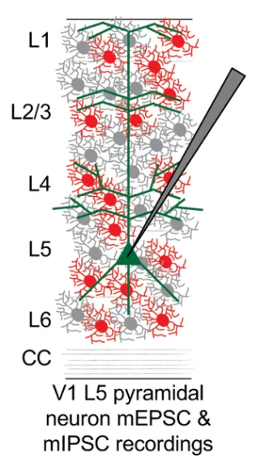
Astrocytic NL2 controls synapse function

Slide 11
Conclusions:
Astrocyte morphogenesis is triggered by direct contact with neurons in vitro
Interactions with neuronal neurexins are required and sufficient for contact-induced astrocyte morphogenesis in vitro
NL2 has an important function in astrocyte morphogenesis in vivo
NL2 is essential for local regulation of synapse development by controlling the formation and/or maintenance of excitatory synapses
NL2 has a critical and previously unknown role as a governor of excitatory and inhibitory synaptic function in the cortex
Gene mutations in neuroligins are associated with a number of neurological disorder such as autism and schizophrenia

