Slide 1
A Unique Microglia Type Associated with Restricting Development of Alzheimer’s Disease
Keren-Shaul et al., Cell, 2017
Ciliberti Rossella, Pattaro Alessia

Slide 2
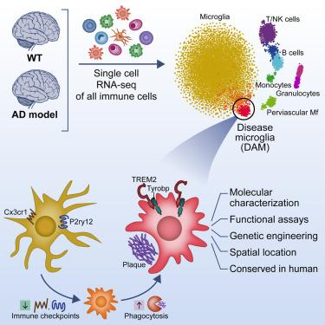
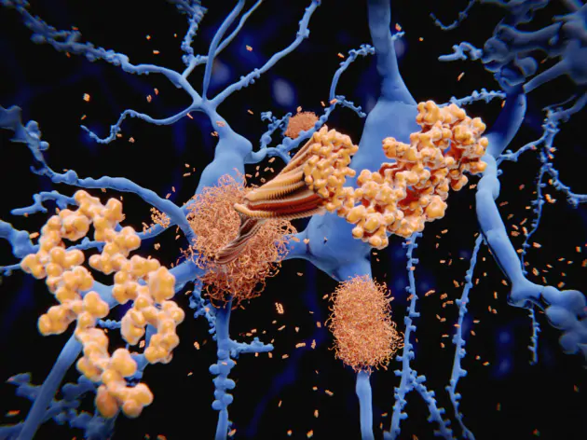
Introduction
Disease-associated microglia (DAM)
Inhibitory pathways suppress unwanted inflammatory responses (CX3CR1)

Slide 3
DAM
What’s the role of this new subtype of Microglia in neurodegenerative diseases?
How can this subtype localization be assessed in brain?
What’s the gene program activated in DAM?

Slide 4
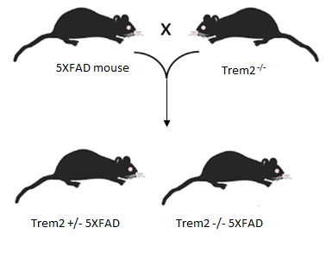
Methods
Heterozygous 5XFAD transgenic mice
For the Trem2 experiments
Heterozygous mSOD1 G93A mice
Human brain tissues of postmortem AD and non-CNS-disease aged matched individuals were obtained from Oxford Brain Bank

Slide 5
Single cell Sorting and Massively Parallel Single-Cell RNA-seq Library preparation (MARS-seq)

Slide 6
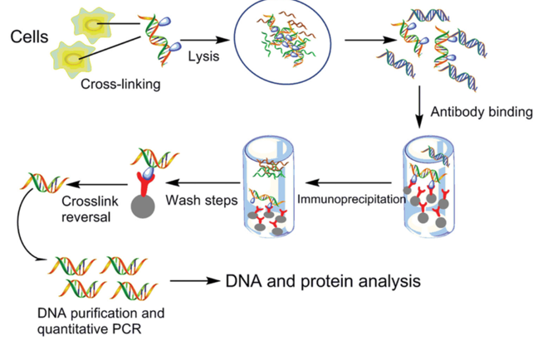
Immunohistochemistry and histochemistry
iCHIP

Slide 7
Results
Identification of a Unique Microglia Type Associated with Alzheimer’s Disease
Lpl
Apoe
Trem2
Ctsd
Tyrobp

Slide 8
Disease-Associated Microglia Dynamics during AD Progression
DAM markers:
CD9
Itgax (CD11c)
Clec7a
Cd63

Slide 9
DAM Are Localized Near the AD Plaques
CD11c and IBA-1 co-expression
Plaque foci
Csf1, Lpl: DAM-specific genes + Aβ
(C) Representative immunofluorescence images of CD11c (green) and microglia (IBA-1, red) in cortical sections of 6-month-old WT and Tg-AD (AD) mice. Cell nuclei are shown in blue (DAPI). Scale bar, 10 μm.
(D) Bar plot showing quantification of CD11c⁺ microglia out of total microglia based on overall 944 cells counted in the cortex of WT and AD mice. ∗∗∗ <0.001. Error bars represent SEM.
(E) Immunofluorescence imaging of CD11c-positive microglia together with Aβ plaques (gray). Scale bar, 10 μm.
(F) smFISH of mRNA molecules for Cx3cr1 (green), a marker for homeostatic microglia, and Csf1 (red), a DAM marker, together with Aβ plaques immunostaining (gray) and DAPI staining (blue) in intact brain tissue taken from 6-month-old WT and AD mice. Imaging of AD mouse brains was performed in a region with low density of Aβ plaques (AD-Aβ distal; bottom left) and in a region with a high density of Aβ plaques (AD-Aβ proximal; right). Large yellow blobs are cytoplasmic auto-fluorescent objects. Scale bar, 5 μm.

Slide 10
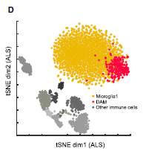
DAM Are Phagocytic Cells Conserved in Human and Other Neurodegenerative Diseases
Lpl: DAM-specific gene
Thioflavin-S: extracellular and intracellular Aβ form label
ALS: amyotrophic lateral sclerosis
(C) Representative image of postmortem AD human hippocampal section (n = 5) stained for LPL (green), microglia (IBA-1, red), and Thioflavin-S (ThioS) for Aβ (gray). Four out of five samples stained positive for microglia expressing Lpl labeled with Aβ particles. Scale bars, 10 μm.
(E) Scatterplot comparing z statistics (Mann-Whitney U test) for the differentially expressed genes in DAM versus homeostatic microglia in ALS (x axis) versus AD (y axis).
(F) Bar plots comparing the percentage of DAM out of CD45⁺ cells taken from the spinal cord of WT and ALS mice at ages 80 days and 135 days.

Slide 11
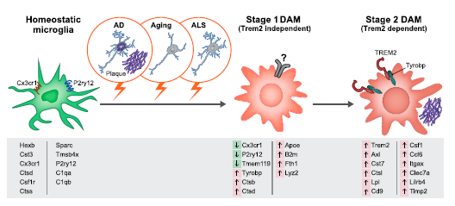
DAM Activation Is Initiated by a Trem2-Independent Mechanism
(A) Projection of microglia on a kNN graph plot displaying the transition from homeostatic microglia (yellow) to stage 1 DAM (orange) and stage 2 DAM (red). The microglia cells (3,864 cells) were extracted from whole brains of 6-month-old WT, 5XFAD, Trem2^{−/−}, and Trem2^{−/−}5XFAD mice (n = 4).
(B) Projection of the mice genotype on the model from (A). Cells enriched for CD11b (microglia; CD45^{low}CD11b⁺) are marked in blue. Cells enriched for CD11c (DAM; CD45^{low}CD11b⁺CD11c⁺) are marked in green.

Slide 12
Discussion
Due to technical limitations, it was difficult to accurately define the immune cell types and states involved in brain homeostasis and disease.
In this paper, overcoming of these limitations was possible thanks to single-cell RNA sequencing that led to the discovery of a novel microglia subtype, DAM.
DAM associates with sites of AD pathology
Trem-2 is a microglia-specific immunoreceptor whose genetic variants are asssociated with increased risk of neurodegenerative diseases and homozygous Trem2 loss of function mutations cause dementia in humans.
Tyrobp induction in DAM.
Two step activation of DAM: Trem2-independent and Trem2-dependent.
microglia homeostatic factors downregulation lipid metabolism and phagocytic pathway induction
Beneficial and detrimental role of DAM: therapeutic (or preventive) approach.
ALS

Slide 13
Perspectives
Therapeutic approach?
Can DAM be involved in other neurodegenerative diseases?
Other new Microglia subtypes?

Slide 14
Bibliography
Keren-Shaul et al., 2017. A Unique Microglia Type Associated with Restricting Development of Alzheimer’s Disease. Cell. 169(7):1276-1290.e17. doi: 10.1016/j.cell.2017.05.018
Wang et al., 2015. TREM2 Lipid Sensing Sustains the Microglial Response in an Alzheimer’s Disease Model Cell;160(6):1061-71. doi: 10.1016/j.cell.2015.01.049.
Chakrabarty et al., 2015. IL-10 alters immunoproteostasis in APP mice, increasing plaque burden and worsening cognitive behavior. Neuron 85, 519–533.
Manassero et al., Beta-amyloid 1-42 monomers, but not oligomers, produce PHF-like conformation of Tau protein Aging Cell 2016, 15, 914
A Unique Microglia Type Associated with Restricting Development of Alzheimer’s Disease

Slide 15
THANK YOU FOR YOUR ATTENTION!

