Slide 1
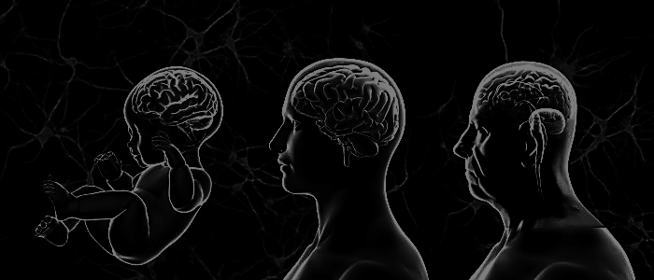
PARK2, PARKIN and PARKINSON

Slide 3
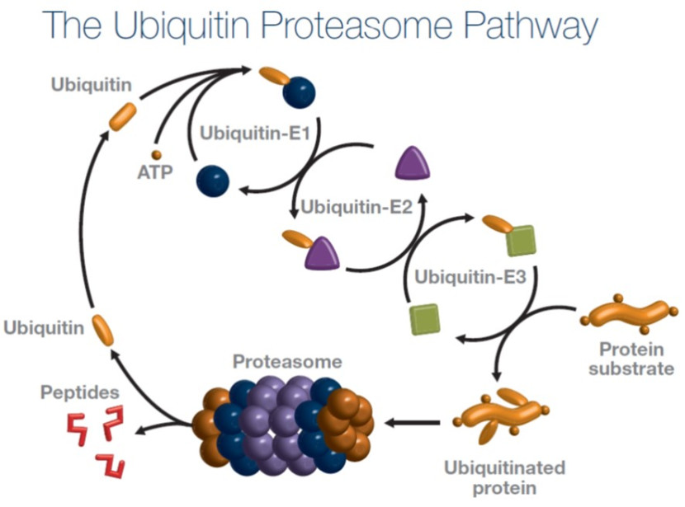
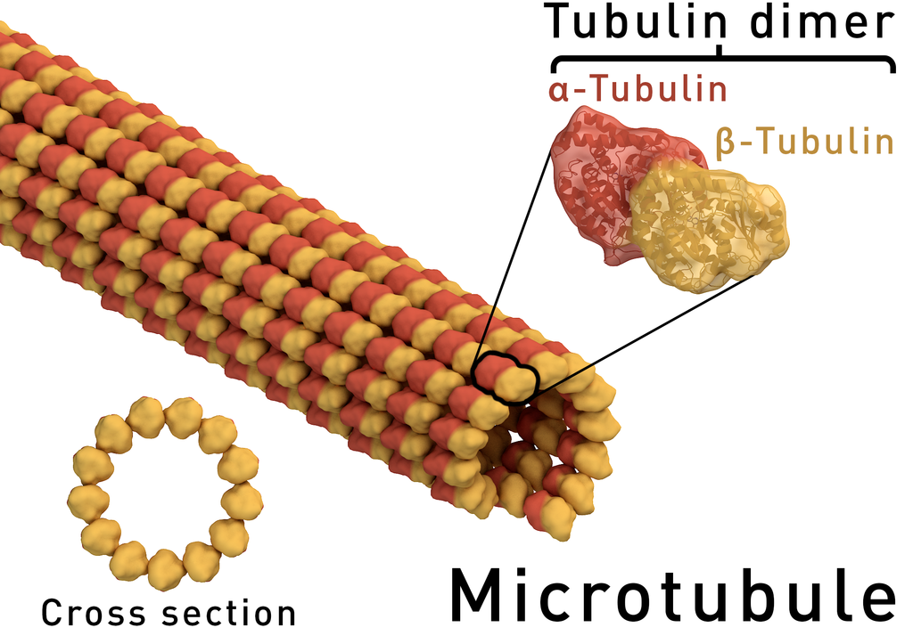
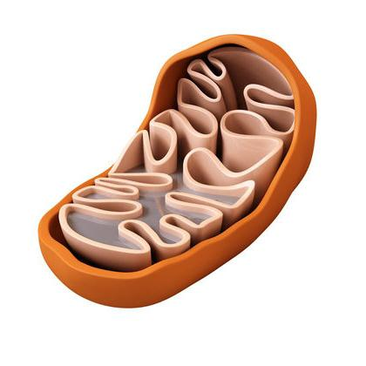
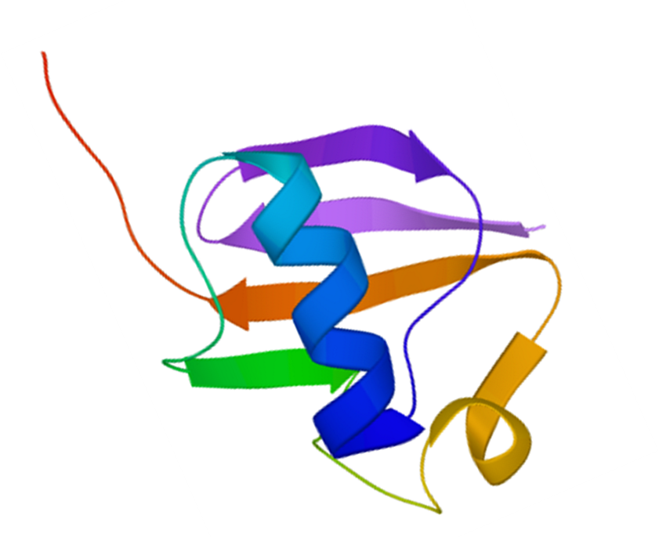
PARK2 gene
MTs dysfunction may be a crucial point in pathogenesis of Parkinson’s disease?
What is the potential effects of Parkin on MTs during aging?
CHROMOSOME 6
Deletion or mutations of PARK2 gene impacts on mitochondria function and MTs turnover and stability
Failure of Parkin plays a major role in aging and age-related disease

Slide 4
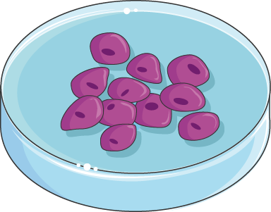
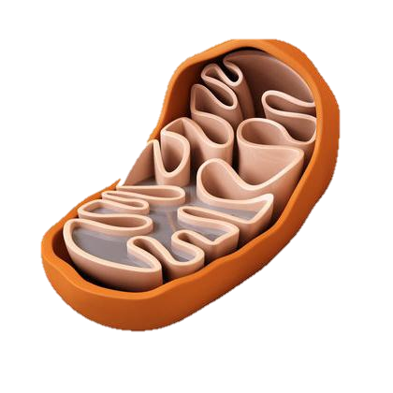
METHODS
Confocal analysis
Immunoelectron microscopy
Western blot
Live-cell imaging
KO
shRNA
PARK2
2 different sets iPS cells lines
With different exon deletion mutations or a point mutation
PC12
WT
10/15 sec
6 sec

Slide 5
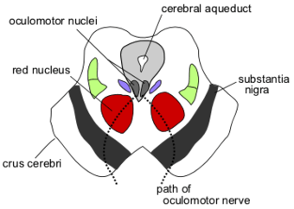
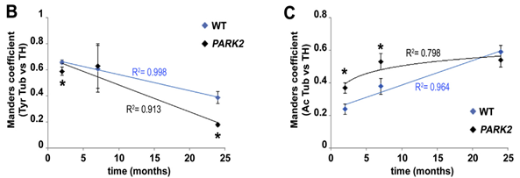
Results
Corpus striatum
Substantia nigra
AGING
ACCELERATE
Evaluate the stability of MTs.
Parkin absence leads to the MT hyperacetylation in mice
2 months
24 months

Slide 6
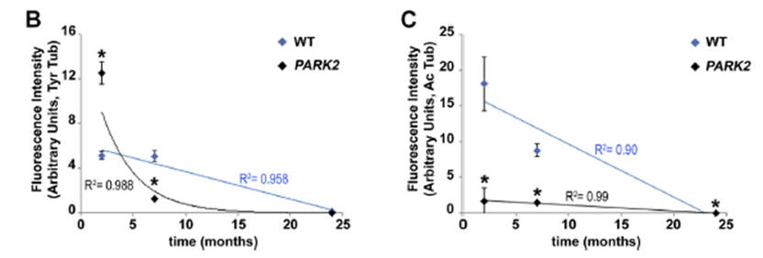
Results
Parkin absence leads to the unbalance in tubulin PTMs in the substantia nigra
Confocal images of substantia nigra of WT and PARK2 knockout mice of different ages

Slide 7
Results
PARKIN ABSENCE IMPACTS MITOCHONDRIAL TRANSPORT IN VIVO.
Electron micrographs of TH-positive
fibers
mitochondria
Confocal images showing the different distribution of mitochondria

Slide 8
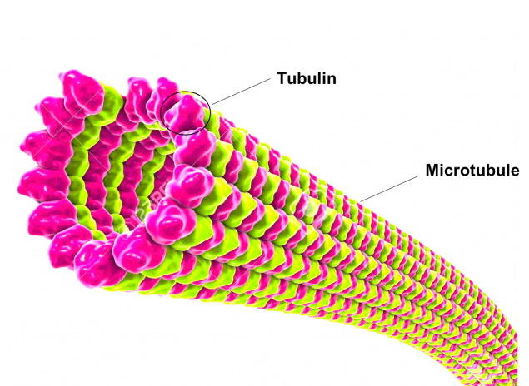
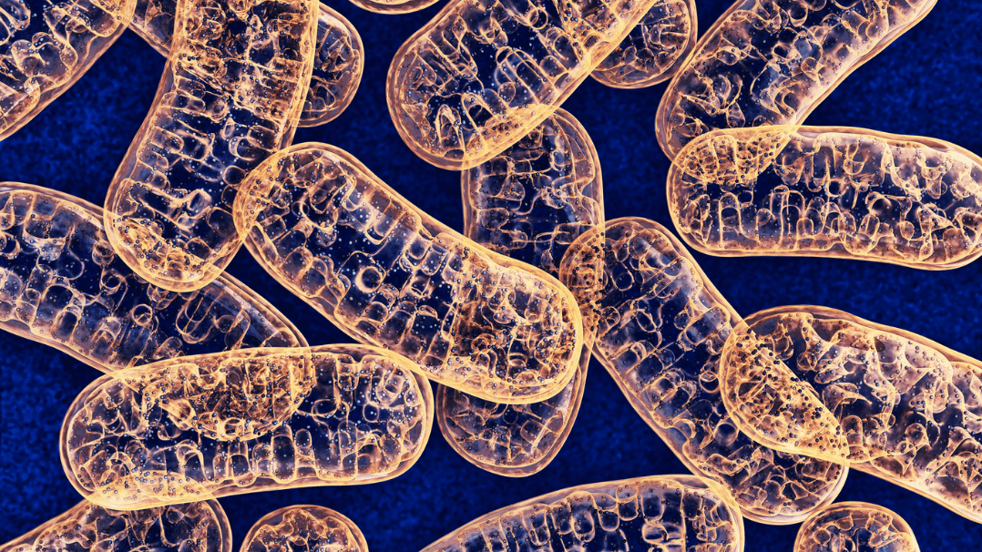
Unbalance of α-tubulin PTMs in PARK2 KO mice
Mitochondria accumulation
PARKIN DIRECTLY MODULATES MTs DYNAMICS?

Slide 9
Results
In parkin silenced PC12 cells there is an increase of Tyr tubulin
Western blot (A) and densitometric (B) analysis. Acetylated Tubulin (Ac Tub) and Tyrosinated tubulin (Tyr Tub) comparison shSCR and Parkin silenced cells (shPARK2)

Slide 10
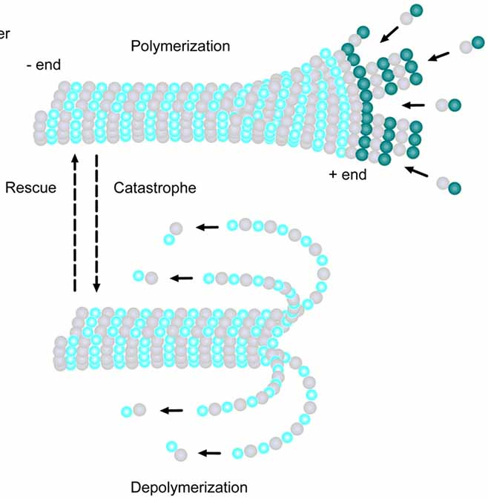
Results
Parkin absence significantly accelerates MT growth
Live cell data using shPARK2 and shSCR cells: in basal conditions (CONT) or after 2 hours of treatment with 1 mM paclitaxel (PTX).

Slide 11
Results
Absence of parkin causes a disorientated mitochondrial trafficking
(H) Histogram showing the percentage of immobile mitochondria (stop, black), mitochondria forward (FWD, light gray) or backward (BWD, dark gray) moving.
Box plots of anterograde velocity (F) and retrograde velocity (G) of mitochondrial transport in shPARK2 and shSCR cells, in basal conditions (CONT) or after 2 hours of treatment with 1 mM paclitaxel (PTX).

Slide 12
Results
PARK2 deficiens cause discontinuity in the Ac MTs, suggesting the idea of a possible intrinsic weakness of MT cytoskeleton in PD patients neurons where functional parkin is missing
(A) Double staining of Tyr Tub (red) and Ac tubulin (green) of a single axon.
(B) Histogram showing the percentage of neuronal processes with continuous (CONT, white) or gapped (GAP, black) Ac tubulin staining in parkin-silenced PC12 cells, in healthy control and in PD patient-derived neurons.

Slide 13
Discussion
֍ PARK2 KO mouse model exhibits nigrorostral deficits.
֍ Parkin is involved in the regulation of the MT system dynamics.
֍ Its reduction in aging and neurodegenerative processes in mice lead to the impairment of mitochondrial transport in an MT dependent manner.
֍ Parkin deficiencies specifically affect Ac MTs, causing discontinuity in the structure.
֍ Mitochondrial transport impairment follows MT hyperacetylation in PARK2 KO mice.

Slide 14
Future forecast
The parkin-mediated deregulation of tubulin acetylation in MTs would possibly induce the PD-associated degenerative process. Starting from this conclusion, we can make some predictions forecast:
֍ Could the modulation of enzymes that specifically acetylate or deacetylate MTs the base of “MTs rejuvenation”?
֍ Paclitaxel restored the physiological MTs growth rate and correcting the direction of mitochondria movement. Could be Paclitaxel a possible treatment for Parkinson disease?

Slide 15
Bibliography
Toyama and Hetzer, Protein homeostasis: live long, won’t prosper. Nat. Rev. Mol. Cell Biol. 14, 2013
https://www.youtube.com/watch?v=4USR1Yrxd5A
Cartelli D, et al., 2013. Microtubule alterations occur early in experimental parkinsonism and the microtubule stabilizer Epothilone D is neuroprotective. Sci. Rep. 3
The Role of the Microtubule Cytoskeleton in Neurodevelopmental Disorders - M. Lasser - Frontiers, 201

Slide 16
Thank you for your attention!
anyway...

Slide 17
METHODS nutshell
Immunoelectron microscopy: thin section, 70 nm, were analysed, after previous immuno-enzymatic procedure with anti-TH , with Philips-CM10 transmission microscope, images, acquired by a digital camera, show quantitative analysis on: mitochondrial aggregation and axon dimension.
Western blot analysis: on proteins from PC12 cells or Mouse brain regions
Confocal analysis: on sagittal sections stained with antibodies:
Tyr tubulin rat IgG
Ac tubulin mouse IgG
VDAC1/porin rabbit IgG
On dopaminergic neurons they use TH antibody mice or rabbit. On different regions: corpus striatum, substantia nigra, nigrostriatal pathway
Live cell imaging: on PC12 cells differentiated in cultures for 3 days, by using NGF, and after parkin silenced using Lipofectamine 2000 and shRNA with a GFP. They were transferred to a heated chamber with a inverted microscope. They recorded a 3’ movie with cooled camera every 6’’ for MT growth and 10 ‘’ for mitochondrial trafficking

