Slide 1
SEX-SPECIFIC FEATURES OF MICROGLIA FROM ADULT MICE
Linda Petrucci
Isabella Tarulli
Villa et al., 2018, Cell.

Slide 2
INTRODUCTION
MICROGLIA

Slide 3
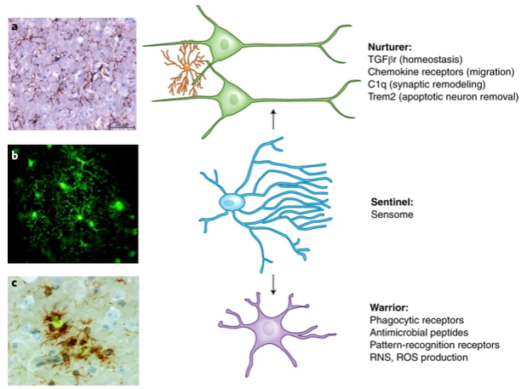
INTRODUCTION
1918: Pio del Rio Hortega → “the third element of CNS”
Principal resident immune cells of CNS
Involved in CNS health and disease
MICROGLIA
Physiological functions
1. Nurturer
Homeostasis
Synaptic remodeling
Synaptic pruning
Phagocytosis
Synthesis of repair factors
2. Sentinel
3. Warrior
Defense
Neuroprotection

Slide 4
INTRODUCTION
Reactive microgliosis → damage associated molecular pathways (DAMPs)
Microglia activation after ischemic injury and others CNS diseases
MICROGLIA
PRO-INFLAMMATORY SIGNALING
STROKE
ANTI-INFLAMMATORY SIGNALING

Slide 5
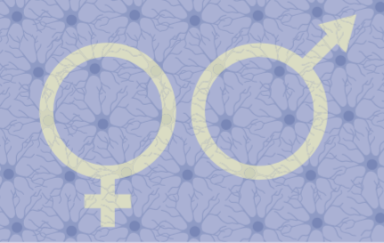
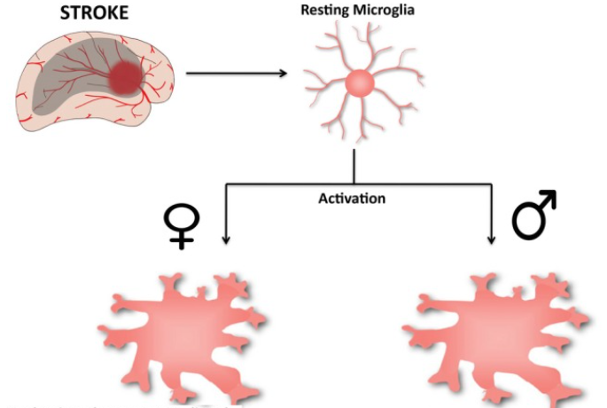
INTRODUCTION
SEX INFLUENCE
Sex has a role in the incidence and outcome of neurological diseases
Sexual dimorphism of microglia after CNS injury
Microglia are responsive to estrogens
Estrogens have anti-inflammatory and neuroprotection activities

Slide 6
SCIENTIFIC QUESTIONS
Identification of trascriptional differences in male and female microglia
Role of these sex-related differences in normal developmental programs and neural pathology
Notes:
Considering all of these findings, the autors started by asking themselves which trascriptional differences were underlying these differen behaviuors observed in male and female microglia and, subsequently, if these differences had any kind of implication with physiological developmental programs and thus if there was any link with neural pthology.

Slide 7
RESULTS
MICROGLIA TRANSCRIPTOME
Notes:
So, the first thing to do was investigate in detail all the trascriptomic details differentiating the migroglia in the two sexes.

Slide 8
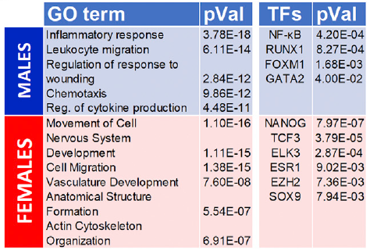
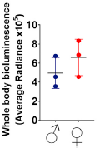
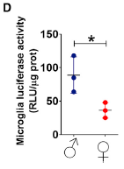
RESULTS
RNA-Seq
MICROGLIA TRANSCRIPTOME
Associated with inflammatory processes
Negative regulation of neurogenesis
Associated with morphogenesis
Repairing mechanisms
Luciferase
assay
Luciferase expression is under control of a
NF-KB responsive synthetic promoter
Male microglia is more poised to inflammatory response than female microglia
Notes:
Trascriptomic analysis and RNASeq highlited a list of differentially expressed genes between male and female microglia: the majority of the genes expressed in male microglia were regulated by TF NFKB and RUNX1, that has been associated with inflammatory activity and negative regulation of neurogenesis. In the female, instead, most of the genes were regulated by TF NANOG and TCF3, mostly associated with morphogenesis, inhibition of inflammatory response and promotion of repairing mechanisms. All of these assumption were confirmed by a luciferase assay, where the authors used a luciferase which expression was regulated by a NFKB responsive promoter, active under inflammatory response. What they saw was that in the whole body the bioluminescence between males and female didn’t present significant differences, whilst specifically in the brain the luciferase was way more expressed in males than in females, highliting a higher level of inflammation.

Slide 9
RESULTS
ESTROGEN ROLE
Notes:
After all of these observation, the next question was if all of these differences were due to different levels of circulatin estrogens between males and females.

Slide 10
RESULTS
ESTROGEN ROLE
OVX
With/without estrogen replacement after 3h and 24h
Differences between OVX females/males and cycling females/males were not significant
DEGs were more expressed in OVX female rather than in wt females but still less than in wt males
Circulating level of sex-hormones are not implicated in this differentiation
Notes:
To answer, authors created a sort of a «breed» model, ovariectomized mice with or without estrogen replacement in 3h and 24h. After ovariectomy the diffences between female and male microglia were not significant, suggesting that the circulating level of estrogen were not fundamental in this diffentiation. Moreover, differential expressed genes had higher levels of expression with respect of wt females but still inferior to wt males ones.

Slide 11
RESULTS
TRANSPLANTATION FROM TRANSGENIC FEMALES COSTITUTIVELY EXPRESSING LUCIFERASE IN MALES MICE WAY VIA TSN ROUTE
Notes:
To demonstrate that microglia differentiation is a process indipendet from the in vivo hormonal content, authors transplanted female microglia identificable with luciferase, expressed costitutively and indipendently from the sex, in males mice via transnasal route

Slide 12
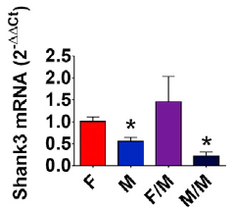
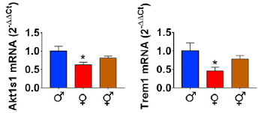
RESULTS
TRANSPLANTATION
Xist mRNA in males → succesful transplantation
Not altered by the transplantation = genomic/epigenetic component?
Proliferation
Sex-specific identities
Brain masculinization:
aromatase
Testosterone Estradiol
Notes:
First of all, the authors were sure that the transplantation was succesfully by measuring expressio levels of Xist, transcripted only in female microglia beacuse of the x chromosome redundancy absent in males. Increasing levels of expression between 3days and 5days after transplantation suggested that the micrgolia was trascriptionally active. Second of all, authors were able to demonstrate that proliferation levels, investigated by measuring Ki67 mRNA levels was not altered by this presidure. Moreover, sex dependent expressed genes mantained their identities both in male and female microglia as demonstrated by the absence of changes between the specific expression before and after the treatment (male genes stay high in males and female genes low, and viceversa in females). So, given the fact that nor proliferation neither sex specific identities were altered by the transplantation suggeste the authors thay a genomic or an epigenetic component may be involved in this differentiation. These component was identified in the perinatal aromatization of testosterone in estradiol that is involved in the process of brain masculinization, and confirmed by the fact that masculinazed females had an expression pattern more similar to males than to females.

Slide 13
RESULTS
FUNCTIONAL RELEVANCE IN ISCHEMIC MICE
Notes:
The last step was the investigation of functional relevance of these differentiation. For this reason authors observed microglia behaviour in ischemic trasplanted mice with induced permanent middle cerebral artery occlusion because it has largely been demostrated that young females present less wide injuries than young male after an ischemic attack.

Slide 14
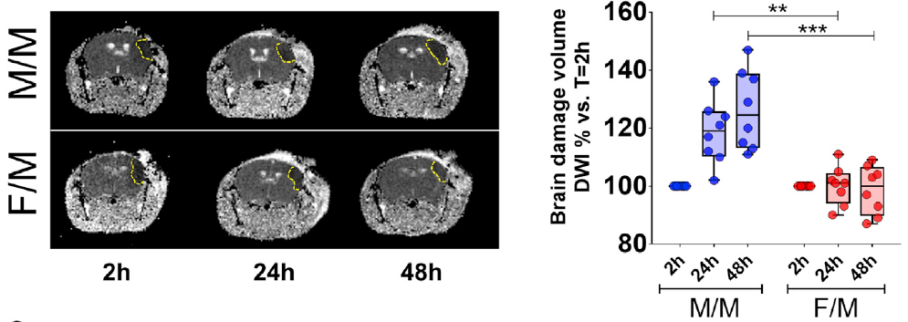
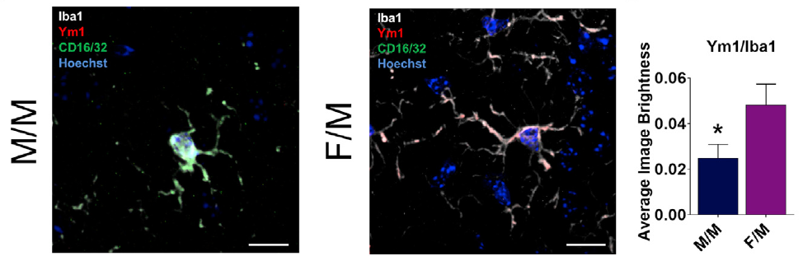
RESULTS
FUNCTIONAL RELEVANCE
F/M present a less extended lesion
F/M present a higher anti-inflammatory phenotype
Notes:
the first thing that they noticed was that observing with MRI trasplanted male mice presented a less extended injury than wt males, demonstrated also by diffusion weighted imaging that evaluates the content of water in the lesion, correlated with its extension. As we see from the graph is very much inferior in trasplanted mice than in wt. Moreover, by immunostaining we can observe that microglia, marked with Iba1m in wt males present higher levels of this CD16/32 marker associated with inflammation, and thus it appears greenish, whilst in trasplanted mice we see a redish shadow on the cell given by the expression og Ym1, associated with anti inflammatory processes, which as we can see from the graph being more expressed in trasplantated mice than in wt.

Slide 15
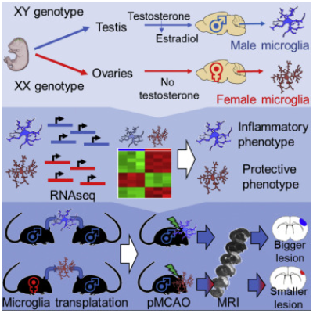
CONCLUSIONS
Transcriptome sequencing indicates sexual differentiation in adult murine microglia
Female microglia show a neuroprotective phenotype, independent from hormonal environment
Female microglia phenotype is retained after transfer into male brains
The presence of female microglia protects male brains from ischemic stroke

Slide 16
FUTURE PERSPECTIVES
The mechanism involved in microglia sexual differentiation remains to be determined
Role of estrogen
Better understanding of the relationships among the endocrine, immune, and nervous systems in young and adult individuals
Sex-related approach therapy

Slide 17
BIBLIOGRAPHY
Suzanne Hickman, Saef Izzy, Pritha Sen, Liza Morsett & Joseph El Khoury, 2018. Microglia in neurodegeneration. Nature Neuroscience
Michael W Salter & Beth Stevens, 2017. Microglia emerge as central players in brain disease. Nature Medicine
Wilbur M. Song & Marco Colonna, 2018. The identity and function of microglia in neurodegeneration. Nature Immunology
Margaret M. McCarthy, Bridget M.Nugent & Kathryn M.Lenz, 2017. Neuroimmunology and neuroepigenetics in the establishment of sex differences in the brain. Nature Reviews Neuroscience
Alessandro Villa, Sara Della Torre, Adriana Maggi, 2019. Sexual diﬀerentiation of microglia. Frontiers of Neuroendocrinology
Alessandro Villa et al., 2018. Sex-Specific Features of Microglia from Adult Mice. Cell Reports
Kerr N, Dietrich DW, Bramlett HM, Raval AP, 2019. Sexually dimorphic microglia and ischemic stroke. CNS neuroscience and therapeutics

Slide 18
THANK YOU FOR YOUR ATTENTION

