Slide 1
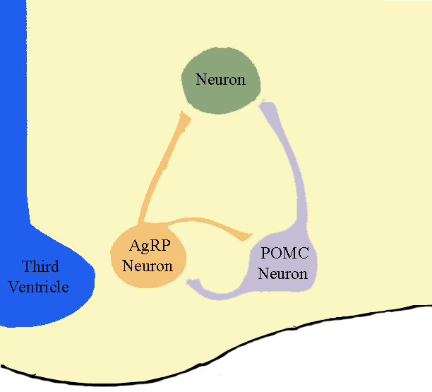
Energy Homeostasis
Second order
Neurons
(TRH, HCRT…)
First order
neurons
Adipocyte
Energy stores
Hypothalamus
Leptin
Fat

Slide 2
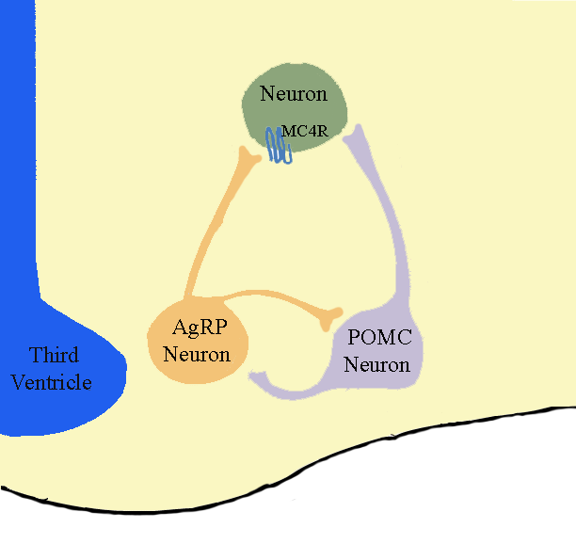
Energy Homeostasis
Reduced food intake,
Increased energy expenditure
α-MSH
Hypothalamus
Leptin
Fat

Slide 3
Energy Homeostasis
Reduced food intake,
Increased energy expenditure
Increased food intake
Decreased energy expenditure
AgRP
α-MSH
Hypothalamus
Leptin
Fat

