Slide 1
Ch4 – Lesson 3.1
further RNA processing

Slide 2
Co-transcriptional processes:
5’-capping
Exon splicing
3’-polyadenylation
Post-transcriptional regulation
editing – methylation
Transport to cytoplasm (for a fraction of RNAs)
Quality control
Localization to cellular subcompartments
Regulated translation
Regulated degradation
RNA interference

Slide 3
Other post-transcriptional modifications to RNAs
N⁶-methyladenosine (m⁶A) (the most studied today – the most frequent)
N¹-methyladenosine (m¹A)
5-methylcytosine (m⁵C)
Pseudo-uridine (most abundant, mostly in rRNA and tRNA, but several mRNAs)
2’-O-methylnucleosides (methylation of 2’-OH of ribose)
Mainly in the nucleus, methylation is frequently co-transcriptional

Slide 4
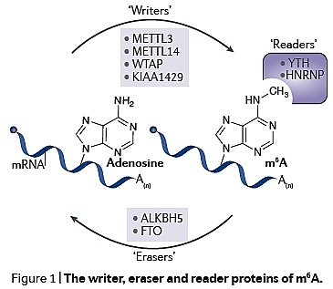
RNA adenine methylation
The YT521‑B homology (YTH) domain family of proteins (YTHDF1, YTHDF2, YTHDF3 and YTHDC1) are direct readers of m⁶A and have a conserved m⁶A-binding pocket.
The heterogeneous nuclear ribonucleoprotein (HNRNP) proteins HNRNPA2B1 and HNRNPC selectively bind m6A-containing mRNAs.
Consensus sequence:
« RRACH »
Localized primarily in nuclear speckles

Slide 5
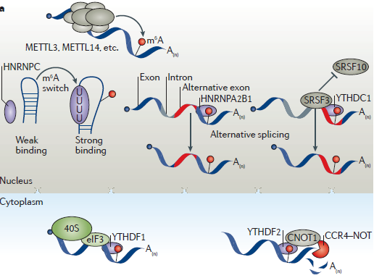
The methyl group at the N6 position of m⁶A does not change Watson–Crick A•U base pairing but weakens duplex RNA by up to 1.4 kcal per mol
Consequence: “indirect” or “direct” effects on protein binding.
indirect
direct
Apparently opposing effects of YTHDF1 and YTHDF2

Slide 6
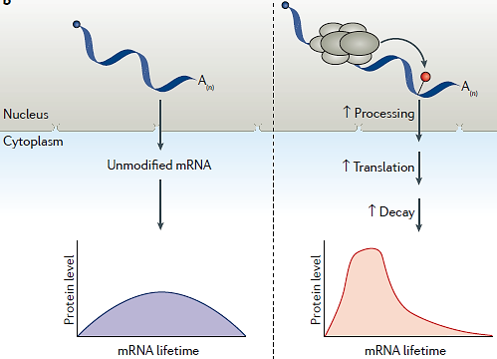
All steps of RNA metabolism were found to be accelerated by m⁶A
A general effect therefore is «sharpening» the window of expression

Slide 7
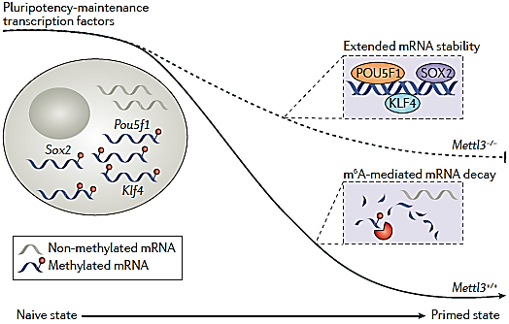
Mettl3-/-
Mettl3+/+
METTL3 is required for the transition of mouse ES cells from a naive to the primed state. During this process, the key pluripotency factor Pou5f1, Klf4 and Sox2 must be cleared.
In mouse ES cells lacking Mettl3, this clearance is defective because non-methylated mRNAs are less subjected to decay, which prevents or delays the establishment of a differentiated transcriptome required to achieve a primed mouse ES cell state. (from Zhao et al., 2017, mod.)

Slide 8
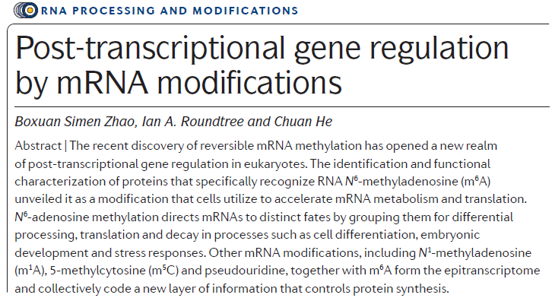
For those of you who are interested in knowing more:

Slide 9
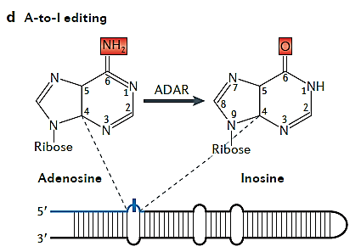
RNA Editing
Inosine behaves as a «G» in translation and secondary structures
Adenosine-to-inosine (A-to-I) editing is carried out by adenosine deaminases acting on RNA (ADAR), which deaminate adenosines into inosines.
The folded GLUR‑2 pre-mRNA substrate is shown with the exon in blue and intron in grey.
Bentley, 2014

Slide 10
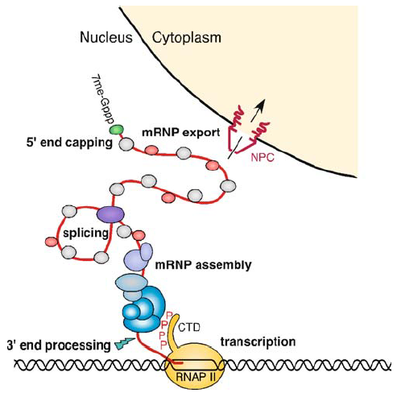
Transport to the cytoplasm
Nucleo-cytoplasmatic transport
dedicated exportins
accompanying proteins are loaded co-transcriptionally
some accompanying proteins kept, other exchanged during transport
mRNP, rather than mRNA
exon junction complex (EJC)
During the second step of splicing, the EJC is deposited approximately 20-24 nt from the 5’ end upstream of the splice junction.
The EJC is made up of several key proteins: RNPS1, Y14, SRm160, Aly/REF and Magoh, among others. These proteins have functions in splicing and transport.
Important function in NMD.
Schematic view of the nuclear side of eukaryotic gene expression, from transcription to nuclear export. NPC Nuclear pore complex, CTD C-terminal domain of Rpb1, RNAPII RNA polymerase II.

Slide 11
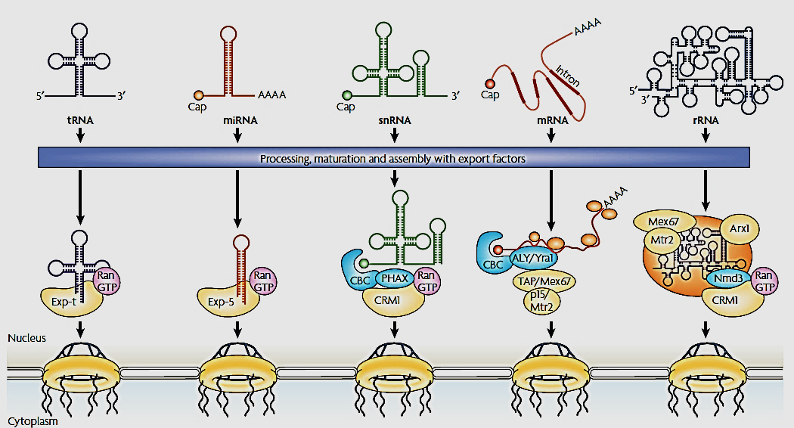
Different RNA export pathways. export adaptors and export receptors
The names of both metazoan and yeast proteins are indicated.
CBC, cap-binding complex; Exp, exportin.
(From Kohler & Hurt, Nat Rev Mol Cell Biol, 8:761, 2007).

Slide 12
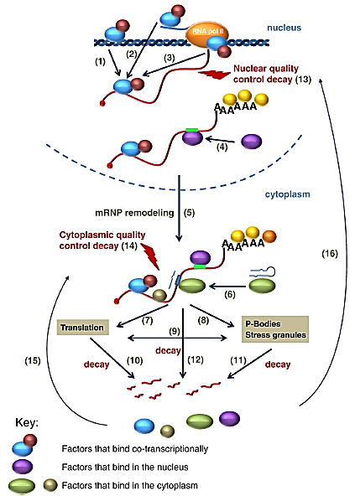
nucleus
cytoplasm
localization
RISC
Modified from: Pérez-Ortin 2015

Slide 13
nucleus
RNPs remodeling in part
cytoplasm
localization
From: Pérez-Ortin 2015

Slide 14
nucleus
Quality control
cytoplasm
localization
RISC
From: Pérez-Ortin 2015

Slide 15
A regulatory role for RNA Quality Control pathways ?

Slide 16
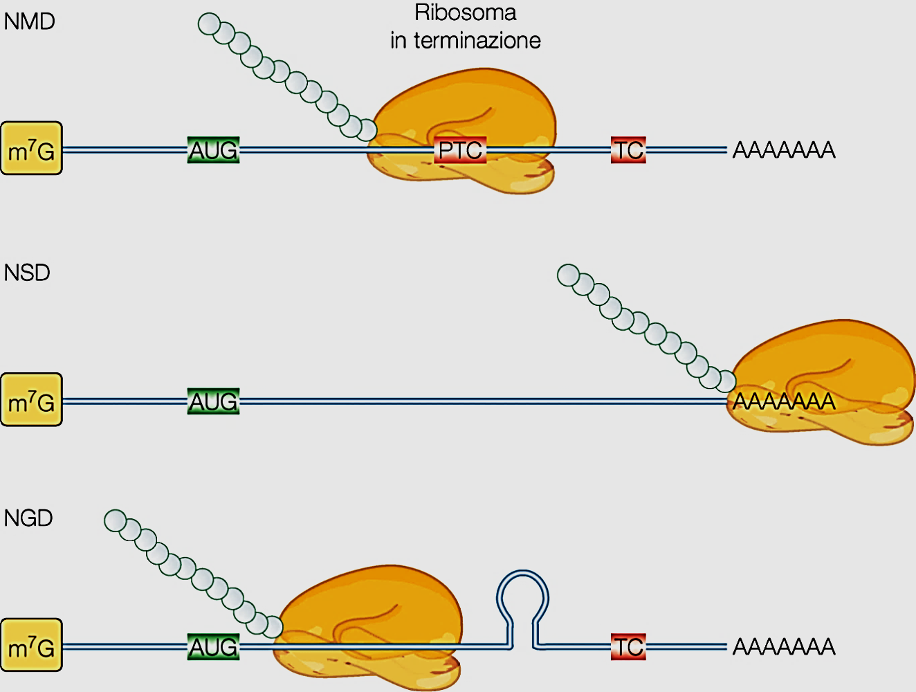
NMD
Terminating ribosome
Nonsense Mediated Decay
Premature termination codon
NSD
2. Non Stop Decay
Absence of termination codon
NGD
3. Non-Go Decay
Pausing by structure before TC

Slide 17
1. Nonsense-mediated decay
stop
Figure 1 | NMD and the ‘position-of-an-exon–exon-junction’ rule. Only the 3′-most
exon–exon junction within a generic mammalian mRNA is shown. Mammalian mRNAs generally have an average of 7–8 splicing-generated exon–exon junctions. A premature termination codon (PTC) that is located in the region indicated in blue, which is followed by an exon–exon junction more than 50–55 nucleotides (nt) downstream, elicits nonsense-mediated mRNA decay (NMD), whereas a PTC that is located in the region indicated in green fails to elicit NMD. The normal termination codon (Ter) usually (but not always) resides within the 3′-most exon.
From: Maquat 2004, Nat Rev Mol Cell Biol 5:89-99.

Slide 18
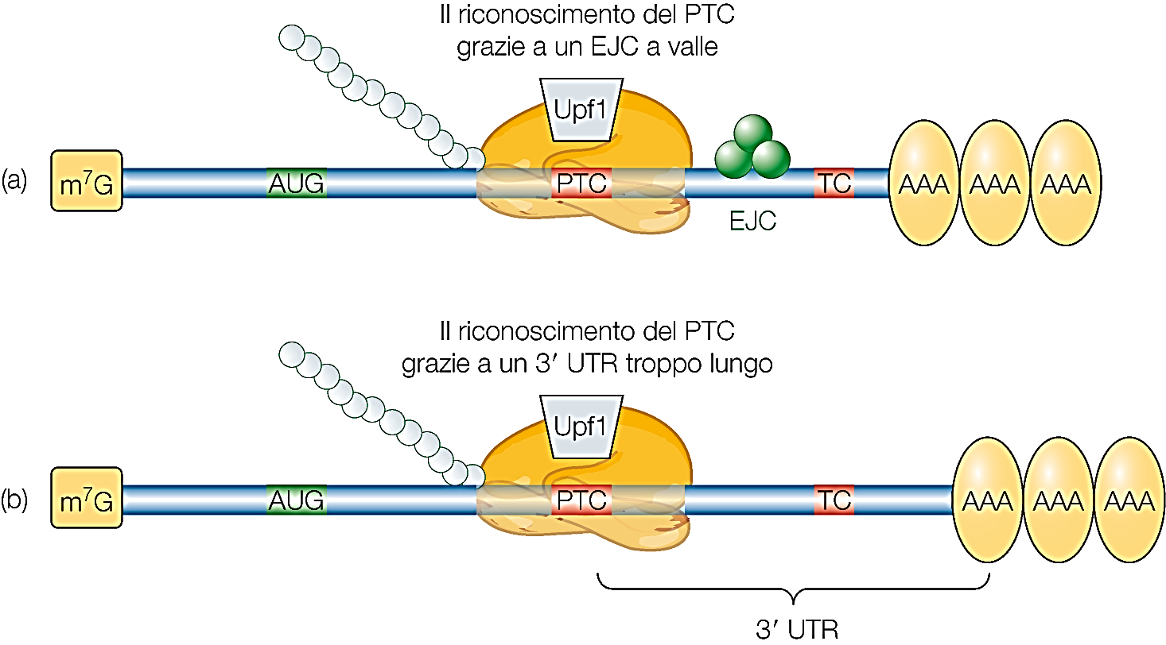
NMD
PTC recognition by downstream EJC
PTC recognition by excessively long 3’-UTR

Slide 19
What is the function of NMD ? Protection ? Regulatory ?
In Mammals, a number of Alternative Splicing events introduce a premature termination codon into the processed mRNA, not followed immediately by pA.
Primary transcript
pA
AUG start codon
STOP codon
Premature STOP codon
This induces NMD. It should be considered a silencing AS event.

