Slide 1
CMB Master Degree
Neurobiological track
2018/2019
Vittoria Berutto
Arianna Rizzo

Slide 2
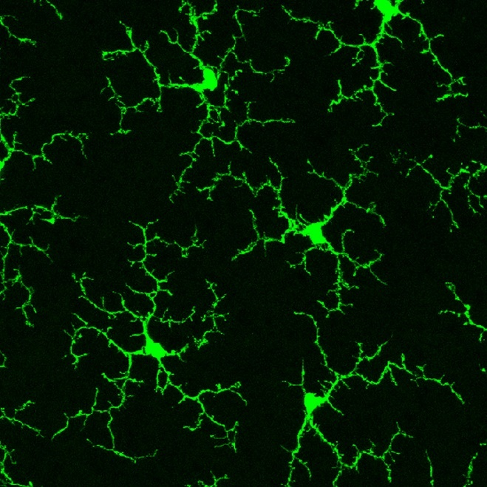
Introduction:
What are microglia?
Neurovascular concept
Regulation of microglial switch

Slide 3
Scientific questions:
May astrocytes and endothelium cells contribute to a gliovascular switch for microglial activation?
Are these differentially activated microglia toxic or beneficial towards neurons?

Slide 4
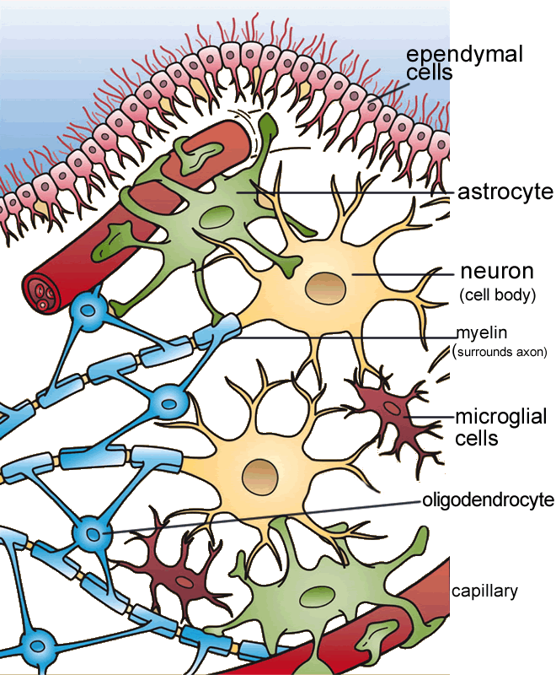
What kind of cell types are studied?
Microglia
Astrocytes
Cerebral endothelial cells

Slide 5
Different effects of oxygen-glucose-deprived endothelium versus astrocytes on microglial activation
Microglial morphology
Quantification of cytokines and growth factors

Slide 6
C
d
Expression levels of CD11b, CD45, CD86 and MHC II
Expression levels of NOS2, CD86, CD206 and Arg1

Slide 7
Alteration of microglial functions
after treatment with conditioned media
from endothelial cells or astrocytes

Slide 8
Different effects of endothelial-activated versus astrocytes-activated microglia on neurons
Neuronal cell viability
Representative hippocampal neurons transfected with pEGF-C1 vector

Slide 9
Discussion and Conclusions:
Endo-CM-treated microglia:
release of large amounts of TNFα and IL-1β
upregulation of CD45, CD86, MHCII and NOS expression
Inhibition of microglial migration and phagocytosis
Astro-CM-treated microglia:
Increase in the production of IGF-1
upregulation of CD206 expression
Enhancement of phagocytosis

Slide 10
Different states of microglial activation
neuronal consequences:
Endothelial-activated microglia are neurotoxic
Astrocytes-activated microglia promote neuroplasticity
HYPOTHESIS OF A GLIOVASCULAR MECHANISM FOR REGULATING THE MICROGLIAL SWITCH

Slide 11
Microglial switch:
a model for in vivo studies

Slide 12
Future perspectives:
To understand how microglia become activated and how they mediate neuroinflammation
Beneficial and detrimental effects of microglial functions in brain ischemia and trauma
Modulation of microglial behaviors is clearly an important topic of investigation
Huge potential for the development of new therapeutic strategies in acute brain injury

Slide 13
Bibliography:
Xing, C., Li, W., Deng, W., Ning, M., & Lo, E. H. (2018). A potential gliovascular mechanism for microglial activation: differential phenotypic switching of microglia by endothelium versus astrocytes. Journal of neuroinflammation, 15(1), 143.
Kim, J. Y., Kim, N., & Yenari, M. A. (2015). Mechanisms and potential therapeutic applications of microglial activation after brain injury. CNS neuroscience & therapeutics, 21(4), 309-319.
Loane, D. J., & Byrnes, K. R. (2010). Role of microglia in neurotrauma. Neurotherapeutics, 7(4), 366-377.

