Slide 1
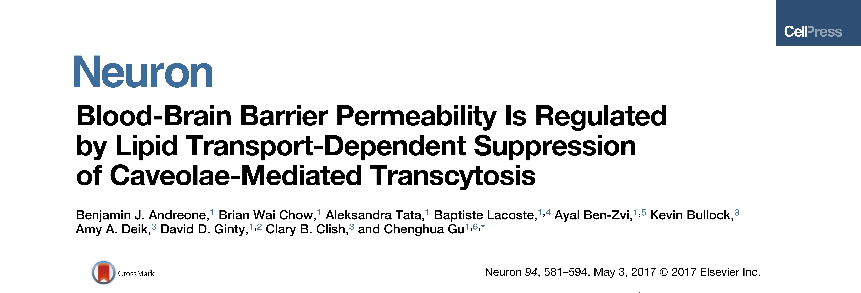
Group component:
Ferro Erminda
&
Giacosa Daniele

Slide 2
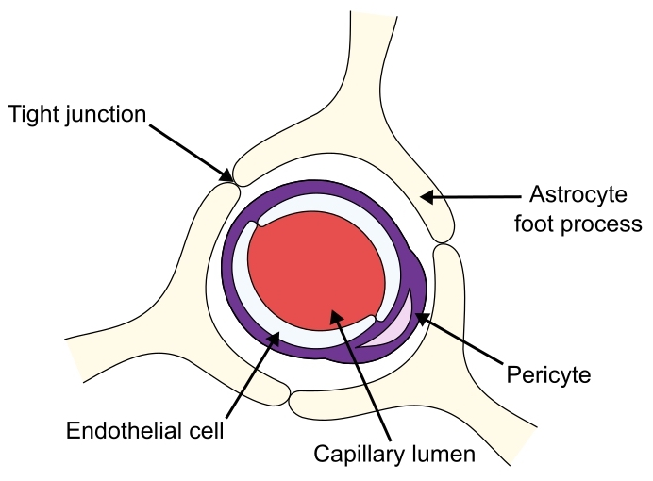
Organization of the Blood Brain Barrier
Double selection:
By the endothelial cells
By the astrocyte
BBB protect brain from outside molecules

Slide 3
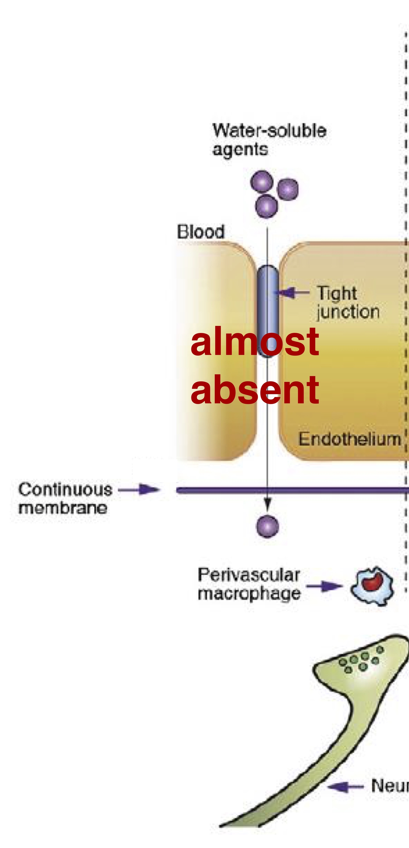
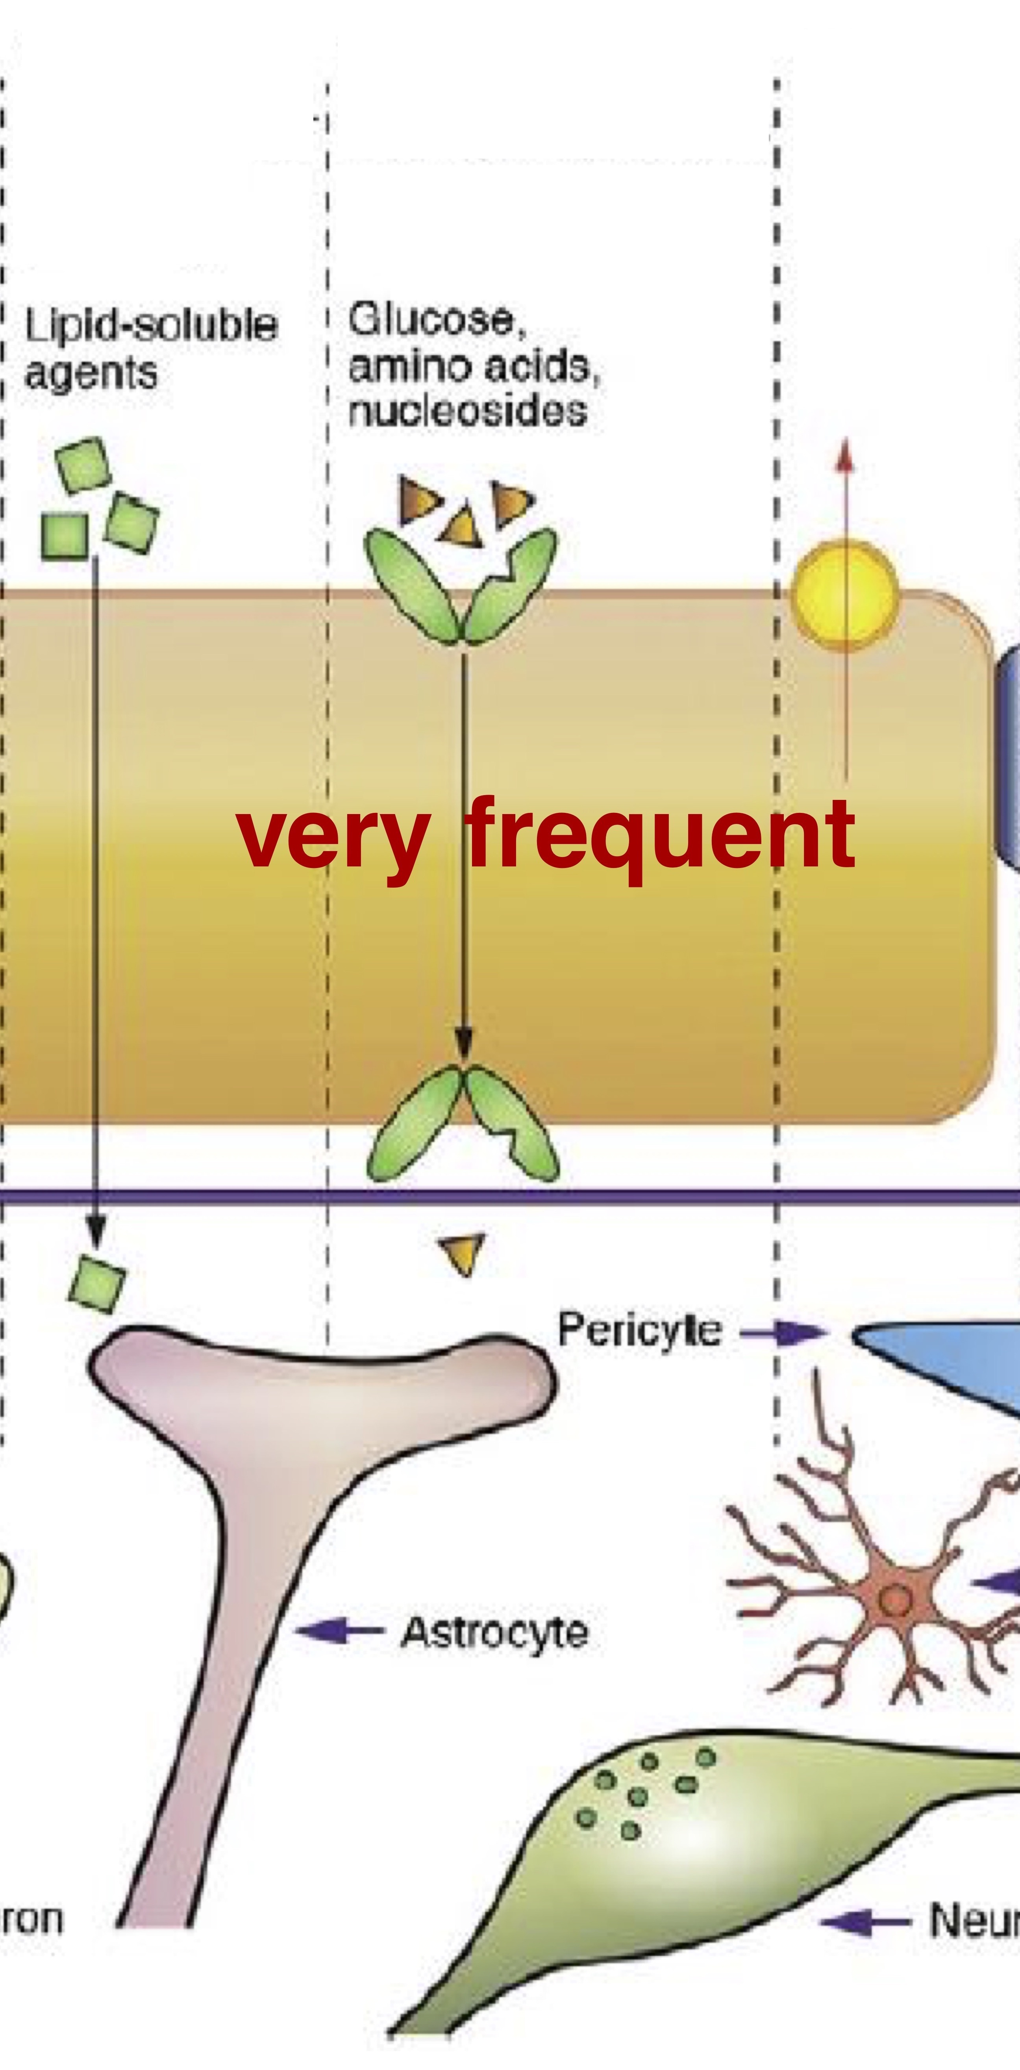
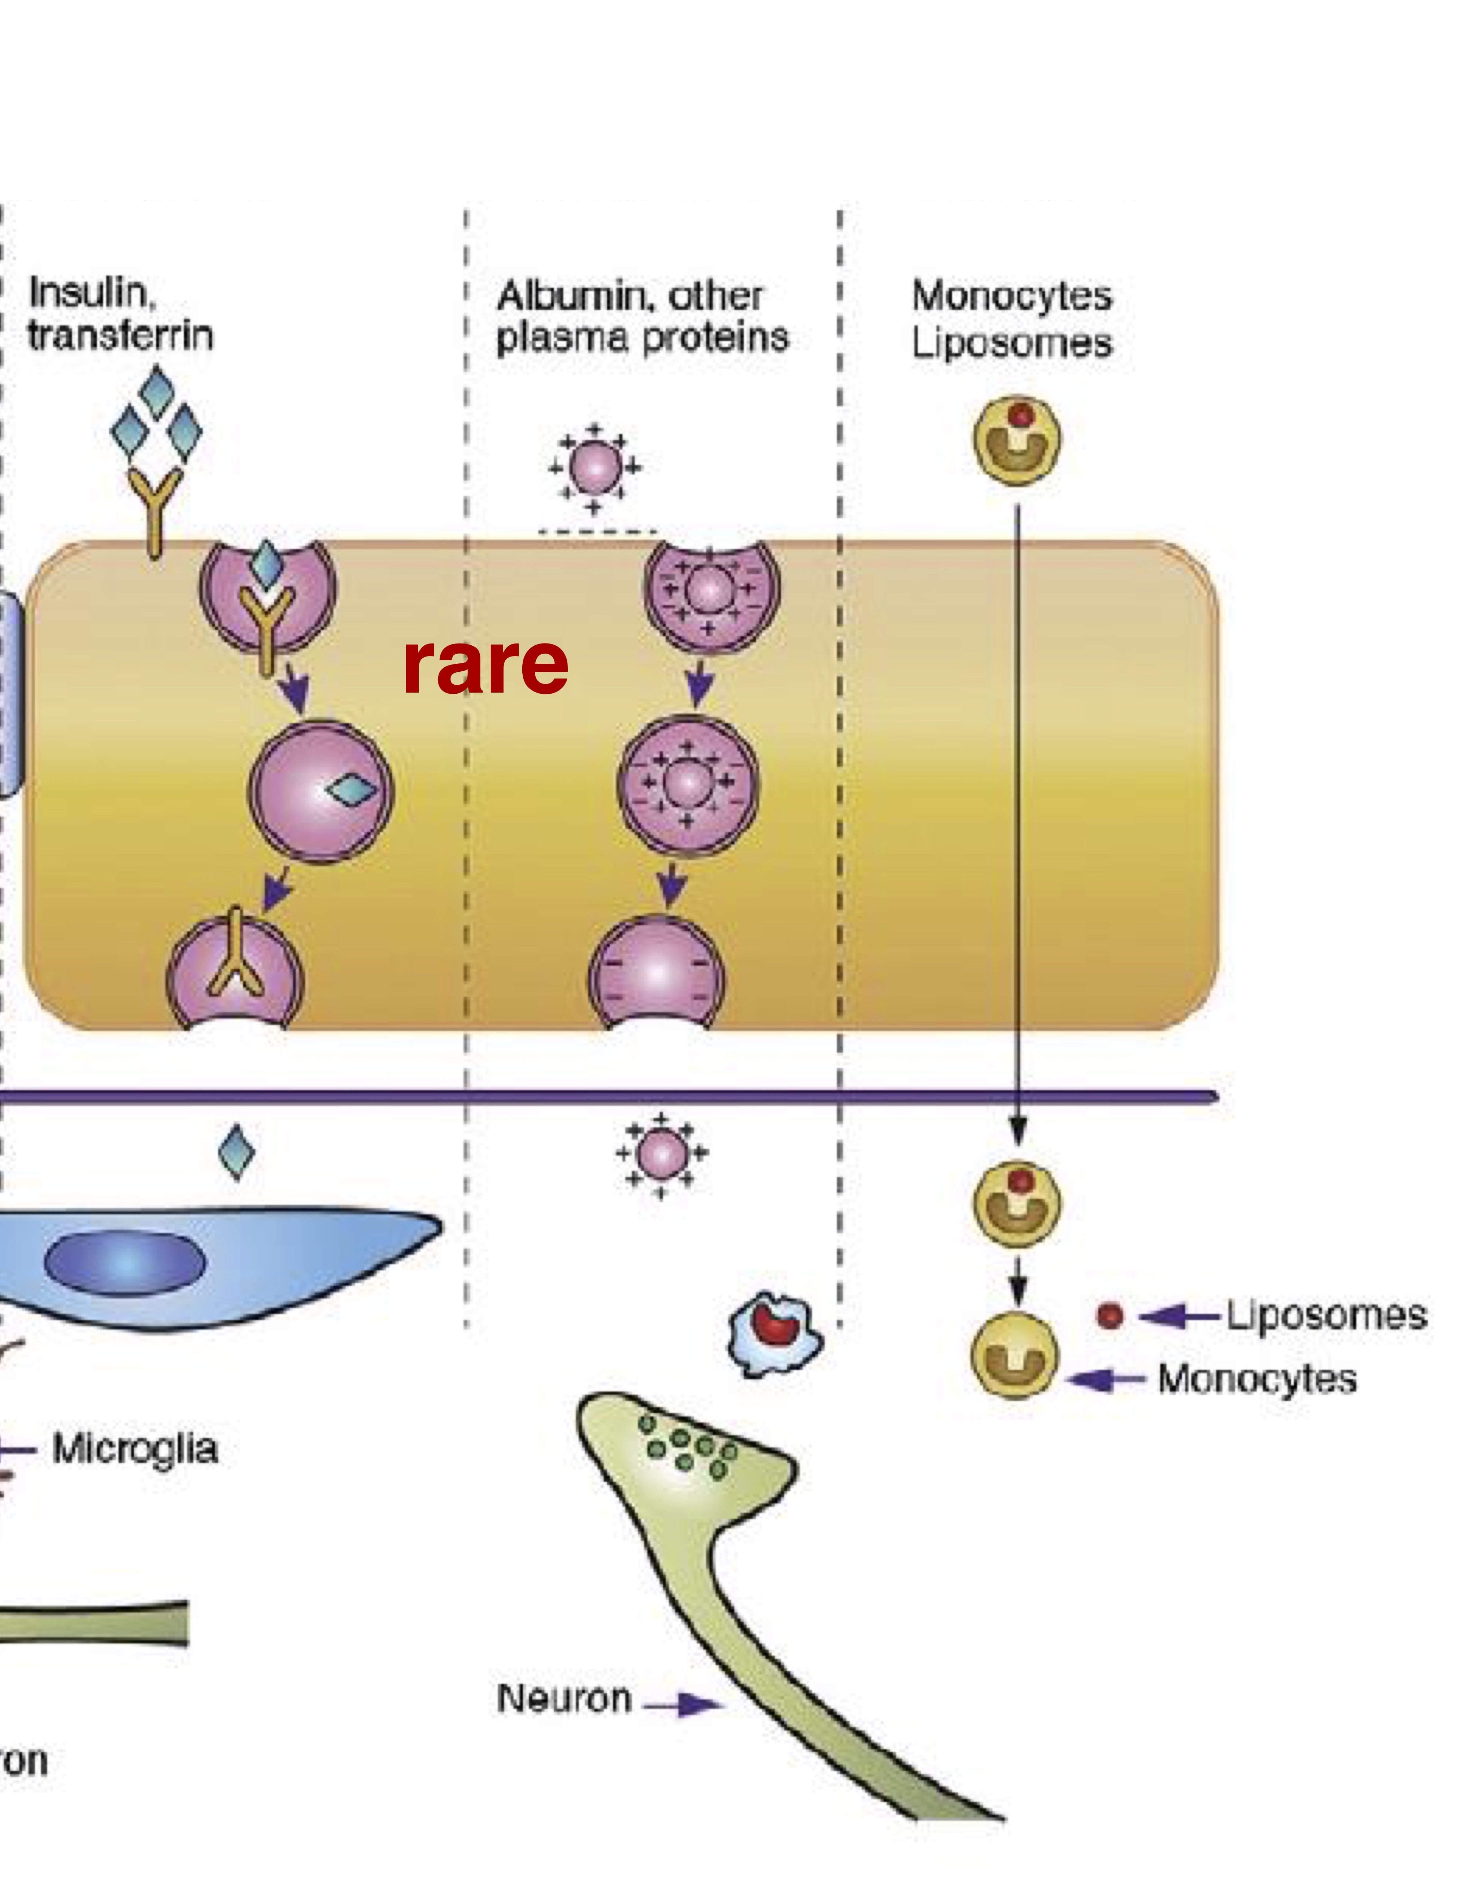
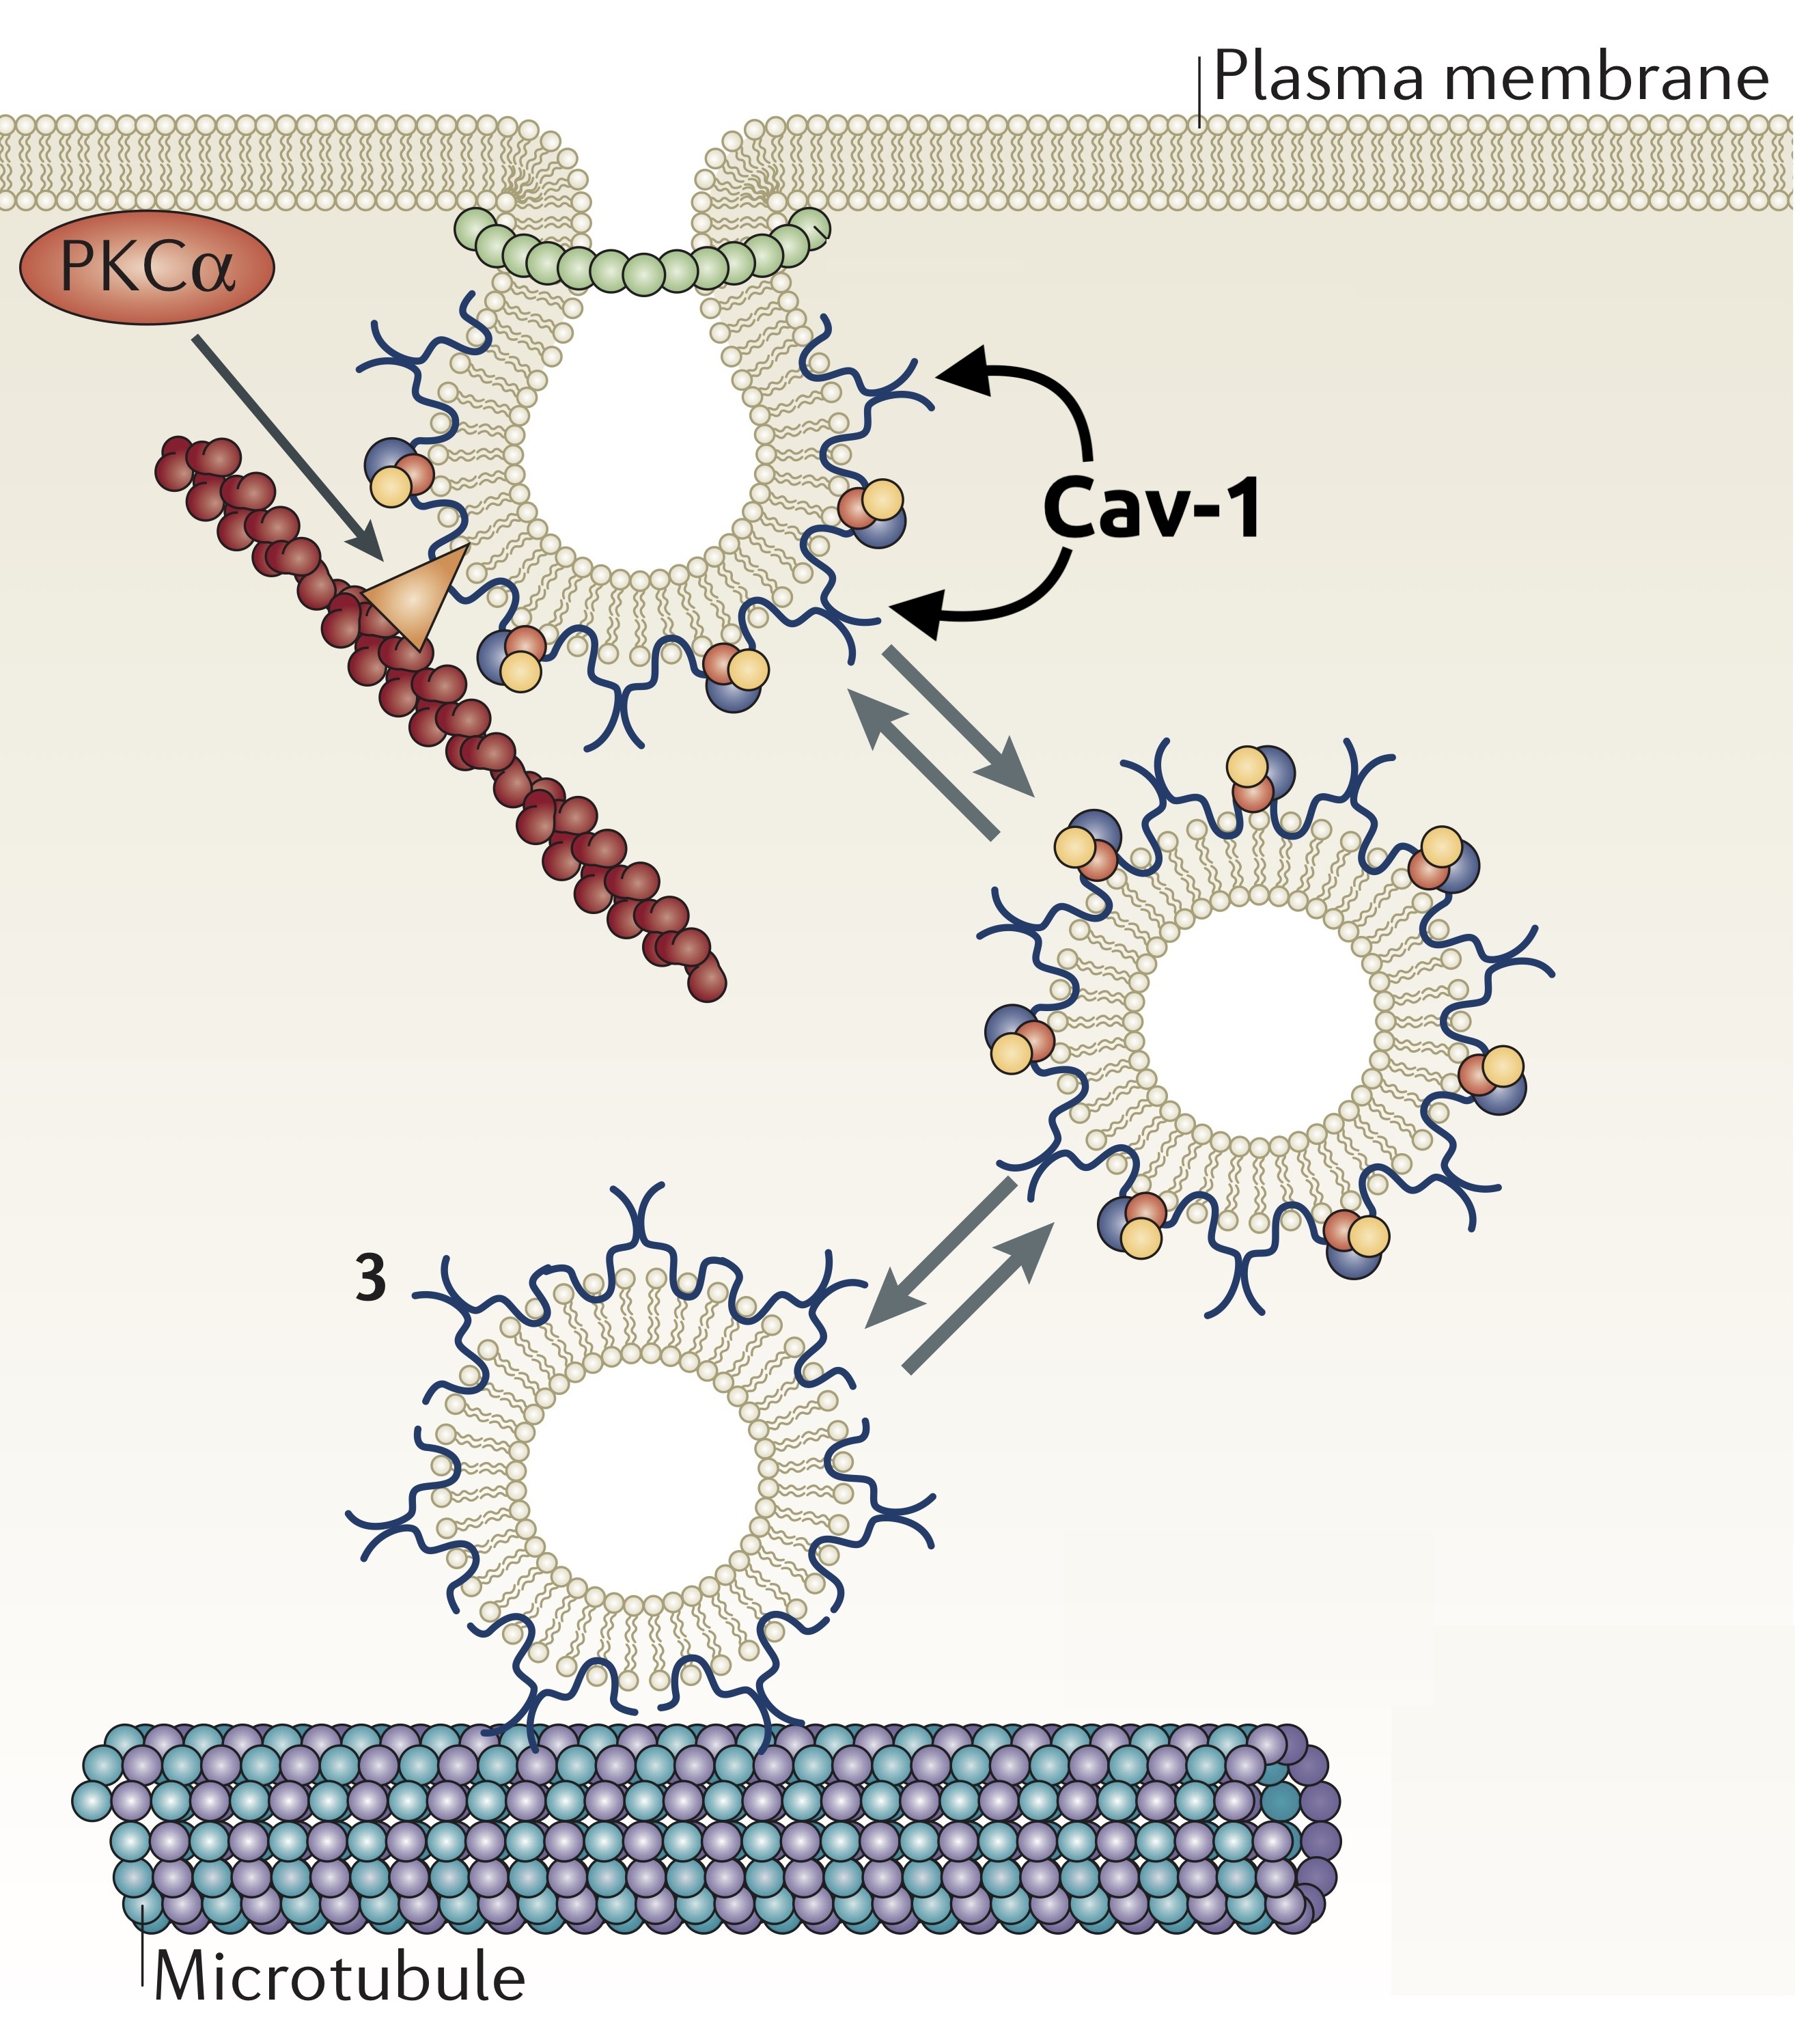
Transport through the BBB
Caveolae transcytosis is receptor independent. It requires:
Specific lipid composition;
The presence of Cav-1

Slide 4
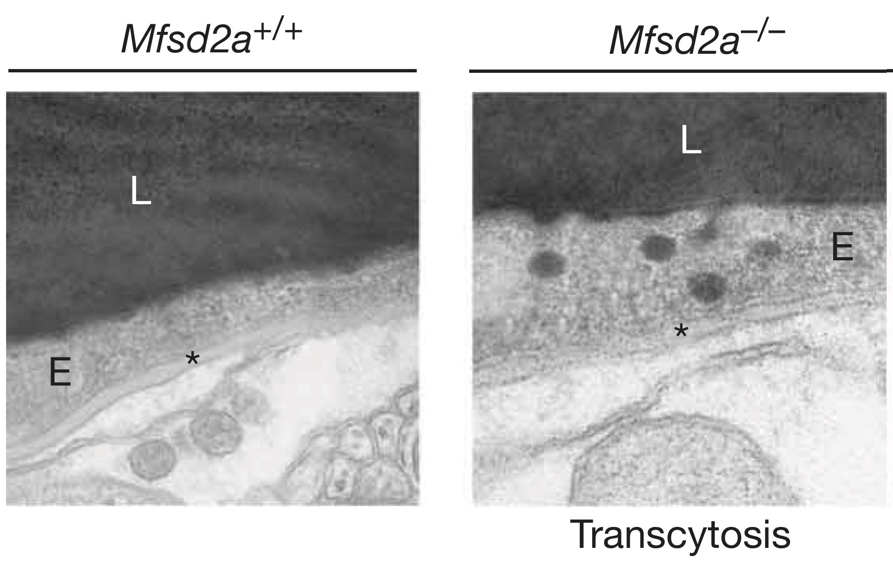
Mfsd2a: an essntial gene in the BBB
The BBB of Mfsd2a-/- mice:
✓ tight junction
💦 leaky (permeable)
≫ vesicle
Behavioural and cognitive impairments
As in Omega-3 fatty acids depletion
Lipidomic analysis
Mfsd2a NECESSARY to suppress end. transcyt.
DHA

Slide 5
Scientific Question
What is the mechanism by which Msfd2a inhibit the transcytosis?
Can the regulation of CNS endothelial cell lipid composition inhibits the transcytosis?
What type of transcytosis is regulated by the lipid composition?

Slide 6
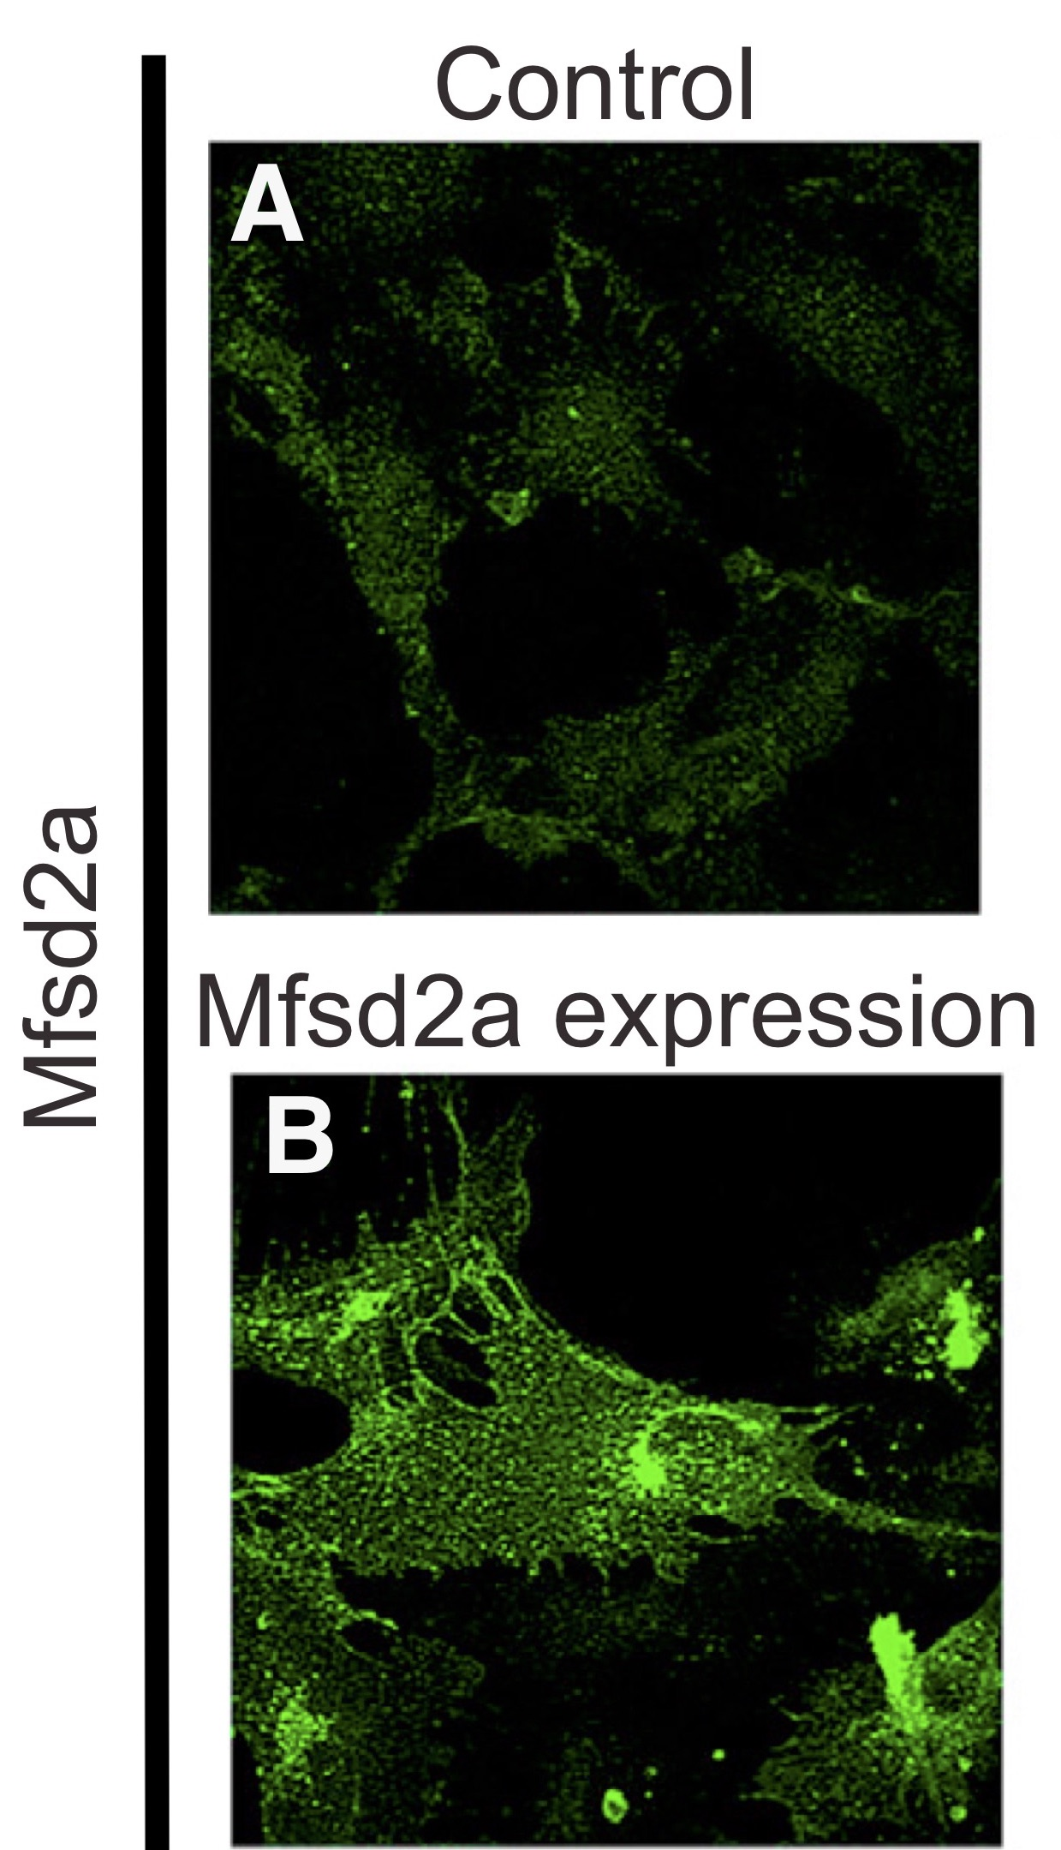
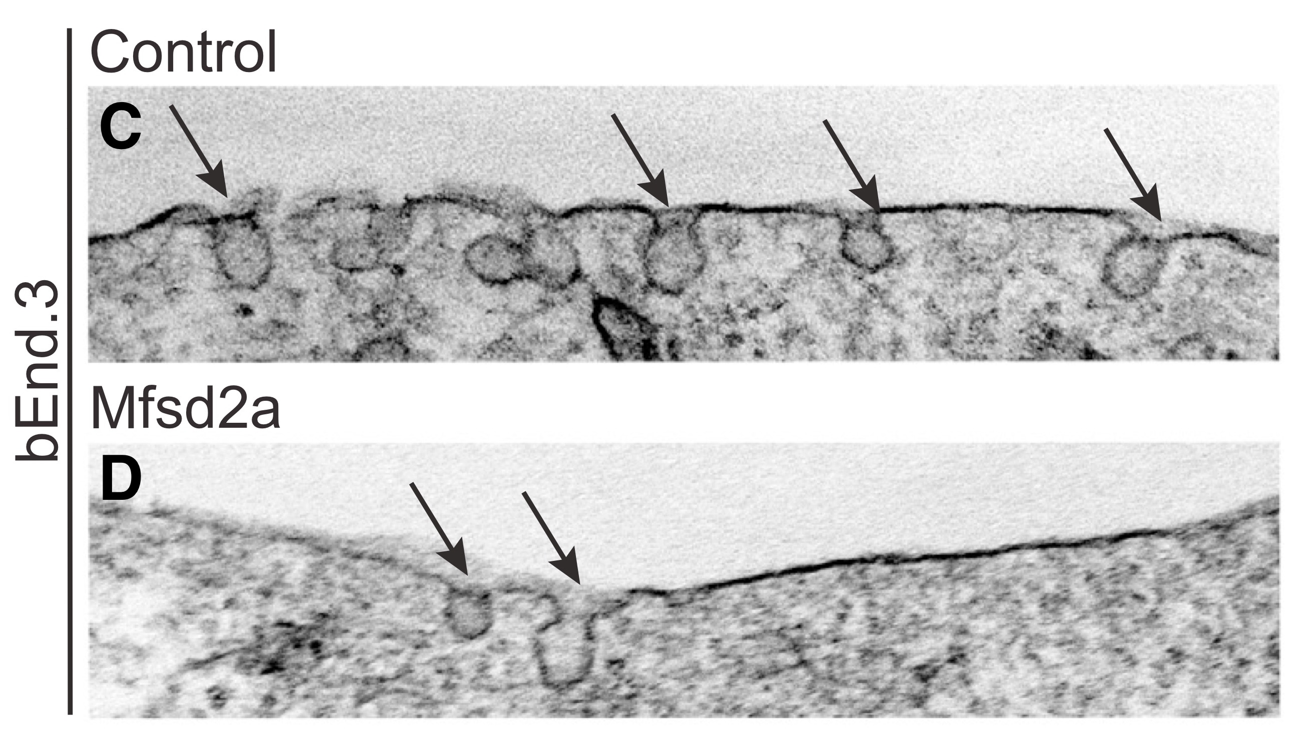
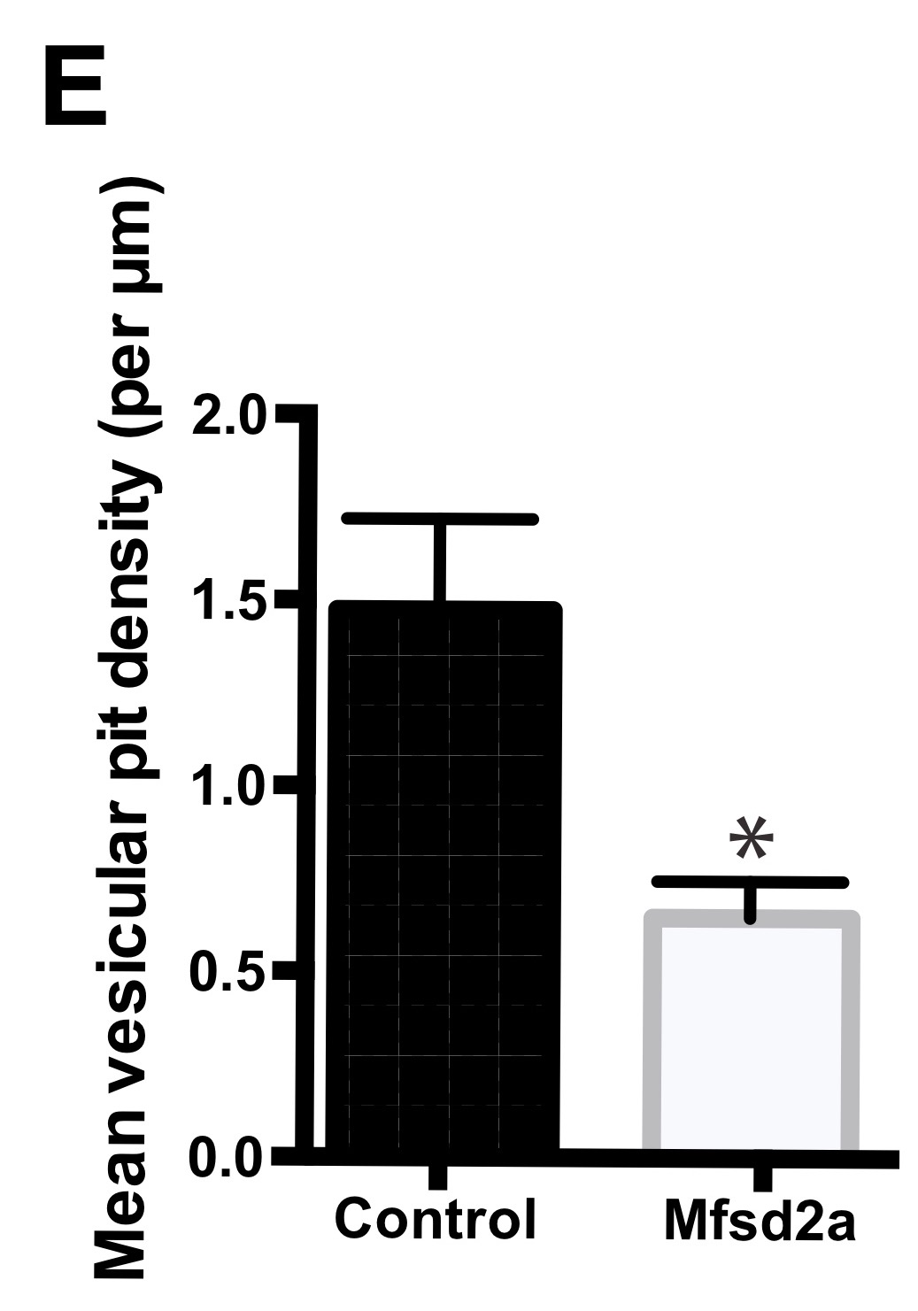
Mfsd2a is necessary…
…and sufficient to repress the transcytosis

Slide 7
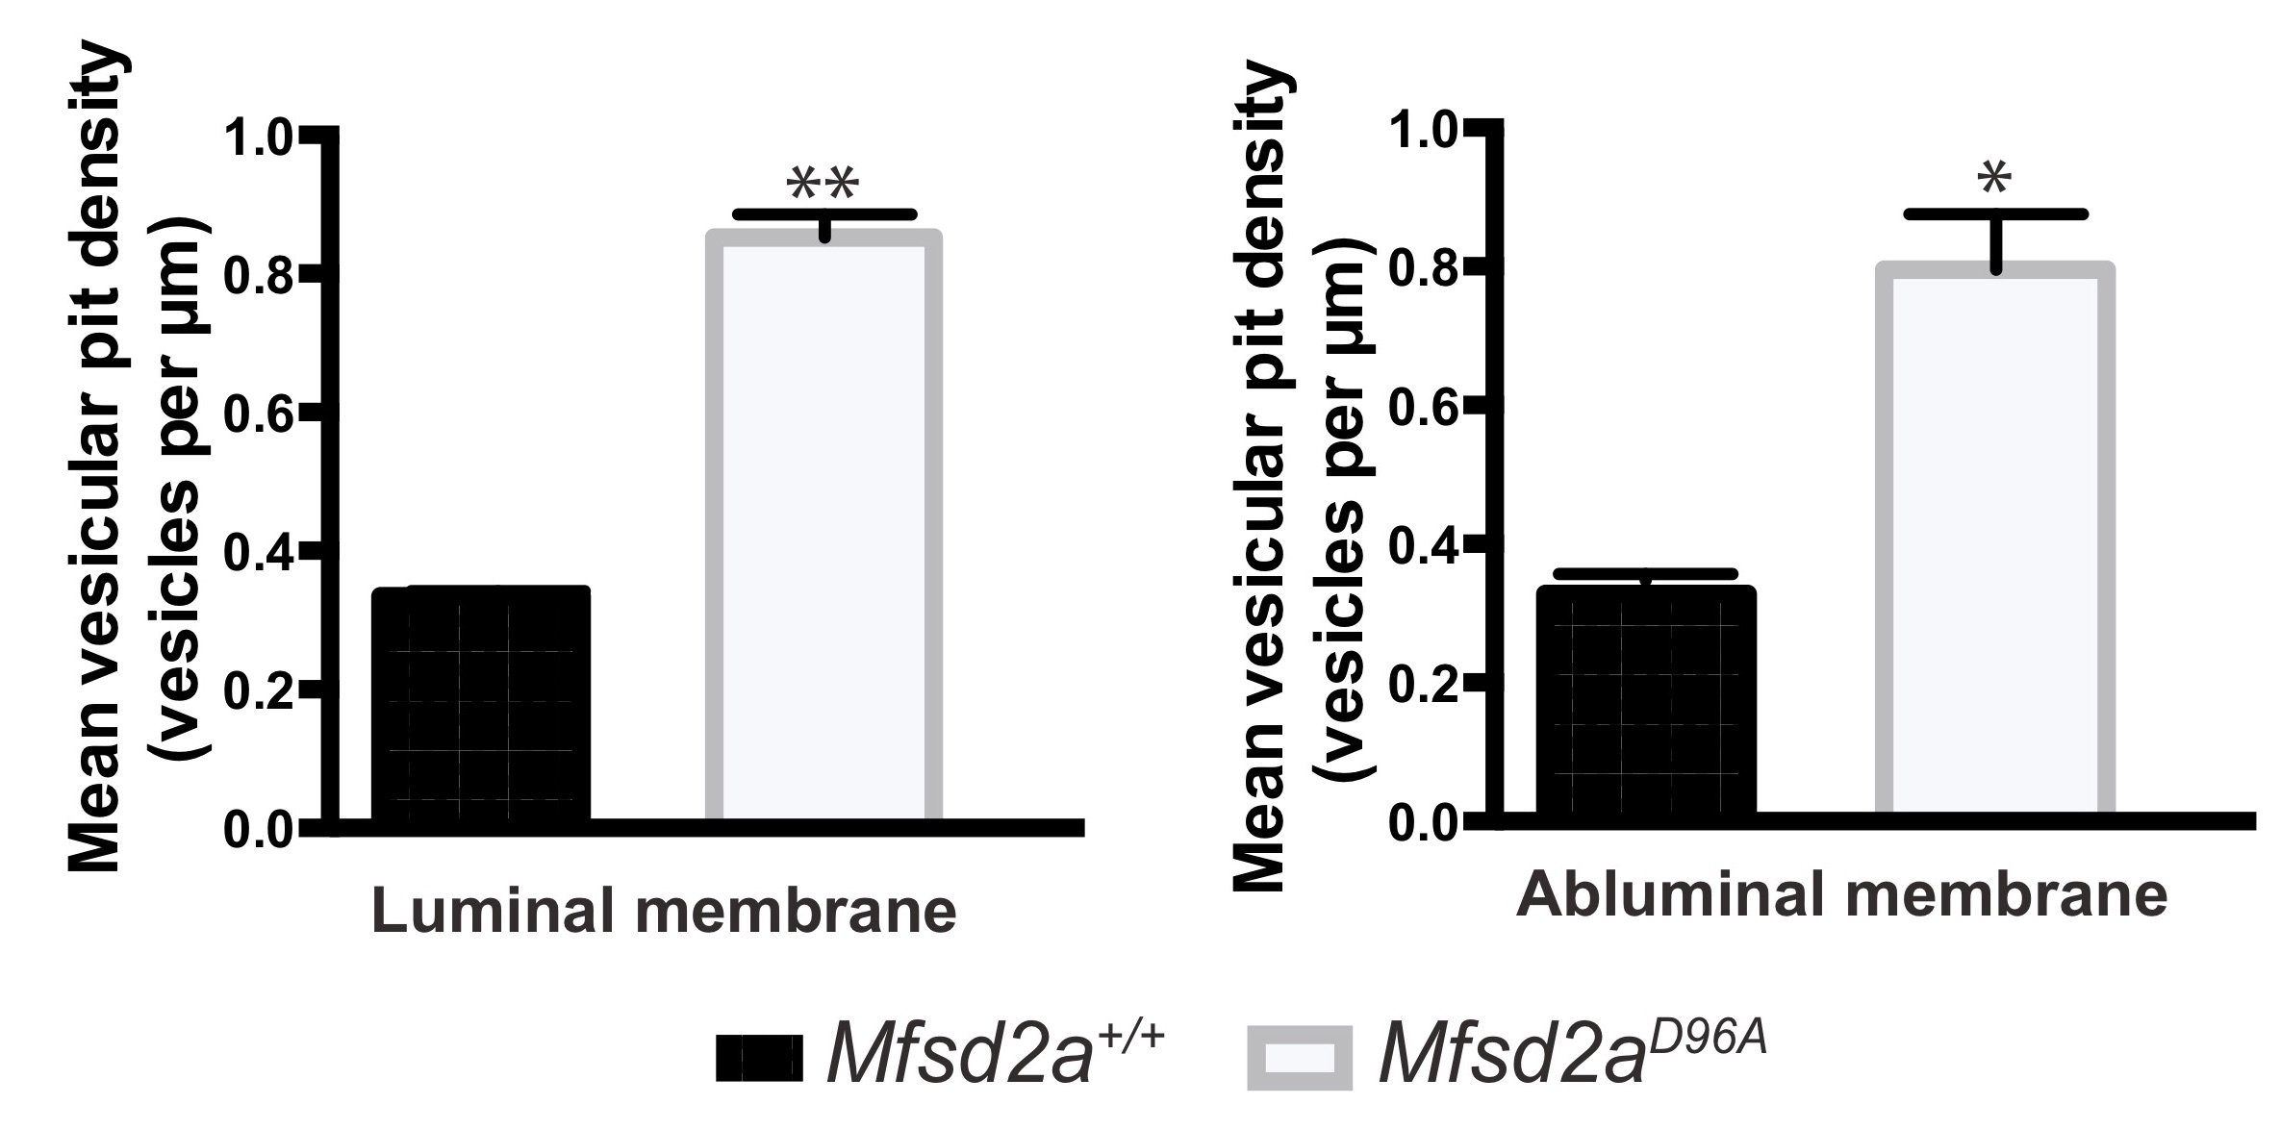
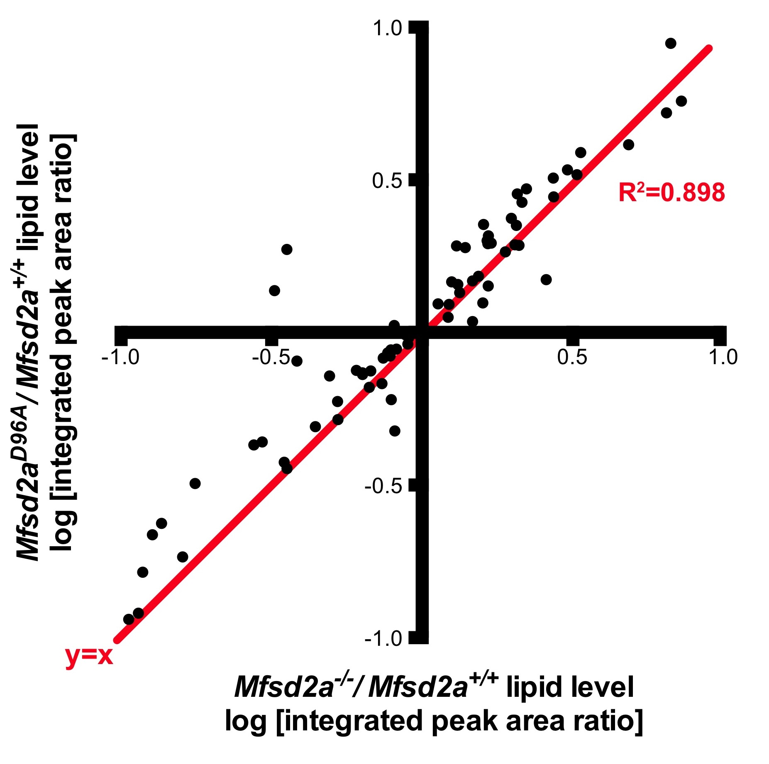
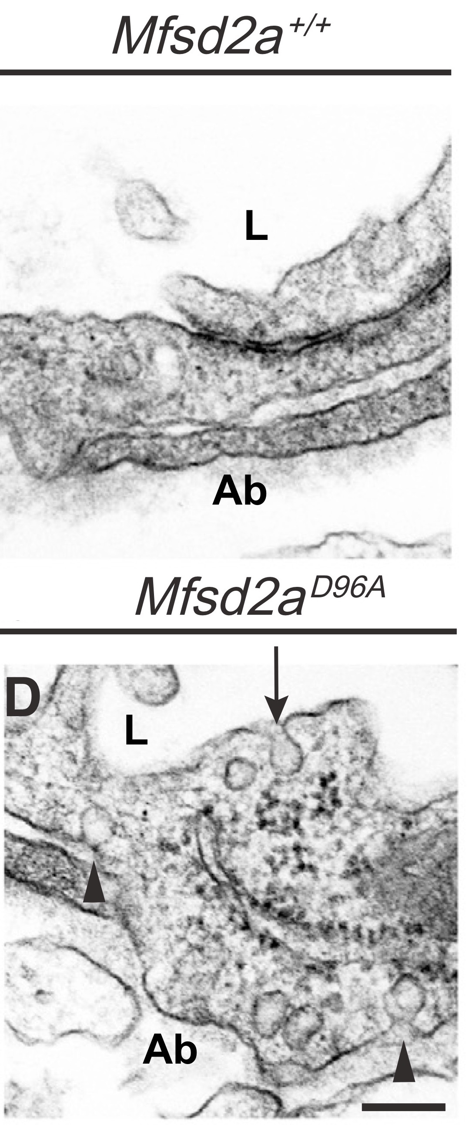
Msfd2a impairs transcytosis by its lipid transport function
The lipid composition in Msfd2a-/- and Msfd2aD96A is almost the same
The number of vesicle in the Msfd2aD96A is higher than the WT

Slide 8
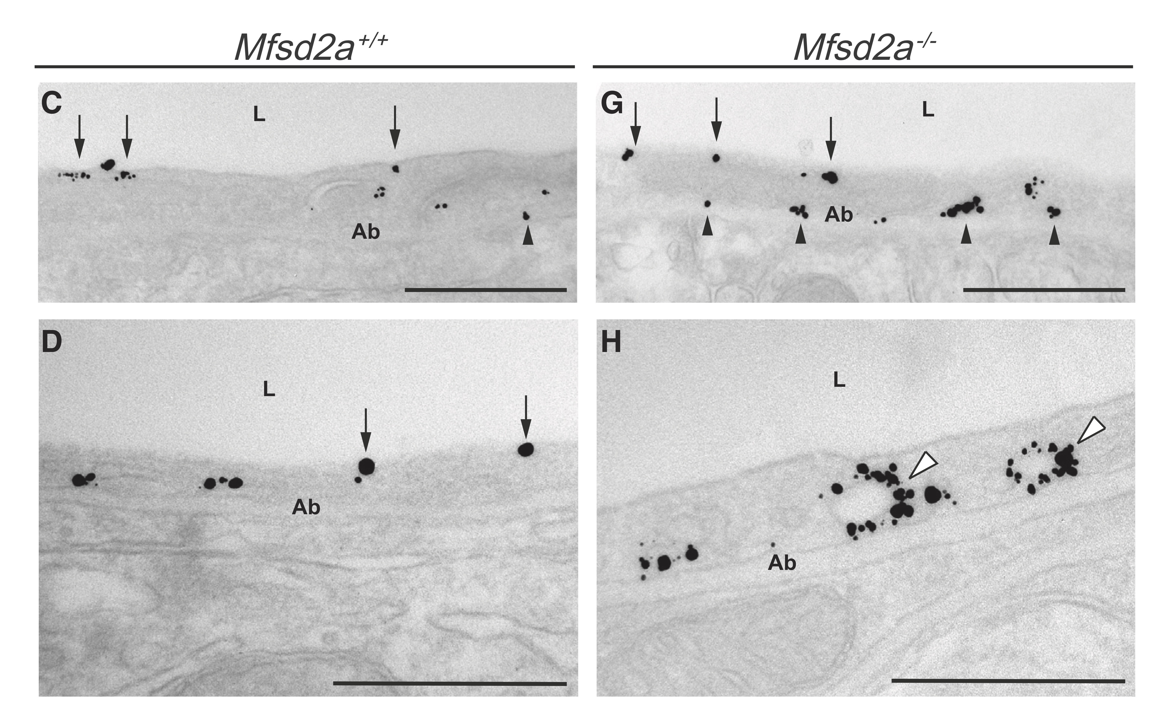
Msfd2a impairs caveolae-mediated transcytosis
Cav-1

Slide 9
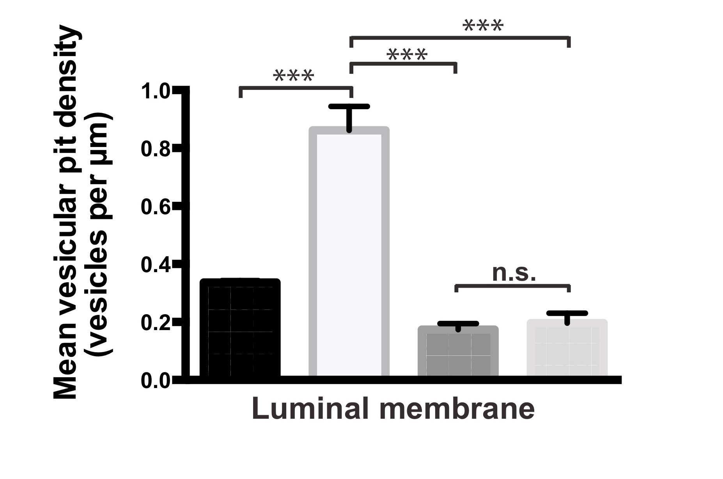
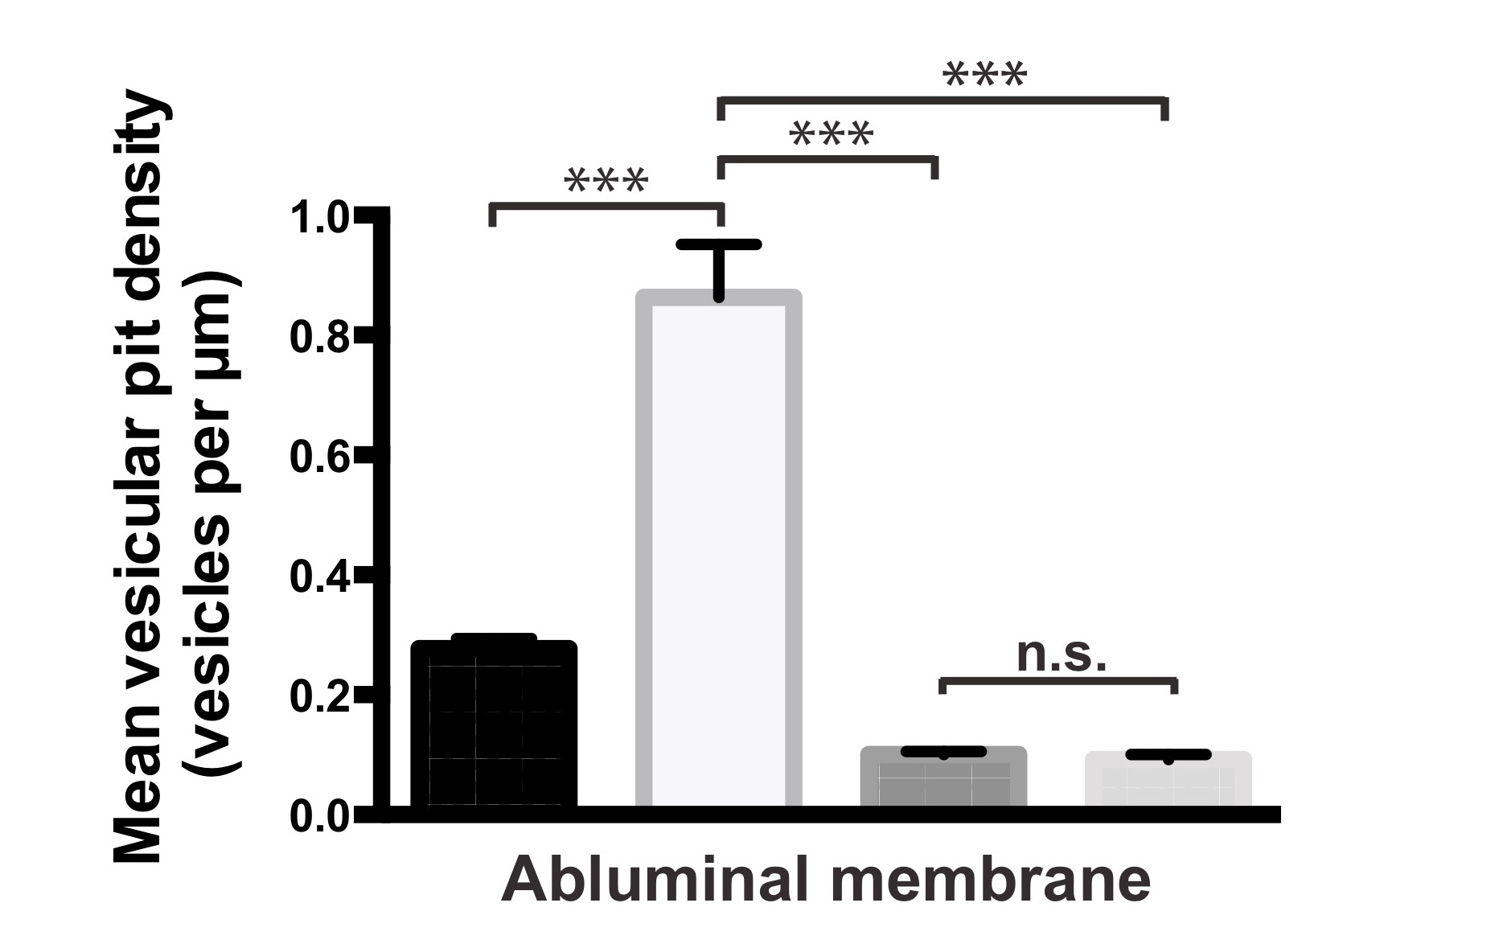
Msfd2a impairs specifically caveolae-mediated transcytosis
Msfd2a^{+/+} | Cav-1^{+/+}
Msfd2a^{-/-} | Cav-1^{+/+}
Msfd2a^{+/+} | Cav-1^{-/-}
Msfd2a^{-/-} | Cav-1^{-/-}
Cav-1 as a limitant factor
Mfsd2a acts upstream of Cav-1 specifically to suppress the caveolae vesicle trafficking pathway at the BBB.

Slide 10
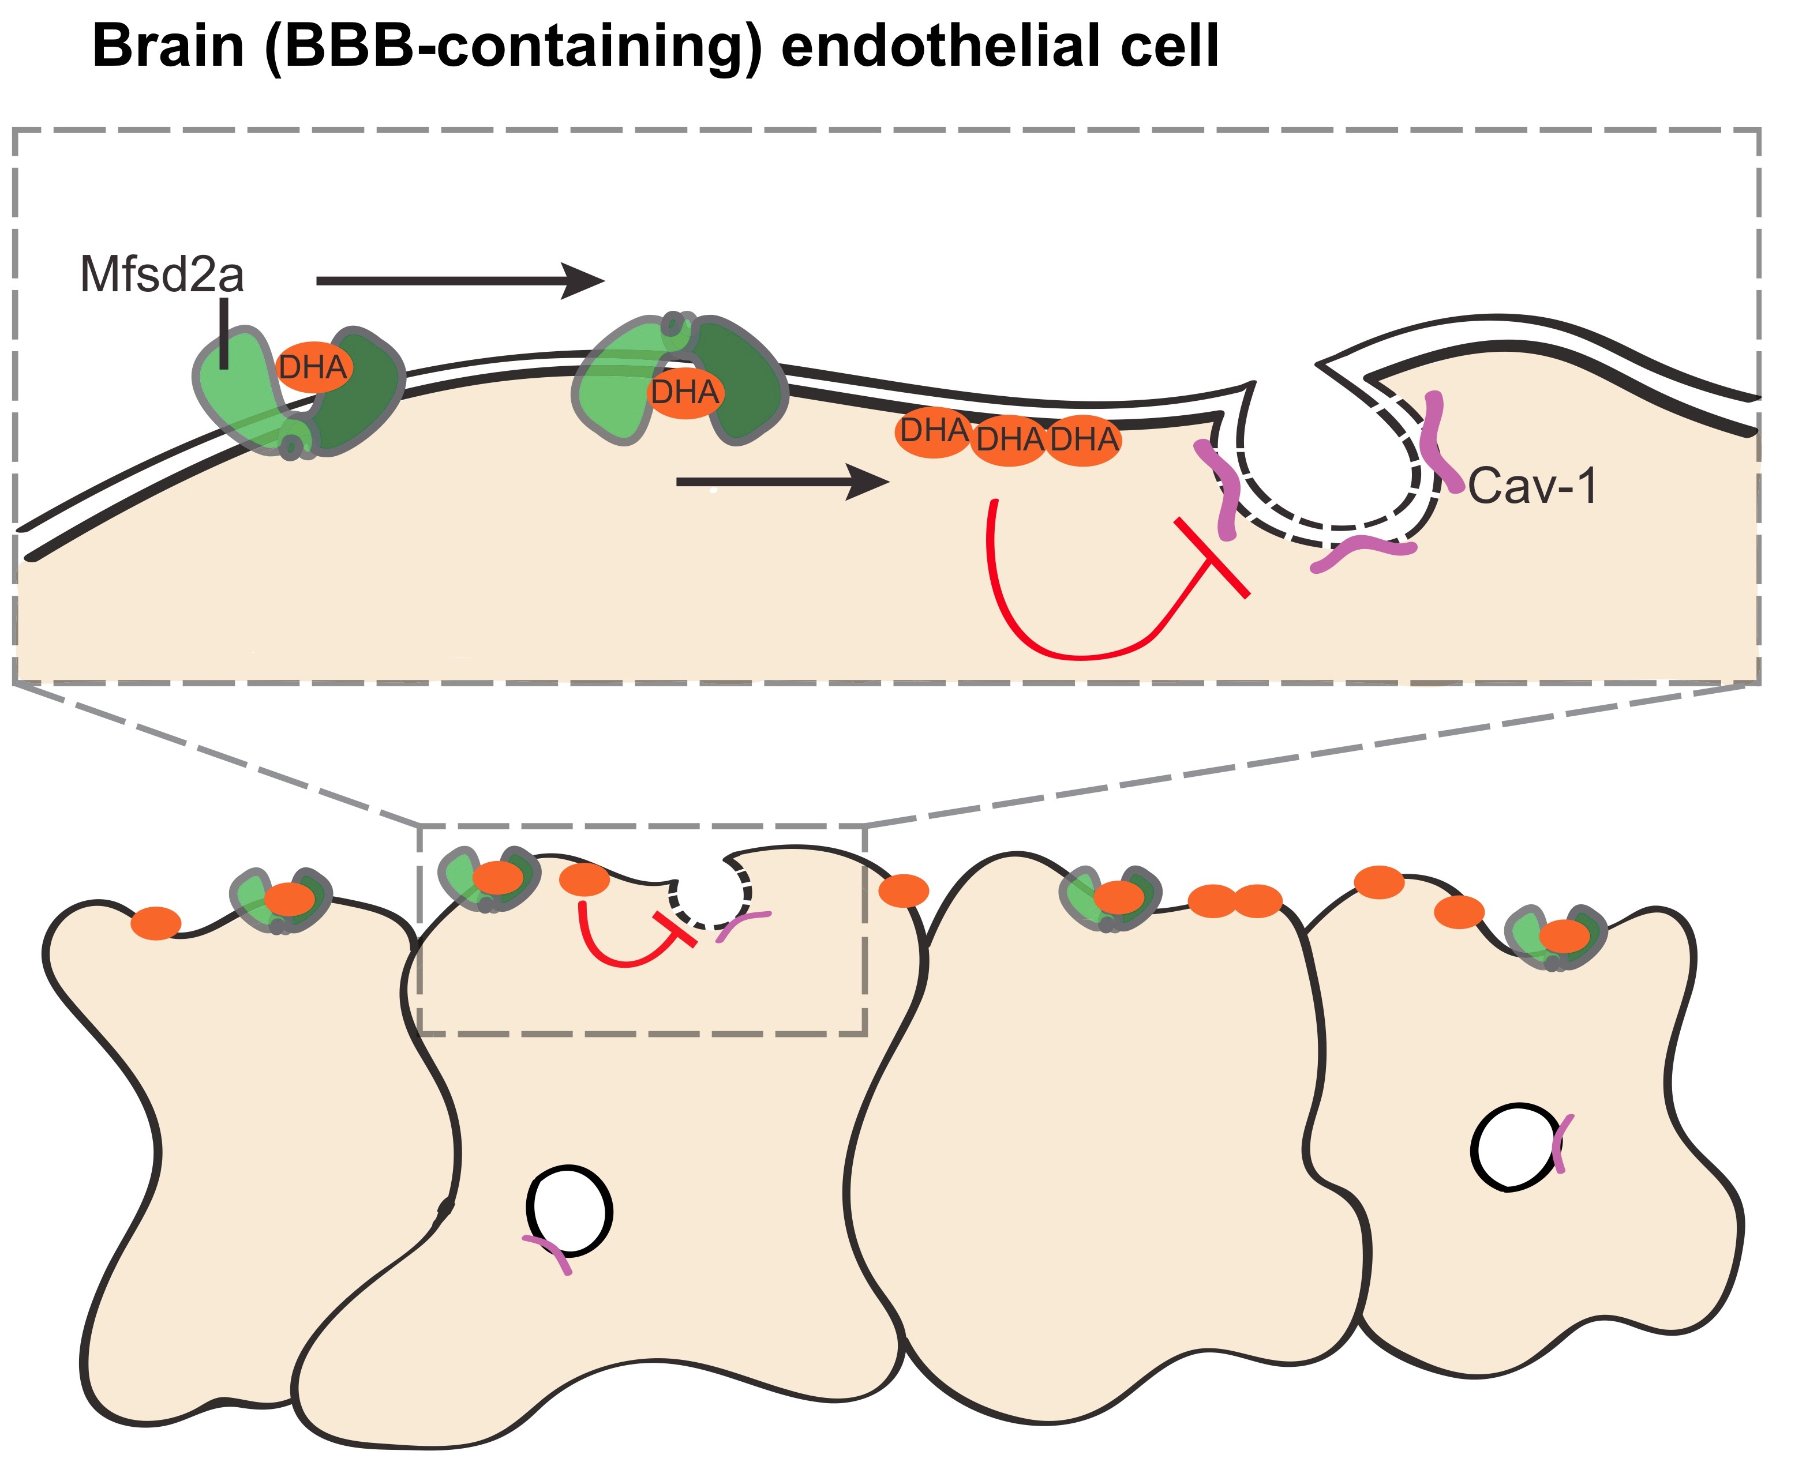
DISCUSSION
Mfsd2a transport DHA into the epithelial cell;
DHA impair caveolae vesicle formation.
The presence of DHA renders the membrane fluid and displaces Cav-1 and Choleserol
HOW???

Slide 11
Future perspectives
Biochemical function of the lipid composition in impairing the vesicle formation;
Tissue specific activation of Mfsd2a;
Understanding mechanism that regulates transcytosis in BBB can be a tool to introduce drugs in the brain.

Slide 12
Bibliography
Thank you for the attention
Andreone, Benjamin J., et al. "Blood-brain barrier permeability is regulated by lipid transport-dependent suppression of caveolae-mediated transcytosis." Neuron 94.3 (2017): 581-594.
Nguyen, Long N., et al. "Mfsd2a is a transporter for the essential omega-3 fatty acid docosahexaenoic acid." Nature 509.7501 (2014): 503.
Ben-Zvi, Ayal, et al. "Mfsd2a is critical for the formation and function of the blood–brain barrier." Nature 509.7501 (2014): 507.
Parton, Robert G., and Miguel A. Del Pozo. "Caveolae as plasma membrane sensors, protectors and organizers." Nature reviews Molecular cell biology 14.2 (2013): 98.

