Slide 1
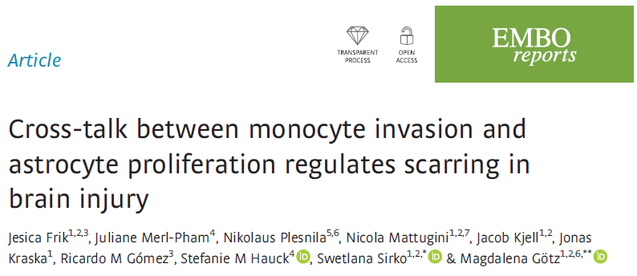

Slide 2

INTRODUCTION:

Slide 3
SCIENTIFIC QUESTIONS:
How does astrocyte proliferation affect monocyte invasion?
----
Which are the consequences on scar formation?
----

Slide 4
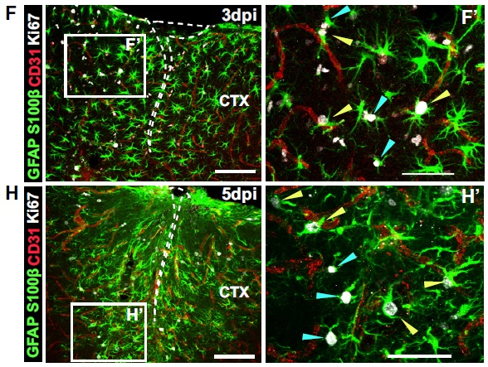
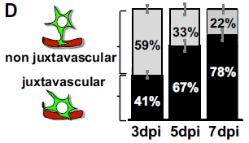
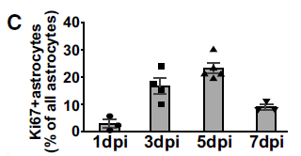
EXPERIMENTAL DATA:
DYNAMICS OF ASTROCYTES PROLIFERATION AND IMMUNE CELL INFILTRATION AFTER CORTEX TRAUMATIC INJURY
Astrocyte localization

Slide 5
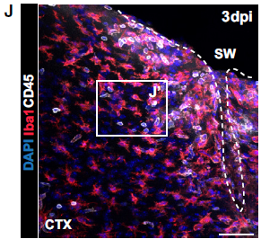
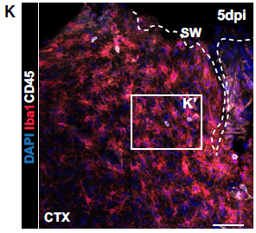
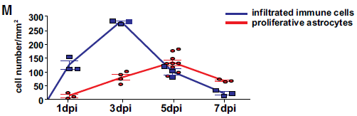
temporal relation between juxtavascular astrocyte proliferation and immune cell invasion

Slide 6
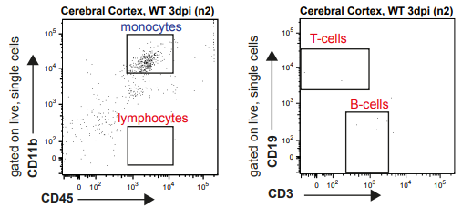
Identification the nature of the invading CD45+ cells after injury

Slide 7
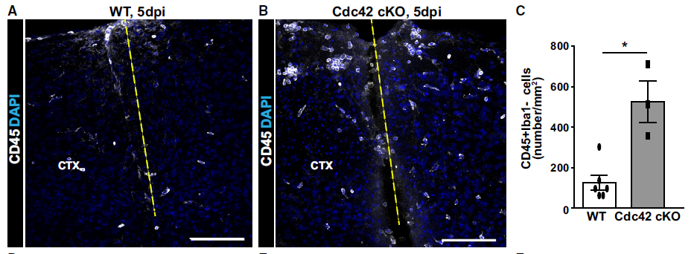
LOSS OF FUNCTION: INCREASED NUMBER OF CD45⁺/Iba1⁻ CELLS IN CEREBRAL CORTEX AFTER STAB WOUND INJURY IN MICE WITH REDUCED PROLIFERATION OF ASTROCYTES.
Astrocyte proliferation influence on invading monocytes

Slide 8
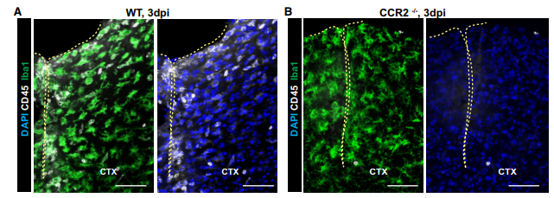
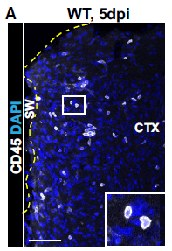
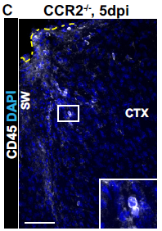
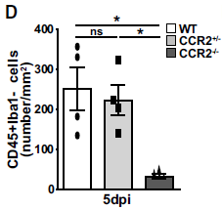
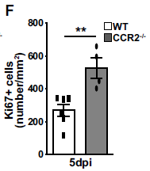
REDUCED INFILTRATION OF CCR2⁺ MONOCYTES INCREASES ASTROCYTE PROLIFERATION
Decrease of monocyte invasion

Slide 9
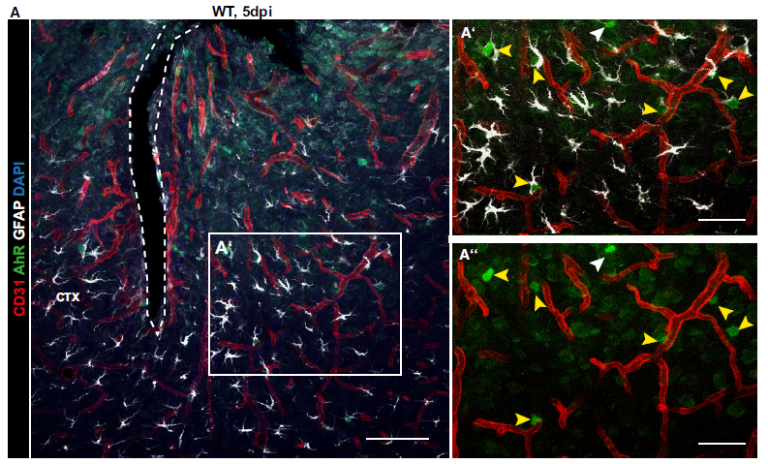
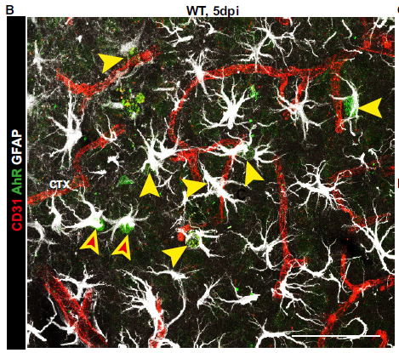
Juxtavascular astrocyte proliferation contribute to restrict monocyte invasion

Slide 10
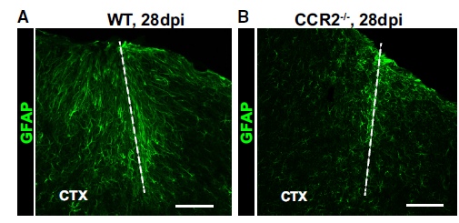
REDUCED SCAR FORMATION AND IMPROVED NEUROPROTECTION IN THE INJURED GM OF CCR2^{-/-} MICE
Long-term consequences of CCR2^{-/-} mice

Slide 11
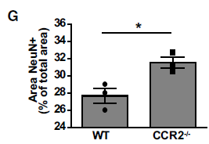
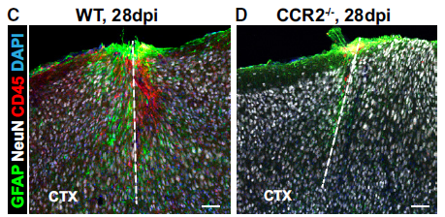
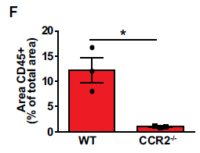
Analysis of neurons in the lesion site

Slide 12
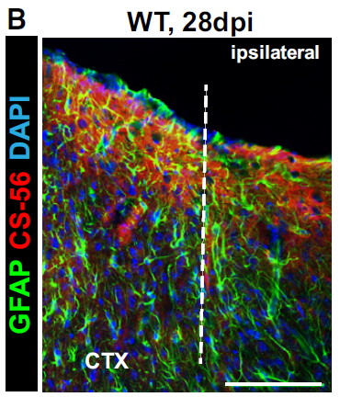
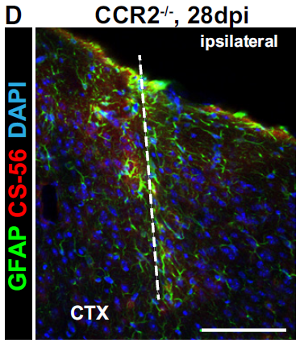
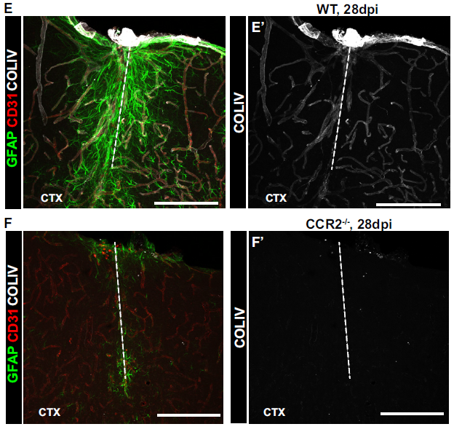
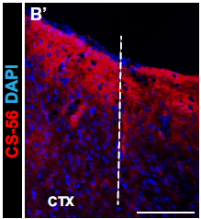
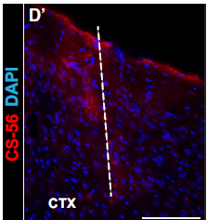
components of the extracellular matrix as further indicators of the scar formation

Slide 13
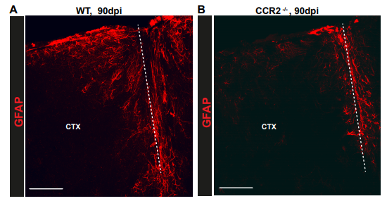
Improvements of the cortex persisted into later stages

Slide 14
CONCLUSION:
Astrocytes proliferation
monocytes
Juxtavascular astrocyte proliferation
Monocyte invasion
Reduced scar formation

Slide 15
Future prospects:
genome-wide expression differences between juxta- and non-juxtavascular astrocytes
----
identify the secretome and surface proteome of invading monocytes
----
determine whether the different effects obtained by blocking CCR2+ cell recruitment are due to differential effects on glial cell proliferation
----

Slide 16
Bibliography:
Burda J, Bernstein A, Sofroniew M. Astrocyte roles in traumatic brain injury. Exp Neurol. 2016 Jan;275 Pt 3:305-315.
----
McGraw J, Hiebert GW, Steeves JD. Modulating astrogliosis after neurotrauma. J Neurosci Res. 2001 Jan 15;63(2):109-15.
----
Anderson MA, Burda JE, Ren Y, Ao Y, O'Shea TM, Kawaguchi R, Coppola G, Khakh BS, Deming TJ, Sofroniew MV. Astrocyte scar formation aids central nervous system axon regeneration. Nature. 2016 Apr 14;532(7598):195-200.
----
Ransohoff RM, Schafer D, Vincent A, Blachère NE, Bar-Or A. Neuroinflammation: Ways in Which the Immune System Affects the Brain. Neurotherapeutics. 2015 Oct;12(4):896-909.
----

