Slide 1
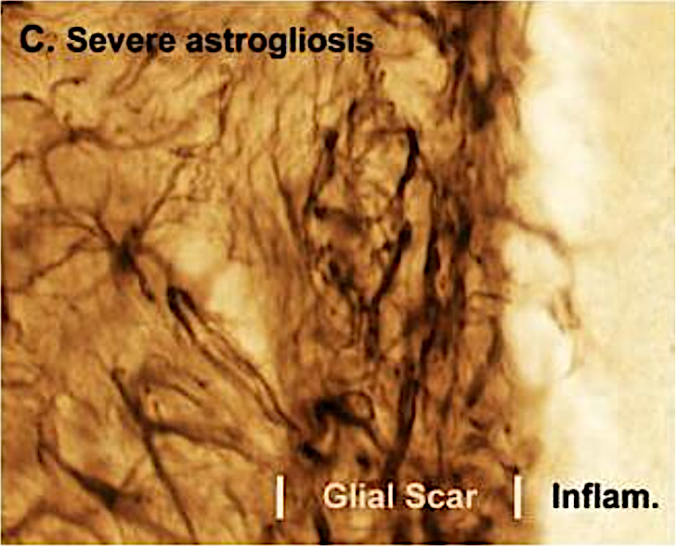
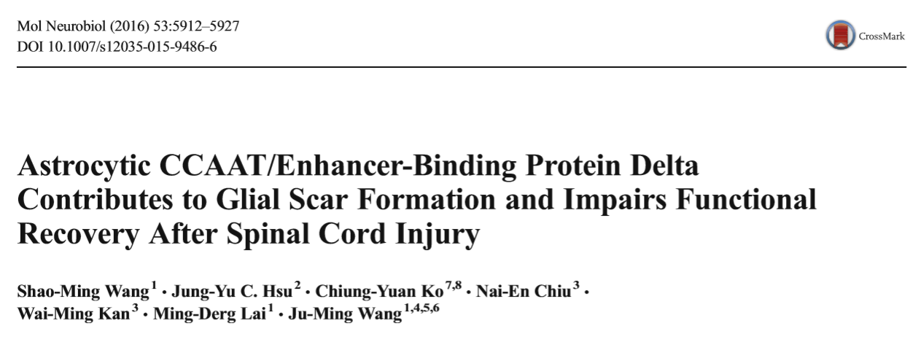
Ilaria Ghia &
Fabio Grieco

Slide 2
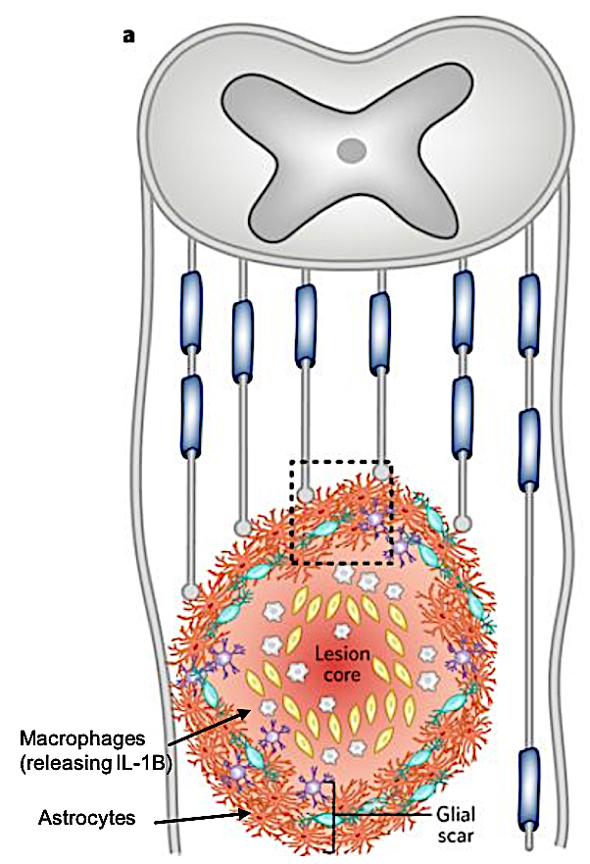
introduction
After spinal cord injury (SCI), infiltrating inflammatory cells release cytokines that induce the aggregation of astrocytes to form a glial scar.
Glial scar formation results mainly from enhanced migration of reactive astrocytes, which relies on RhoA GTPase and metalloproteinases (MMPs) activation.
C/EBPδ is a transcription factor upregulated in inflammatory conditions by pro-inflammatory cytokines.
Activated C/EBPδ in astrocytes promotes chemo-attraction and migration.

Slide 3
Scientific questions
Has C/EBPδ a regulatory role in the inflammatory responses after SCI, contributing to glial scar formation?
Comparation of wound healing events between WT and C/EBPδ^{-/-} mice after SCI
How does C/EBPδ affect the migratory behaviour of astrocytes?
in vitro analysis of cultured astrocytes

Slide 4
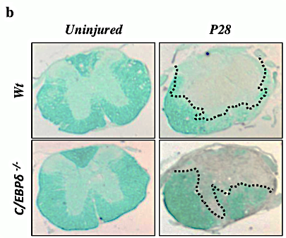
C/EBPδ deficiency results in decreased glial scar formation and increased white matter sparing after SCI
GFAP immunostaining for reactive astrocytes
Luxol Fast Blue staining for white matter

Slide 5
Results
Scar
C/EBPδ
White matter
Depletion of C/EBPδ reduces glial scarring and promotes white matter sparing.

Slide 6
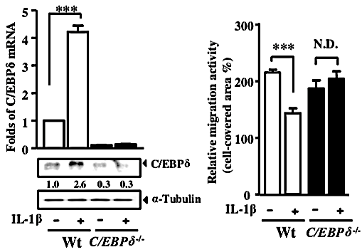
C/EBPδ does not affect astrocyte proliferation but impedes astrocyte migration
Ki-67 immunolabeling for proliferative cells both in vitro and in vivo (not shown)
qPCR and WB for mRNA and protein quantification (left) and scratch wound assay with IL-1β treatment

Slide 7
Scratch wound assay

Slide 8
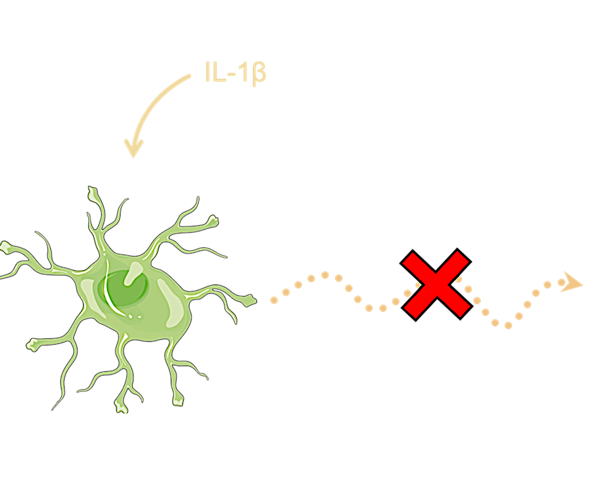
Results
With C/EBPδ
No migration
Without C/EBPδ
C/EBPδ DOES NOT PROMOTE ASTROCYTIC PROLIFERATION BUT DOES AFFECT MIGRATION.

Slide 9
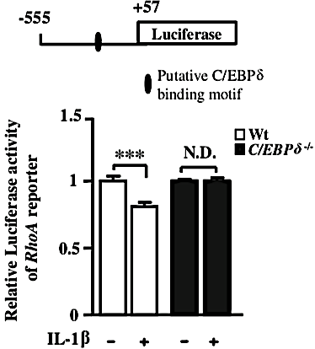
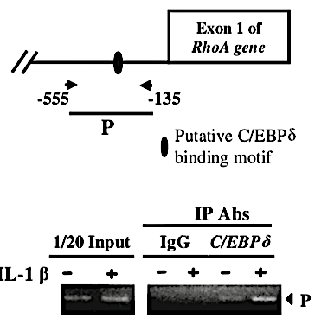
C/EBPδ attenuates astrocyte self-migration through the inhibition of RhoA
WB for RhoA family GTPases
Lucifease reporter assay to assess RhoA promoter activity
ChIP DNA binding assay with α-C/EBPδ Ab

Slide 10
Chromatin Immunoprecipitation assay
DNA-protein cross-linking
Chromatin isolation and sonication
Immunoprecipitation
Reverse cross-linking and precipitation
PCR amplification and analysis
Proteins
Genomic DNA

Slide 11
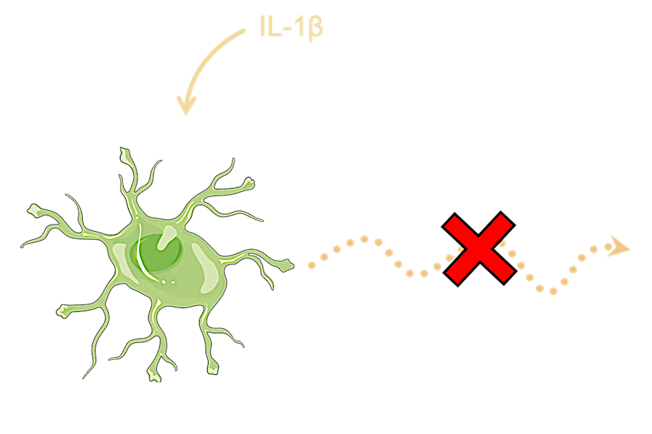
Results
No migration
C/EBPδ represses RhoA expression and contributes to attenuated migration of IL-1β-stimulated astrocytes.

Slide 12
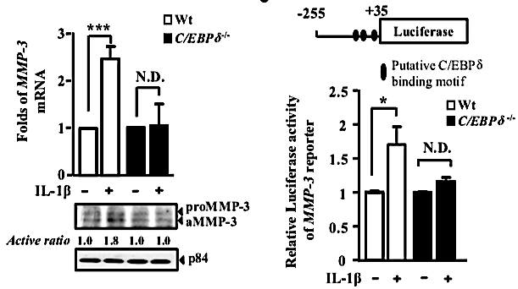
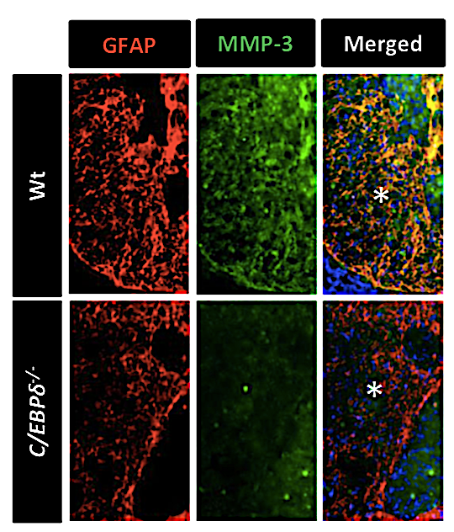
C/EBPδ induces astrocytic expression of MMP-3, which promotes the migration of inactive astrocytes
qPCR and WB for MMP-3
Luciferase reporter assay to assess MMP-3 promoter activity
GFAP and MMP-3 immunostaining

Slide 13
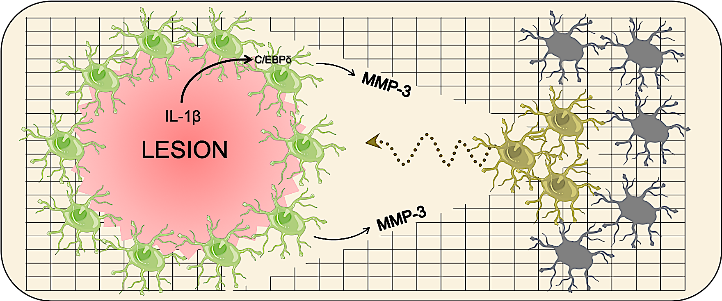
Results
Reactive astrocytes expressing C/EBPδ promote migration of inactive astrocytes through MMP-3 expression.

Slide 14
Discussion and conclusions
This study proposes a model to explain how C/EBPδ modulates glial scar formation after sci:
il-1β activates the expression of c/ebpδ in reactive astrocytes close to the lesion.
activated c/ebpδ inhibits rhoa expression and reduces the migration of reactive astrocytes.
c/ebpδ in reactive astrocytes also enhances the expression of mmp-3, promoting the migration of adjacent inactive astrocytes.

Slide 15
Open questions and future perspectives:
The possible involvement of non-astroglial cells in the C/EBP∂ expression has to be investigated.
A better understanding of the processes occurring after SCI will allow to elaborate a strategy to improve motor function recovery, eliminating “the bad effect” of glial scarring.
The regulation of C/EBPδ downstream genes or proteins can be utilized as a therapeutic option, in the future, to reduce astrogliosis damages in neurodegenerative pathologies like Alzheimer’s or Parkinson’s diseases.

Slide 16
Bibliography
IncuCyteⓇ Scratch Wound Assay Protocol
Saleh et al., “An efficient chromatin immunoprecipitation (ChIP) protocol for studying histones modifications in Arabidopsis plants”, Nat protoc, 2008, 3:1018-1025
Sofroniew, “Molecular dissection of reactive astrogliosis and glial scar formation”, Cell, 2009, 32(12):638-647
Wang et al., “Astrocytic CCAAT/Enhancer-Binding Protein Delta Contributes to Glial Scar Formation and Impairs Functional Recovery After Spinal Cord Injury”, Mol Neurobiol, 2016, 53:5912-5927

Slide 17
Thank you for your attention!

