Slide 1
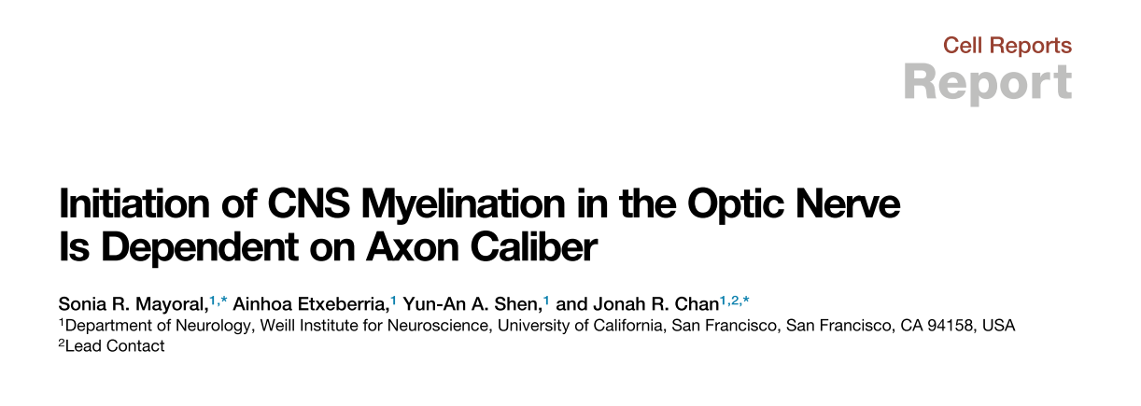
Cellular Neurobiology Course
Student’s Seminars 2018/2019
Dallorto Eleonora
Pirro Giulia

Slide 2
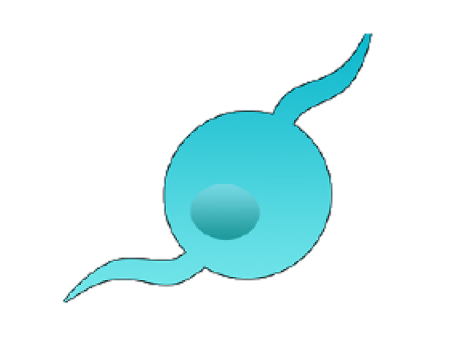
1.0 Introduction
OLs Differentiation process
Neural Stem cell
Glial Precursor Cell
Oligodendrocyte Precursor Cell
Pre-Oligodendrocyte
Myelinating Oligodendrocyte

Slide 3
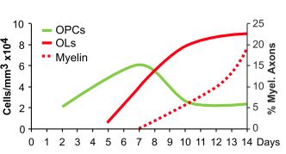
1.0 Introduction
OLs Differentiation process in the Optic Nerve

Slide 4
2.0 Scientific Questions ..??
Is the OLs differentiation process dependent from the neuronal signal?
Is the myelination associated to the axon caliber?

Slide 5
2.0 Scientific Questions ..??
Is the OLs differentiation process dependent from the neuronal signal?
Is the myelination associated to the axon caliber?

Slide 6
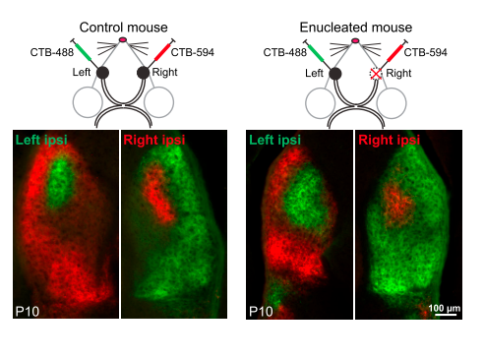
2.1 Enucleation of Postnatal Wlds Optic Nerve Disrupts Neuronal Activity
Wallerian degeneration slow (Wlds) homozygous mouse mutants

Slide 7
2.1 Enucleation of Postnatal Wlds Optic Nerve Disrupts Neuronal Activity
→ Enucleation avoid neuronal activity in the optic nerve

Slide 8
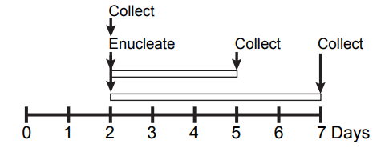
2.2 Elimination of Dynamic Neuronal Signaling Does Not Disrupt OL Differentiation

Slide 9
→ Dynamic neuronal signaling is not necessary for OL differentiation in the developing optic nerve
2.2 Elimination of Dynamic Neuronal Signaling Does Not Disrupt OL Differentiation

Slide 10
2.0 Scientific Questions ..??
Is the OLs differentiation process dependent from the neuronal signal?
Is the myelination associated to the axon caliber?

Slide 11
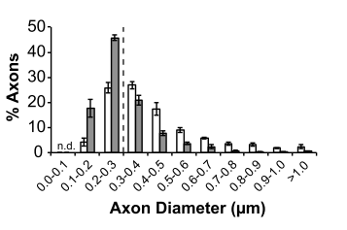
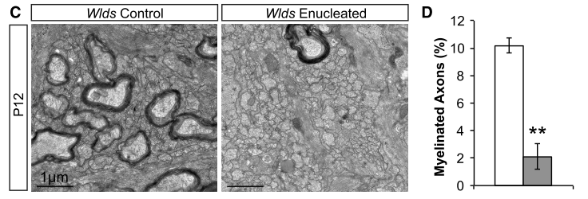
2.3 Enucleation Results in Subthreshold Axon Calibers and Disrupted Myelination

Slide 12
2.3 Enucleation Results in Subthreshold Axon Calibers and Disrupted Myelination

Slide 13
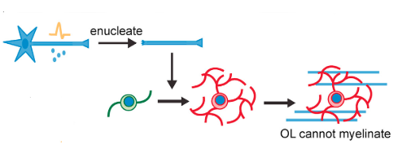
2.3 Enucleation Results in Subthreshold Axon Calibers and Disrupted Myelination
→ Enucleation may disrupt a normally permissive environment for myelination

Slide 14
2.3 Enucleation Results in Subthreshold Axon Calibers and Disrupted Myelination
→ Enucleation may disrupt a normally permissive environment for myelination
Hypertrophy ?

Slide 15
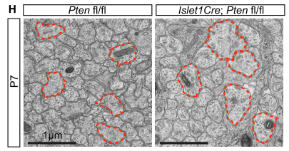
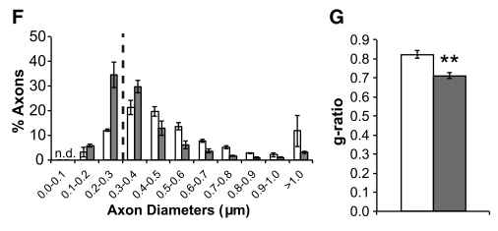
2.4. Increasing Axon Calibers by Cre/loxP strategy
PTEN : negative regulator of PI3K/Akt pathway
RGC-specific Pten conditional knockout (cKO) mice

Slide 16
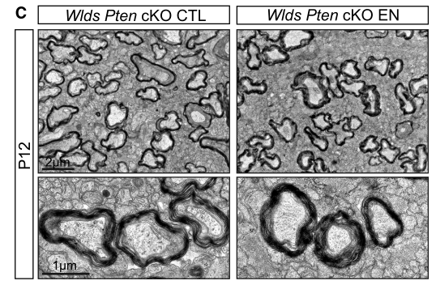
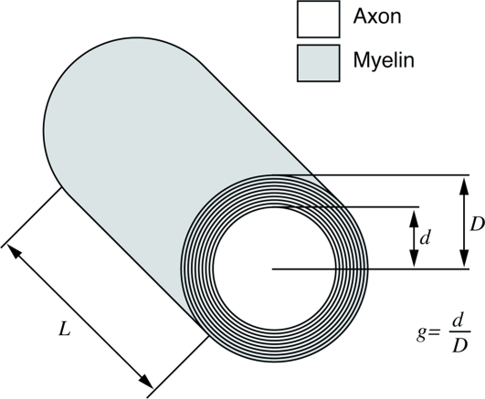
2.5 Increasing Axon Calibers Rescues Myelination Defect and Reveals Hypermyelination

Slide 17
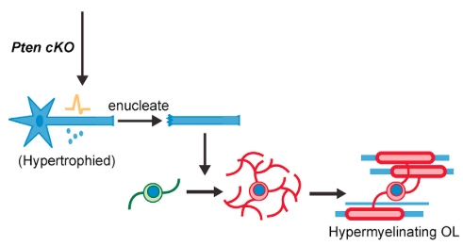
2.5 Increasing Axon Calibers Rescues Myelination Defect and Reveals Hypermyelination
→ Mechanism that limits the number of wraps of myelin dependent on dynamic neuronal signaling

Slide 18
3.0 Discussion
Oligodendrocyte differentiation is not dependent on dynamic neuronal signals
Supra-threshold axon caliber is necessary for myelination in vivo
Dynamic neuronal signaling in not necessary for oligodendrocyte myelination
Neuronal signaling may be required for limiting myelin wraps

Slide 19
4.0 Future Perspectives
Which are the biophysical properties that allow axonal myelination
Which factors control OL differentiation in both white and grey matter
Specific factor which controls membrane wrapping in other areas in CNS

Slide 20
4.0 Bibliography
Mayoral, S. R., Etxeberria, A., Shen, Y. A., Chan, J. R., Mayoral, S. R., Etxeberria, A., … Chan, J. R. (2018). Initiation of CNS Myelination in the Optic Nerve Is Dependent on Axon Caliber Report Initiation of CNS Myelination in the Optic Nerve Is Dependent on Axon Caliber. CellReports, 25(3), 544–550.e3.
Klingseisen, A., and Lyons, D.A. (2018). Axonal regulation of central nervous system myelination: structure and function. Neuroscientist 24, 7–21.
Miron, V.E., Boyd, A., Zhao, J.W., Yuen, T.J., Ruckh, J.M., Shadrach, J.L., van Wijngaarden, P., Wagers, A.J., Williams, A., Franklin, R.J.M., and Ffrench- Constant, C. (2013). M2 microglia and macrophages drive oligodendrocyte differentiation during CNS remyelination. Nat. Neurosci. 16, 1211–1218.
Lesche, R., Groszer, M., Gao, J., Wang, Y., Messing, A., Sun, H., Liu, X., and Wu, H. (2002). Cre/loxP-mediated inactivation of the murine Pten tumor sup- pressor gene. Genesis 32, 148–149.

Slide 21
Thank you for your attention!

