Slide 1
Transferrin Functionalized Liposomes Loading Dopamine HCl: Development and Permeability Studies across an In Vitro Model of Human Blood–Brain Barrier
Antonio Lopalco 1, Annalisa Cutrignelli 1,*, Nunzio Denora 1,2, Angela Lopedota 1,
Massimo Franco 1 and Valentino Laquintana 1
Nanomaterials: 20 March 2018
Sara Barsanti e Stefania Lunetta

Slide 2
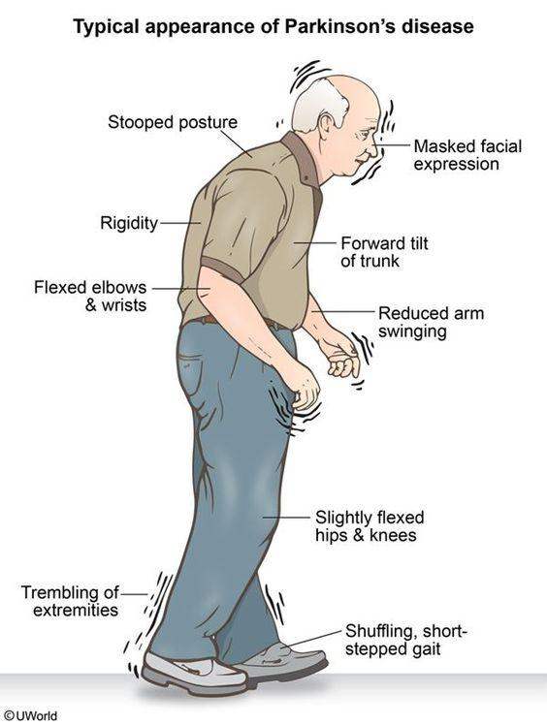
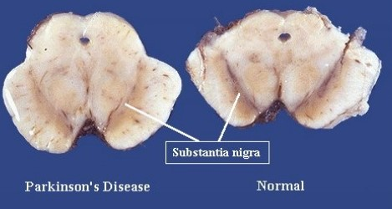
INTRODUCTION
Parkinson’s disease is a progressive neurodegenerative disease of the CNS that mainly affects the motor system.

Slide 3
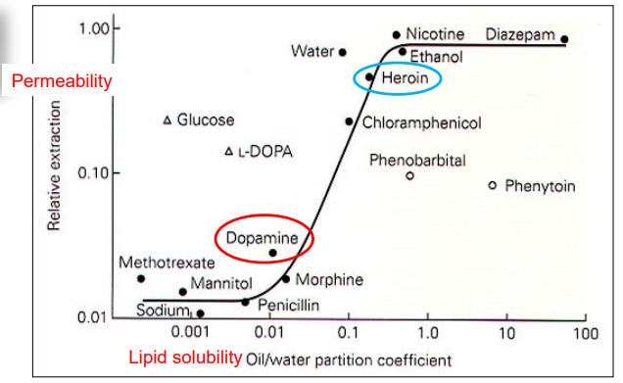
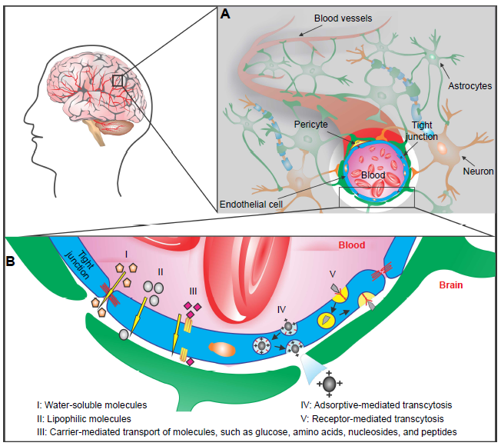
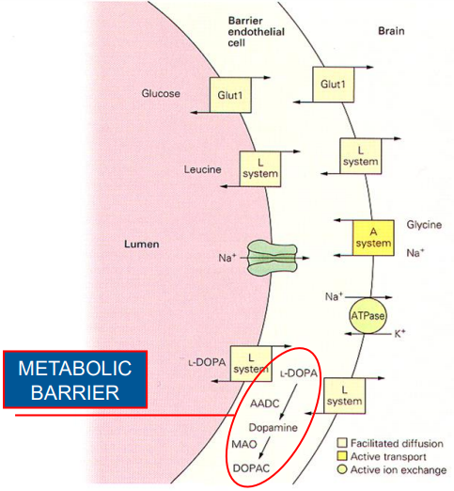
Dopamine can NOT cross the Blood-Brain Barrier

Slide 4
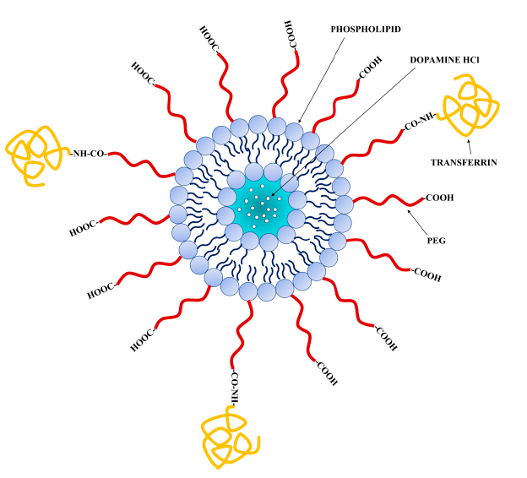
Liposomes
Structure
-lipid bilayer
-acqueus compartment
Advantages
Biocompatibility
Non invasive
Low toxicity
Reduce side effects
Specific drug delivery: FUNCTIONALIZATION

Slide 5
2. SCIENTIFIC QUESTION
Does Transferrin Functionalizated Liposomes allow an higher drug permeability across an In Vitro model of Blood-Brain Barrier?

Slide 6
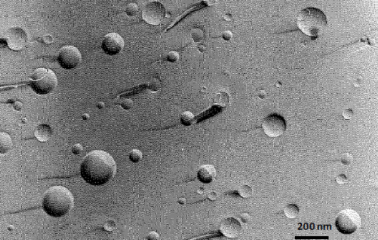
3. EXPERIMENTAL DATA
Preparation of Tf- funcrionalized and unfunctionalized LPs
Phisicochemical characterization
Size
Polidispersity Index (PDI)
Z-potential
Encapsulation Efficiency
Stability
Freeze-fracture electron microscopy

Slide 7
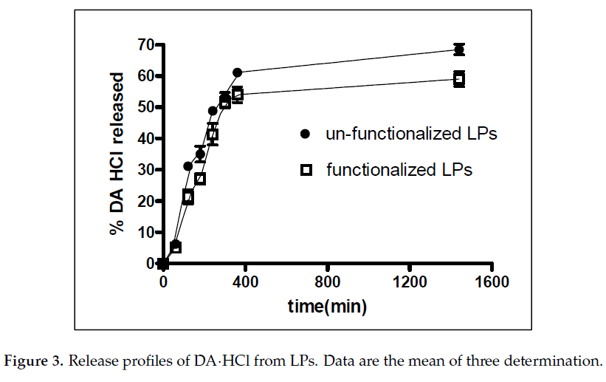
In Vitro release studies
Tf functionalized LPs
release a LOWER amount of DA than unfunctionalized LPs.

Slide 8
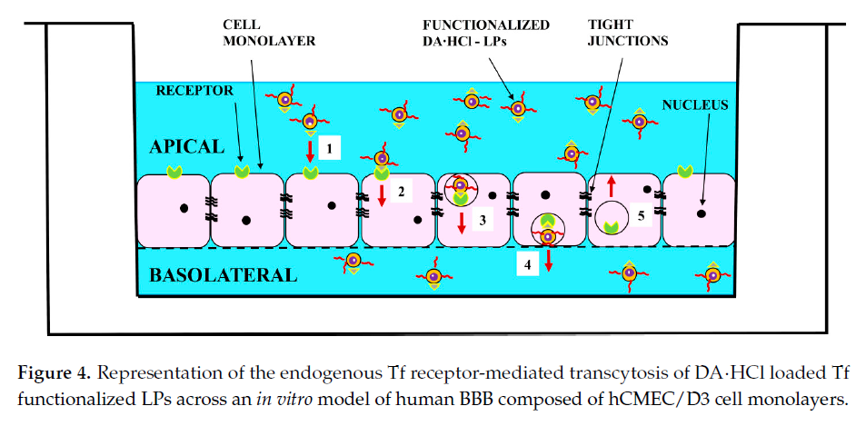
In Vitro Transport Analysis across The BBB Model
5X

Slide 9
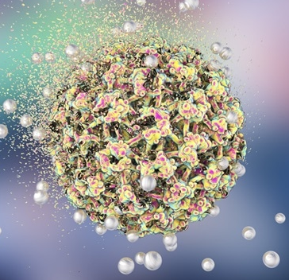
4. CONCLUSIONS
The employment of Liposomes decorated with Transferrin seems to be a promising strategy for brain drug delivery, since it ensure
Absense of citotoxicity
Improving benefits
Decreasing complications to the patient.

Slide 10
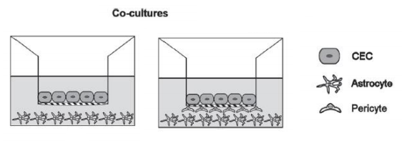
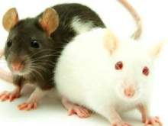
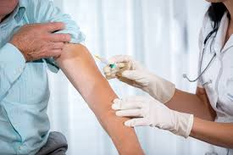
5. FUTURE PERSPECTIVES
Co-culture in vitro
In Vivo Animal Model
Clinical trials In Vivo in Humans

Slide 11
6. BIBLIOGRAPHY
1. Lopalco, A. et al. Transferrin Functionalized Liposomes Loading Dopamine HCl: Development and Permeability Studies across an In Vitro Model of Human Blood-Brain Barrier. Nanomater. Basel Switz. 8, (2018).
2. Vieira, D. B. & Gamarra, L. F. Getting into the brain: liposome-based strategies for effective drug delivery across the blood-brain barrier. Int. J. Nanomedicine 11, 5381–5414 (2016).

Slide 12
Thank you
for your attention!

