Slide 1
The following animation shows how in a linearly polarized light the electric field vector oscillates along one and only one direction (z, in the figure) and perpendicular to the propagation axis (x).
An observer located on the x axis will see the electric field vector that reaches a maximum and then decreases until it passes through zero, changes its sensus and then it reaches a minimum and then regrows again. The sine wave always remains confined in the xz plane and the observer would see a vector oscillating along z.

Slide 2
When two polarized waves are present simultaneously in two perpendicular planes, the resulting wave properties depend on the intensity and phases of the two component waves. The following animation shows the wave resulting from the sum of two waves of the same intensity, frequency, wavelength and in phase but polarized according to two perpendicular planes (horizontal for red and vertical for green)
The result of the sum between the two waves, is another polarized plane wave (the blue one) with the polarization plane shifted by 45 ° with respect to the polarization planes of the two original waves

Slide 3
If the two waves are not in phase (there is a difference of 90 ° between their phases) the resulting electromagnetic wave is circularly polarized. In practice, the electric field vector E rotates with a frequency equal to the frequency of the radiation: the result is that the tip of the vector runs along a spiral trajectory. The wave then propagates as a function that describes a spiral trajectory and no longer a sinusoidal one
An observer located on the x axis will see the electric field vector rotating.

Slide 4
Right- and left-hand circularly polarized light.

Slide 5
What happens when two circularly polarized waves are added together?
If the two waves have the same intensity, frequency and wavelength but are left and right polarized respectively, the resulting light will be linearly polarized.
A linearly polarized light can be seen as the sum of two circularly polarized waves, a left hand and a right hand one.

Slide 6
Circular dichroism
What happens if the material preferentially absorbs one of the two components (left or right) of linearly polarized light?
In the figure the two circularly polarized components of the linearly polarized light are absorbed differently: the circularly polarized right (red) is not absorbed while the circularly polarized left (green) is absorbed.

Slide 7
Circular dichroism
The electric field vectors exit the medium with different intensities and the sum vector describes an elliptical trajectory. The light is called elliptically polarized.

Slide 8
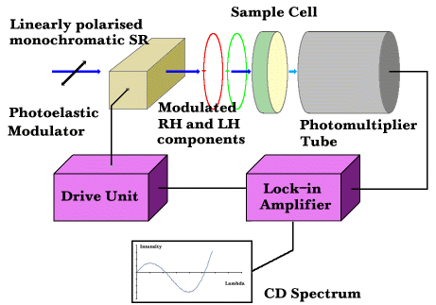
The CD spectrophotometer
A linearly polarized radiation produced by a Xenon lamp (a), very powerful (150-450 W) is used. The radiation then passes through the monochromator (b), which selects the desired wavelength, and through the polarizing filter (c), which polarizes it linearly. The heart of the CD spectropolarimeter is the so-called electro-optic modulator (d), consisting of a crystal able to alternatively pass the left or right component of the linearly polarized light according to the electric field to which it is subjected. The electro-optical modulator is subjected to an alternating electric field, whereby the sample (e) is alternately crossed by the left and right components. If the two components are absorbed differently, the detector (f) originates an oscillating intensity signal. The amplitude of this oscillation makes it possible to measure circular dichroism.

