Slide 1
Prevention of Metabolic Syndrome onset in Schizophrenia by Akt suppression in downstream signaling pathway activated by SGAs
Elisa Damo, Marta Forcella
Turin, 29.05.2018

Slide 2
Schizophrenia
Abnormal social behavior
Failure to understand reality

Slide 3
Schizophrenia

Slide 4
Treatments
First Generation Antipsychotics
Second Generation Antipsychotics
(SGAs)
attenuation of positive and negative symptoms
few adverse side effects

Slide 5
Second Generation Antipsychotics
Cardiovascular disease risk factors

Slide 6
Aim of the research
replacing
improving
SGAs
Metabolic Syndrome

Slide 7
Schizophrenia
SGAs
Inflammation
Metabolic Syndrome

Slide 8
Experimental tools
Schizophrenia model
Second Generation Antipsychotics
Anti-inflammatory Drugs
DISC1
Clozapine
Ibuprofen

Slide 9
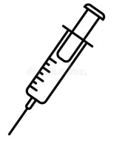
How to decrease the inflammatory state?
DISC1
DISC1
RNA interference
↑miR-7
Clozapine
Ibuprofen
miR-7
PTEN
↓ inflammation
↑ inflammation
PTEN
↑ Akt
Akt

Slide 10
How to detect the decrease of the inflammatory state?
Blood analyses of:
Cytokines (IL-12, IFN-ϒ, TNF-α, and sIL-2R)
Leptin/Adiponectin ratio (Metabolic Syndrome marker)
Molecular analyses of:
miR-7, PTEN, AKT
Behavioural tests

Slide 11
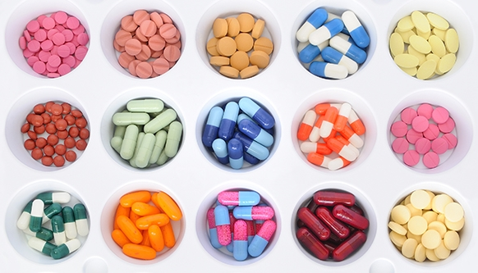
Who will support us?
Facilitates the communication of ideas
Helps the dialogue with:
government bodies,
international agencies
pharmaceutical industry.

Slide 12
Why our collaboration?

Slide 13
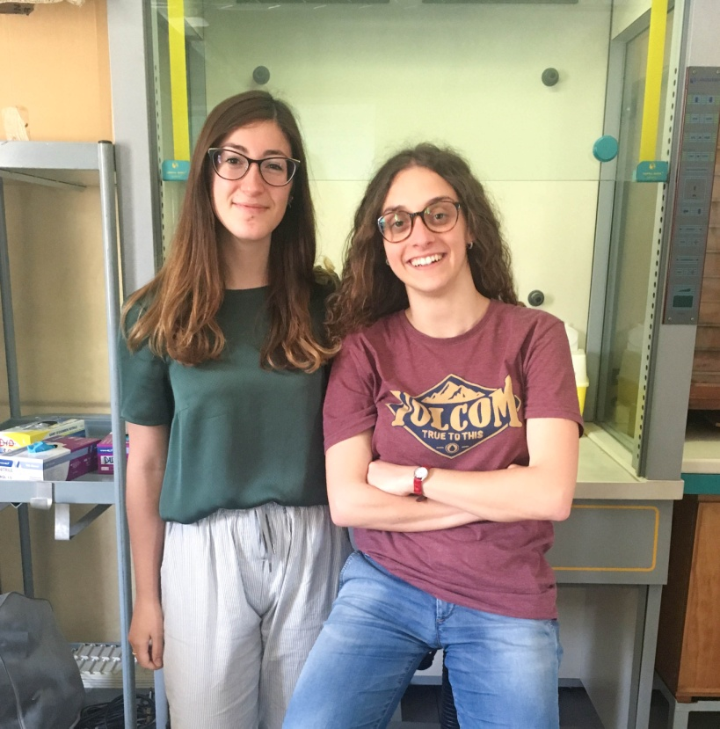
Thanks for your attention!
We are looking for PhD students
and money
Thanks to:
ECNP
D.J. Porteous’s team

Slide 14
References
Chen, Vincent Chin-Hung et al.
Leptin/Adiponectin ratio as a potential biomarker for metabolic syndrome in patients with schizophrenia
Psychoneuroendocrinology , Volume 92 , 34 – 40.
doi: 10.1016/j.psyneuen.2018.03.021
Johnstone M, Thomson PA, Hall J, McIntosh AM, Lawrie SM, Porteous DJ.
DISC1 in Schizophrenia: Genetic Mouse Models and Human Genomic Imaging.
Schizophrenia Bulletin. 2011;37(1):14-20. doi:10.1093/schbul/sbq135.
Prata J, Santos SG, Almeida MI, Coelho R, Barbosa MA.
Bridging Autism Spectrum Disorders and Schizophrenia through inflammation and biomarkers - pre-clinical and clinical investigations.
Journal of Neuroinflammation. 2017;14:179. doi:10.1186/s12974-017-0938-y.
Hinal Patel1 and V. H. Patel
Inflammation and Metabolic Syndrome: An Overview
Current Research in Nutrition and Food Science Vol. 3(3), 263-268 (2015)
Doi:10.12944/CRNFSJ.3.3.10
Oda Y, Kanahara N, Iyo M.
Alterations of Dopamine D2 Receptors and Related Receptor-Interacting Proteins in Schizophrenia: The Pivotal Position of Dopamine Supersensitivity Psychosis in Treatment-Resistant Schizophrenia.
Hashimoto K, Prokai-Tatrai K, eds. International Journal of Molecular Sciences. 2015;16(12):30144-30163. doi:10.3390/ijms161226228.
Papanastasiou E.
The prevalence and mechanisms of metabolic syndrome in schizophrenia: a review.
Therapeutic Advances in Psychopharmacology. 2013;3(1):33-51. doi:10.1177/2045125312464385.
Nidhi Malhotra, Sandeep Grover et al.
Metabolic syndrome in schizophrenia
Indian Journal of Psychological Medicine. 2013;35(3):227-240. doi:10.4103/0253-7176.119471.
ECNP https://www.ecnp.eu/

Slide 15
How to decrease the inflammatory state?
Clozapine
D2R
↑ inflammation
AARB2 + PP2A
Akt

Slide 16
How to decrease the inflammatory state?
Clozapine
↓ inflammation
D2R + AARB2 + PP2A
Akt

