Slide 1
A novel approach in ASD studies via the analysis of the conserved miRNAome expression between human and mice
GRANT PROPOSAL
Cristina Basile, Laura Tasca
Developmental Neurobiology,
Prof. Jeroen Pasterkamp,
Prof.sa Silvia De Marchis
Tuesday, 28th May 2018

Slide 2
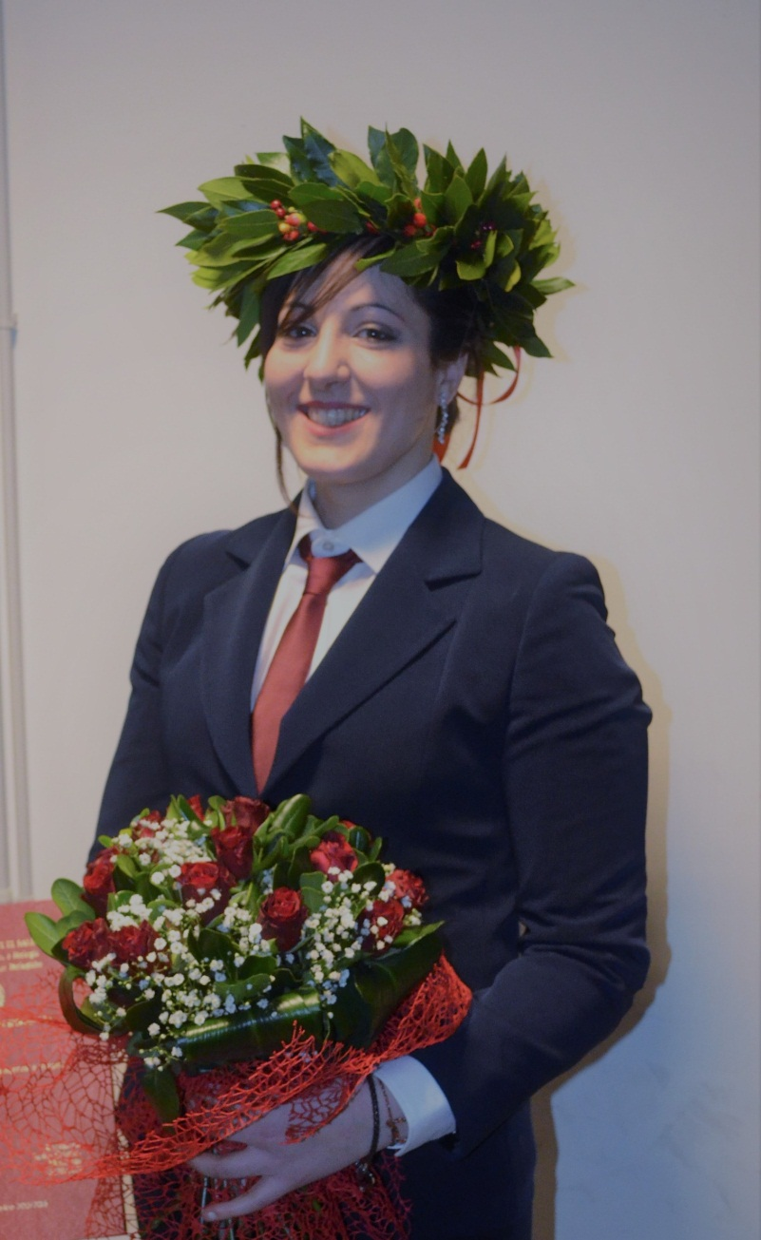
About us
We are young, but we have a strong passion and:
A clinical eye, thanks to the working experience in a hospital, combined with a great interest in neurodegenerative disorders
Cristina
An experience into the neuroscience field, thanks to two years spent working in lab, and the co-authorship of a published work
Laura

Slide 3
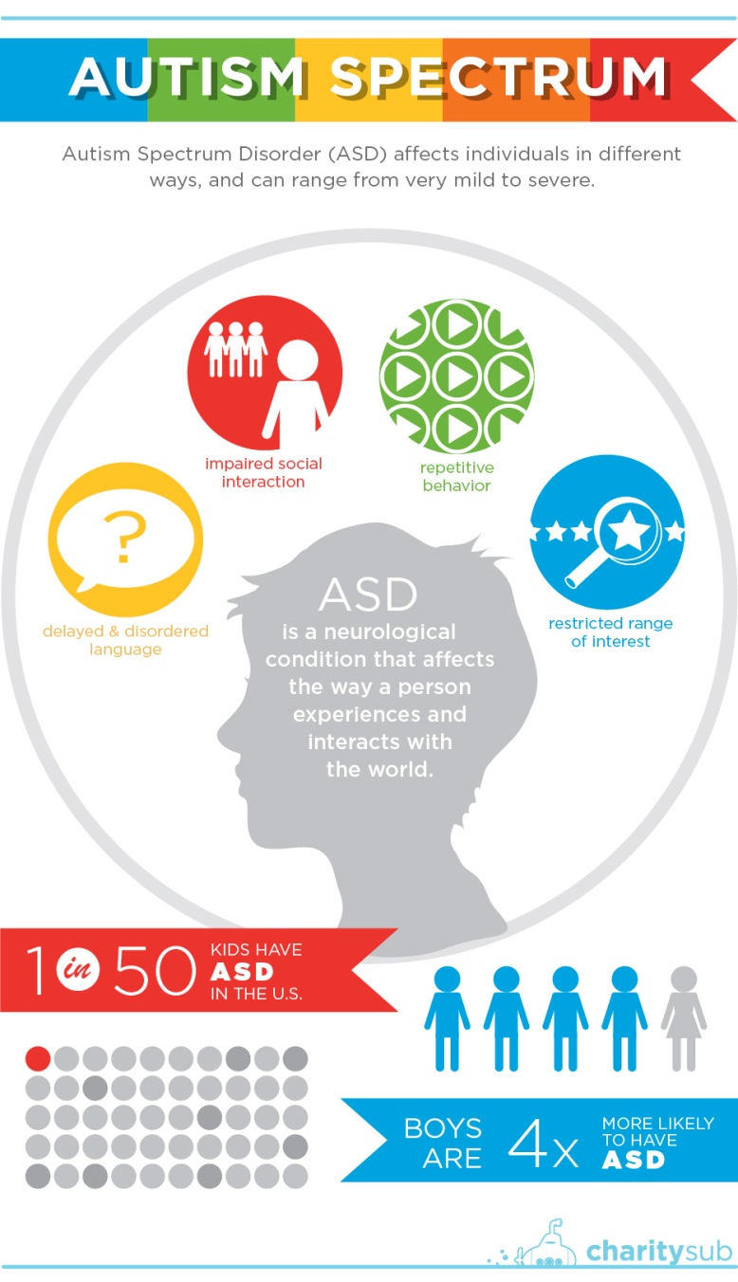
Autism Spectrum Disorder (ASD)
Average autism’s cost
$2.4 million for an autistic individual with intellectual disability
Economical
Psychosocial interventions
Behavioral therapies to acquire self-care, social and job skills
Therapeutic approach
Pharmacological therapies
Antidepressants, antipsychotics, anticonvulsants
Notes:
Autism is a neurodevelopmental disorder affecting 1 in 50 kids in the USA characterized by (read fig).
Autism is complex pathology caused by a combination of genetic and environmental factors,
That is not only not also a highly invalidating pathology, but it also has a huge economical weight, in fact (read fig)
Nowadays, the therapeutic approach are symptoms targeted, and in particular are combined by (read fig)

Slide 4
miRNAs
20% CGH array - 30% whole – exome sequencing
Leading role of miRNAs in temporal/spatial regulation of gene expression
Human-mice conservation as a filter for miRNAs selection
Derghan A. et al., Front. Neur. 2016
Notes:
miRNAs are doubled processed both in the nucleus and in the cytoplasm, where they act by recognizing mRNA and thus causing mRNA degradation aand translational repression
The reason why we decided to use this approach is to test the huge amount of unresolved case of autism
One interesting point of view of our project is to use the conservation among human and mice as a filter in the miRNAs selection (Greater biological meaning of all those conserved miRNAs respect to the non-conserved ones)

Slide 5
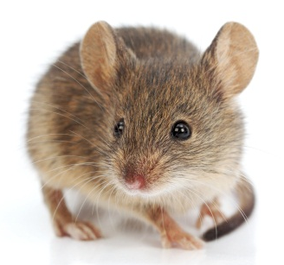
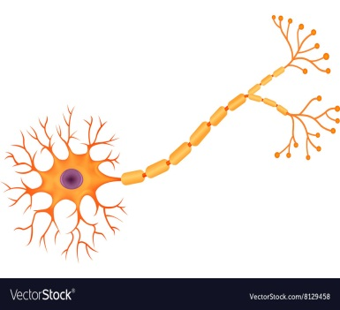
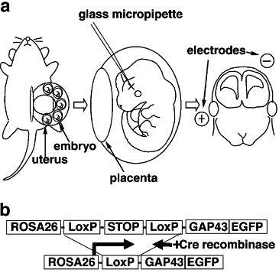
Experimental plan
In-silico approach
Experimental part
In-vivo in utero electroporation
miRNAome
miRNA disease model
In-vitro neurons cultures
miRNAome
Therapies
5-6 months
2-3 months
9-10 months
Nakahira et al., Developmental biology (2006)
Notes:
Our experimental plan, about 20 months long, will be divided into an in silico approach (composed by the miRNAome creation in both human and mice and their comparison) and an experimental part (composed by in vitro test on neurons and in vivo works on embryos and adult mice), the goals of project would be the characterization of our miRNAs model and the discovery of new therapies diseases-targeted

Slide 6
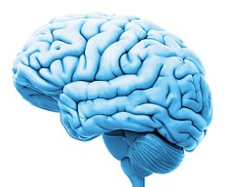
miRNAome
20
20
miRNAome
Cerebral cortex
Basal ganglia
Corpus callosum
Cerebellum
Brain stem
Hippocampus
Amygdala
5 - 10 miRNAs
15
Bioinformatic analysis
Cntnap2-/- mice
Notes:
In-silico approach is first composed by the creation of two miRNAs libraries of the most affected regions in the brain (such as), one of about 20 patients and 20 healthy controls, and one of about 15 mice affected by ASD (Cntnap2-/-)
This step will be followed by the comparison of these two libraries by bioinformatic analysis to select the conserved miRNas among the most expressed in human and mice.

Slide 7
In-vitro cortical neurons
Dendritic spines stabilization and formation (via IF/WB of Pak3/1)
Cellular features
Neurons
Cultures
Synaptic pruning
(via LTD measurements by electrodes)
2 miRNAs
Control
"in situ" detection of miRNA by LNA
Notes:
The selected miRNAs will be further investigated in in-vitro culture of cortical neurons, and in particular we would like to test the dendritic spines formation, found impaired in ASD, by IF and WB analysis of the marker Pak3 and 1, responsible for dendritic spines formation an stabilization, and the synaptic pruning activity performed by the microglia via the IF analysis of the PSD95 protein in lysosomal vesicles found in microglia cells after engulfment of synapses.

Slide 8
In-vivo mice embryo
In utero electroporation overexpression of miRNAs
Circuit activity modulation (via WB of oxytocin)
Cellular features
Neuroinflammation (via WB of NFkB)
Notes:
These miRNAs will be further investigated in vivo by in utero electroporation overexpression. This technique consist in the miRNAs injection in brain embryos followed by the electroporation, allowing a migration of the miRNAs to the opposite pole of the brain.
After the in utero electroporation, the mice will be sacrificed and on the brain embryo will be tested the circuit activity modulation via WB analysis of the oxytocin level, a neuromodulatory hormones involved in pro-social behaviour and bounding, impaired in ASD, and the neuroinflammation via WB of NFkB, found increased in ASD

Slide 9
In-vivo pups/adults
In utero electroporation overexpression of miRNAs
Anatomical features
Head circumference measurements
Comparison of the MRI to see changes in the white matter
Morphological features
Purkinje cells numbers and connectivity (via IF/electrodes)
Notes:
Following the pregnancy, in the adult mice will be investigated the head circumference, that has been found increased in ASD. This will also be assessed by comparison of the MRI of affected mice and controls, to see changes in the outer radiate white matter that has been found increased in ASD and characterized by an increased connectivity intrahemispherical
Among the morphological features, we will also assess the number of the purkinje cells and its connectivity, that has been found decreased in ASD

Slide 10
In vivo pups/adults
In utero electroporation overexpression of miRNAs
Abnormal social interactions (three chambers apparatus)
Behavioural tests
Deficits in communication (response to several inputs)
Repetitive behaviours (scoring of different behaviours)
Rescue
Anti-miRNAs sub ministration
Possible therapies
Notes:
Following the pregnancy, in the adult mice will be then performed behavioural analysis, to test the presence or not of the stereotyped behaviour such as abnormal social interactions, investigated by the three chamber apparatus, deficits in communication measuring the response to several inputs and repetitive behaviours by scoring of jumping grooming and others.
Finally, we will try to rescue the descripted phenotype by anti-miRNAs sub ministration

Slide 11
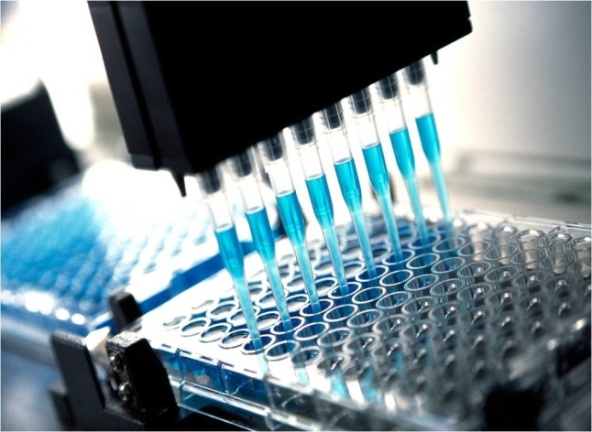
Why this project
New ASD therapies
Scientific purposes
Insight into related pathologies such as
Depression
Mitochondrial pathologies
Closer collaboration with associations to help spread economical awareness and sensitization of the people closer to the interested parties
Human perspective

Slide 12
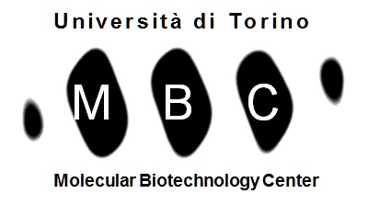
Collaboration

Slide 13
Images References
Direct evidence that ventral forebrain cells migrate to the cortex and contribute to the generation of cortical myelinating oligodendrocytes; Eiko Nakahira, Tetsushi Kagawa, Takeshi Shimizu, Martyn D. Goulding, Kazuhiro Ikenaka; Developmental Biology 291 (2006) 123–131
How do microRNAs regulate gene expression?; Ian G. Cannell1, Yi Wen Kong 1 and Martin Bushell, Biochemical Society transactions (2008) 36:6
An Emerging Role of micro-RNA in the Effect of the Endocrine Disruptors; Derghal A, Djelloul M, Trouslard J, Mounien L; Front Neurosci. 2016 Jun 30;10:318

