Slide 1
MICAL-1 AND NCAM CO-LOCALIZE IN RAB6+ CARGO VESICLES
MICAL-3 regulates Rab6 vesicle trafficking (Grigoriev et al., Curr Biol 2011).

Slide 2
RAB6 VESICLES IN REGIONS OF ABERRANT ACTIN

Slide 3
DEFECTS IN RAB6 VESICLES AND F-ACTIN ARE DEPENDENT ON THE MICAL-1 MO DOMAIN

Slide 4
LATRUNCULIN RESCUES ACTIN DEFECTS IN MICAL-1 GROWTH CONES

Slide 5
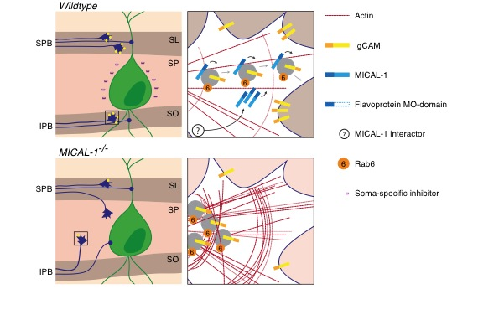
SUMMARY

