Slide 1
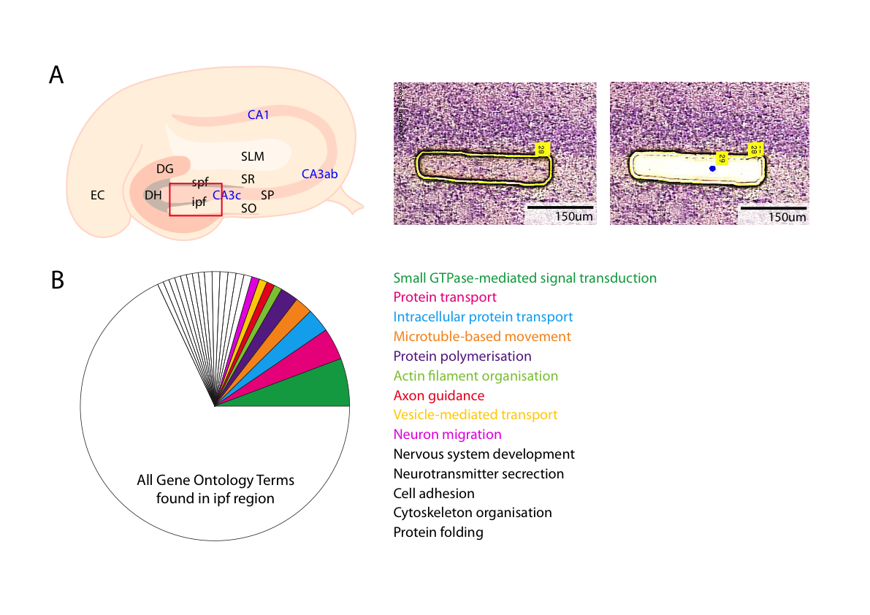
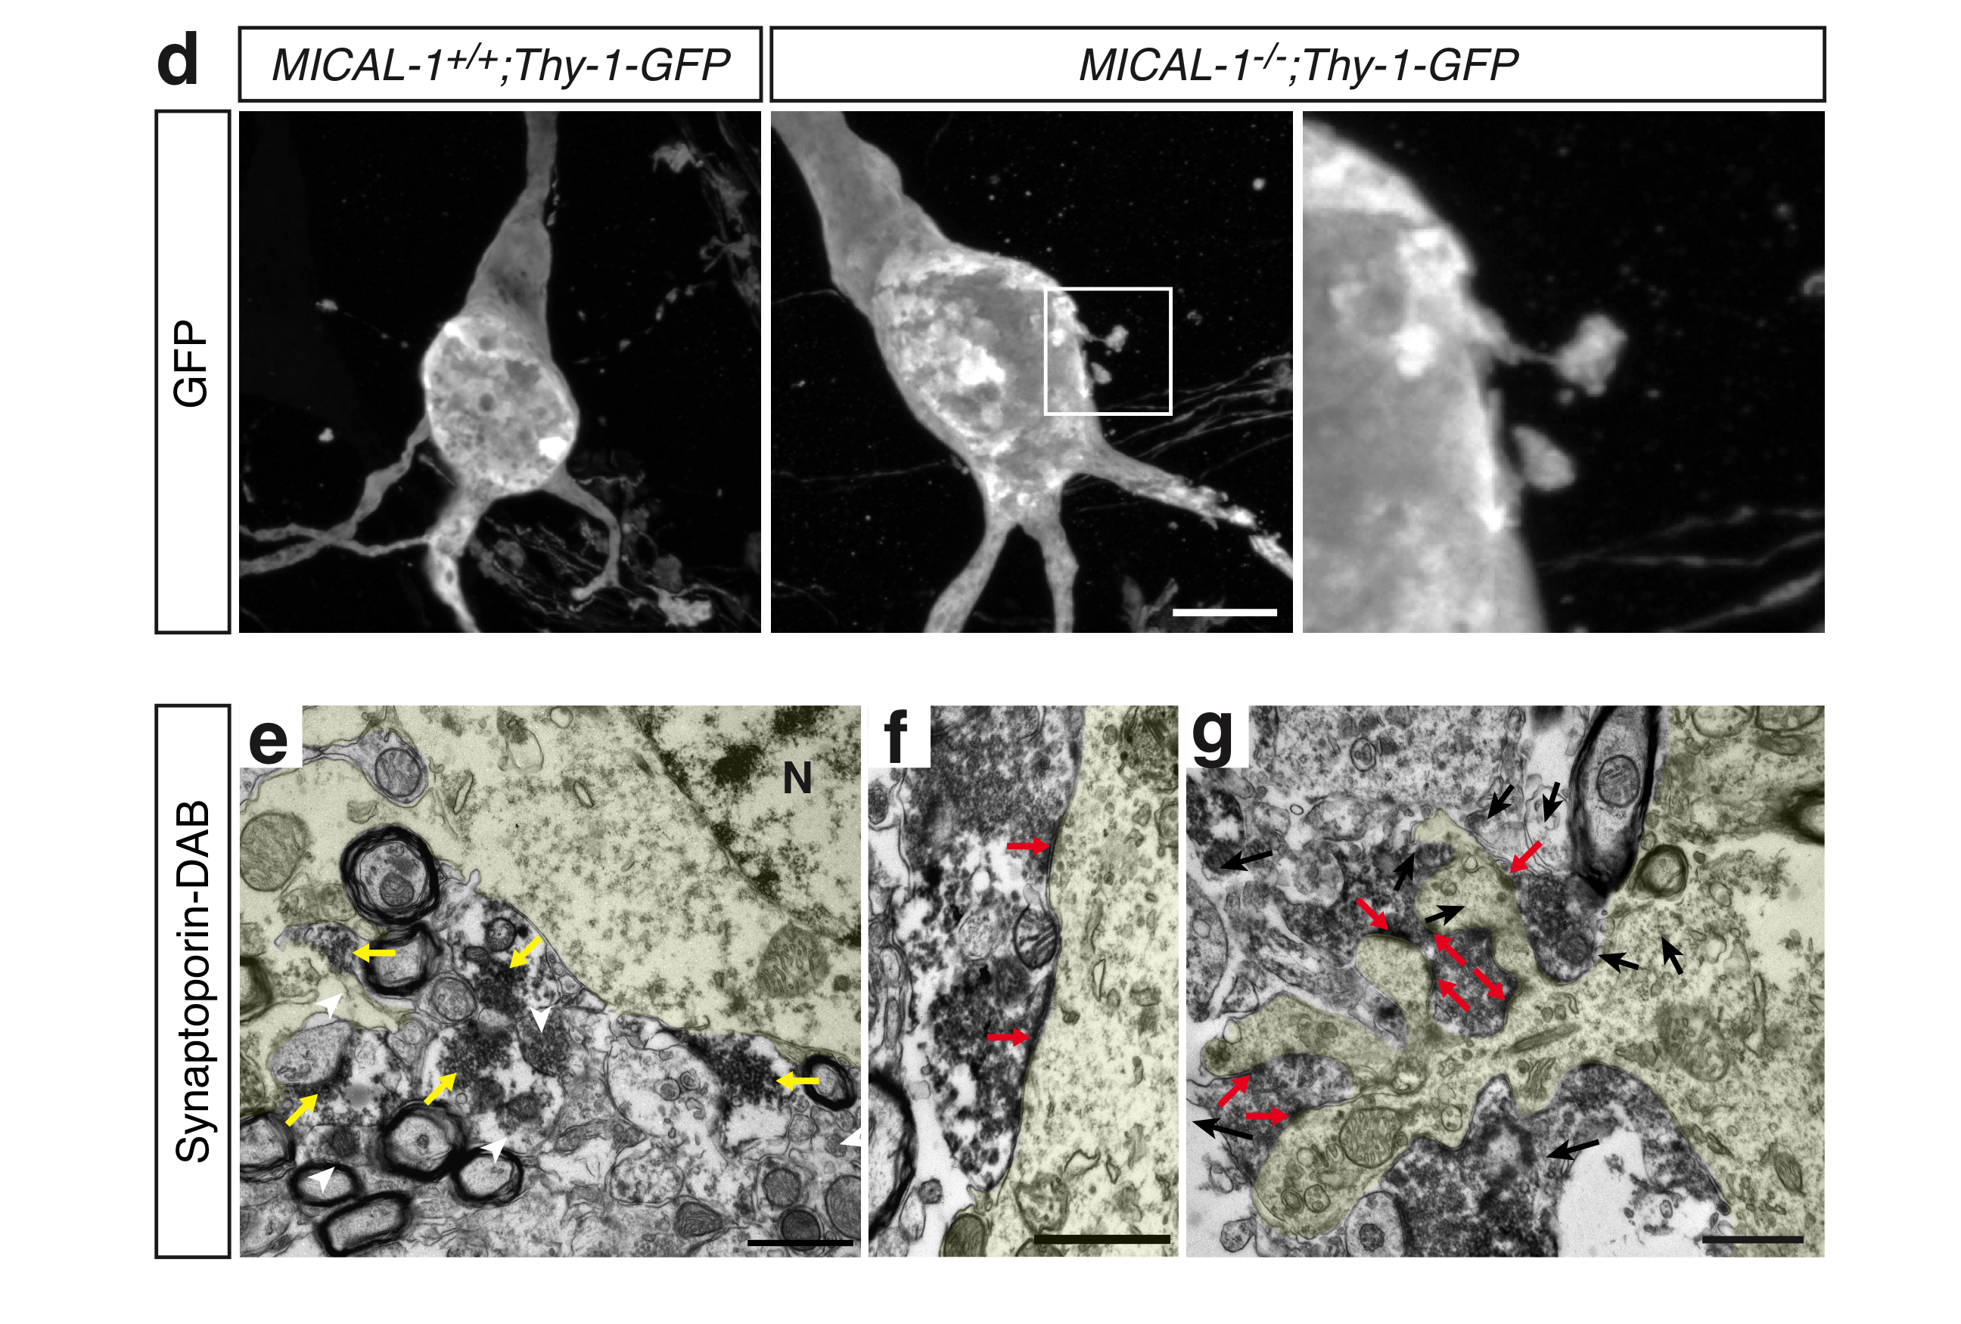
MOSSY FIBERS SYNAPSE ON PYRAMIDAL NEURON CELL BODIES IN MICAL-1 KNOCKOUT MICE

Slide 2
LCM-PROTEOMICS
Schmidt et al., 2014 Neuron
Protein transport | Cell adhesion | Axon development
Amph, Arf, GDi1, MDi1, Stx1b, Rab1a, 1b, 2a, 3a, 5a, 5b, 5c, 7, 8a, 8b, 10, 11a, 11b, 14, 15, 35 | Cntn1, L1Cam, Ncam1, Rac1, Thy1, Tln1 | Dbn1, Dcx, Gap43, GFAP, Mapt Nptn, Stmn1, Tubb3, Vim

Slide 3
REDUCED IGCAM CELL SURFACE EXPRESSION
IN MICAL-1 KO MICE

Slide 4
GENETIC INTERACTION BETWEEN MICAL-1 AND CHL1 OR NCAM

Slide 5
REDUCED PSA-NCAM CELL SURFACE LEVELS IN MICAL-1 KO GROWTH CONES

