Slide 1
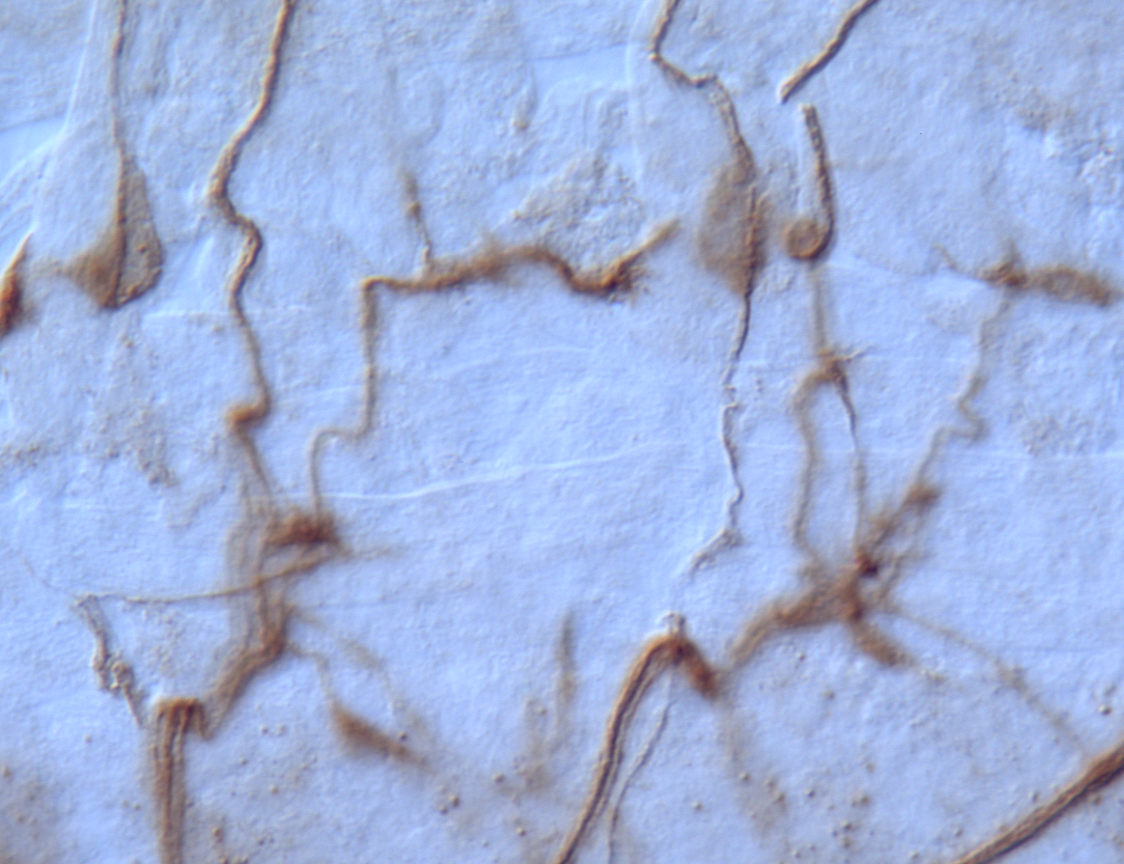
MO ACTIVITY IS REQUIRED FOR AXON GUIDANCE
ISN
ISN
12
Monooxygenase Domain
13
6
7
GXGXXG DG GD
Df(3R)swp2^{MICAL}/Df(3R)swp2^{MICAL}
Site-directed mutagenesis (no FAD binding)
WXWXXW DG GD
MICAL transgenic fly
RESCUE
MICAL LOF fly
MICAL^{GW} transgenic fly
NO RESCUE

Slide 2
MICAL CAUSES F-ACTIN DEPOLYMERIZATION
Actin severing and disassembly
Methioinine 44 – pointed end actin subunit
Hung et al., 2010, 2011

Slide 3
MICAL-1 REGULATES MICROTUBULE DYNAMICS
Morinaka et al., 2011

Slide 4
ROLE FOR MICALS IN VERTEBRATE PLEXIN-A SIGNALING?
MICAL-1-3 bind plexinAs (A1-A4)
Neuronal expression MICAL1-3 and plexinAs overlaps
Knockdown of MICAL-1 or MICAL-3 blocks growth cone collapse by Sema3A in culture

Slide 5
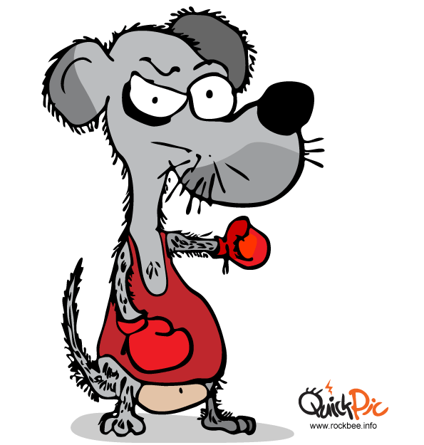
MICAL-1 AND MICAL-3 KNOCKOUT MICE
Wildtype locus
ATG
MICAL-1
S
SacI
S
SacI
1
2
3
Targeted locus
S
S
S
ATG
SacI
SacI
S
pGK-Neo
loxP
frt
1
2
3
X Cre mice
S
SacI
S
SacI
Knockout locus
loxP

Slide 6
NO SEMAPHORIN/PLEXIN PHENOTYPES IN MICAL-1/3 KNOCKOUT MICE
Growth cone collapse induced by different semaphorins intact in MICAL-1/3 knockout mice
Whole-mount neurofilament

Slide 7
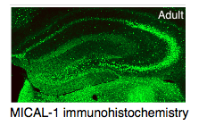
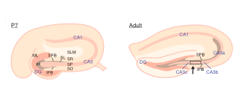
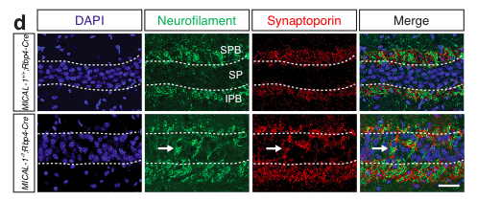
DEFECTS IN HIPPOCAMPAL LAMINATION IN MICAL-1/3 KNOCKOUT MICE
Van Battum et al., 2014 Nature Comm

