Slide 1
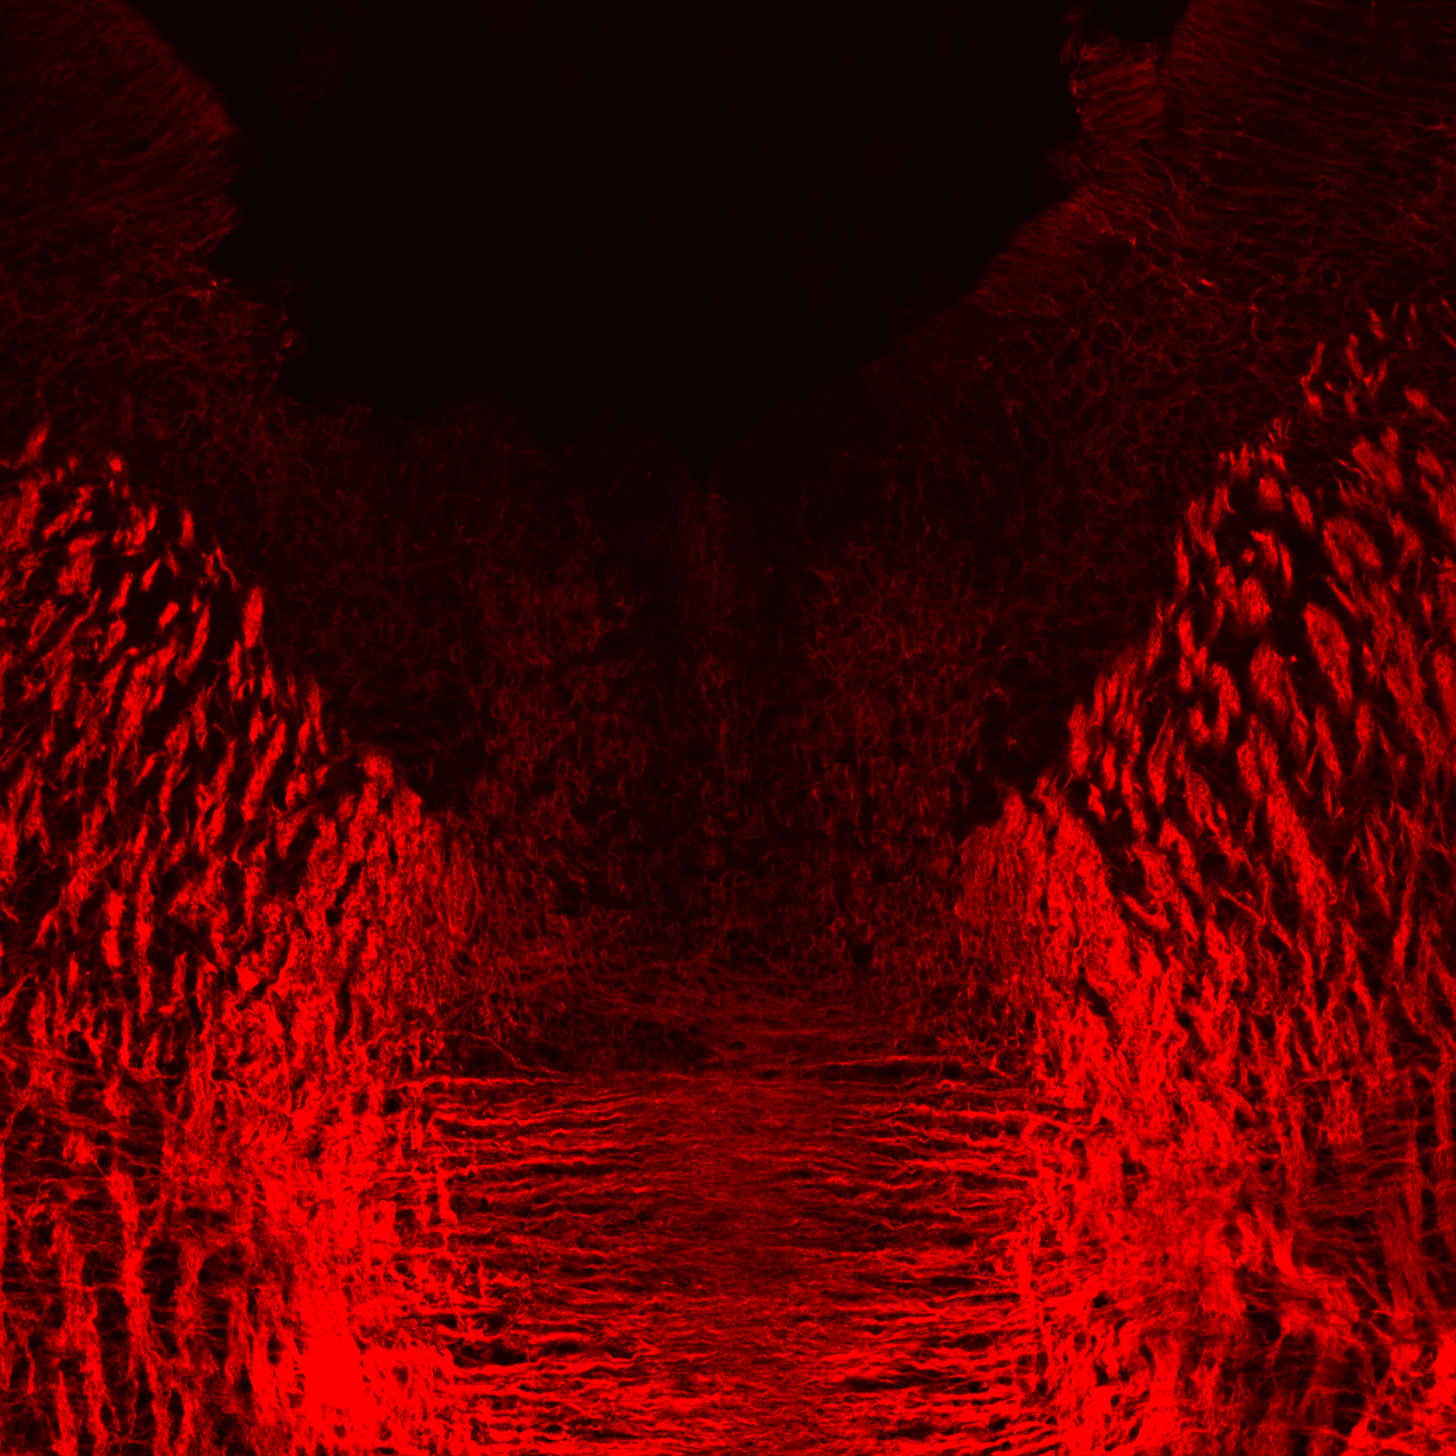
Paper discussion I

Slide 2
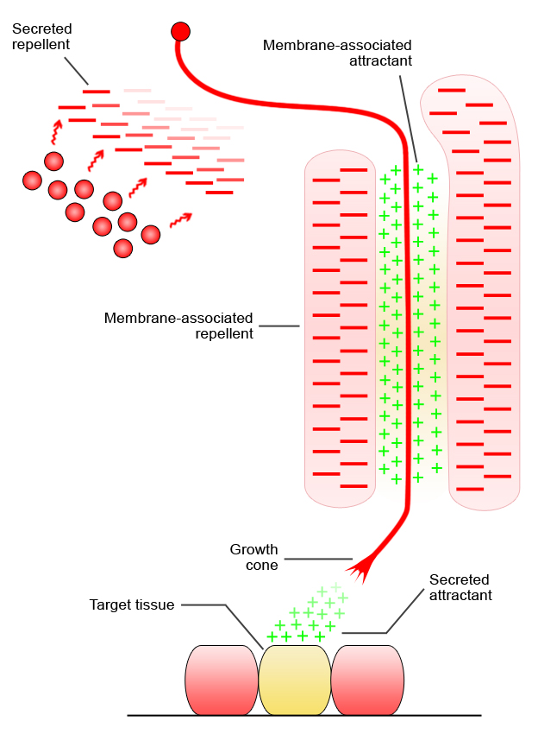
AXON GUIDANCE
Van Battum, Brignani & Pasterkamp, Lancet Neurology, 2015

Slide 3
SEMAPHORIN SIGNALING
Semaphorin
Semaphorin
receptor
axon guidance cue
growth cone
ECM
cytosol
axon
cytoskeleton
??
??
cytoskeleton

Slide 4
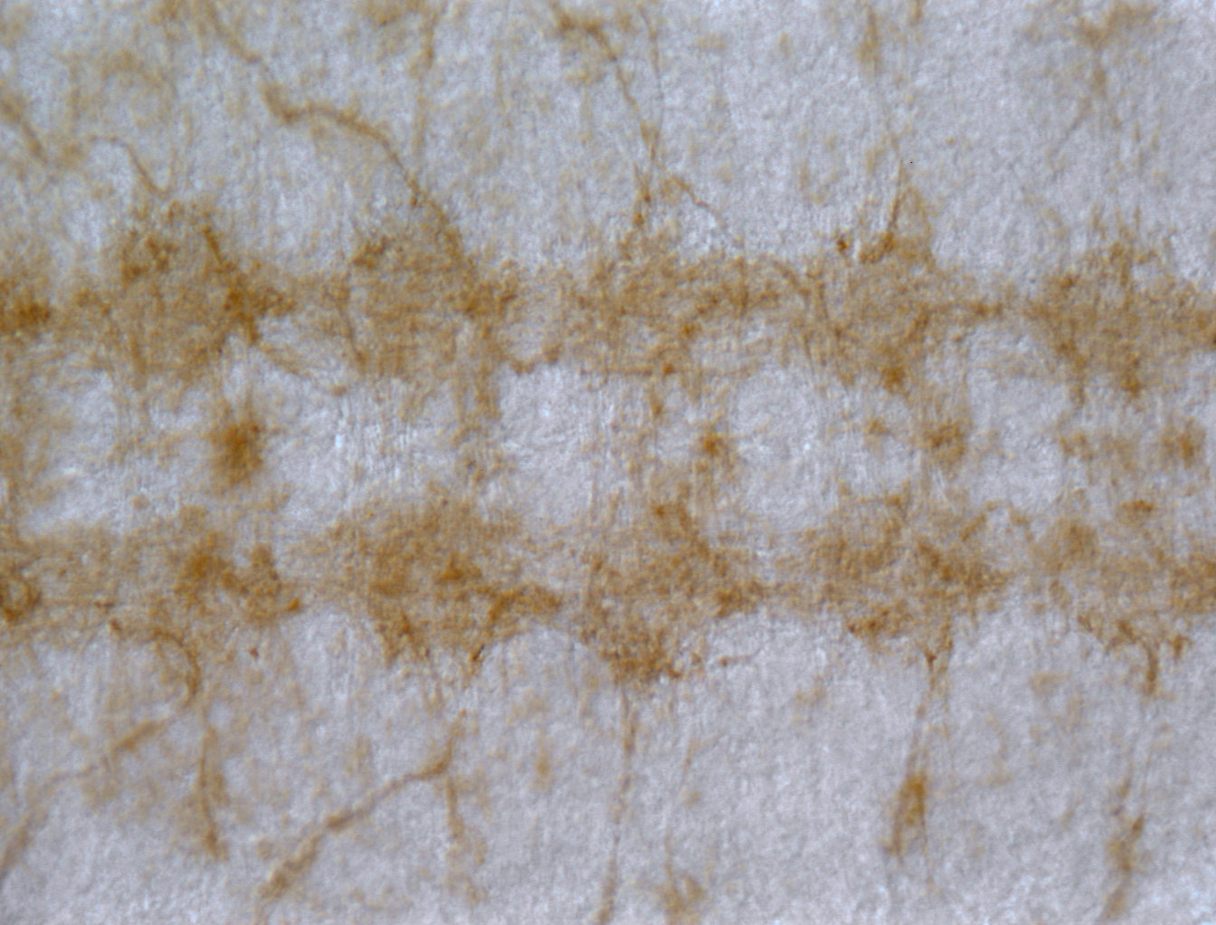
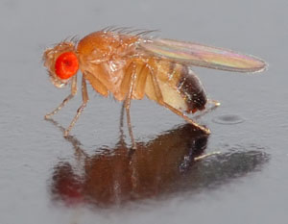
Molecule interacting with CasL
IHC with α-MICAL antibody
Sema-1a
midline
PlexA
Co-IP MICAL & PlexA
Input
IP
Input
IP
Yeast-2-hybrid
Blot:
Anti-HA (PlexA)
Anti-MICAL
Terman, Mao, Pasterkamp et al, Cell, 2002

Slide 5
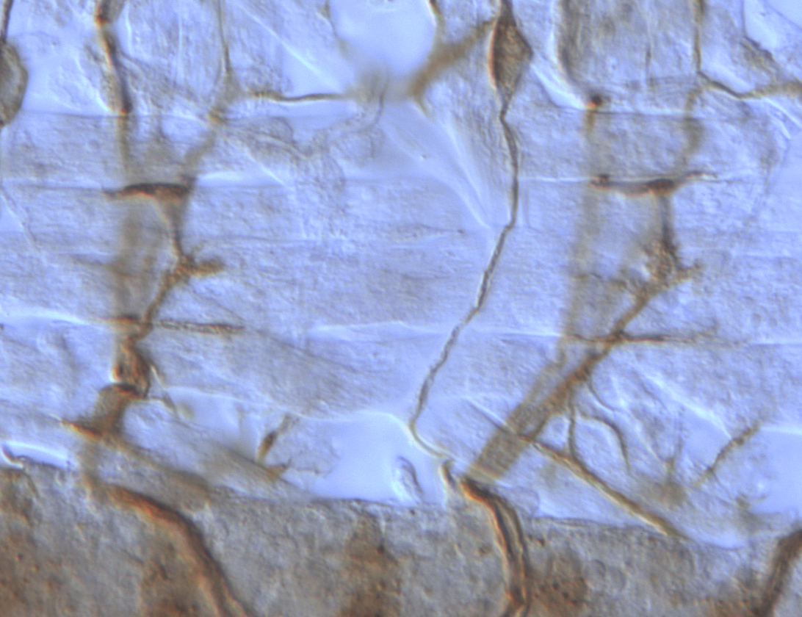
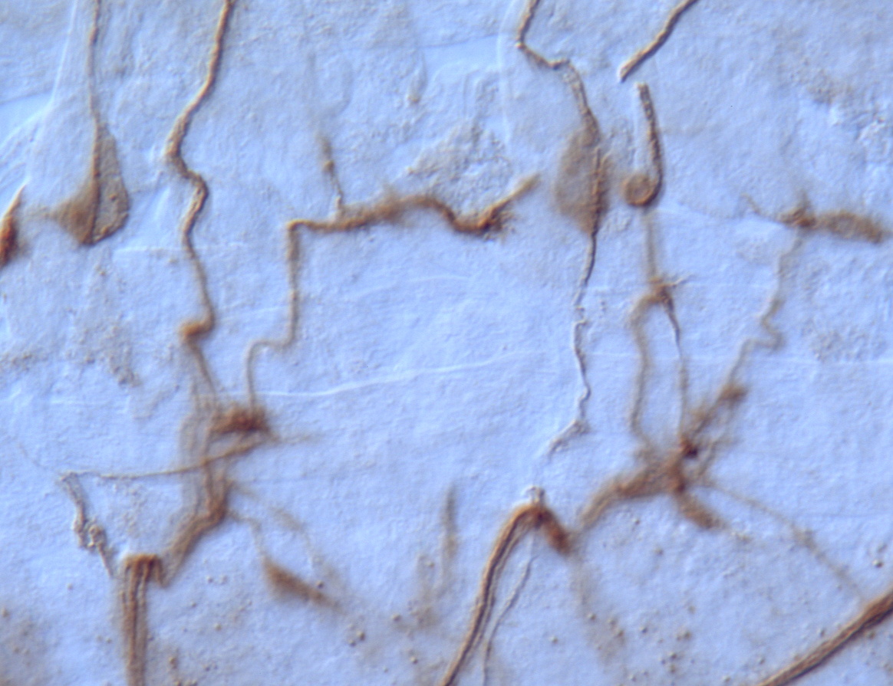
MICAL ACTS DOWNSTREAM OF SEMA-1a/PlexA
Sema-1a
wildtype
MICAL LOF
PlexA
ISN
ISN
ISN
ISN
12
13
C1
12
6
7
C2
PlexA
b
13
6
7
+/+
Df(3R)swp2^{MICAL}/Df(3R)swp2^{MICAL}
MICAL = PlexA = Sema-1a

Slide 6
MICAL IS A MULTIDOMAIN PROTEIN
Coiled-Coil Motif (ERM alpha-like)
Calponin Homology Domain
LIM Domain
Proline Rich
Region
D-MICAL
Flavoenzyme
Variable Region (1)
Variable Region (2)
Plexin Interacting
Region
MICAL=Molecule interacting with CasL

Slide 7
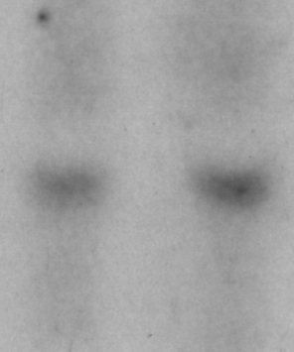
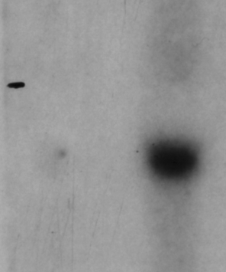
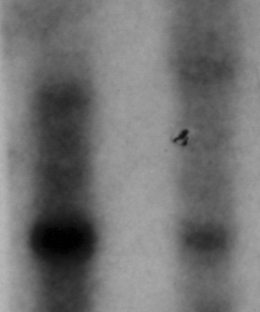
MICAL EXPRESSION IN THE BRAIN
E19
AD
MICAL-1
~3.7 kb
E15
E19
P5
P14
AD
MICAL-1
MICAL-2
MICAL-2
~4.2 kb
MICAL-3
GAPDH
MICAL-3
>11 kb
RT-PCR, rat whole brain cDNA
>9 kb

Slide 8
MICALS CONTAIN A MONOOXYGENASE DOMAIN
Monooxygenase Domain
FAD Binding
Motifs
GXGXXG DG GD
Electron donor
FAD
Distinctive features of a flavoprotein monoxygenase (hydroxylase)
GXGXXG DG GD
Oxidoreductases catalyze the insertion of one atom of molecular oxygen into their substrates
Consensus dinucleotide binding sequence, binds ADP moiety FAD
Binds pyrophosphate moiety FAD
Binds ribose moiety FAD
Oxidation of aa is known to regulate the activity of several different molecules:
Actin, small GTPases, GAP43 ……

Slide 9
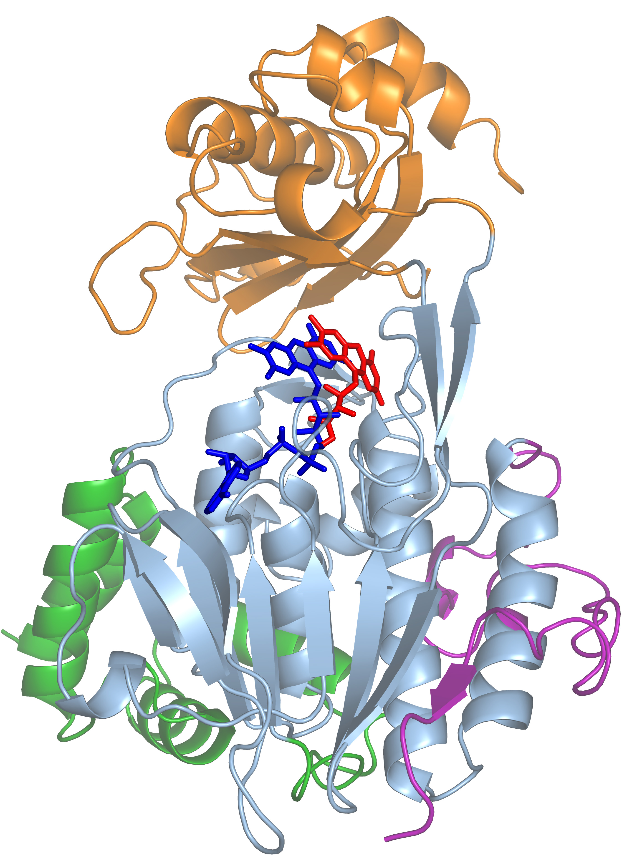
MICAL-1 CRYSTAL STRUCTURE
Christiaan Siebold
Yvonne Jones
(University of Oxford)
MO domain
FAD
FAD binding domain
linker
NADPH-dependent

Slide 10
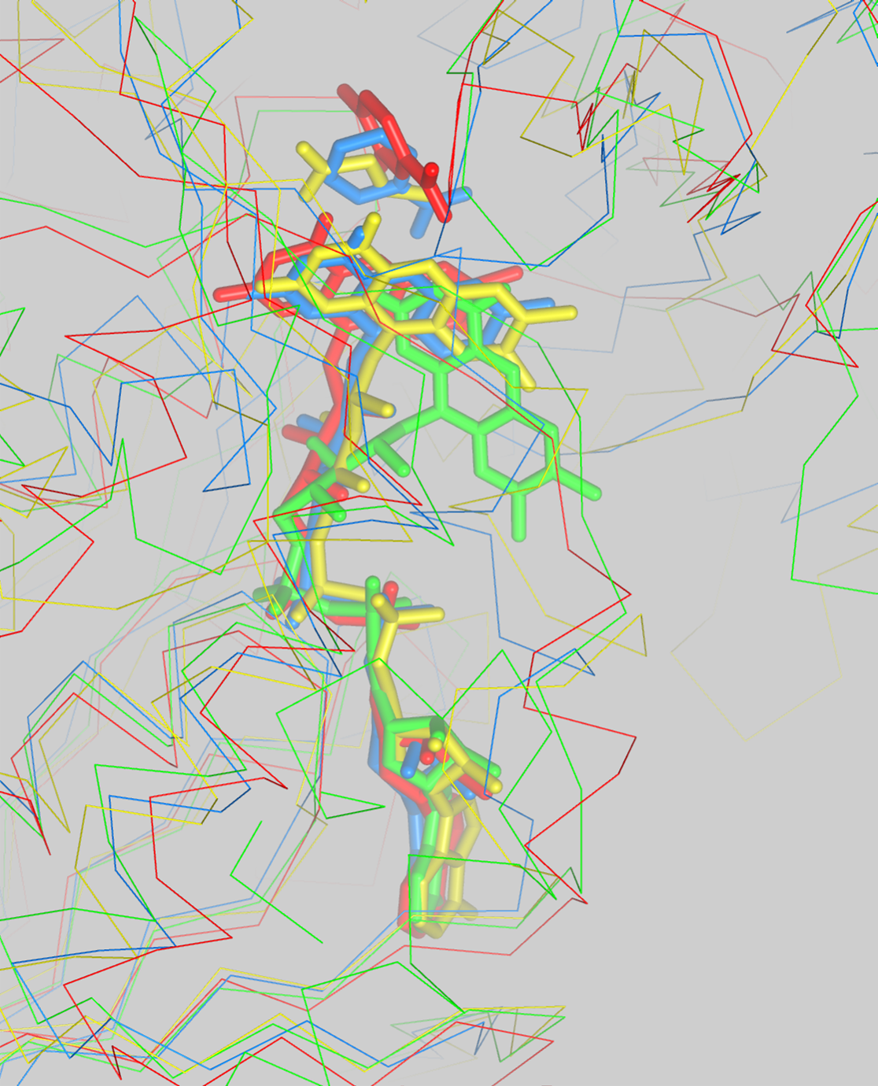
MICAL-1 CRYSTAL STRUCTURE
Entrance of the active site
red: p-hydroxybenzoate hydroxylase
yellow: Sarcosine Oxidase
blue: D-amino acid oxidase
green: MICAL-1

