Slide 1
Master in Cellular and Molecular Biology
Medical and Cancer Genetics course
MEDICAL GENETICS
Teacher: Claudia Giachino
Lesson 3
Chromosomal diseases

Slide 2
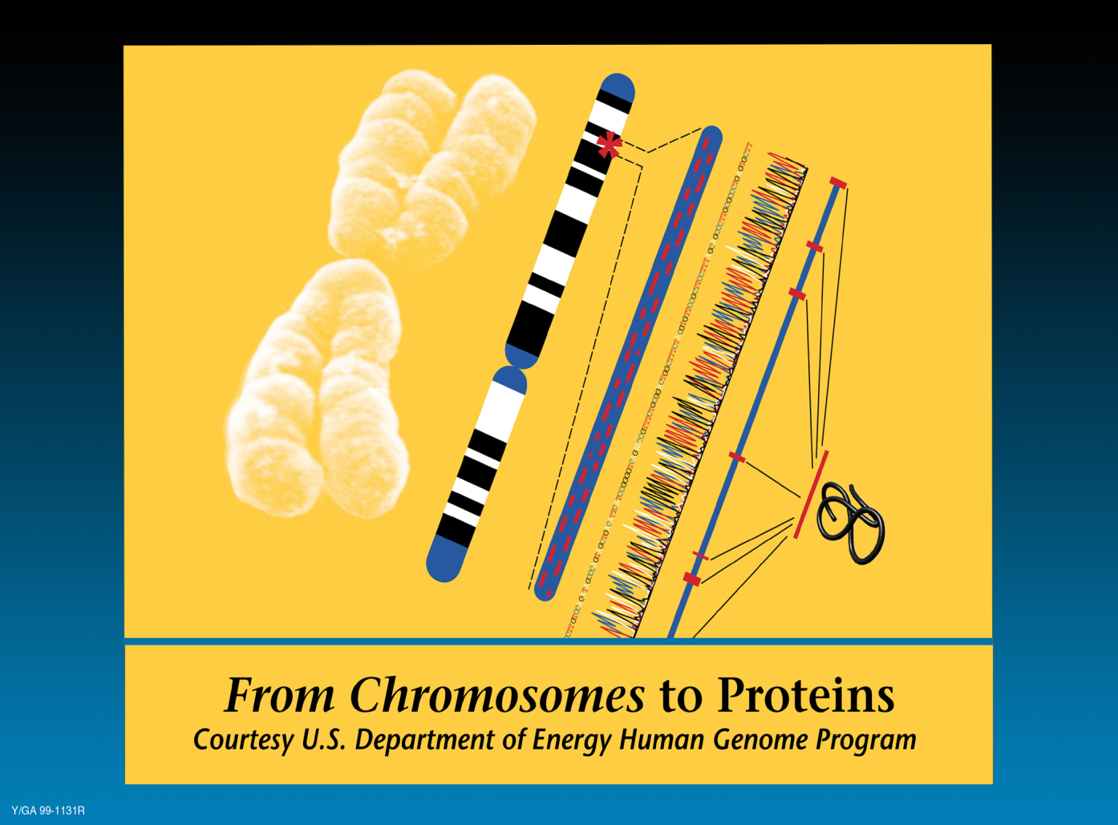
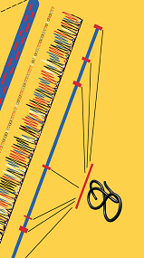
What diseases are attributable to genetics
Monogenic or hereditary diseases
Chromosomal diseases
Multifactorial or complex diseases

Slide 3
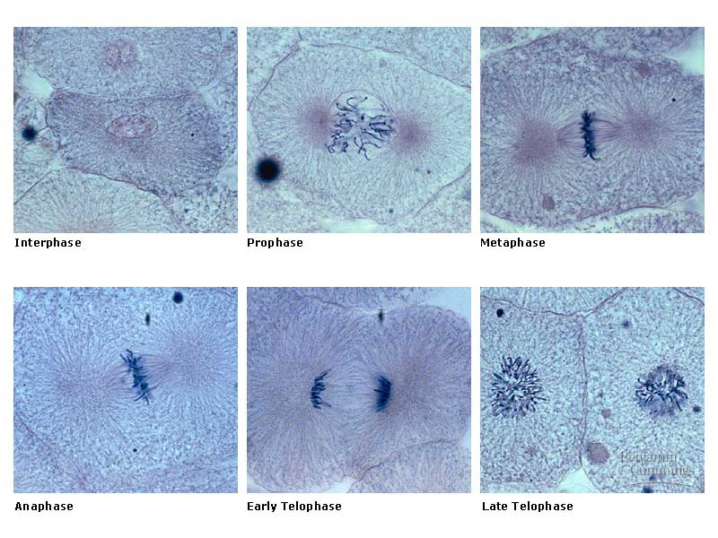
Chromosomes are [literally] the colored bodies
in latin: “chromo” “soma”
http://www.sc.edu/union/Sears/im.mitosis2.jpg

Slide 4
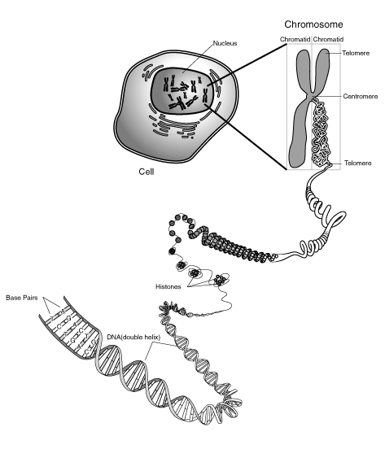
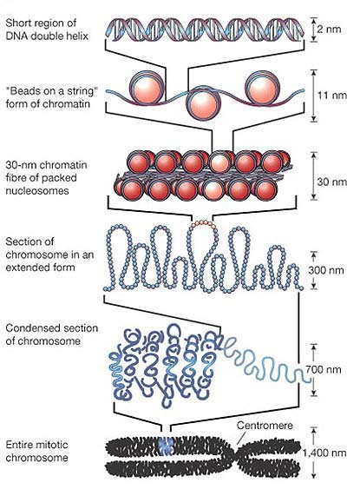

Slide 5
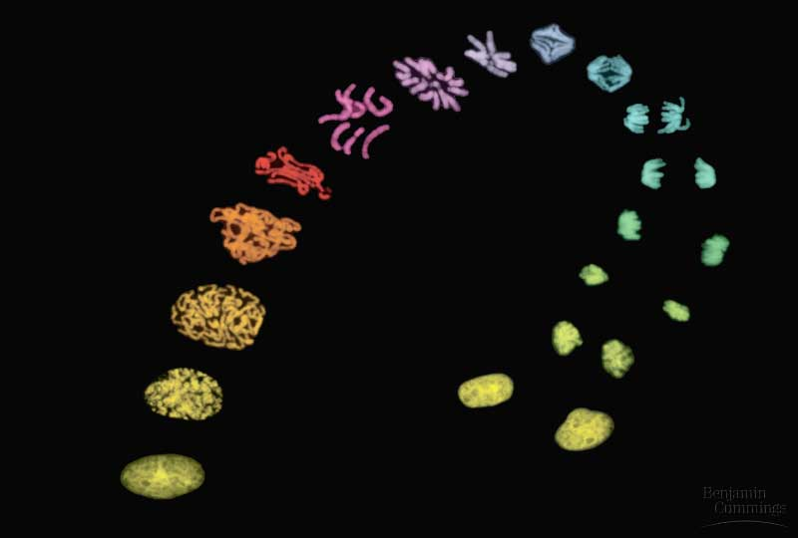
Chromosomes get duplicated in cell divisions
http://www.sc.edu/union/Sears/im.mitosis.jpg

Slide 6
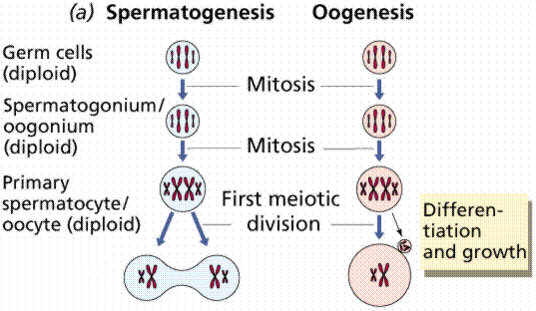
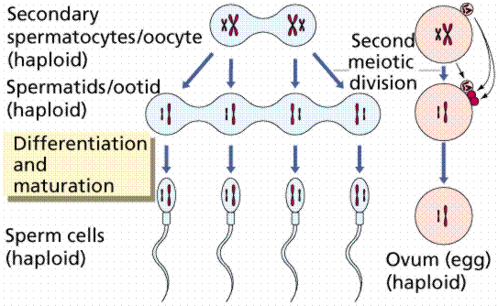
Sperm and eggs have only half the
number of chromosomes found in other cells
http://www.emc.maricopa.edu/faculty/farabee/BIOBK/BioBookmeiosis.html

Slide 7
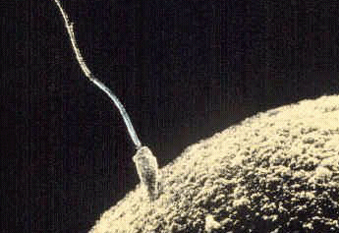
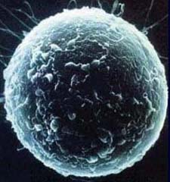
During fertilization a sperm cell joins an egg cell
http://www.vetmed.vt.edu/ACCD/Researchpage.htm
http://www.justthefacts.org/9months/month0.htm

Slide 8

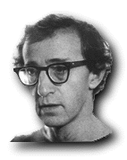
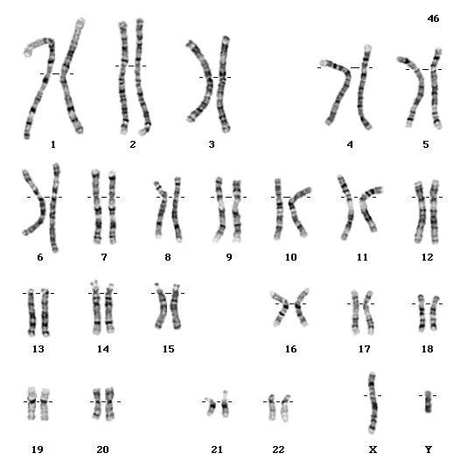
The sperm decides the sex of the offspring

Slide 9
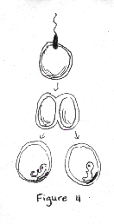
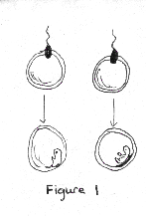
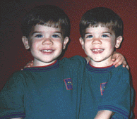
Individuals with identical chromosomes look identical
Fraternal twins
Identical twins
http://www.childrenofsalem.com/days/kids/ericbran/ericbran1.html
Same degree of similarity as any two siblings

Slide 10
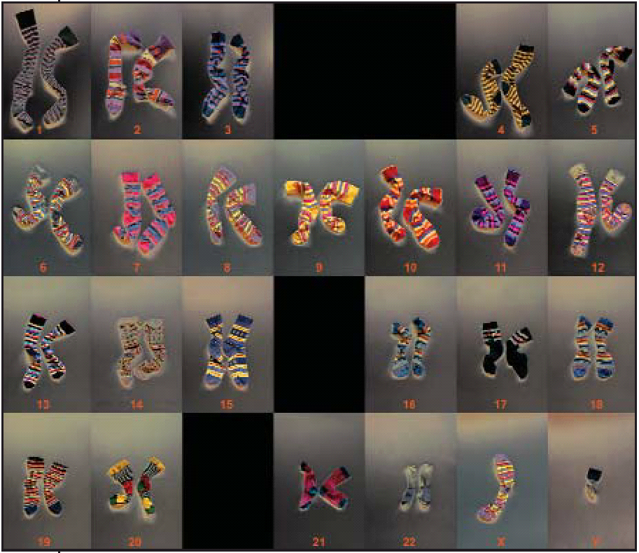
Chromosomal diseases
2008

Slide 11
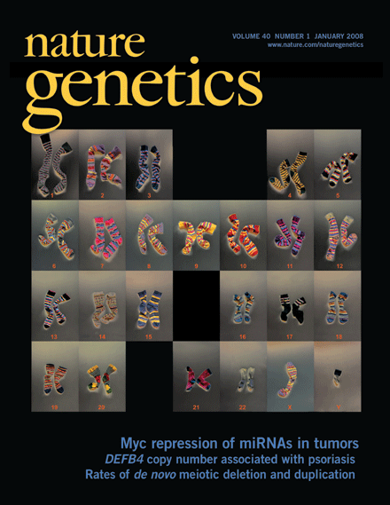
THE STUDY OF CHROMOSOMES: CYTOGENETICS
Principles of cytogenetics
classification
frequency of chromosomal diseases
the most frequent diseases
molecular cytogenetics methods

Slide 12
THE STUDY OF CHROMOSOMES: CYTOGENETICS
Principles of cytogenetics
classification
frequency of chromosomal diseases
the most frequent diseases
molecular cytogenetics methods

Slide 13
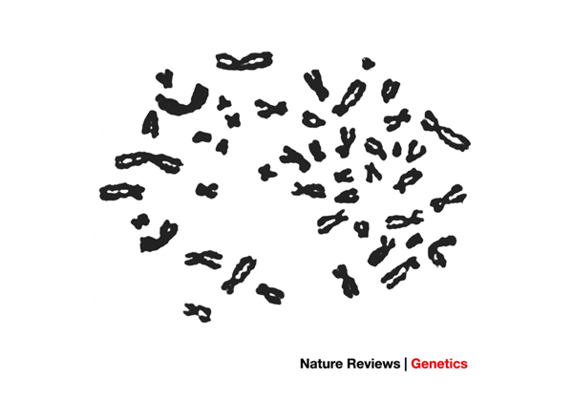
The picture that established 46 as the chromosome number in man
1955
Reproduced with permission from Ref. 1 © (1956) Mendelian Society of Lund for the Scandinavian Association of Genetics.

Slide 14
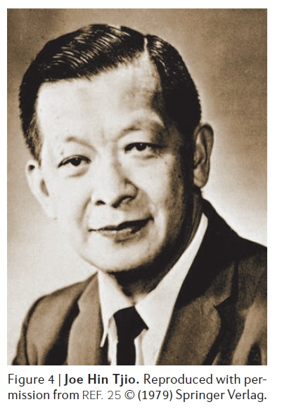
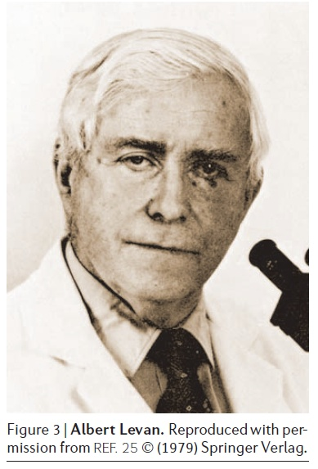
The picture that established 46 as the chromosome number in man
Reproduced with permission from Ref. 1 © (1956) Mendelian Society of Lund for the Scandinavian Association of Genetics.

Slide 15
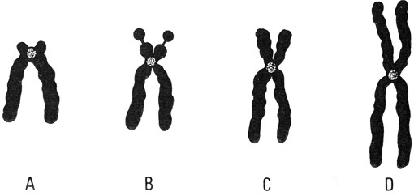
Chromosomes
Individual chromosomes of a cell differ in shape and size. The position of the centromere determines the shape of chromosomes.
The position of the centromere allows you to classify the chromosomes into 4 types:
A: acrocentrics: terminal position of centromere
B: telocentrics: sub-terminal position of centromere (not present in humans)
C: submetacentrics: sub-median position of centromere
D: metacentrics: mid position
of centromere
Individual chromosomes of a cell differ in shape and size. The position of the centromere determines the shape of chromosome:
The position of the centromere allows you to classify the chromosomes into 4 types:
A: centromere position acrocentric: Terminal
B: telocentrici: centromere subterminal position (not present in humans
C: submetacentrics: centromere
transversal band position
Q: metacentric centromere:
mid position

Slide 16
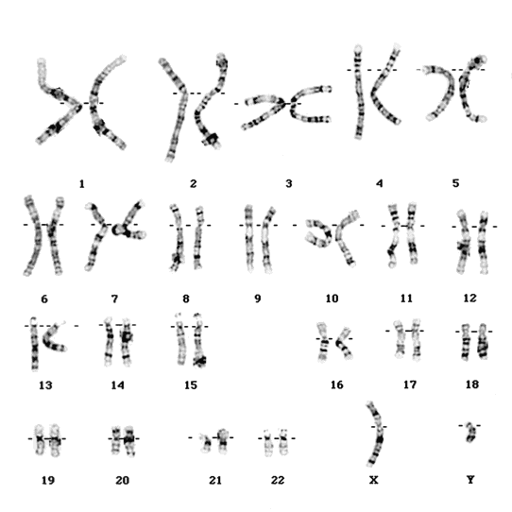
The karyotype
The karyotype is a photographic reconstruction of the chromosomal structure of an individual.
A karyotype is a photograph where the individual's chromosomes, duplicated and condensed as they appear under a microscope during the mitotic metaphase (highest condensation state), are sorted by their size and shape.

Slide 17
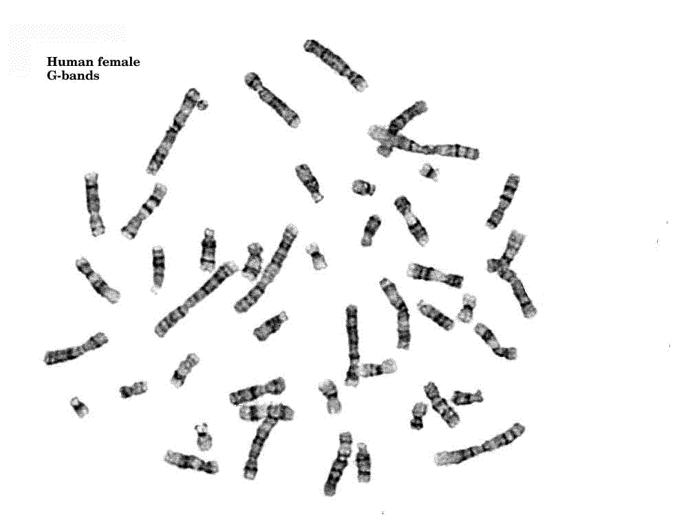
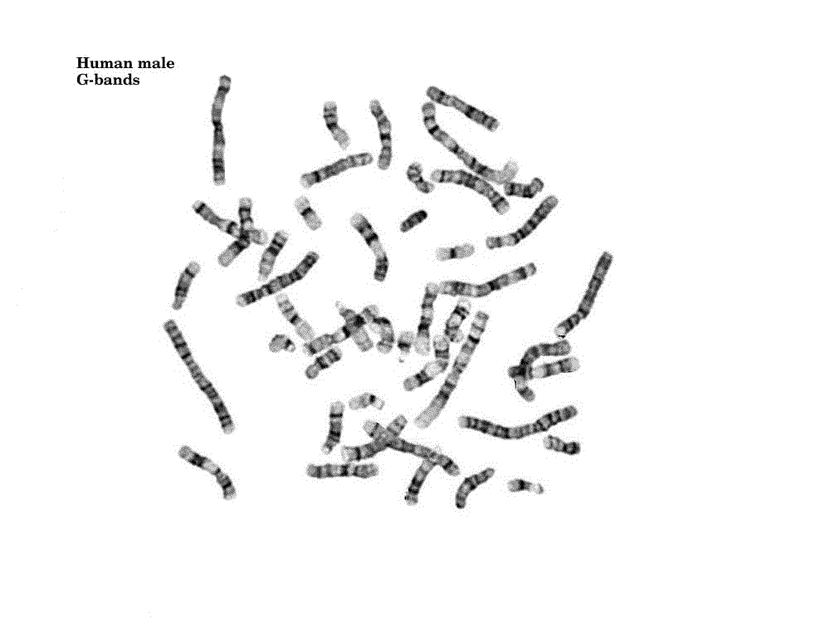
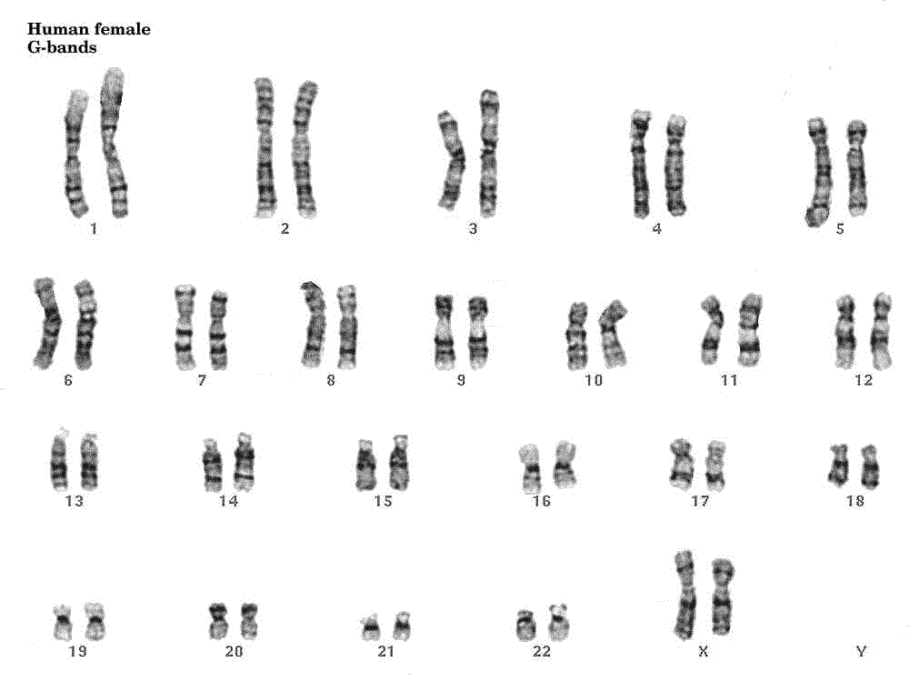
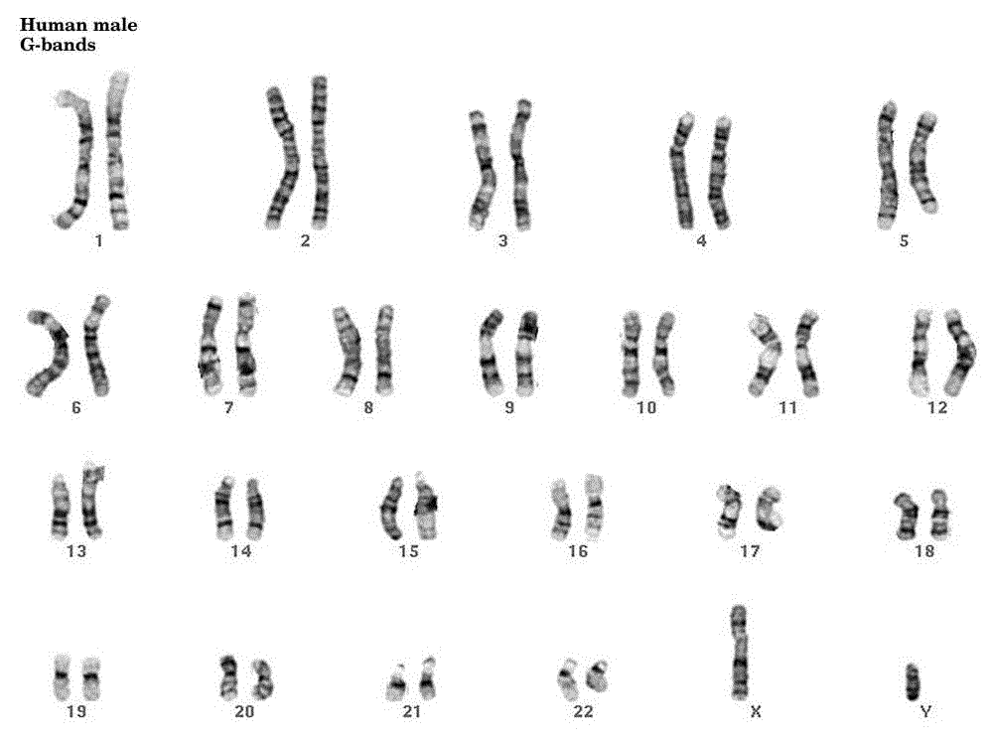

Slide 18
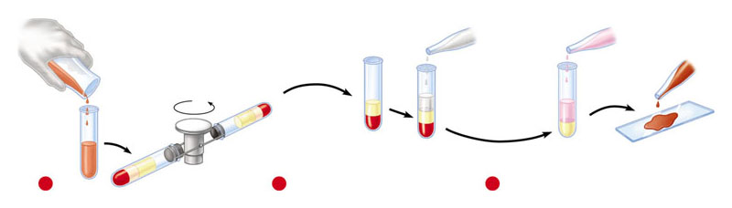
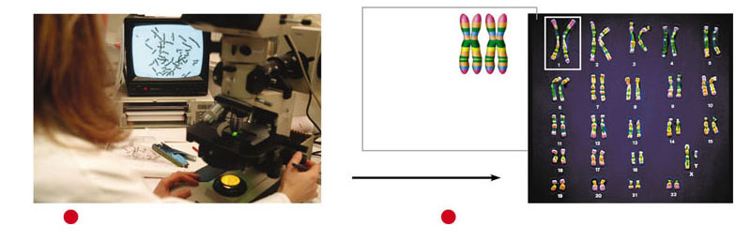
The karyotype
Karyotype preparation from a blood sample:
Hypotonic solution
Fixative
Red cells stratify at the bottom
Dye
Centrifuge
Blood sample
White cells
Plasma
The liquid part is eliminated and the cells are mixed with a hypotonic solution.
This procedure does inflate and break out the red blood cells. White blood cells swell but do not break, and the chromosomes move apart from each other.
By centrifuging again, the swelled white blood cells go to the bottom.
The liquid part containing the broken red blood cells is eliminated.
A fixative is added to the white blood cells.
1
2
3
The blood sample is centrifuged to separate
the cells from the liquid part.
Centromere
Sister
chromatids
Homologous
chromosomes
2,600X
4
The preparation is observed under a microscope that is connected to
a digital camera. The image is fed into a computer which sorts
chromosomes by size and shape.
5
The ordered arrangement of chromosomes obtained is the karyotype.
The 46 chromosomes represented here include 22 pairs of autosomes and
2 sex chromosomes, an X and a Y. Each chromosome consists of
2 chromatids attached together so closely that they are hardly
distinguishable.

Slide 19
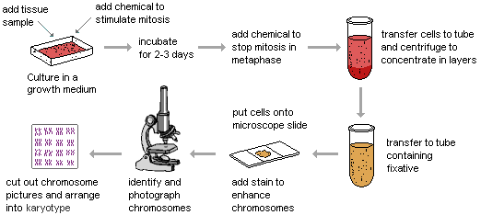

Slide 20
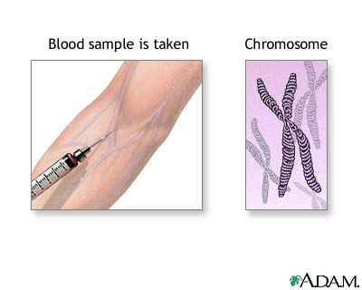
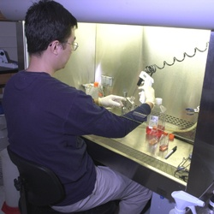
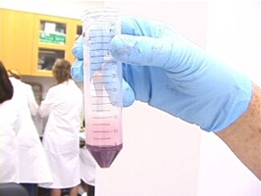
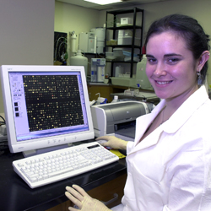
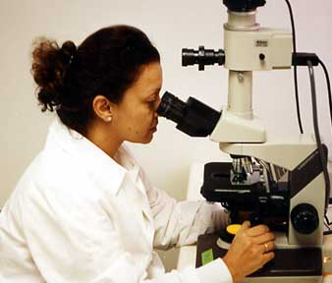
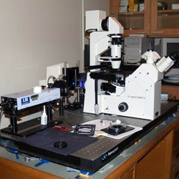

Slide 21
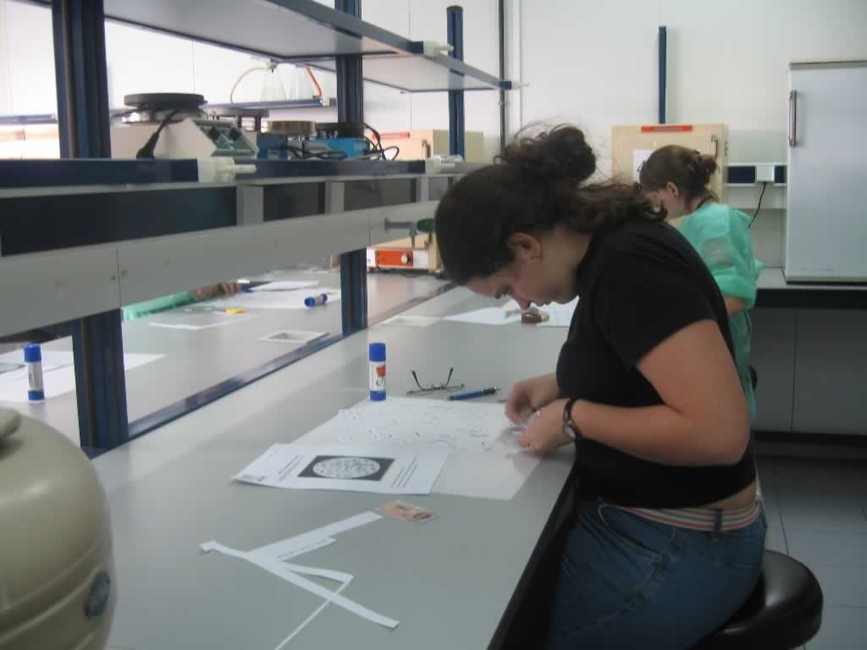
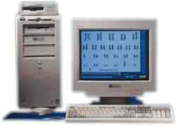
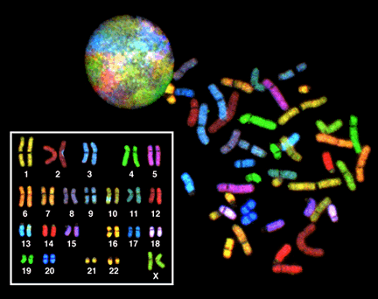
The karyotype
The reconstruction of the karyotype is now carried out with a computerized image Analyzer, but until a few years ago the reconstruction took a lot of work because the individual chromosomes were cropped from the picture and pasted on a card.

Slide 22
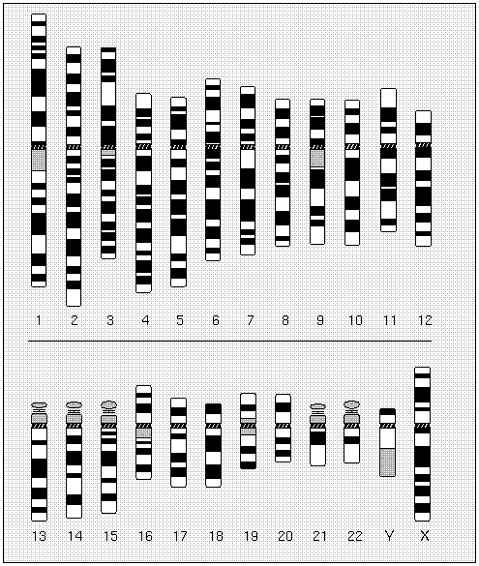
The ideographs are schematic representations of the banding of each chromosome achievable with each type of method. The representation of the chromosomal set as a series of banded chromosomes is called karyogram.

Slide 23
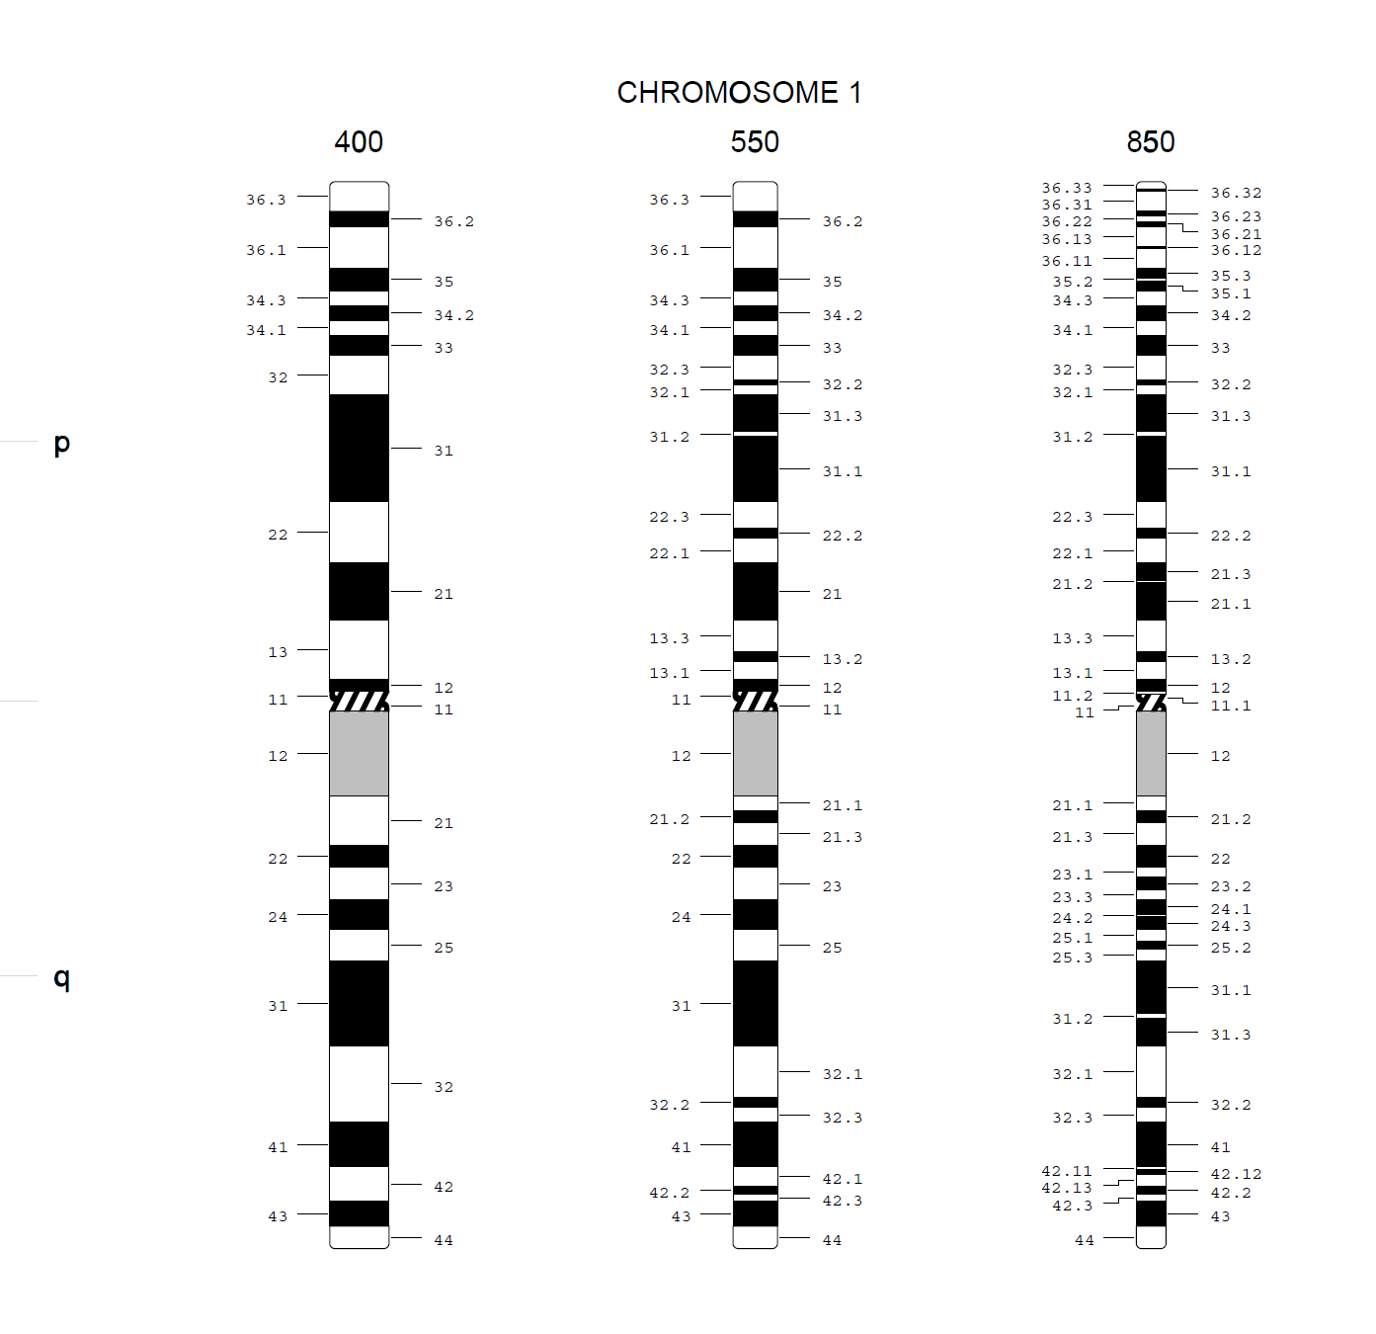
With three types of techniques, you can get in the entire human karyotype 400, 550, or 850 bands, respectively.

Slide 24
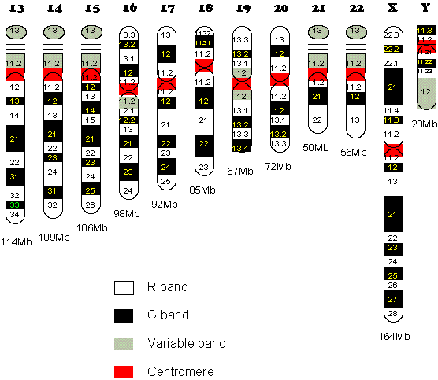
The banding
Typically, the chromosomal banding takes place with the Giemsa staining, also known as G banding, in which the slide is first treated with a saline or enzymatic solution, then it is colored in Giemsa solution, leading along the main axis of chromosomes to a sequence of regions with different staining intensity called chromosomal bands. Chromosomal bands are characteristics of each chromosome, allowing their classification according to a standardized scheme.
The banding is used to distinguish the different chromosomes and to study possible chromosome number and/or structure abnormalities (genomic and chromosomal mutations)

Slide 25
Techniques | Procedure | Banding pattern
G banding | Partial proteolysis followed by Giemsa staining | Dark bands are rich in AT Light bands are rich in GC
R banding | Heat denaturation followed by Giemsa staining | Dark bands are rich in GC Light bands are rich in AT
Q banding | Enzymatic digestion followed by staining with a fluorescent dye, Quinacrine | Dark bands are rich in AT Light bands are rich in GC
C banding | Barium hydroxide denaturation followed by Giemsa staining | Dark bands are rich in constitutive heterochromatin

Slide 26
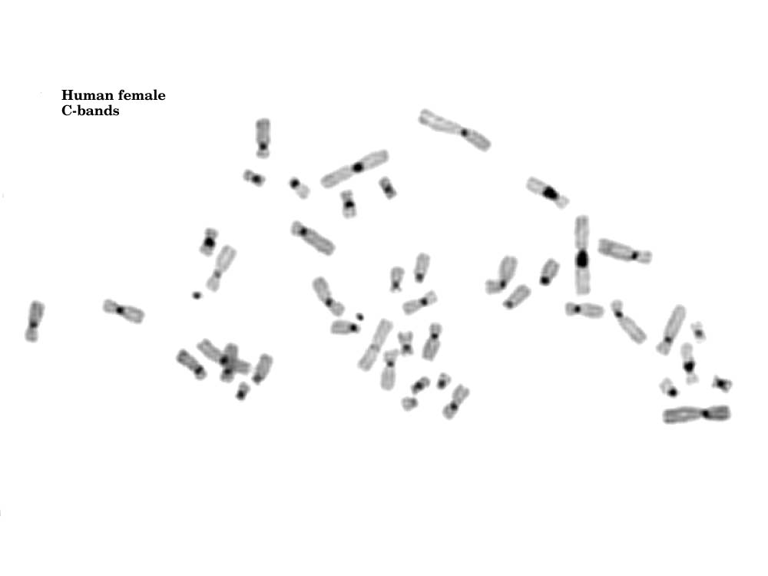
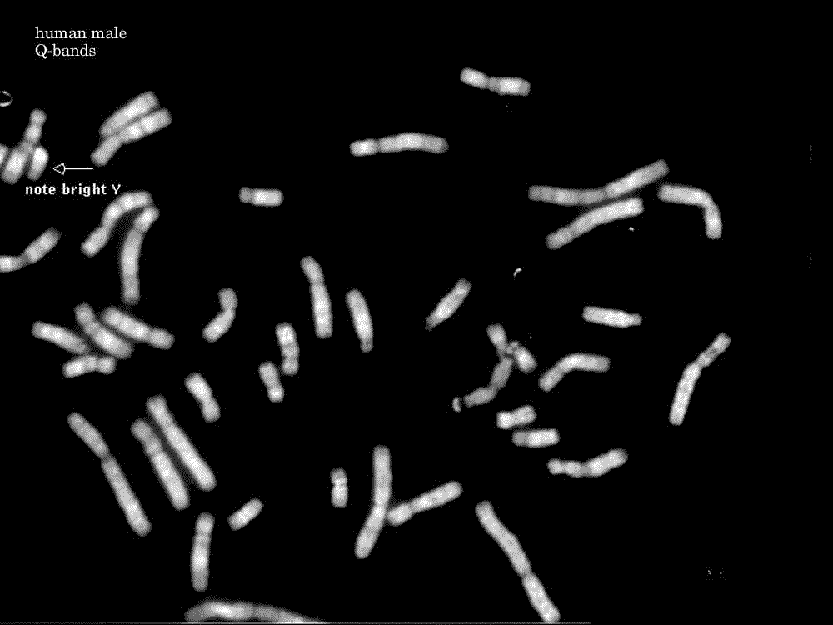
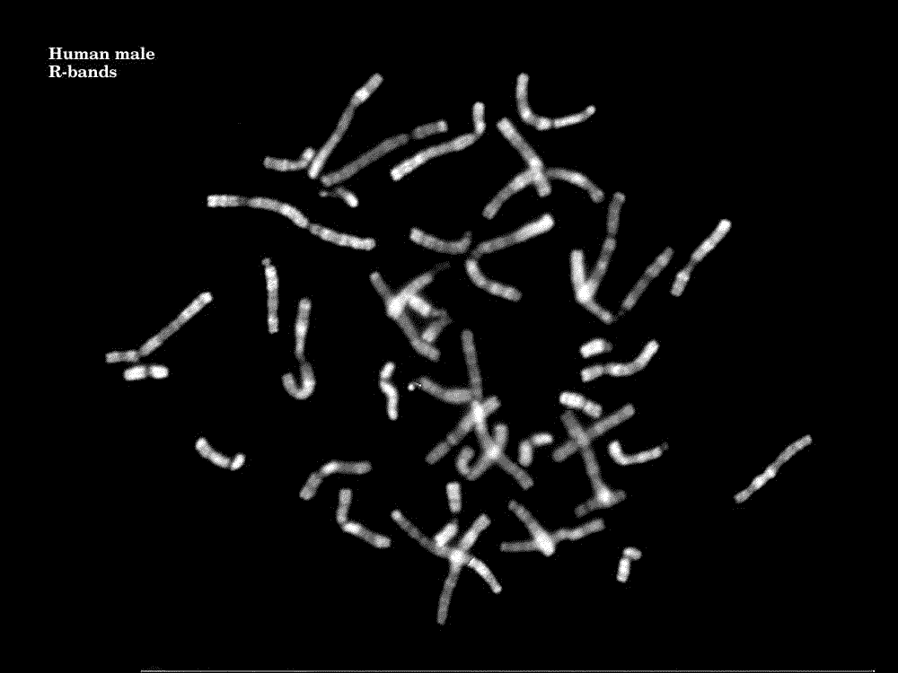

Slide 27
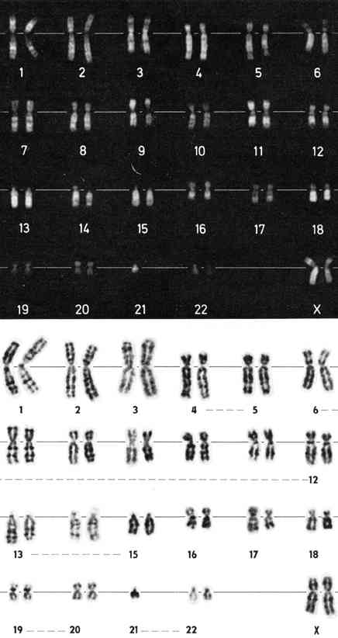

Slide 28
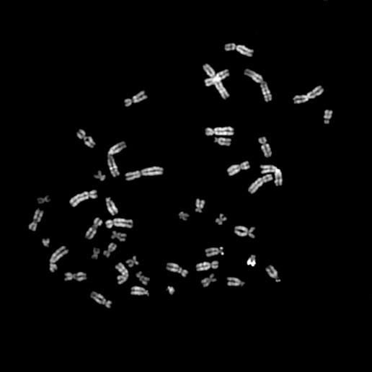
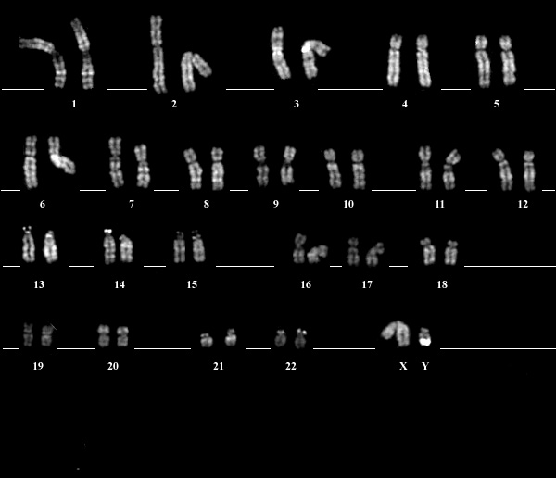
Chromosome observation through a microscope
Karyotype construction

Slide 29
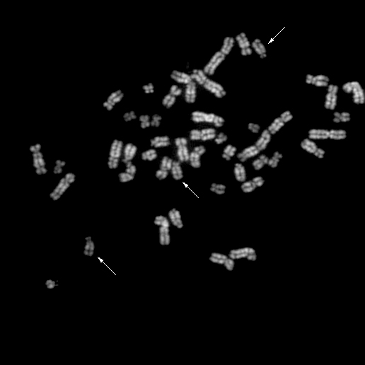
SOME EXAMPLES
Chr. 15 x 3 !!!

Slide 30
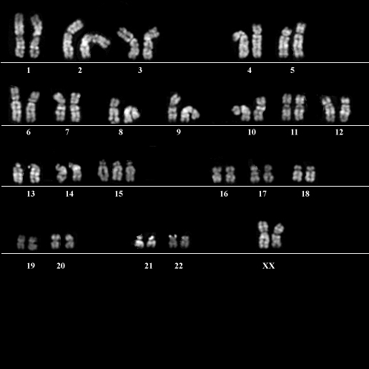
karyotype
47,XX + 15
Trisomy is the most frequent constitutional chromosomal anomaly in humans.
The majority of trisomies are lethal during early embryogenesis.

Slide 31
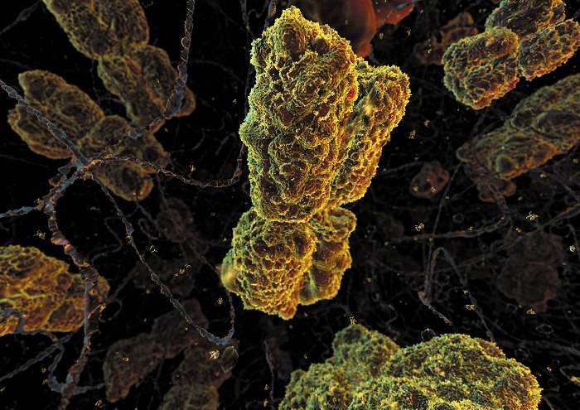
The smallest alteration of one chromosome visible using standard karyotype analysis is that of a band or sub-band that includes a stretch of DNA on average 4 million bases long.
It follows that alterations visible looking at the karyotype are those of great extension, as genomic mutations or chromosomal mutations, while you cannot highlight with this approach those alterations affecting a few bases.

Slide 32
THE STUDY OF CHROMOSOMES: CYTOGENETICS
Principles of cytogenetics
classification
frequency of chromosomal diseases
the most frequent diseases
molecular cytogenetics methods

Slide 33

Classification criteria for chromosomal anomalies
Based on gene dosage alterations
Based on the presence in all the body’s cells or in a part of them
Based on the type of anomaly

Slide 34


Gene dosage alterations
Balanced:
In the majority of cases they are not correlated with an altered phenotype
Unbalanced:
They are correlated with an altered phenotype (malformations and/or mental retardation)

Slide 35
Presence in body’s cells
COSTITUTIONAL ANOMALIES: present in all the body’s cells.
SOMATIC ANOMALIES: present in a small subgroup of cells or tissues. Different chromosomal constitutions although all cells are deriving from the same zygote. GENETIC MOSAIC.

Slide 36

Types of anomaly
Numerical
trisomies
Monosomies
triploidies
tetraploidies
Structural
translocations
inversions
deletions
duplications

Slide 37

Chromosomal alterations
Alterations of chromosomal structure can cause congenital pathologies and tumors.
Chromosomal breakage can lead to rearrangements causing genetic disorders.
When changes occur in somatic cells they contribute to tumor formation.

Slide 38

Chromosomal alterations
Deletions, duplications, inversions:
Deletion
Duplication
Cromosomi
omologhi
Inversion

Slide 39


Chromosomal alterations
Translocations:
Translocation
Nonhomologous chromosomes
Cromosome 9
Cromosome 22
Translocation
«Philadelphia chromosome»
Activated oncogene

Slide 40

Severity of chromosomal abnormalities
Severity is correlated to the type of chromosome and to the quantity of affected genes
The more serious is the chromosomal imbalance, the earlier will be the termination of pregnancy

Slide 41
And in cases of balanced anomalies?
The problem does not exist for the carrier itself
but it may exist for his/her offspring...

Slide 42


Slide 43
CARRIER OF A BALANCED TRANSLOCATION:
HE CAN PRODUCE UNBALANCED GAMETES THAT WILL GENERATE ZYGOTES WITH EITHER PARTIAL TRISOMY OR PARTIAL MONOSOMY AT DEFINED CHROMOSOMAL REGIONS

Slide 45

BALANCED 14/21 ROBERTSONIAN
TRANSLOCATION

Slide 46
BALANCED 14/21 ROBERTSONIAN
TRANSLOCATION

Slide 47
BALANCED 14/21 ROBERTSONIAN
TRANSLOCATION

Slide 48
THE STUDY OF CHROMOSOMES: CYTOGENETICS
Principles of cytogenetics
classification
frequency of chromosomal diseases
the most frequent diseases
molecular cytogenetics methods

Slide 49

The frequency of numerical chromosomal anomalies is:
Directly correlated to maternal age
Inversely correlated to gestational age

Slide 50
Non-disjunction
An abnormal number of chromosomes may be the result of non-disjunction, an inconvenience that may take place in two ways:
•homologous chromosomes of a pair do not separate during meiosis I;
•meiosis I occurs on a regular basis, but chromatids of a couple do not divide in one of the cells during meiosis II.

Slide 51


Non-disjunction
0
Non-disjunction during
meiosis I
Normal meiosis I
Non-disjunction during meiosis II
Normal meiosis II
Gametes
Gametes
n + 1
n + 1
n −1
n −1
n + 1
n −1
n
n
Number of chromosomes
Number of chromosomes

Slide 52

Non-disjunction
Fertilization of an egg which has undergone a non-disjunction with a normal gamete
Cellula uovo
n + 1
Zigote
2n + 1
Spermatozoo
n (normale)

Slide 53


Non-disjunction
Are there factors that influence the non-disjunction?
Not well known
Where and when does the non-disjunction occur?
More frequently in maternal meiosis I

Slide 54


Slide 56
The frequency of chromosomal abnormalities at birth is 0.65%
Alteration Prevalence
(in 1000 newborns)
Numerical alterations
Trisomies of autosomes
+21 1,25
+18 0,13
+13 0,07
Aneuploidies of sexual chromosomes
47,XXY 1 in 1000 males
47,XYY 1 in 1000 males
47,XXX 1 in 1000 females
45,X 0,12 in 1000 females
Structural alterations
Balanced translocations 2
Unbalanced traslocations 0,4

Slide 57
THE STUDY OF CHROMOSOMES: CYTOGENETICS
Principles of cytogenetics
classification
frequency of chromosomal diseases
the most frequent diseases
molecular cytogenetics methods

Slide 58




The most frequent aneuploidies at birth

Slide 59

Diseases due to chromosomal aberrations.
1. ANEUPLOIDIES (numerical anomalies)
- Down syndrome, Patau, Edwards
- Klinefelter syndrome
- Turner syndrome

Slide 60


Slide 61


Slide 62


Slide 63


Down syndrome
Down syndrome is caused by the trisomy of chromosome 21.
5000×

Slide 64




Characteristic features of Down syndrome
(1:700 live births)
40.000 cases in Italy
Neurological:
  Mental retardation 100%
  Alzheimer from 35y of age 100%
Muscular hypotonia 100%
Short stature 70%
Head:
  Brachycephaly 75%
  Epicanthic fold 60%
  Brushfield spots iris 55%
  Protruding tongue 45%
  Dysplastic ears 50%

Slide 65



trisomy 21 Down
Short limbs, wide hands 65%
Short little finger 60%
Palmar Simian crease 60%
heart
  Congenital cardiac defects 40%
Gastrointestinal anomalies
  Atresia/duodenal stenosis 250x
  Imperforate anus 50x
  Hirschsprung disease 300x
Immune and hematopoietic systems:
  Myeloproliferative disorders 300x
  Leukemia (ALL e AML) 10-20x

Slide 66
Contributions from the Genome project: pathogenesis
The gene content of chromosome 21 is now estimated to be 329, including 165 experimentally confirmed genes, 150 gene models based on expressed sequence tag databases, and 14 computer predictions (see http://wwweri.uchsc.edu).
An additional, unexpected finding is that the actual fraction of chromosome 21 that is transcribed into RNA might be an order of magnitude higher than the fraction occupied by gene coding sequences.
One striking conclusion that can be drawn from the gene content of chromosome 21 is that there are sets of genes on the chromosome that are involved in the same metabolic pathway or biological system.

Slide 67
Genes that may have input into Down syndrome include:
Superoxide Dismutase (SOD1)-- overexpression may cause premature aging and decreased function of the immune system; its role in Senile Dementia of the Alzheimer's type or decreased cognition is still speculative
COL6A1 -- overexpression may be the cause of heart defects
ETS2 -- overexpression may be the cause of skeletal abnormalities
CAF1A -- overexpression may be detrimental to DNA synthesis
Cystathione Beta Synthase (CBS) -- overexpression may disrupt metabolism and DNA repair
DYRK -- overexpression may be the cause of mental retardation
CRYA1 -- overexpression may be the cause of cataracts
GART -- overexpression may disrupt DNA synthesis and repair
IFNAR -- the gene for expression of Interferon, overexpression may interfere with the immune system as well as other organ systems
Other genes that are also suspects include APP, GLUR5, S100B, TAM, PFKL, and a few others. Again, it is important to note that no gene has yet been fully linked to any feature associated with Down syndrome.

Slide 69



Slide 70

Types of anomalies in Down Syndrome

Slide 71


Slide 72


Slide 73

Down syndrome
The incidence of Down syndrome in the offspring of healthy parents increases with maternal age
90
80
70
60
Children with Down syndrome
(out of 1000 live births)
50
40
30
20
10
0
20
25
30
35
40
45
50
Maternal age (years)

Slide 74
Woman 37,5 years old anni e mezzo alla data presunta del parto
MESI COMPLETATI
ANNI 0 1 2 3 4 5 6 7 8 9 10 11
25 1376 1372 1367 1363 1358 1353 1348 1343 1338 1333 1328 1322
26 1317 1311 1306 1300 1294 1289 1283 1277 1271 1264 1258 1252
27 1245 1239 1232 1225 1219 1212 1205 1198 1191 1183 1176 1169
28 1161 1154 1146 1138 1130 1123 1115 1107 1099 1090 1082 1074
29 1065 1057 1048 1040 1031 1022 1014 1005 996 987 978 969
30 960 951 942 932 923 914 905 895 886 877 867 858
31 848 839 829 820 810 801 791 782 772 763 753 744
32 734 725 716 706 697 687 678 669 660 650 641 632
33 623 614 605 596 587 578 570 561 552 544 535 527
34 518 510 502 494 486 478 470 462 454 446 439 431
35 424 416 409 402 395 387 381 374 367 360 354 347
36 341 334 328 322 316 310 304 298 292 287 281 275
37 270 265 259 254 249 244 239 235 230 225 221 216
38 212 207 203 199 195 191 187 183 179 175 171 168
39 164 161 157 154 151 147 144 141 138 135 132 129
40 126 124 121 118 116 113 111 108 106 103 101 99
41 97 94 92 90 88 86 84 82 81 79 77 75
42 73 72 70 69 67 65 64 63 61 60 58 57
43 56 54 53 52 51 49 48 47 46 45 44 43
44 42 41 40 39 38 37 36 35 35 34 33 32
45 31 31 30 29 29 28 27 27 26 25 25 24
Risk of 1/239 to have a Down child

Slide 75



Slide 76
The only other human trisomies compatible with birth are:
Trisomy 13 (Patau syndrome)
cleft lip, small malformed head, abnormal under foot. Life expectancy:130 giorni
Trisomy18 (Edwards syndrome)
ears from Faun, small jaw, narrow pelvis, abnormal under foot. Life espectancy: a few weeks
For all other trisomies patients die in utero.

Slide 77


trisomy 18 Edwards
(1/6.500 births)
90% caused by maternal non-disjunction
M/F = ¼
Only 2.5% conceptions are completed
Of these, 33% die within 1 month from conception, 50% within 2 months
Over 100 anomalies
  Weight below the norm, sucking difficulties
  Hypotonia
  Hydrocephalus, epilepsy
  Heart defects
  Hypoplasia of fingernails
  Feet with prominent heel
  Crossed legs

Slide 78





trisomy 13 Patau
(1/12.000-20.000 births)
90% caused by maternal non-disjunction
Only 2.5% conceptions are completed
Of these, 33% die within the first month, 50% within 2 months
  Weight below the norm, sucking difficulties
  Microcephaly
  Blindness and deafness
  Microphthalmia/anophthalmia
  Labiopalatoschisis 80%
  Epilepsy
  Cardiac malformations
  Feet with prominent heel

Slide 79


Slide 80


Turner syndrome
Short stature
Pterygium colli
Shield-shaped thorax
Elbow deformity (cubitus valgus)
Poor breast development

Slide 81

X monosomy (45,X0) Turner
Takes its name from the endocrinologist Henry Turner who described it in 1938
Turner syndrome (TS) defines a complex female human phenotype, due to complete or partial absence of the second sex chromosome
Depends on a mistake in spermatogenesis in 80% of cases and does not correlate with parental age
A previous child with TS does not increase the reproductive risk expected for an age-matched couple

Slide 82

X monosomy (45,X0) Turner
Ii is the only monosomy compatible with life, but 98% of all TS monosomic fetuses undergoes spontaneous miscarriage
The incidence in abortions is about 7-10%, while at birth the incidence is 1/2500 females.
It is unclear why the 45, X0 karyotype is lethal in utero while compatible with postnatal survival
The real X chromosome monosomy is responsible for 45% of TS cases; others have mosaicism (45, X/46, XX) and/or an abnormal X chromosome
A low level of somatic Turner mosaicism, less than 2%, is found in the normal population

Slide 83
X monosomy (45,X0) Turner
"menopause before menarche”
The ovaries are elongated and formed by stromal tissue devoid of follicles: oocytes often undergo apoptosis in 2 years of life
Prepubertal ovarian failure leads to primary amenorrhea, infertility and estrogen deficiency
In less than 10% of cases, puberty can occur and pregnancies are possible though at an increased risk of fetal losses
Also in relation to the heterogeneity of genotype, phenotype is manifest in a very variable manner

Slide 84


Slide 85



X monosomy (45,X0) Turner
1:2.500

Slide 86


Slide 87


Slide 88


Slide 89

After puberty, the ovaries should develop into plump 3 to 5 cm ovoid organs, but these "streak" ovaries are typical for Turner's syndrome.

Slide 90


Slide 91
Ranke MB.
Why Treat girls with Turner Syndrome with Growth Hormone? Growth and Beyond.
Abstract
Turner Syndrome (TS) is a rare disorder, characterized by numerous signs and symptoms, which are also highly variable in their expression in individuals. The understanding of the genetic basis of the phenotype has advanced greatly during the past decades. The most consistent features, which negatively affect the quality of life in these individuals, are short stature and impaired gonadal function. After recombinant human growth hormone (rhGH) became available and was shown to improve height, it was then approved and has been used widely. Yet it remains a challenge to decide on the optimal treatment modality for individuals with TS and to evaluate the benefits and risks also in terms of karyotype of GH on growth and on other organ systems.
Pediatr Endocrinol Rev. 2015 Jun;12(4):356-65.

Slide 92


Slide 93



Slide 94

Klinefelter syndrome.
Tall stature
Gynecomastia
disproportion of limbs
hypogonadism

Slide 95

Klinefelter syndrome (47,XXY)
1:900-1:600 males
50% of pregnancies is successful
male phenotype
main features:
Tall stature
  hypogonadism, low testosterone levels, lack of sperm production (azoospermia) and then infertility
  Gynecomastia
  Both intelligence and life expectancy are almost normal

Slide 96
Other cytogenetics forms
There are also Klinefeler cases 48,XXYY and 48,XXXY in 1 case out of 17,000 and 1 out of 50,000 born males
49,XXXXY in 1 case out of 85,000 -100,000
There are also males 46,XX carrying a translocation of part of chromosome Y on chromosome X where translocationd includes the sex determining region (SRY)
mosaics

Slide 97

The PAR regions on sex chromosomes contain non inactivated genes, as the double dosage is ensured anyway
PAR1 contains 24 genes, PAR2 only 4 genes

Slide 98
SHOX gene
Short stature HOmeoboX-containing
Either mutations or deletions of SHOX gene mapping in PAR1 cause growth retardation and short stature.
The short stature of Turner Syndrome females (X0) results from one single copy of SHOX (and also the shortened fourth metacarpus)
The increased stature of Klinefelter syndrome males (XXY) and of triple X females (XXX) might be a consequence of 3 SHOX gene copies

Slide 99
Other abnormal sex chromosome combinations are:
XYY
Controversial history, has tried to associate the condition
XYY in a predisposition to violence, today widely shown
that there is no relationship. These males are fertile. During
meiosis there is a normal XY pairing, the second Y does not pair and is not passed on to gametes.
XXX
Phenotypically normal and fertile females. During meiosis only two X chromosomes get paired, the third X chromosome does not pair and is not transmitted to gametes.

Slide 100
Males (47,XYY)
1:1.000 males
Male phenotype
Main features:
  Tall stature
  normal fertility
  No correlation with paternal age
  Both intelligence and life expectancy are perfectly normal

Slide 101
Trisomy X (47,XXX)
1:1.200
70% of pregnancies is successful
Error in maternal disjunction and correlation with maternal age
Main features:
  Tall
  Normal fertility, cycle irregularities
  Both intelligence and life expectancy are normal

Slide 102
Sex chromosome alterations
The non-disjunction can produce gametes with an abnormal number of sex chromosomes.
An abnormal number of sex chromosomes usually does not compromise survival

Slide 103


Slide 104

This is triploidy, which occurs when there is double fertilization of an ovum (dispermy). The result may be 69, XXX or 69, XXY or 69, XYY.
The extra set of paternal chromosomes predisposes to formation of a partial mole.

Slide 105
Triploid syndrome, also called triploidy, is an extremely rare chromosomal disorder. If this occurs in only some cells, it is called mosaic triploidy, and is less severe.
Triploidy affects approximately 1-2% of pregnancies, but most miscarry early in development.

Slide 106

Scattered grape-like villi are present in this placenta, consistent with a partial hydatidiform mole.

Slide 107

A characteristic fetal finding with triploidy is syndactyly involving the third and fourth digits of one or both hands or feet.

Slide 108
Most fetuses with triploidy do not survive to birth. Mosaic triploidy has an improved prognosis, but affected individuals have moderate to severe cognitive disabilities.
Many organ systems are affected by triploidy, but the central nervous system and skeleton are the most severely affected.

Slide 109
Diseases due to chromosomal aberrations.
2. STRUCTURAL ANOMALIES
- cri du chat syndrome
- chromosome 18 anomalies
- Microdeletion syndromes (see below)

Slide 110



Slide 111
Cat cry syndrome (or syndrome du cri du chat) is a rare genetic disorder caused by the deletion of part of chromosome 5 ("5 p-deletion"). Identified by the French physician Lejeune in 1963, it has an incidence of one case per 50000 births.
The syndrome is named after the cat-like cry, characteristic of affected individuals. The loss of genetic material is associated with delayed psychomotor development and severe mental retardation, but the absence of serious malformations in a significant percentage of cases can ensure a long survival.
Clinical picture:
In addition to the typical cat cry caused by hypoplasia of the laryngeal cartilages (which disappears within the first few month), there is a serious mental disability (with a tendency to self mutilation), microcephaly, growth retardation and a characteristic appearance of the face that looks roundish, enlarged nasal bridge, low-set ears and micrognathia. In 15% of cases there is a congenital heart defect.

Slide 112

Chromosome 18 abnormalities
There are five major syndromes that occur when there are abnormalities of chromosome 18.
Within each syndrome there are a variety of characteristics and a wide range in severity.
Some individuals are mosaic or have translocations involving another chromosome and so do not fit exactly into one of these syndromes.
The most frequent structural abnormalities of chromosome 18 are 18q-, 18p-, ring 18.

Slide 113


Slide 114
DIAGNOSIS: genetic counselling and prenatal cytogenetics

Slide 115
Genetic counselling
Genetic counselling is an informed and appropriate communication
In order to be informed it must start from the identification of a genetic defect in a patient and from calculating the risk to the other members of the family
In order to be appropriate it has to establish a relationship of trust and confidence without being directive, i.e. it must not direct the family towards a single goal, but leave the freedom of evaluation and choice
Genetic counselling may concern:
1. diagnosis of a clinically manifest genetic disorder
2. the reproductive risk of a couple in preconception period
3. prenatal diagnosis
4. the prediction of a future genetic disease
5. genetic susceptibility

Slide 116
Genetic counselling
Genetic counselling seeks to determine which family members are affected and which can be carriers of the disease, and then calculate the probability of every other person in the household (even not yet born) of being a carrier or to inherit the disease

Slide 117
general reproductive risk
for a couple for which personal and family medical history has excluded an increased risk in relation to the population it is
 3-5% in case of defects detected at birth (chromosomal abnormalities 0.65%)
 8-10% detectable within 10 years of age

Slide 118
Reproductive risk assessment in the preconception period
optimal time (but more than half of pregnancies occur unexpectedly)
data collection (visit, habits, medications, lab investigations)
PURPOSE: identification of healthy carriers of genetic disorders
•carriers who have a reproductive risk regardless of the partner
•carriers in which the risk is manifested only in the case of marriage with a partner carrier

Slide 119

carriers who have a reproductive risk regardless of the partner
 women with X-linked mutations (example: Duchenne muscular dystrophy)

Slide 120

carriers who have a reproductive risk regardless of the partner
Carriers of a balanced chromosomal translocation (reciprocal)
Exchange of genetic material between nonhomologous chromosomes
No modifications in gene dosage
frequency 1/520 newborns
phenotypically normal
reciprocal translocation

Slide 121
Nuchal translucency
Triple test
Ultrasound
3T
US
NT
Weeks of
pregnancy
10
12
14
16
19
21
26
A
EA
CVS
Amniocentesis
Chorionic villi sampling

Slide 122



Slide 123


Slide 124
triple test interpretation of results
Fetal anomaly | AFP Alpha-feto protein | Beta hCG Chorionic gonadothropin | uE unconjugated Estriol
NTD =neural tube defects* |  | Normal | Normal
Trisomy 21
Trisomy 18
NTD: anencephaly, spina bifida (incomplete closure of 1 or more vertebrae)
and encephalocele (herniation of brain tissue)

Slide 125


Slide 126
prenatal cytogenetics
from amniocytes
from chorionic villi
should be representative of fetal cells
difficult to obtain

Slide 127
A couple with family history of chromosomal abnormalities is indication of carrying out a fetal karyotype and extending the investigation to relatives

Slide 128

Fetal Testing

Slide 129
Chorionic villous sampling
Villi constitute a placental layer interposed between the basal decidua adhering to the uterus wall, and the chorial plate situated externally in the
fetal side of placenta.
In villi many actively reproducing cells are present which allow to study the karyotype.
Microscopic image of chorionic villi

Slide 130

Chromosomal analysis
Study of the fetal chromosomal arrangement on chorionic villous, amniotic fluid and fetal blood.
Turnaround time varies depending on the sample analysed (1-3 weeks).

Slide 131



PREIMPLANTATION DIAGNOSIS
Preimplantation genetic diagnosis (PGD) is a new procedure that allows to obtain early prenatal diagnosis for chromosomal anomalies

Slide 132
PGD
•PGD refers to genetic profiling of embryos prior to implantation, and sometimes even of oocytes prior to fertilization.
•PGD thus is an adjunct to assisted reproductive technology, and requires in vitro fertilization (IVF) to obtain oocytes or embryos for evaluation.
•PGD is considered in a similar fashion to prenatal diagnosis.
•When used to screen for a specific genetic disease, its main advantage is that it avoids selective pregnancy termination as the method makes it highly likely that the baby will be free of the disease under consideration.
•PGD is useful when there are previous chromosomal or genetic disorders in the family and within the context of in vitro fertilization programs.

Slide 133













Slide 134

Preimplantation diagnosis
The employment of PGD by using molecular probes for different chromosomes allows the analysis of some aneuploidies in blastomeres.

Slide 135
Conception
20% abortion before implantation
42% abortion within 7th week of pregnancy
        10% abortion between 7th and 12th week of pregnancy
        3% abortion after 12th week of pregnancy
BIRTH only 25% of conceptions

Slide 136

Frequency of chromosomal abnormalities in prenatal diagnosis
Maternal
Age A.F. CVS
35y 0.76 % 0.78 %
40y 2.50 % 3.40 %
45y 8.33 % 7.14 %

Slide 137
Frequency of chromosomal abnormalities in germ cells
Chromosomal abnormalities are present normally in a certain percentage of adult gametes.
These abnormalities origin as new mutations during the gametogenesis of subjects with a normal chromosomal arrangement

Slide 138

Chromosomal abnormalities in sperm
Around 10% of fertile male sperm possess chromosomal abnormalities:
45% numeric abnormalities
55% structural abnormalities
    (prevalently breaks)

Slide 139
Chromosomal abnormalities in oocytes
Around 25% of oocytes possess chromosomal abnormalities
(prevalently aneuploidies)

Slide 140
THE STUDY OF CHROMOSOMES: CYTOGENETICS
Principles of cytogenetics
classification
frequency of chromosomal diseases
the most frequent diseases
molecular cytogenetics methods

Slide 141

Classical cytogenetics
Allows identification of chromosomal rearrangements involving no less than 5 Mb.

Slide 142
When the karyotype (classical cytogenetics) is not enough

Slide 143
Molecular cytogenetics
Combines the possibility of DNA analysis, proper of molecular biology techniques, with chromosome structure whose study is the subject of classical cytogenetics.

Slide 144


Molecular cytogenetics
Allows a targeted analysis of a chromosomal region allowing to highlight rearrangements of several hundred kilobases.

Slide 145
Clinical molecular cytogenetics techniques
FISH (fluorescence in situ hybridization)
PRINS (primed in situ labeling)
PCR in situ (polymerase chain reaction in situ)
CGH (comparative genomic hybridization)
NGS (next generation sequencing)
others

Slide 146
Molecular cytogenetics techniques
FISH (fluorescence in situ hybridization)
CGH (comparative genomic hybridization)
etc.

Slide 147

FISH (Fluorescence in situ hybridization)
•It is a hybridization technique that allows, after fixation of metaphases and interphasic nuclei on a slide, to identify specific sequences in nucleic acids.
•This identification is made through non-isotopic labeled probes, using fluorochromes that emit at different wavelengths.

Slide 148
FISH probes
FISH probes must be targeted, cannot be helpful in overall genomic analyses
telomere
centromere
whole chromosome
locus

Slide 149

CHROMOSOME PAINTING

Slide 150


Slide 151


Slide 152




DIAGNOSIS OF ANEUPLOIDIES

Slide 153


Slide 154


Slide 155

Down syndrome

Slide 156
FISH IN PRENATAL DIAGNOSIS
from 15 ml amnyotic fluid
metaphase: - Karyotype
- FISH for microdeletion diagnosis
- FISH for chromosomal rearrangement diagnosis
from 2 ml amnyotic fluid
nucleus: - FISH for sex determination - FISH for numerical anomalies diagnosis

Slide 157
FISH
ADVANTAGES
speed
identification of microdeletions and complex rearrangements
diagnosis on nuclei
DISADVANTAGES
expensive
uncomplete diagnosis

Slide 158
Remember that..
95% of chromosomal anomalies consist of aneuploidies involving chromosomes 21, 13, 18, X and Y.

Slide 159


The comparative genomic hybridization (CGH) technique allows the detection of deleted or duplicated sequences in the genome to be tested (green) on the basis of a comparison with a reference genome (red).
Two differently colored fluorescent probes are prepared: they hybridize simultaneously on chromosomes. If in a chromosomal region prevails the color related to the reference genome (red) this means that the genome to be tested (green) has a deletion in that region. Duplications are indicated instead by the prevalence of the green color.

Slide 160


Slide 161


1 2 3 4 5

Slide 162


Slide 163


The array interrogates in a single experiment thousands portions of DNA
that cover the entire genome at very high resolution
(100 kb, 20 kb, 1 kb, …)
deletions/duplications easily detectable; balanced rearrangements not detectable

Slide 164



High resolution banding (1980) and
FISH technologies (1990):
Microdeletion syndromes

Slide 165




del(15)(q11-13)
del(7)(q11.23)
del(22)(q11.2)
Clinicians started to request FISH analysis
for patients having even minor signs related
to these syndromes

Slide 166
MAIN MICRODELETION SYNDROMES
CHROMOSOMAL
LOCALIZATION
PATIENTS WITH
MICRODELETION
SYNDROME

Slide 167

Imprinting
Notes:
Figure 1. Imprint establishment and propagation during gametogenesis and development. The paternal allele (dashed line) is imprinted and the maternal allele is expressed (solid line). The "imprint mark" (black box) represents a parental-specific methylation established during gametogenesis. A: The maternal and paternal genomes have different imprint patterns following fertilization. B: Both "imprint marks" and imprint reading are maintained during somatic cell division. C: The parental specific imprints are erased in the primordial germ cells. D: The appropriate "imprint marks" are reestablished for the next generation
Am J Pathol 1999 Mar;154(3):635-47
Genomic Imprinting: Implications for Human Disease
J. Greg Falls* , David J. Pulford* , Andrew A. Wylie* and Randy L. Jirtle*

Slide 168
Imprinting
•In primordial germ cells imprinting is completely erased and DNA is demethylated
•Later in the male germline a new imprinting pattern is determined that in some loci is complementary to that of the female germline
•The chromosomes on which the imprinting occurs (7, 11, 15) will retain this pattern and will reproduce it at each mitosis
•You can always distinguish between maternal and paternal chromosome gene expression
Notes:
Figure 1. Imprint establishment and propagation during gametogenesis and development. The paternal allele (dashed line) is imprinted and the maternal allele is expressed (solid line). The "imprint mark" (black box) represents a parental-specific methylation established during gametogenesis. A: The maternal and paternal genomes have different imprint patterns following fertilization. B: Both "imprint marks" and imprint reading are maintained during somatic cell division. C: The parental specific imprints are erased in the primordial germ cells. D: The appropriate "imprint marks" are reestablished for the next generation
Am J Pathol 1999 Mar;154(3):635-47
Genomic Imprinting: Implications for Human Disease
J. Greg Falls* , David J. Pulford* , Andrew A. Wylie* and Randy L. Jirtle*

Slide 169
Uniparental disomy
Two copies of the same chromosome are inherited from only one parent
It often occurs through a transient trisomic stage, followed by a loss of the single chromosome and maintainance of the double chromosome

Slide 170


Slide 171
Prader Willi/Angelman
Chromosomal region 15q11-q13, in man, contains both genes with exclusively maternal expression and genes with exclusively paternal expression
Mutations and deletions of exclusively maternally expressed genes cause the Angelman syndrome
Mutations and deletions of exclusively paternally expressed genes cause Prader Willi syndrome
Genes with exclusively maternal (or paternal) expression can be altered through 4 different mechanisms:
  microdeletion
  maternal (or paternal) uniparental disomy
  imprinting defects
  Mutations of UBE3A, a ubiquitin ligase gene with exclusively maternal expression (Angelman)

Slide 172

Angelman
• “happy puppet syndrome” you can identify it in puppy (Dopey) "aslept", the youngest of the dwarfs who never learned to speak
• mental retardation with absent speech, difficulty in balance, excessive good mood

Slide 173



Angelman
Prevalence of 1/20.000 newborns
Seizures and/or EEG alterations and microcephaly

Slide 174
Prader-Willi
Prevalence 1/15.000
hyperphagy>obesity
Excessive intake of liquids
Abnormal reactions to sedatives
acromicria (reduced limb size)
Insensitivity to pain, skin lesions
Mood swings

Slide 175



Prader-Willi
1/15.000

Slide 176
WILLIAMS SYNDROME
Typical facies (elfin facial feature with low nasal bridge)
Failure to thrive
Cardiac problems
Psychological problems

Slide 177




Williams-Beuren
Incidence at birth 1/7.500-1/20.000, but can remain undiagnosed

Slide 178
Williams genetics
“de novo” deletion
autosomal dominant inheritance
Deletion of 1.6MB involving 21 contiguous genes in heterozygosity at locus 7q11.23
  Elastine gene
  LIM kinase 1 (LIMK1)
  CLIP-115 that binds microtubules
  Transcription factors GTF2I and GTF2IRD1
  positional effect on other genes surrounding the deletion

Slide 179

Williams
FISH delezione 7q11.23
Evidenced through FISH but not through kariotype

Slide 180

Williams behaviour
•mild or medium mental retardation (IQ between 41 and 80)
•poor concentration skills
•delay in learning the language and then exaggerated
loquacity
•friendly and affectionate personality
•easily give confidence to strangers
•anxiety, often worried about the welfare of others
•hypersensitivity to sounds
•visual and auditory memory often out of the ordinary
•remember people, places and musical motives
•predisposition to learn languages and music

Slide 181


Williams signs and appearance
Elfin facial feature
blu eyes (77%) with starry iris pattern (74%) in North-European, squint (40%)
Nose with bulbous tip
Wide mouth and chubby cheeks
microdontia e micrognathia
height 10 cm less than normal
hypercalcemia
Peripheral pulmonary artery stenosis
aortic stenosis, supravalvular

Slide 182



http://www.wsf.org/family/photoalbum/wsfphoto.htm
Williams
photos

Slide 183


WILLIAMS
SYNDROME

Slide 184



DiGeorge (velocardiofacial) syndrome
DiGeorge syndrome caused by del22q11.2 is the most frequent microdeletion syndrome, with an incidence of 1 out of 4000—5000 newborns
The deletion includes 3Mb and at least 30 genes

Slide 185
DiGeorge
It is characterised by
  Cardiac abnormalities (commonly interrupted aortic arch, persistent truncus arteriosus)
  T-cell deficiency (recurrent infections)
  Cleft palate
  Facial abnormalities
  hypocalcemia (low blood calcium, leads to convulsions)

Slide 186

Migrating neural crest cells make a contribution to the embryonic structures affected in DiGeorge syndrome.
The cartoon represents a human embryo at 4–6 weeks gestation.
The migration of neural crest cells from the hindbrain to the branchial arch/pharyngeal pouch system and cardiac outflow tract is indicated by the arrows.
Examples of malformations associated with perturbation of this process are listed and these overlap substantially with those seen in 22q11DS AAA, arch arteries; PDA, persistent ductus arteriosus; IAA, interrupted aortic arch.

Slide 187

DiGeorge
cognitive impairments
•Patients usually have a below-borderline normal IQ
•The severity of hypocalcemia early in childhood is associated with autism-like behavioral difficulties
•Adults with DiGeorge syndrome are a specifically high-risk group for developing schizophrenia.

Slide 188


