Slide 1
2201M21
-
CELLULAR AND MOLECULAR BIOLOGY COURSE
BIOLOGIA CELLULARE E MOLECOLARE
SVB0104 - CANCER GENETICS
LESSON #8
2nd year / 2° Semester
Teacher: Antonella Roetto, PhD
antonella.roetto@unito.it

Slide 2
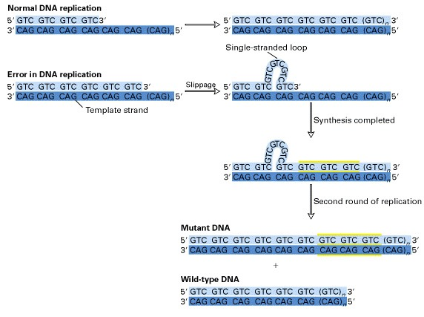
Microsatellites are prone to “slippage” during DNA replication
Mispairing occurs between the template and the new synthesised strand
Unpaired DNA is forced to “loop out”
The“loop” is on the new strand : addition of a repeat unit
The “loop” is on the template strand : loss of a repeat unit
Microsatellite mutation rate is about 10,000 times higher than that of a single base change

Slide 3
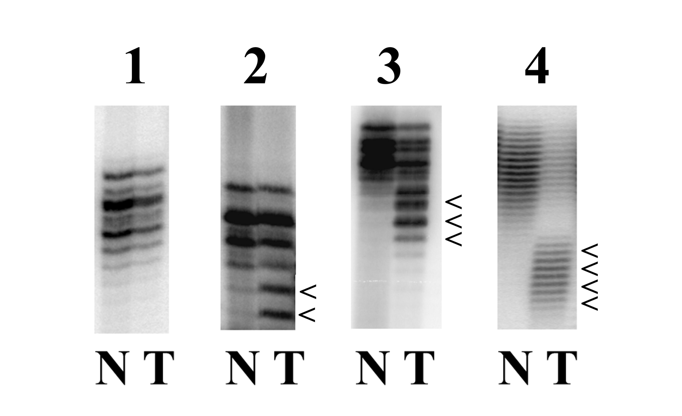
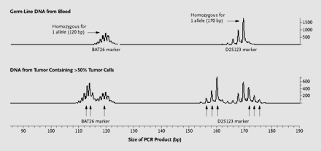
Microsatellite Instability - MSI
MMR protein inactivation causes the huge accumulation of mutations at the microsatellites…..
DNA alterations inactivate several proteins facilitating carcinogenesis…
TGFβ Receptor II
AAG TGC ATT ATG AAG GAA AAA AAA AAG CCT GGT GAG
Lys Cys Ile Met Lys Glu Lys Lys Lys Pro Gly Glu
MSI tumors result in frameshifting mutations within coding sequences, functionally inactivating the corresponding proteins

Slide 4
How does MMR altered genes-associated carcinogenesis work ?
MMR inactive protein
High number of mutations in repeated sequences of target genes
Selective advantage of a cell clone
BAX
IGFIIR
TGFβRII
β2-microglobulin
TCF4
AXIN2
PTEN
hMSH3
hMSH6
MBD4
Target genes
transcription regulation
apoptosis
MMR
methylation
immune response
signal transduction pathways

Slide 5
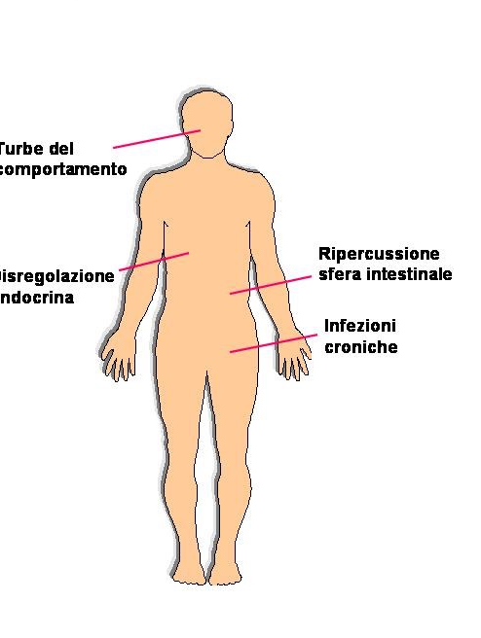
Lynch syndrome or
HNPCC
HNPCC:
two “hits” model,
first costitutive,
second somatic
The syndrome is associated with a germline mutations in one of the MMR genes
Heterozygous status causes susceptibility
The second “hit” is associated with MSI in tumours

Slide 6
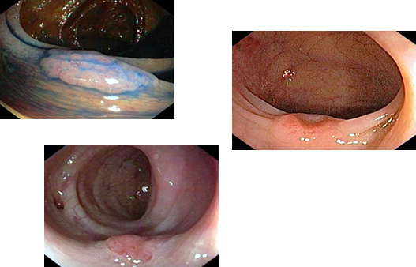
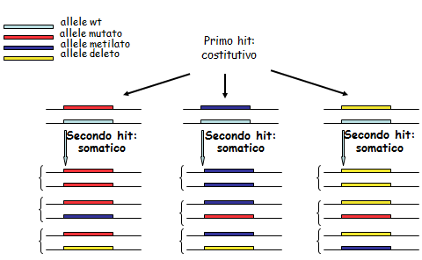
Lynch syndrome or HNPCC
Most common hereditary CCR(3-4%)
Vertical transmission ; CCR may onset at young age (<50 aa), mainly involving right colon
Extra-colonic tumours (endometrial, gastric, urinary and e biliopancreatic cancer)
In linkage with germinal mutations of MMR genes
2.Somatic mutations
1.Germline mutations
49% MLH1 mutations
39% MSH2 mutations
10% MSH6 mutations
1-2% PMS2 mutations

Slide 7
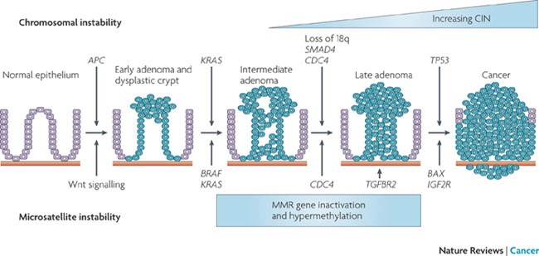
HNPCC shows an accelerated carcinogenesis
Poor information concerning the early lesions
In advanced stages both CIN and MSI features
LOH of MMR genes
Microsatellite instability of adenoma -carcinoma sequence genes

Slide 8
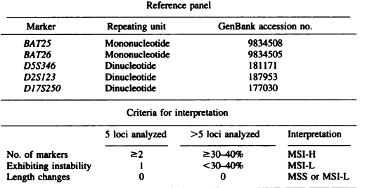
1998 BETHESDA CONSENSUS CONFERENCE
Poorly proficient for MSH6-associated instability detection
Recommended to use matched normal/tumor pairs

Slide 9
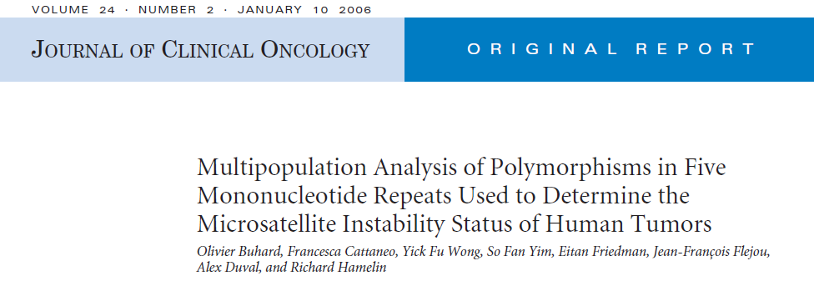
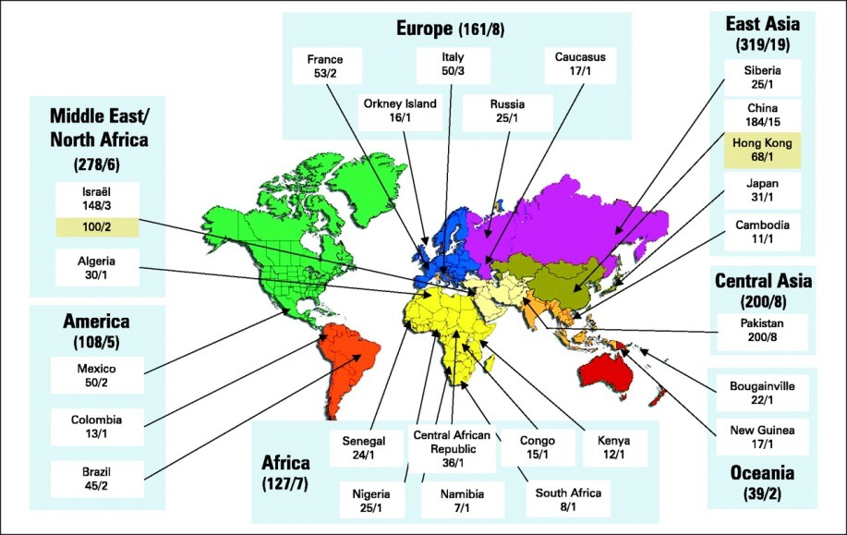
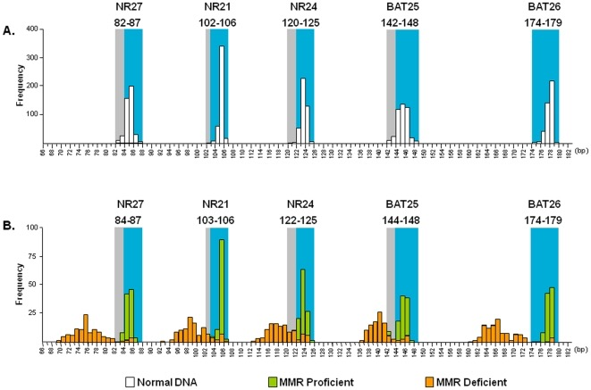
2004-2006
New panel with 5 mononucleotides: the “pentaplex”
Improved MSH6-associated instability detection
No need of matched normal/tumor pairs
Poor detection of MSI-L
Ethnic background variation differencies

Slide 10
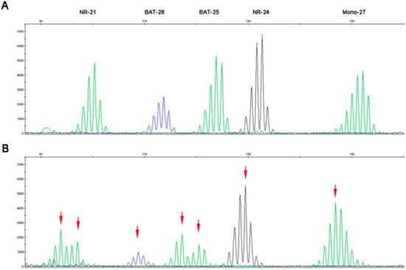
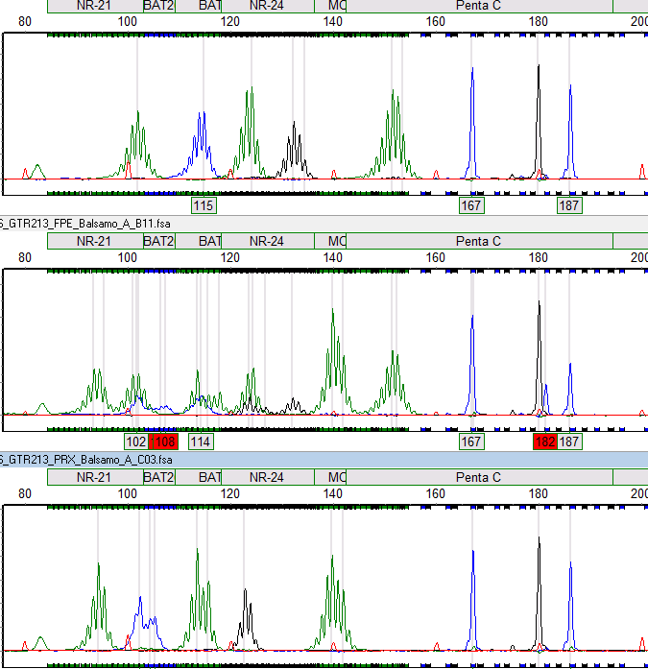
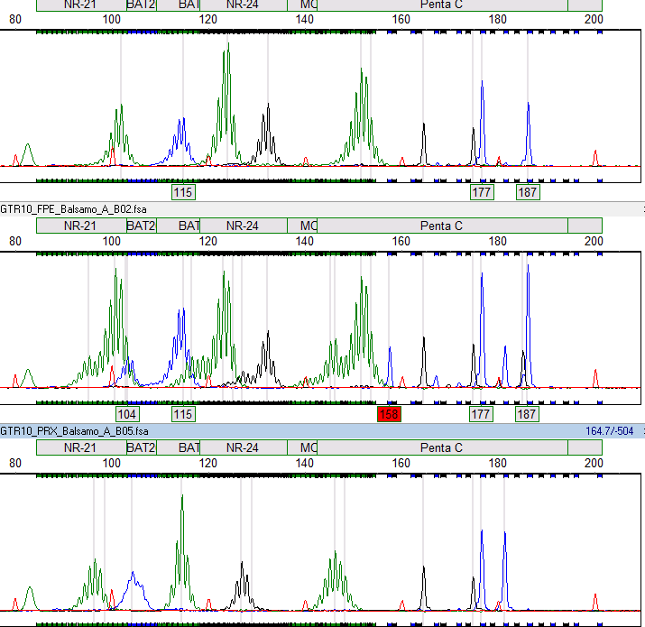
Normal
Tumor
NR21
BAT25
NR27
NR21
BAT25
NR27
BAT26
NR24
BAT26
NR24
Lymphocytes
FFPE tumor
Xenopatient tumor

Slide 11
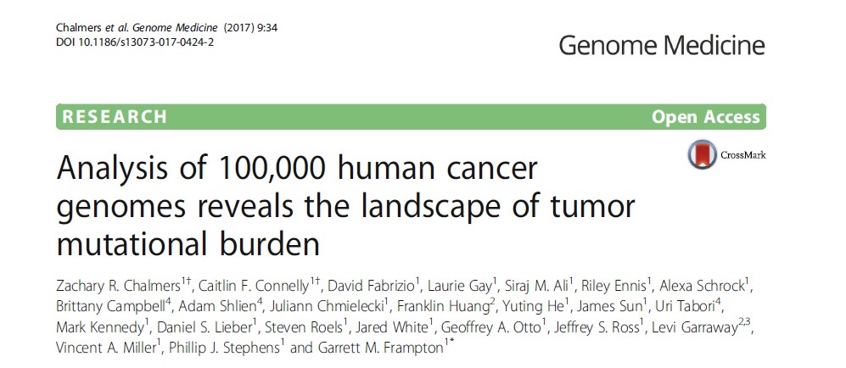
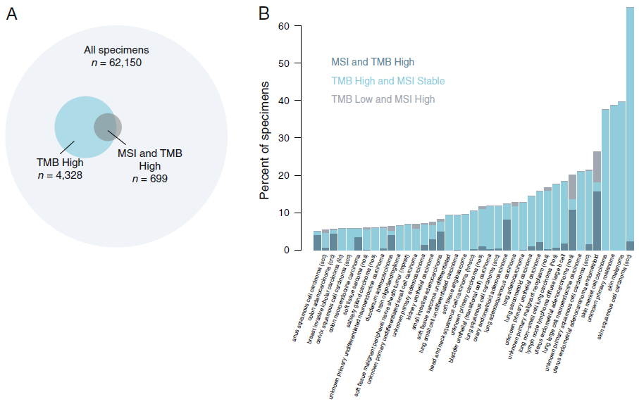
MSI tumors typically harbor more than 1,000 coding somatic mutations per tumor cell genome compared with the 50 to 100 somatic mutations found in microsatellite stable (MSS) tumors
The majority of MSI samples show high tumoral mutational burden (TMB).
The reverse is not true

Slide 12
MSI tumors features
Clinical poorly differentiated
↑ lymphocyte infiltration
↓ low distant metastasis frequency
good prognosis
Molecular MMR mutations
Immunological immunosurveillance
Hystopathological mutated proteins absence or mislocation

Slide 13
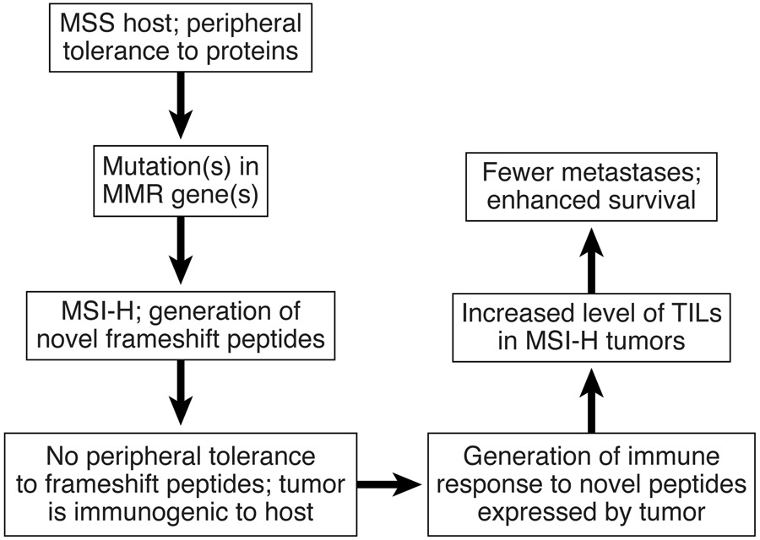
MSI tumors
High mutational load neoantigens formation (10-50 more than in MSS)
These abnormal peptides are presented
through the MHC I to cytotoxic T-lymphocytes (CTLs) as neo-antigens, resulting in an increased TIL density
MSI tumors show a better prognosis than MSS ones

Slide 14
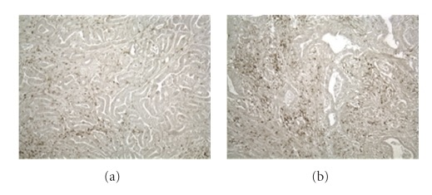
MSI tumors draw cytotoxic T lymphocites (TIL)
MSI patients show an increased level of CD3+ lymphocytes (b) in respect to MSS (a)
Immunosurveillance increases tumour shrinkage
MSI tumors loss β2 microglobuline and HLA I expression
Cells are not able to present the new proteins to the antigens
Immunosurveillance decreases tumour increase

Slide 15
Cancer and Immunology
Tumor cells interact with the immune system in the tumor microenvironment
Immunoediting process through which immune system can limitate or promote cancer development
Three phases:
elimination of tumor cells by T lymphocytes
equilibrium
immune escape

Slide 16
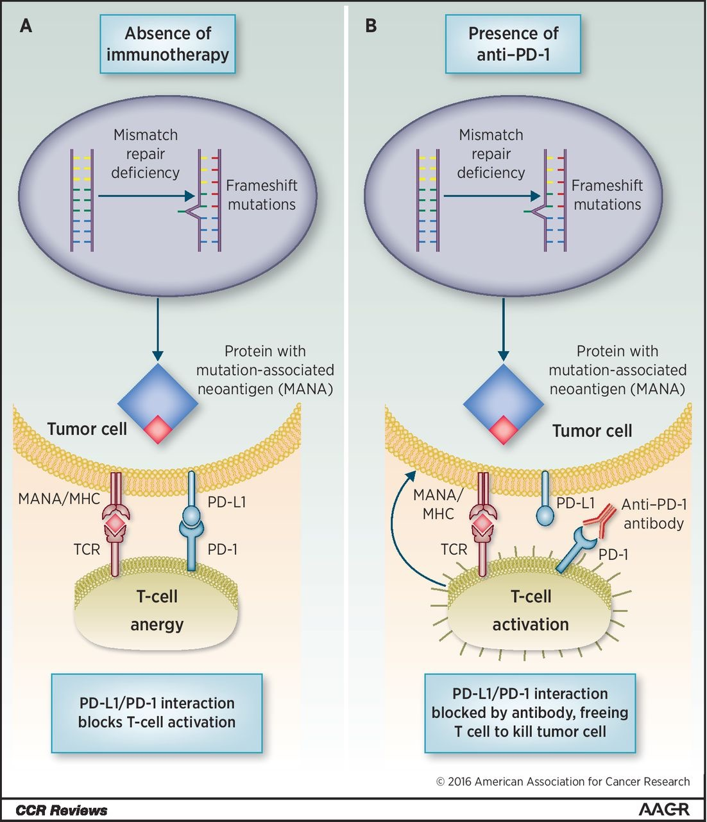
The immune system can regulated through checkpoint receptors, including programmed death 1 pathway
(PD-1 and its ligand PD-L1)
Dudley et al, Clinical Cancer Res, 2016
Inhibitors of these pathways lead to stimulation of activated T-cells and antitumoral immunity

Slide 17
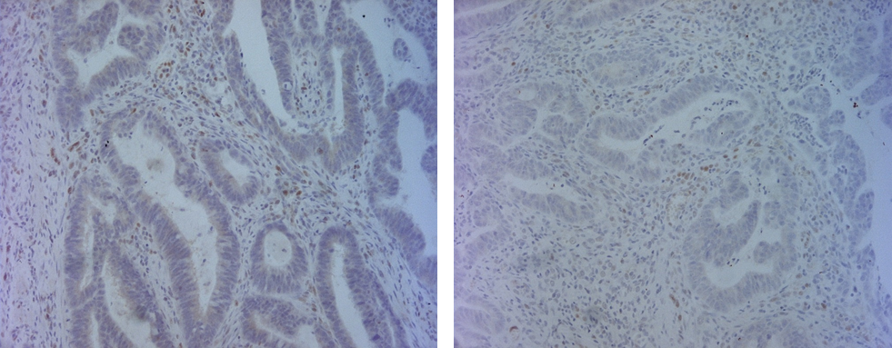
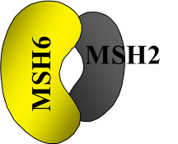
Protein expression of MMR genes
Expression loss of one of the proteins suggest the genetic analysis
MLH1
PMS2
hMLH1/hMSH2 are stable when hPMS2/hMSH6 are lost
MLH1
PMS2
hMSH2
hMSH6

Slide 18
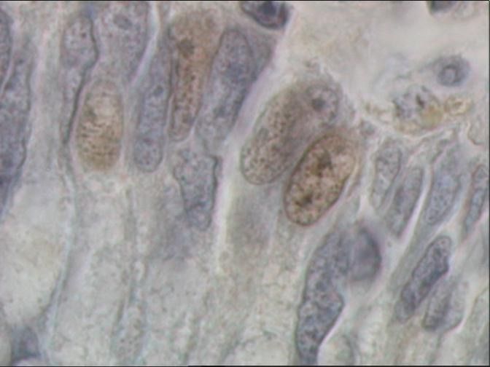
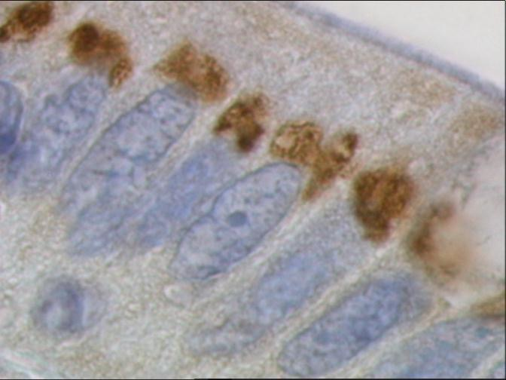
MAP patients carrying biallelic germline MUTYH mutations show a characteristics perinuclear MUTYH expression in the colonic mucosa and adenomas cells
Control
MAP patient

Slide 19
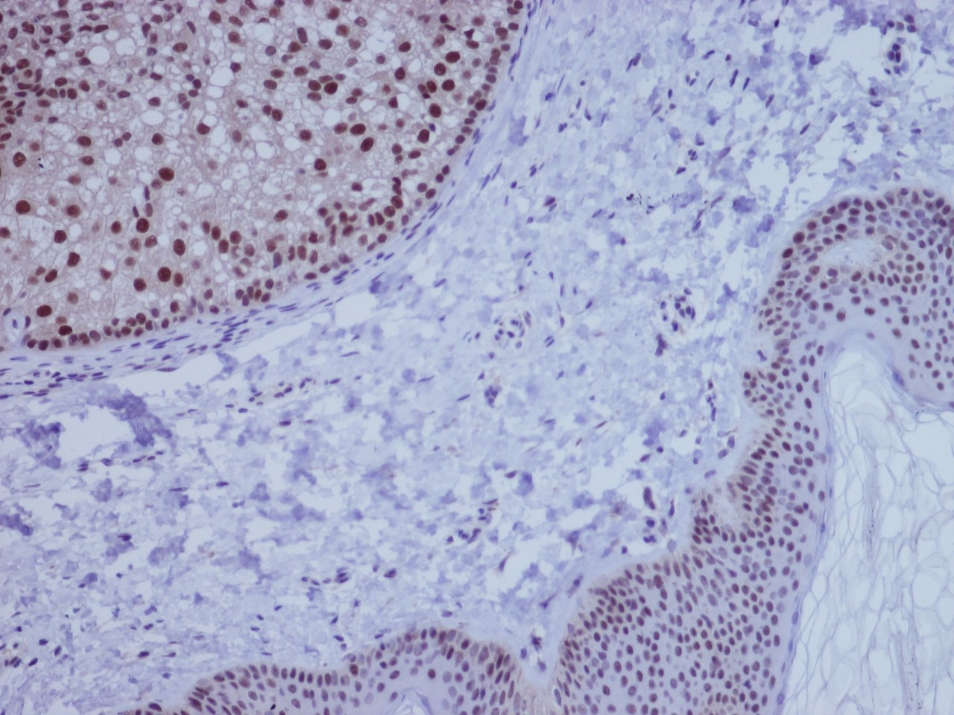
Normal nuclear MLH1 expression in sebaceous adenoma and epidermis
IHC is inexpensive and readily available at most institutions
Lack of expression of a specific protein may indicate a specific gene to be tested
Useful in the search of MSH6 mutations
from C. Digregorio
It may miss abnormalities caused by untested proteins or mutations that lead to qualitative, but not quantitative (missense mutations)
Staining can be heterogeneous throughout tumor samples, and scoring may not be readily reproducible
IHC and PCR are sensitive and specific biomarkers for MMR and MSI
The two tests show high concordance (>95%)

Slide 20
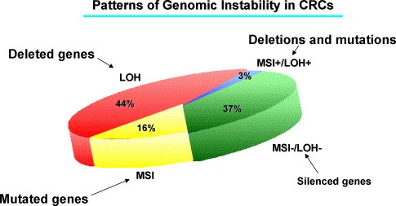
Microsatellite instability is a common feature of different tumour types
It involves 15 % of CRC
Lynch syndrome 20%
Sporadics 80%
Somatic inactivation of both alleles, mainly for MLH1 hypermethylation
Germline inactivation of one allele and following somatic inactivation of the second allele

Slide 21
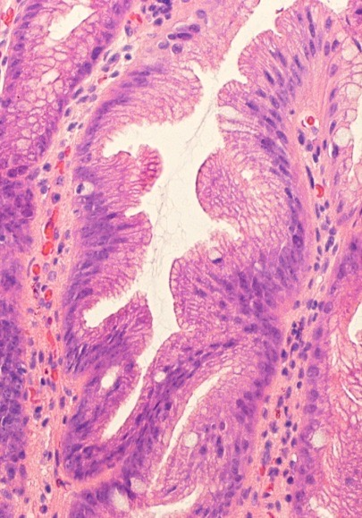
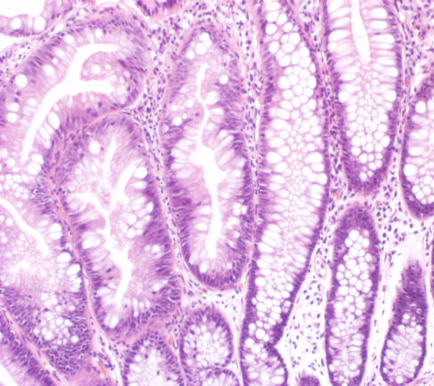
MSI in sporadic CRC
Hystotype : presence of
serrated adenomas
Serrated pathway
From J.Jass
high frequency of BRAF p.V600E mutations
- high frequency of hypermethylated genes (CIMP)
1. Somatic mutation
Methylation of MLHI promoter
2. Somatic mutation
Methylation of MLHI promoter

