Slide 1
2201M21
-
CELLULAR AND MOLECULAR BIOLOGY COURSE
BIOLOGIA CELLULARE E MOLECOLARE
SVB0104 - CANCER GENETICS
LESSON #2b
2nd year / 2° Semester
Teacher: Antonella Roetto, PhD
antonella.roetto@unito.it

Slide 2
Oncogenes and hereditary tumors
Medullary thyroid carcinoma can be sporadic or familial
Familial cases are found in
Multiple Endocrine Neoplasia II (MEN II)
Autosomic dominant pattern

Slide 3
Oncogenes and hereditary tumors
MEN II A and B
FMTC
Autosomic dominant
RET oncogene

Slide 4
The RET oncogene is a member of the glial cell line-derived neurotrophic factor (GDNF) family and encodes for a receptor tyrosine kinase
loss of function mutations are associated with the development of Hirschsprung's disease (congenital megacolon : occurs when part or all of the large intestine or parts of the gastrointestinal tract have no ganglion cells and cannot function)
b) gain of function mutations are associated with the development of various types of human cancer, including medullary thyroid carcinoma, multiple endocrine neoplasias type 2A and 2B, pheochromocytoma and parathyroid hyperplasia

Slide 5
RET germline gain–of-function mutations and phenotypes

Slide 6
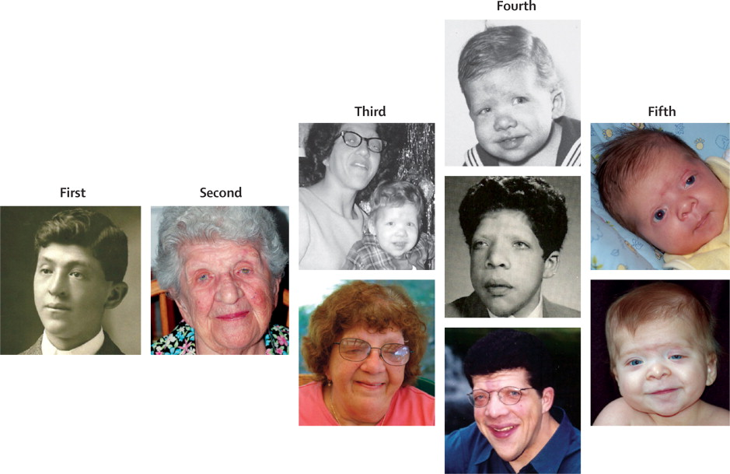
Oncogenes, their pathways and hereditary diseases
Noonan Syndrome
It is a genetic multisystem disorder characterised by
1) distinctive facial features, 2) developmental delay, 3) learning difficulties, 4) short stature, 5) congenital heart disease, 6) renal anomalies, 7) lymphatic malformations, and 8) bleeding difficulties
Autosomal dominant
Prevalence of 1 in 1000-2500
Mutations that cause Noonan syndrome alter genes encoding proteins with roles in the RAS–MAPK pathway, leading to pathway dysregulation

Slide 7
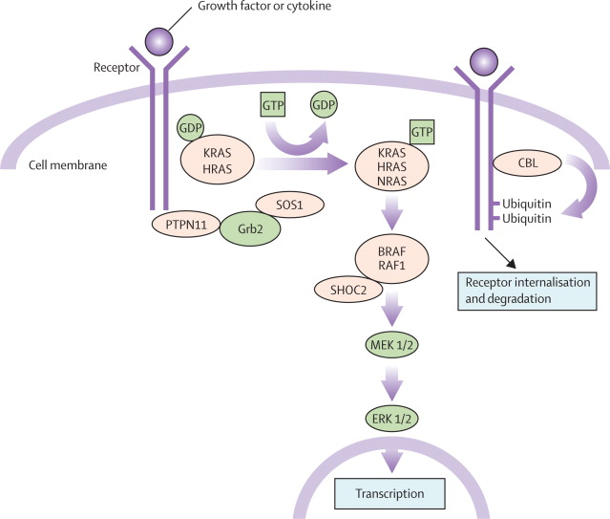
Mutations in Noonan Syndrome
KRAS/NRAS 2% of cases-mild gain of function
PTPN11 50% of cases- gain of function
SOS-1 10% of cases
RAF1-BRAF 5-10% of cases
Genotype-phenotype correlations
PTPN11 pulmonary stenosis; less hypertrophic cardiomyopathy; short stature; patients with N308D and N308S have little or no intellectual disability; juvenile myelomonocytic leukaemia
SOS1 less short stature, less intellectual disability, language delays similar to cardiofaciocutaneous syndrome
RAF1 more hypertrophic cardiomyopathy, more naevi, lentigines, café au lait spots
KRAS more severe cognitive delay ; similar to cardiofaciocutaneous syndrome

