Slide 1
DNA MUTATIONS
LOSS OF FUNCTION
The protein product may have reduced or no function
Recessive phenotypes because for most genes the precise quantity is not crucial;
This type of mutation generally affects tumor suppressor genes
Sometimes the product of the mutated allele affects the product of the normal allele (p53, APC) dominant negative or haploinsufficiency
GAIN OF FUNCTION
The protein product may function in an abnormal way
This type of mutations generally affects oncogenes
Dominant phenotype because mutations involve the escape from the normal control or doing something different
The product of the mutant allele prevents the product of the normal allele of functionioning
The distinction is sometimes difficult and the same gene can be affected by both loss or gain of function mutations !!!

Slide 2
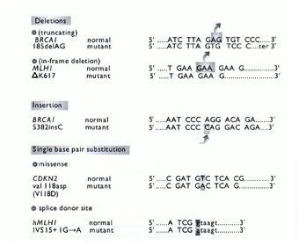
Mutations can be quantitative or qualitative
Coding-sequence
Non-coding sequence
Gene-promoters
Splicingh sites
Genomic repeated sequences
SEQUENCE SITES
TYPES
DELETIONS
INSERTIONS
Structural chromosomal abnormalities:
deletion, amplification
translocation
inversion
insertion
SINGLE BASE PAIR SUBSTITUTION
missense
splice donor site

Slide 3
MUTATION SCREENING
SSCP
DGGE
DHPLC
DNA chips
Non-functional methods
Functional methods
Protein Truncation Test (PTT)
In situ hybridization PCR
CHARACTERIZATION
Sanger sequencing, pyrosequencing, mass array (MALDI-TOF), Next-Generation Sequencing(NGS)…

Slide 4
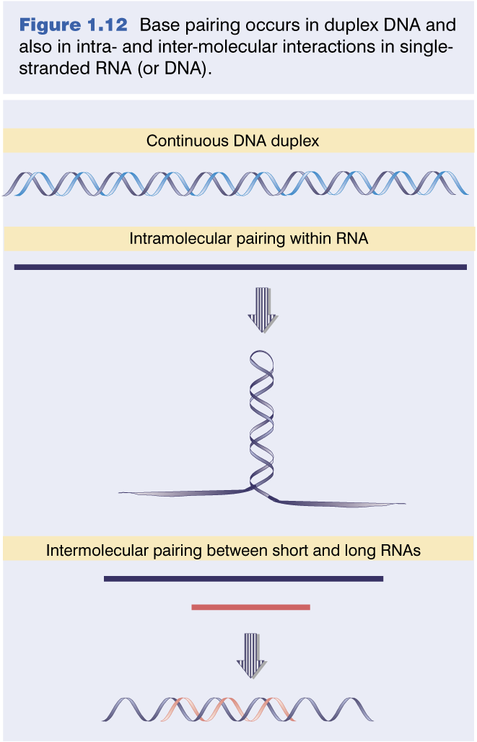
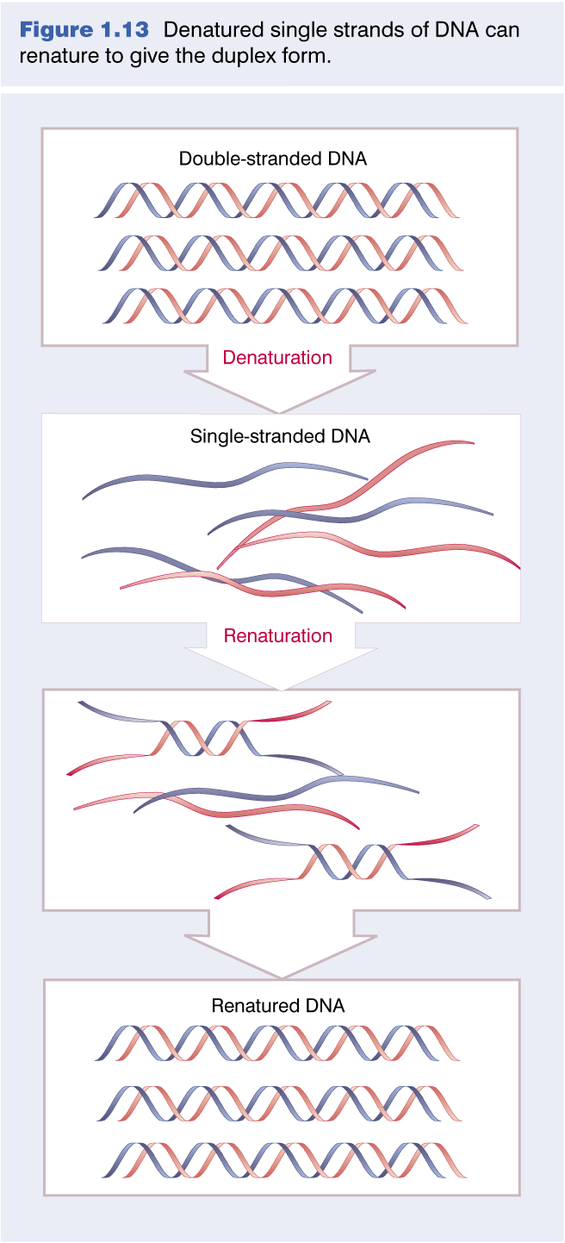
Mutational analysis based on the DNA ability of denaturation, separation and reassociation

Slide 5
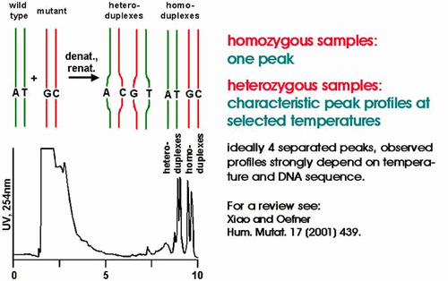
Denaturing High Performance Liquid Chromatography (DHPLC)
is a chromatographyc method for the detection of DNA base substitutions, small deletions or insertions
PCR amplification of a region with a hemizygous polymorphism gives two fragments corresponding to the wild type and polymorphic alleles
Denaturation – re-association of this PCR product creates hetero and homoduplexes molecules
Heteroduplexes are thermally less stable than homoduplexes and will be resolved differently by chromatography when subjected to a specific high temperature
The mismatch will decrease the interaction with the column (matrix) and reduce retention time compared to the homoduplexes in chromatographic separation

Slide 6
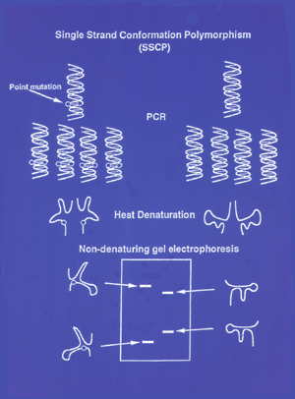
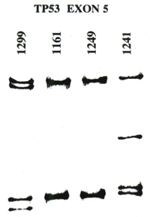
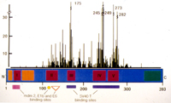
Single Strand Conformation Polymorphism
Methods
Results
p53 mutation distribution

Slide 7
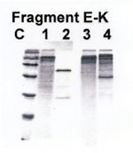
PROTEIN TRUNCATION TEST
Transcript or gene Wild-type Truncating mutation Mutated
PCR amplification ⇓ RNA transcription ⇓ Protein transduction ⇓ Protein resolution with SDS- PAGE ⇓ Autoradiographic detection ⇓

Slide 8
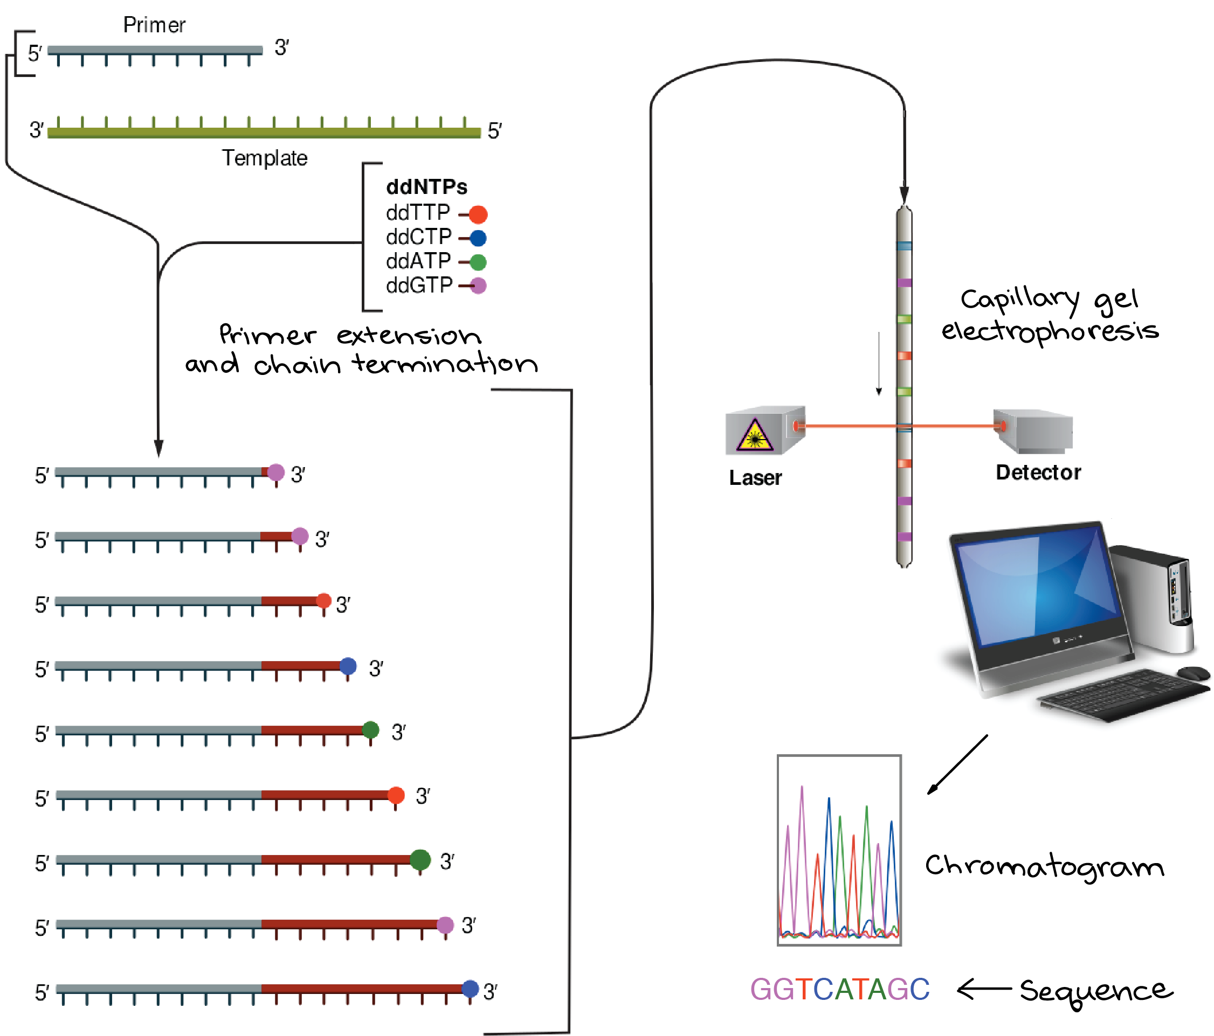
MUTATION CHARACTERIZATION
Sanger sequencing is a qualitative method of DNA sequencing based on the selective incorporation of chain-terminating dideoxynucleotides by DNA polymerase during in vitro DNA replication.
Developed by Frederick Sanger and colleagues in 1977, it was the most widely used sequencing method for approximately 40 years.
More recently, higher volume Sanger sequencing has been supplanted by "Next-Gen" sequencing methods, especially for large-scale, automated genome analyses.
However, the Sanger method remains in wide use, for smaller-scale projects, validation of Next-Gen results and for obtaining especially long contiguous DNA sequence reads (> 500 nucleotides).

Slide 9
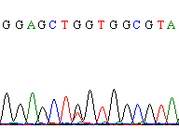
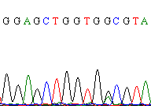
Sanger sequencing with automatic sequencer
T
Missense mutation
T>G
frameshift

Slide 10
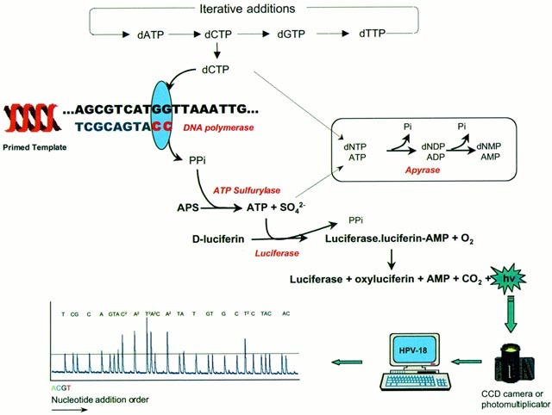
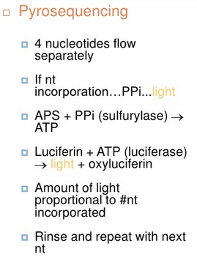
PYROSEQUENCING
It allows to follow the activity of DNA polymerase during nucleotide incorporation into a DNA strand by analyzing the pyrophosphate released during the process
quantitative method : DNA metilation, SNPs, alleles quantification

Slide 11
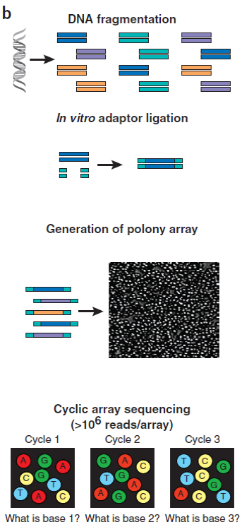
Next Generation Sequencing
Massively parallel or deep sequencing are related terms that describe a DNA sequencing technology which has revolutionised genomic research
Sanger NGS
1 sequence ~ 800 bp (~1 kb) 1 exome ~ 50 Mbp (10 Gb)
1 genome ~ 3 Gbp (0.5 Tb)
Technology basics
DNA is fragmented
Adaptors ligated to fragments
Several possible protocols yield array of PCR products
Emulsion PCR
Bridge PCR
Enzymatic extension with fluorescently tagged nucleotides.
Cyclic readout by imaging the array.

Slide 12
The raw image data is truly huge: 1-2 TB
The images are immediately processed into intensity data (spots w/ location and brightness)
Intensity data is then processed into basecalls
(A, C, T, or G plus a quality score for each)
Basecall data is on the order of 5-10 GB/run
Align sequence reads to reference genome
Assemble contigs and whole genomes
CNV/Structural alteration/Mutation/SNP calling/genotyping

Slide 13
Processing (sequencing run)
storage/autom. pipeline
Raw data (images)
seq. data (sequence)
2 TB
Assembly (de novo)
500 GB
mapping (to reference)
200 GB
variants (SNP, mut., struct. ...)
Custom scripts
1 GB
Meaningful variants (causative SNP, mut., struct. ...)
Data visualisation & annotation
3 MB
Integrated analysis (other databases, phenotyping ...)
From a typical human genome:
3-5 million variants
1000-1300 possibly damaging changes in RefSeq transcripts, including:
- 40-80 stop codons
- splice site changes
- non-synonimous changes
Supervised analysis

Slide 14
How to decide when a genomic VARIANT is pathogenic
Type of a.a. change: a change modifying the protein structure
Previous evidence: variant found in other patients with the same pathology
De novo :variant only found in the patient affected by that pathology
A new change: a variant not identified in 100 healthy controls
Functional studies (in vitro)
Functional studies are the best evidence !!!!

Slide 15
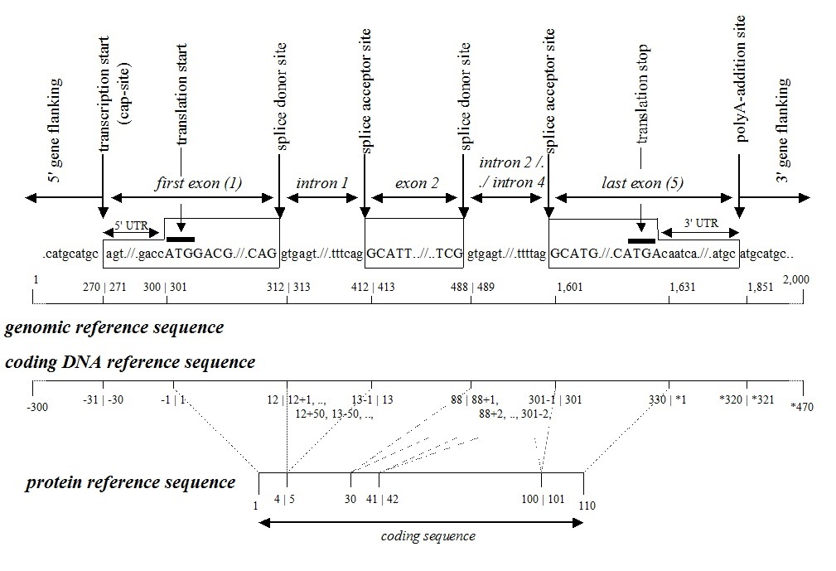
http://www.hgvs.org/mutnomen
Genomic DNA
A) there is no nucleotide 0; B) nucleotide 1 is the A of the ATG-translation initiation codon; C) the nucleotide 5' of the ATG-translation initiation codon is -1, the previous -2, etc. D) the number of the last nucleotide of the preceding exon, a plus sign and the position in the intron, like c.77+1G, c.77+2T; F) the number of the first nucleotide of the following exon, a minus sign and the position upstream in the intron, like ..., c.78-2A, c.78-1G.
Substitutions
A nucleotide substitution is a sequence change where one nucleotide is replaced by one other nucleotide (see Standards - Definition). Nucleotide substituions are described using a ">“.
A ) c.76A>C denotes that at nucleotide 76 an A is changed to a C B) c.-14G>C denotes a G to C substitution 14 nucleotides 5' of the ATG translation initiation codon C) c.88+1G>T denotes the G to T substitution at nucleotide +1 of an intron D) c.89-2A>C denotes the A to C substitution at nucleotide -2 of an intron

Slide 16
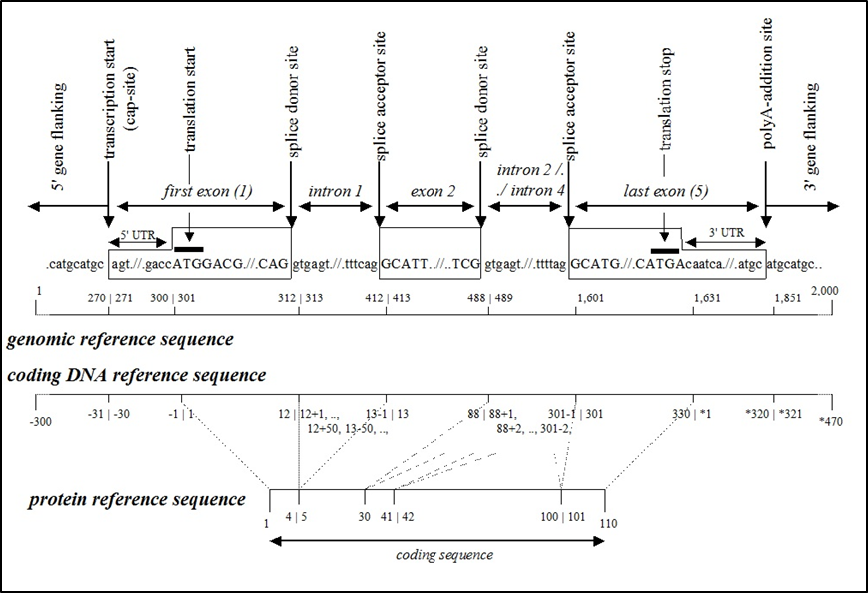
Deletions
A nucleotide deletion is a sequence change where one or more nucleotides are removed.
Deletions are described using "del" after an indication of the first and last nucleotide(s) deleted, separated by a "_" (underscore).
A) c.76_78del (alternatively c.76_78delACT) denotes a ACT deletion from nucleotides 76 to 78
Duplications
Duplications are designated by "dup" after an indication of the first and last nucleotide(s) duplicated.
A) g.5dupT (or g.5dup, not g.5_6insT) denotes a duplication ("insertion") of the T nucleotide at position 5 in the genomic reference sequence changing ACTCTGTGCC to ACTCTTGTGCC
B) c.77_79dup (or c.77_79dupCTG) denotes that the three nucleotides 77 to 79 are duplicated
Insertions
Insertions are designated by "ins" after an indication of the nucleotides flanking the insertion site, followed by a description of the nucleotides inserted.
For large insertions the number of inserted nucleotides should be mentioned :
A) c.76_77insT denotes that a T is inserted between nucleotides 76 and 77 of the coding DNA reference sequence

Slide 17
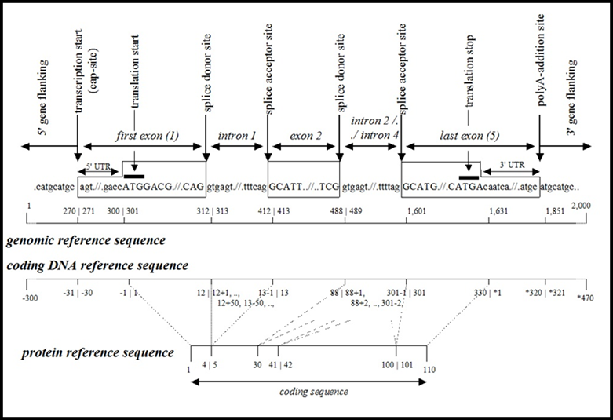
PROTEINS
Substitutions
Substitutions can be described without using the specific ">"-character which is used on DNA and RNA level (i.e. p.Trp26Cys instead of p.Trp26>Cys).
Deletions
Deletions are designated by "del" after a description of the deleted segment, i.e. the first (and last) amino acid(s) deleted.
A) MKLGHQQQCC to MKL___QQCC is described as p.Gly4_Gln6del (alternatively p.G4_Q6del)
B) MKLGHQQQCC to MKLGHQQCC is described as p.Glndel (p.Q8del)
Duplications
Duplications are designated by "dup" after a description of the duplicated segment, i.e. the first (and last) amino acid(s) duplicated.
A) MKLGHQQQCC to MKLGHQGHQQQCC is described as p.Gly4_Gln6dup (alternatively p.G4_Q6dup)
B) MKLGHQQQCC to MKLGHQQQQCC is described as p.Gln8dup (alternatively p.Q8dup)
Insertions
Insertions are designated by "ins" after a description of the amino acids flanking the insertion site, followed by a description of the inserted amino acids. When the insertion is large it may be described by its length (e.g. p.Lys2_Leu3ins34).
A) p.Lys2_Leu3insGlnSer (alternatively p.K2_L3insQS) describes the change from MKLGHQQQCC to MKQSLGHQQQCC
B) p.Arg78_Gly79ins23 describes the in-frame insertion of a 23 amino acid sequence

