Slide 1
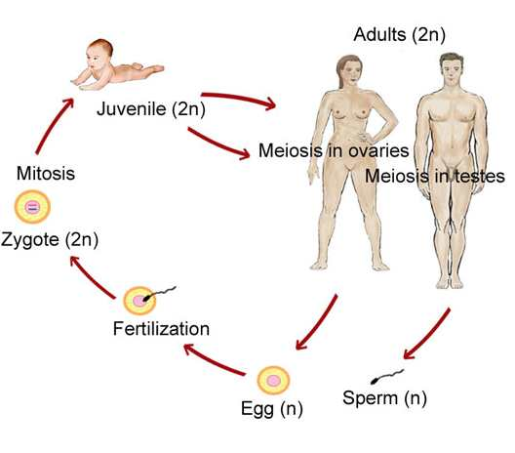
The life cycle:
from fertilization to death

Slide 2
Metazoa
Early development
is generalizable:
each animal passes through similar stages of early development

Slide 3
Embryogenesis:
fertilization
cleavage (cell divisions→blastomeres)
gastrulation (germ layers: ectoderm, mesoderm,endoderm)
neurulation
organogenesis

Slide 4
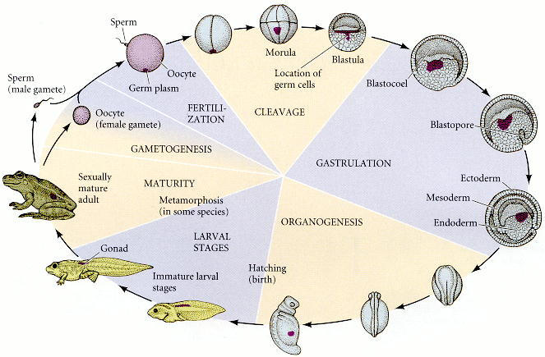
Developmental history of a frog

Slide 5
Developmental Biology
“the study of the molecular mechanisms which control the different stages of embryo development and the differention of cells, tissues and organs of the body…
…but also regeneration and aging”

Slide 6
Cell fate, potency and commitment
The number of different cell types in the embryo increases as development proceeds
Cell fate
the range of cell types a particular cell can give rise to during normal development.
Cell potency
the entire repertoire of cell types a particular cell can give rise in all possible environments (e.g. a cell can differentiate in an abnormal way if it is experimentally grafted in an ectopic region).

Slide 7
Cell fate, potency and commitment
The potency of a cell is an intrinsic property and is greater than or equal to its fate
fate = potency + environment
(e.g. its contact with other cells in the embryo).

Slide 8
Cell fate, potency and commitment
As cell fate becomes restricted following each decision in the developmental hierarchy, cells are said to be committed to a certain fate (or developmental pathway).
commitment occurs in stages

Slide 9
Levels of developmental commitment
Specification
From Wolpert

Slide 10
Levels of developmental commitment
The fate of a cell that is specified is reversible…it can be respecified
From Wolpert

Slide 11
Levels of developmental commitment
Uncommitted→Specified→Determined→Differentiated
From Wolpert

Slide 12
Mechanisms of developmental commitment
How cells differentiate?
Synthesis of new proteins
Selective gene expression
Cytoplasmic determinant External Inductive signals

Slide 13
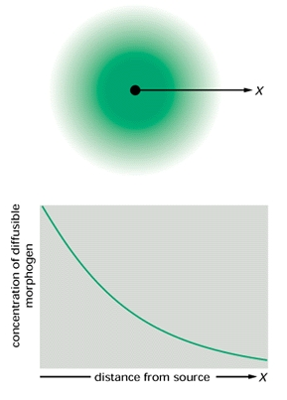
Inductive signals
Single response
(stereotyped)
Different responses at different concentration
MORPHOGEN
Soluble molecules secreted at a distance from a target cell
Concentration gradient= Morphogenetic gradients
a morphogen can specify more than one cell type depending on its concentration
Relevant for pattern formation!

Slide 14
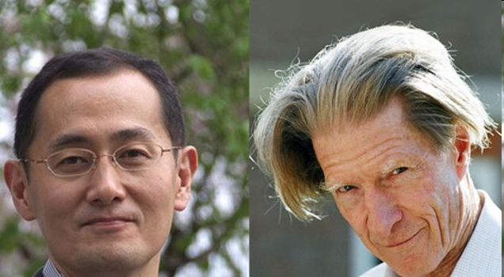
The Nobel Prize in Physiology or Medicine 2012 Sir John B. Gurdon and Shinya Yamanaka
“the reversal of cell differentiation”
Cloning in frog
1962
Principle
of genome
conservation
From nuclear
transfer
to nuclear
reprogramming
iPSCs
Oct4
Sox2
Klf4
c-Myc
“for the discovery that mature cells
can be reprogrammed to become pluripotent”

