Slide 1
BIBLIOGRAPHIC TUTORIAL Dr. Elisa Anedda (elisa.anedda@unito.it)
Lesson 2
Master Cellular and molecular biology A.A. 2019/2020

Slide 2
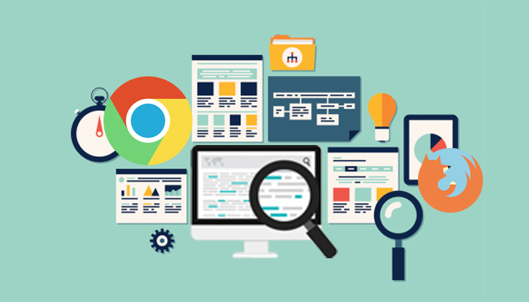
SEARCH ENGINES
Search engines are endless in the world wide web, but in the next slides you’ll find the most used in the scientific field. All of them are important, but finding the perfect one for your research it’s up to you!

Slide 3
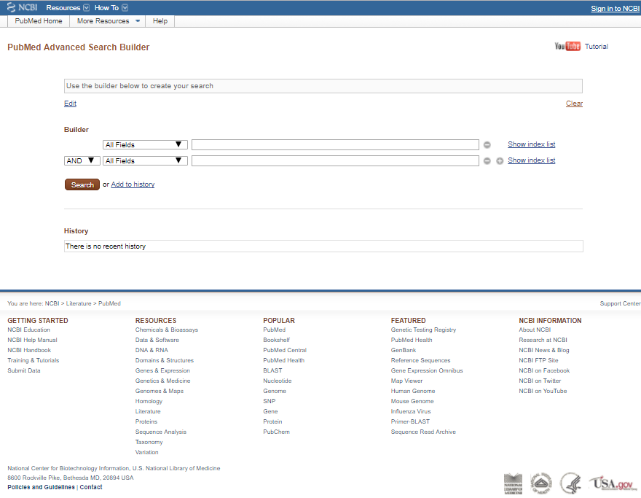
https://www.ncbi.nlm.nih.gov/pubmed/advanced

Slide 4
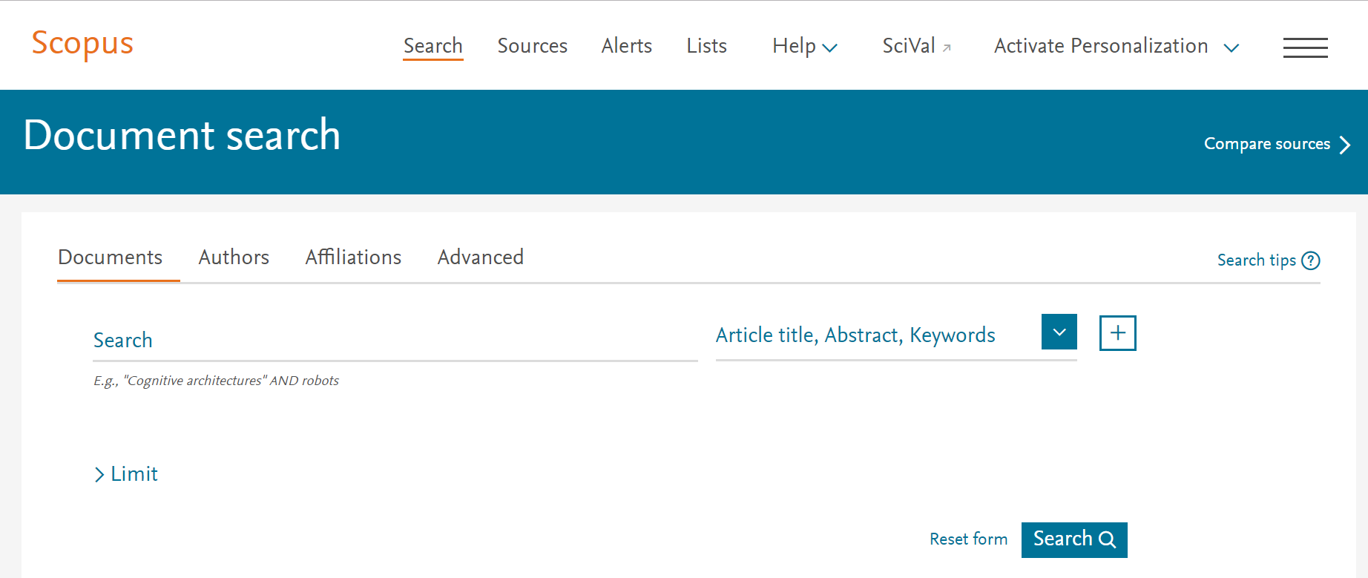
https://www.scopus.com/

Slide 5
https://webofknowledge.com/

Slide 6
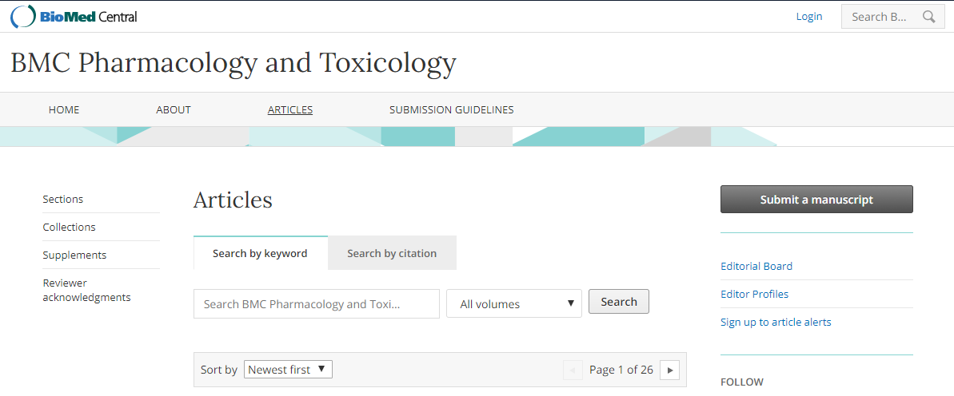
https://www.biomedcentral.com/journals#Life Sciences

Slide 7
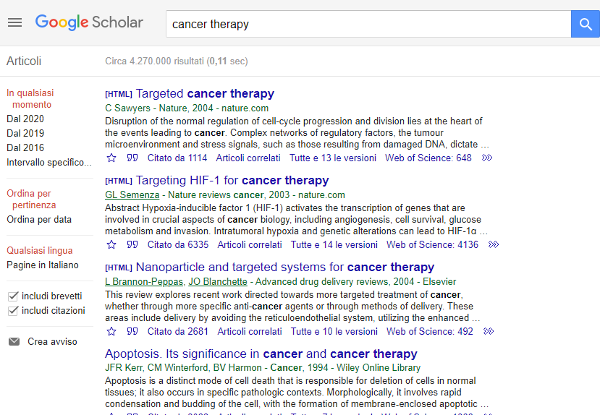
https://scholar.google.it/

Slide 8
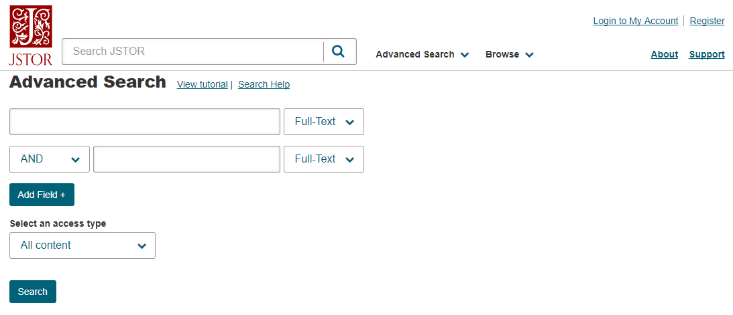
https://www.jstor.org/action/showAdvancedSearch?acc=off&wc=on

Slide 9
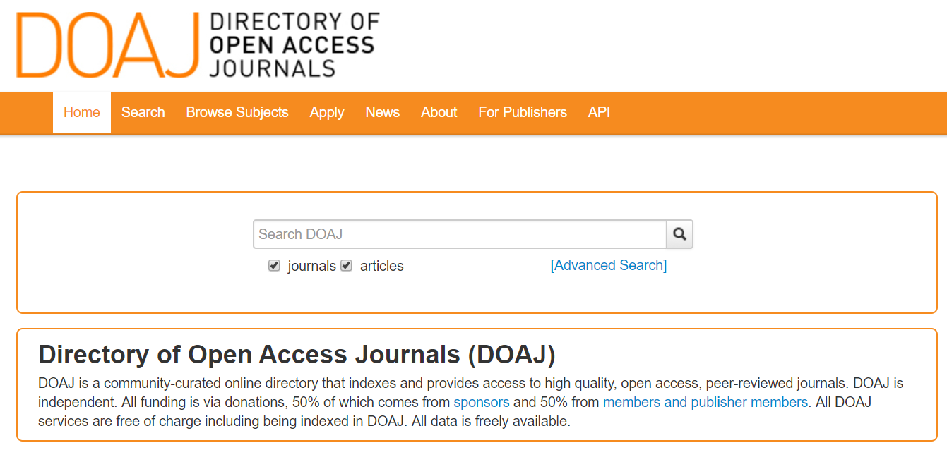
Open access journals
https://doaj.org/

Slide 10
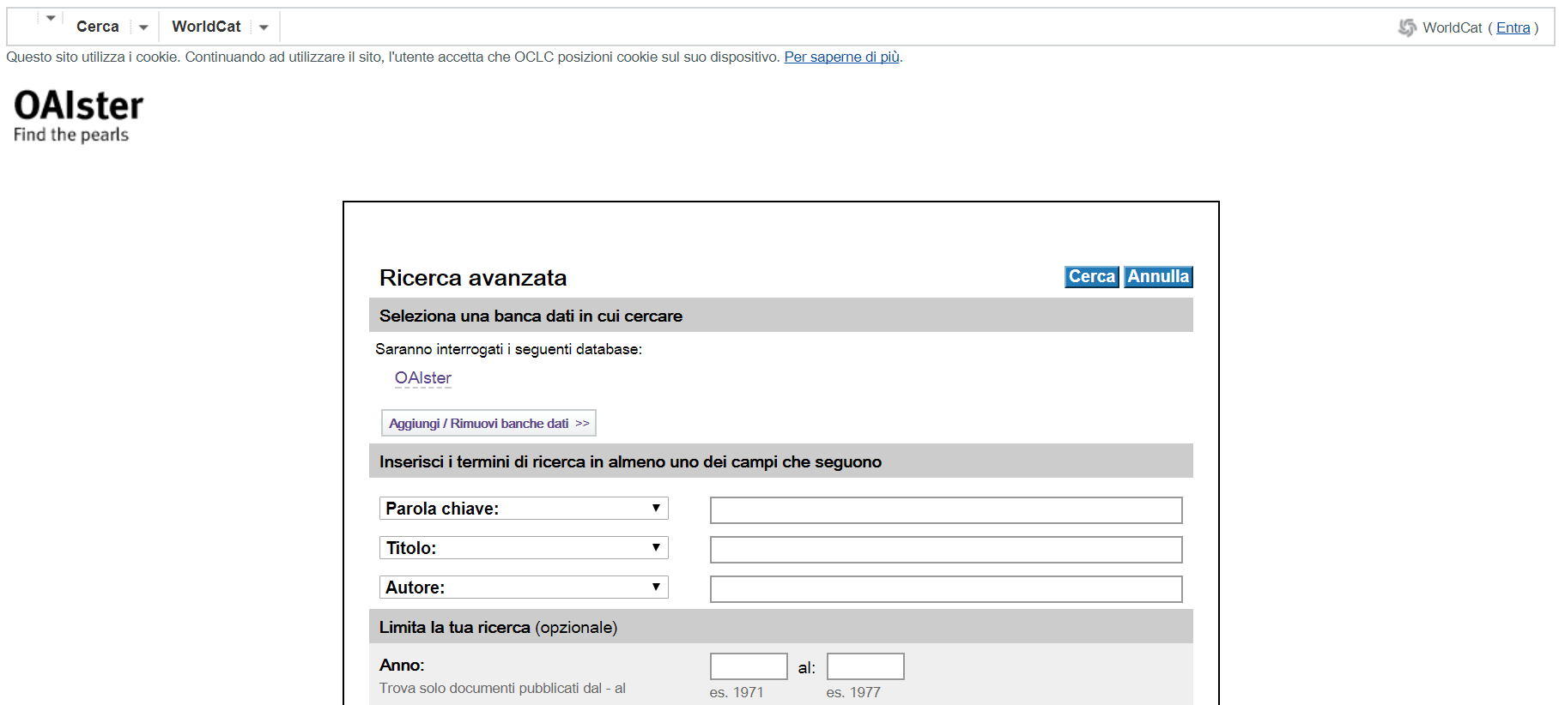
http://oaister.worldcat.org/advancedsearch

Slide 11
OPAC
OPAC (Online Public Access Catalogue) has the advantage to be consulted from any computer connected to the web.
OPACs can be single or collective libraries if they partecipate to a coordinated library system

Slide 12
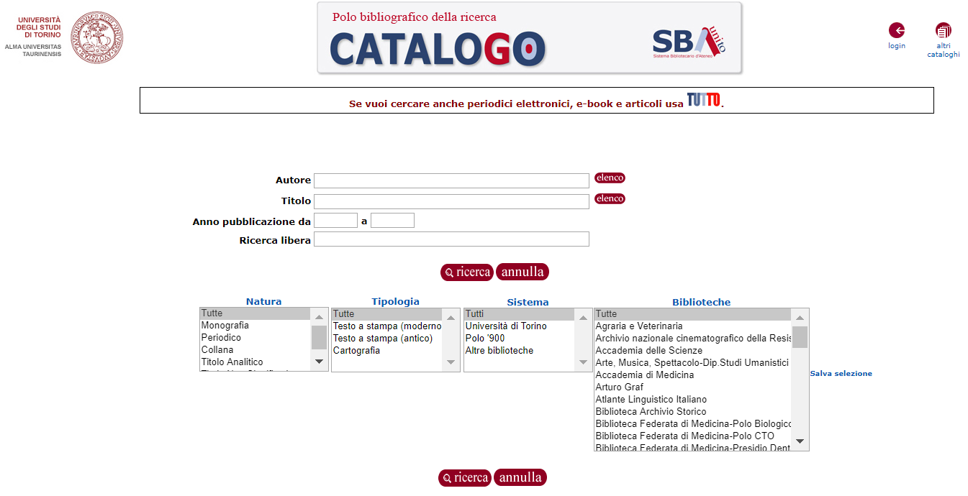
http://unito-opac.cineca.it/SebinaOpac/Opac?locale=it_IT

Slide 13
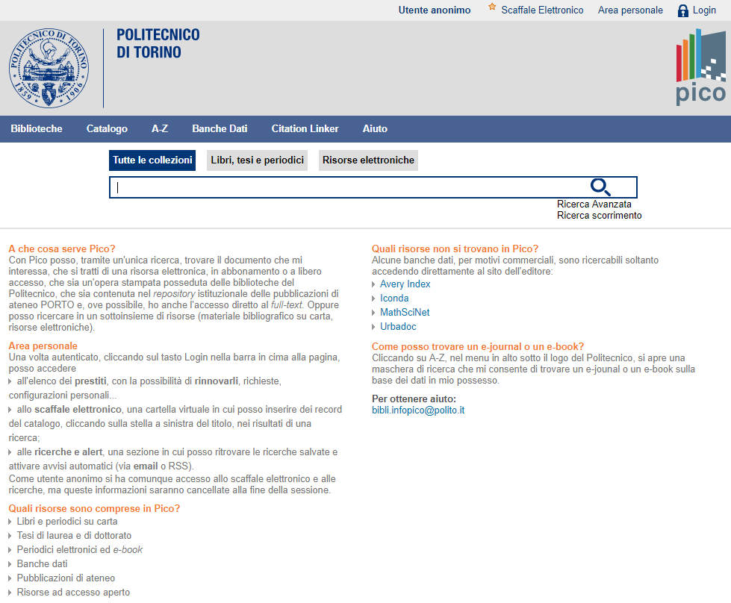
http://pico.polito.it/primo_library/libweb/action/search.do?vid=39pto_v

Slide 14
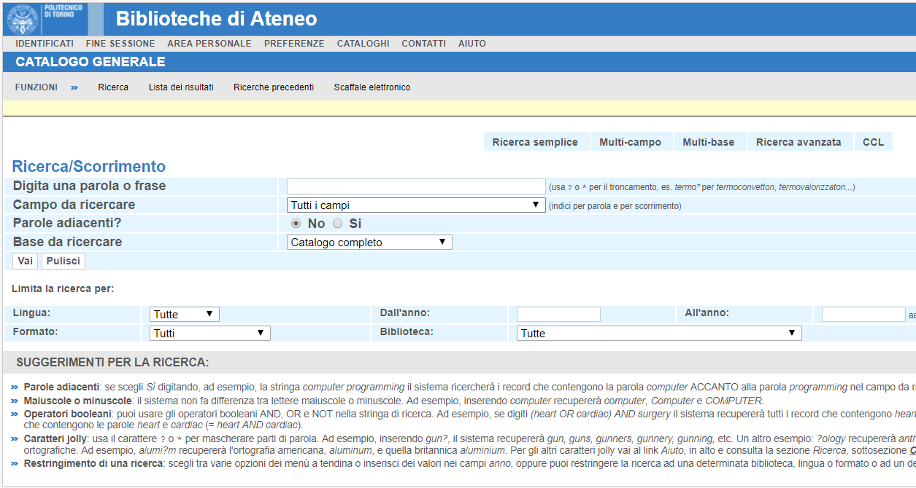
http://opac.biblio.polito.it/F/V8MSB7PDSRHJTS5862YU55B89FJK1M74D2RID85ASMESTP2AJ8-03626?&pds_handle=GUEST

Slide 15
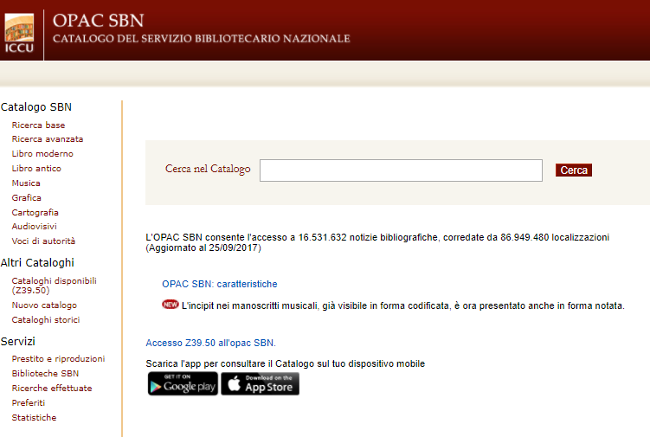
http://opac.sbn.it/opacsbn/opac/iccu/free.jsp

Slide 16
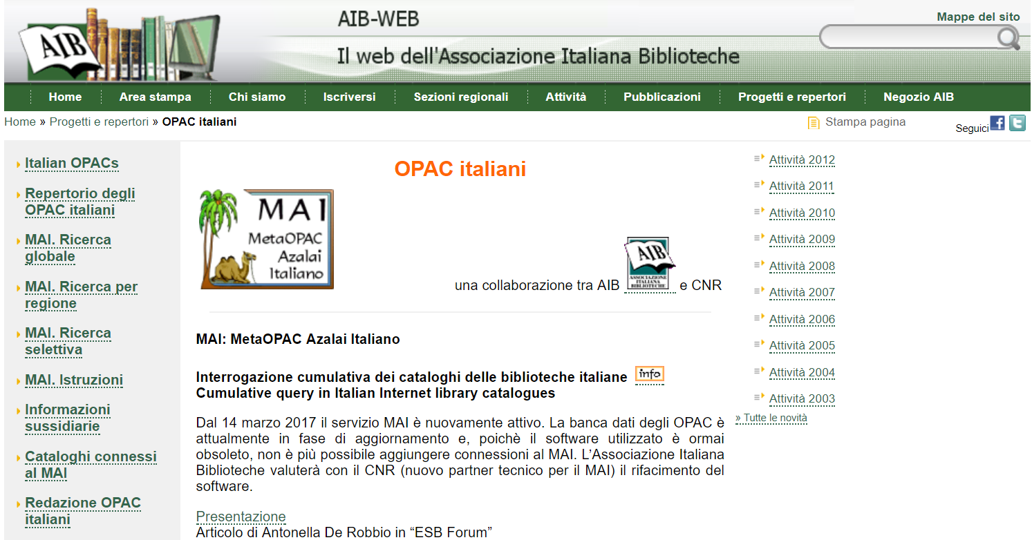
The MetaOPAC is an online catalogue that interrogates at the same time indipendent OPACs and accessible independentely using a specific software.
http://www.aib.it/progetti/opac-italiani/

