Slide 1
2201M21
-
CELLULAR AND MOLECULAR BIOLOGY COURSE
BIOLOGIA CELLULARE E MOLECOLARE
SVB0104 - CANCER GENETICS
LESSON #14
2nd year / 2° Semester
Teacher: Antonella Roetto, PhD
antonella.roetto@unito.it

Slide 2
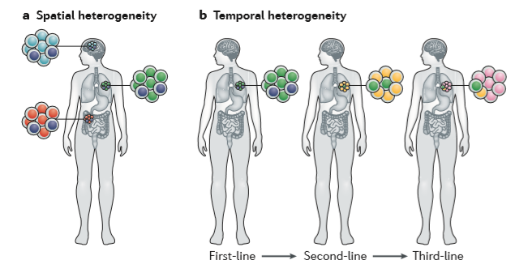
Tumour heterogeneity
Intertumoral heterogeneity
spatial heterogeneity
Intratumoral heterogeneity
temporal heterogeneity
Dagogo-Jack and Shaw, 2018

Slide 3
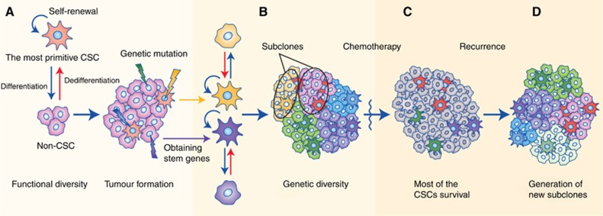
Tumour heterogeneity
Stochastic model casual mutation /s clonal expansion tumor development
Hierarchical models cancer stem cells (CSCs) at the apex
They are reasonable systems that have been hypothesised to describe tumour heterogeneity.
Each model alone inadequately explains tumour diversity, the two models can be integrated to provide a more comprehensive explanation.

Slide 4
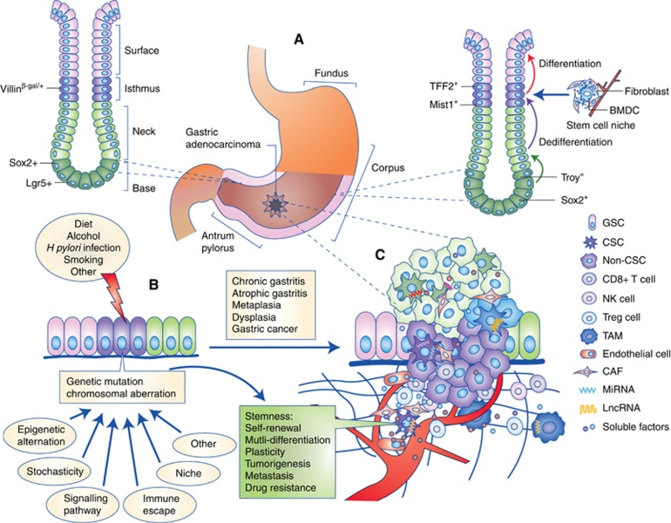
Tumour heterogeneity
Emerging evidence has characterised tumours using a hierarchical organisational structure, with cancer stem cells (CSCs) at the apex.

Slide 5
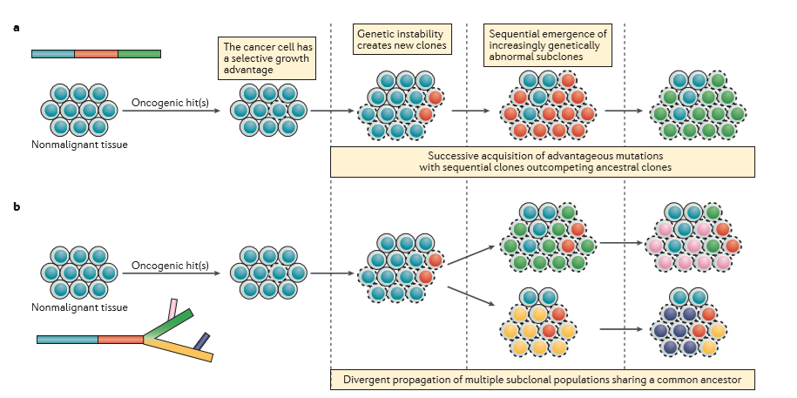
Tumor evolution models
Dagogo-Jack and Shaw, 2018

Slide 6
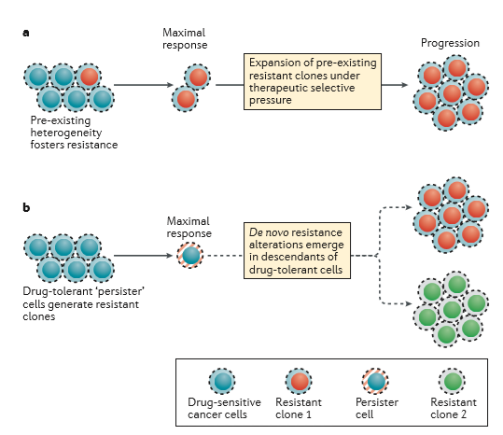

Slide 7
Non-invasive monitoring of cancer heterogeneity
The clinical status of a patient and the location of progressing lesions might make performing a repeated tissue biopsy procedure infeasible.
Moreover, analyses involving single ­site biopsy sampling might result in underestimation of the degree of spatial heterogeneity, and sampling intervals that are tolerated by the patient might not enable the true extent of temporal heterogeneity to be captured accurately.
Noninvasive ‘liquid biopsies’ analysis of tumor­ derived genetic material extracted from a patient’s blood are a promising strategy for addressing the shortcomings of tissue sampling. Genotyping of genetic material obtained from circulating tumor cells, circulating exosomes shed by tumors, and circulating cell­ free tumor DNA (ctDNA)
Es. In a prospective study involving 121 patients with metastatic CRC, 26 patients were found to have KRAS mutations in plasma that were not identified by tissue genotyping.
Longitudinal plasma analysis is an effective tool for gauging the influence of treatment on the molecular and/or genetic situation of a patient’s cancer over time.
Es. Several reports suggest that the plasma EGFR T790M allele decreases over time in patients treated with EGFRT790M­ specific inhibitors, such as the third ­generation EGFR inhibitor osimertinib

Slide 8
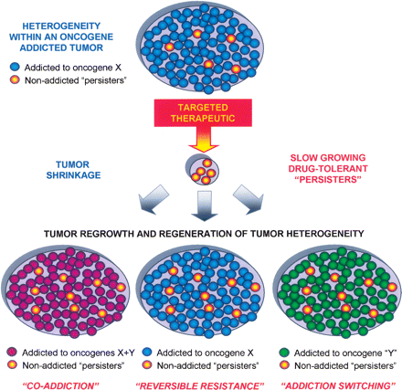
Resistance to therapeutics targeting oncogene addiction: heterogeneity of tumour cells
A tumor is composed of a cell population which is addicted to a specific oncogene, but with a subpopulation of non addicted cancer cells
Upon treatment with a TKIs, tumor shrinkage results from ablation of the addicted cells, but non addicted cells are mantained
These non-addicted cells have the capacity to regenerate

Slide 9
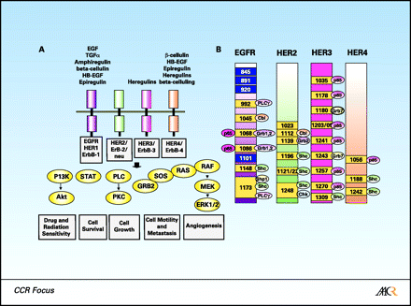
EGFR family pathway
Ono et al., Clin Cancer Res, 2006
Tyrosin kinase receptors
Activation
Omo/dimerization
Amplificaton
Mutation
Cell transformation control
EGFR expression has been reported indifferent neoplasia
Head-neck, gastric, colon,breast,lung cancers…..

Slide 10
Dagogo-Jack and Shaw, 2018

Slide 11
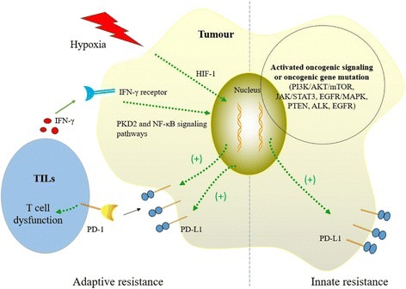
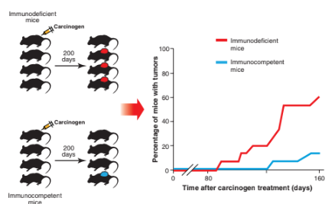
Immunotherapy
The imune system can recognise and interact with tumor

Slide 12
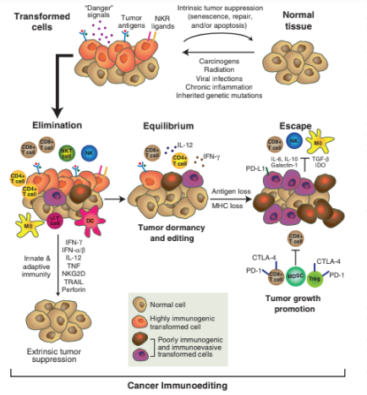

Slide 13
Immunotherapies
MOAb against PD-PDL /CTLA-4
Immunosuppressive mieloid cells
CART-T
Vaccines and tumor neoantigens

Slide 14
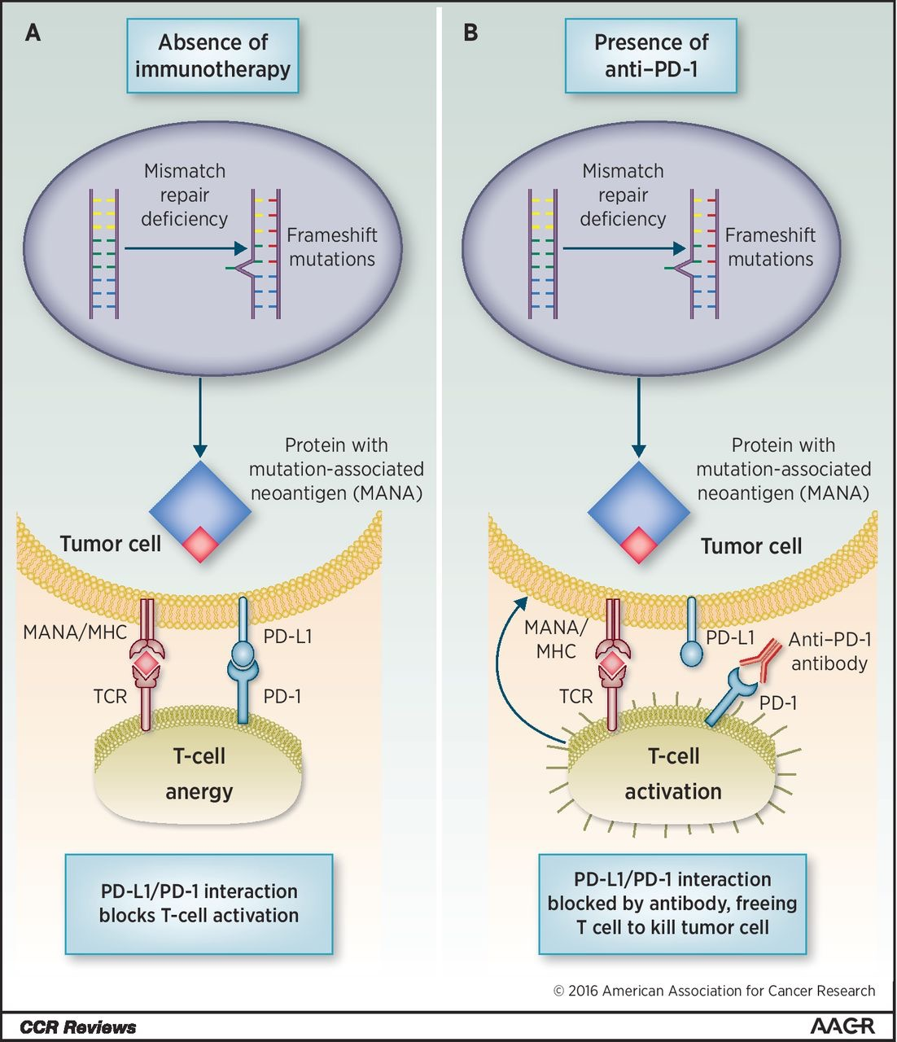
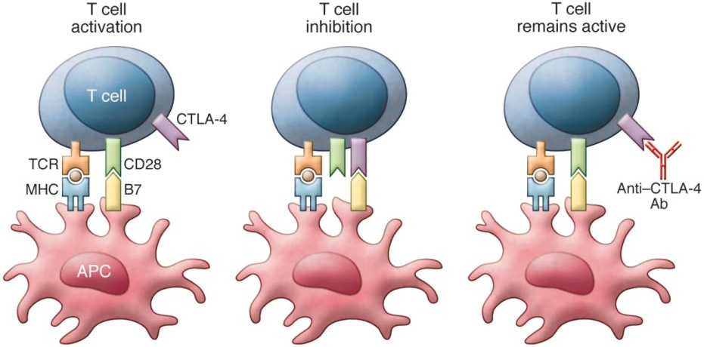
Immune checkpoint blockade therapy
Binding of B7 to CTLA-4 inhibits T cell function. Anti–CTLA-4 antibodies block CTLA-4 binding and prevent inhibition of T cell function.
Buchbinder and Hodi, JCI, 2015
Dudley et al, Clinical Cancer Res, 2016
Inhibitors of these pathways lead to stimulation of activated T-cells and antitumoral immunity

Slide 15
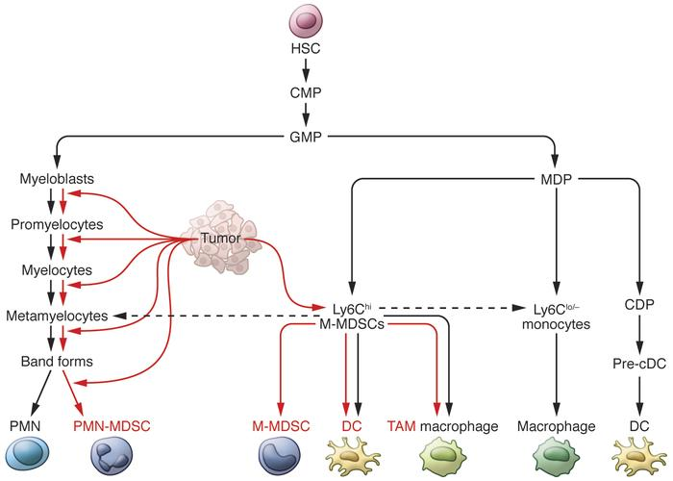
Myeloid derived suppressor cells (MDSCs)
Marvel and Gabrilovich, 2015
Tumor reprograms myeloid cells to create an immunosuoppressive environment
MDSC potential role as prognostic/diagnostic biomarkers and therapeutic targets

Slide 16
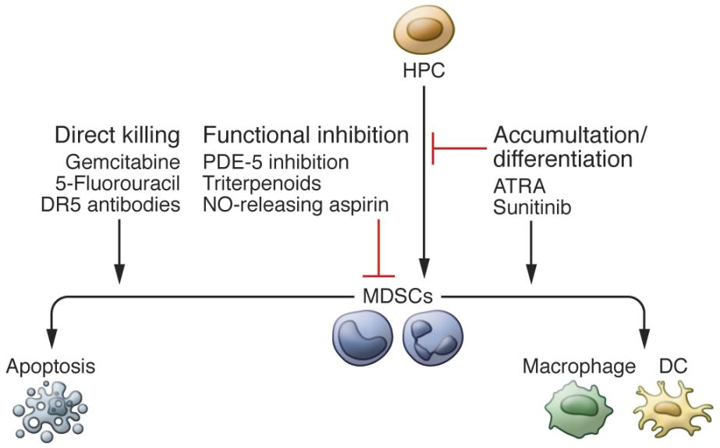
Myeloid derived suppressor cells (MDSCs) targeting

Slide 17
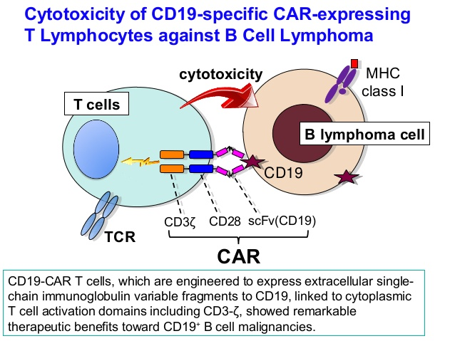
CAR-T cells adoptive immunotherapy

Slide 18
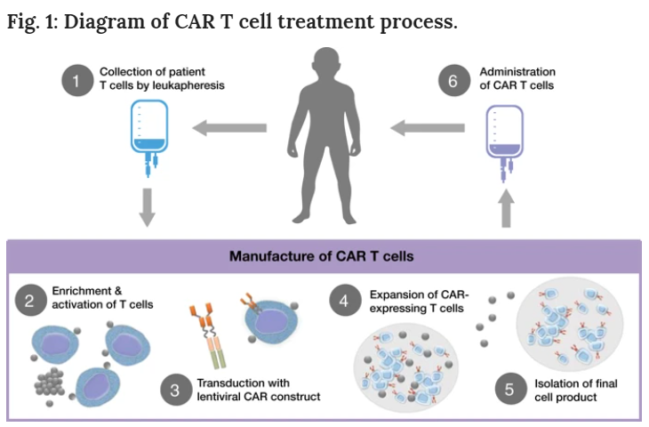
Hucks and Reingold, 2019
Acute and chronic lymphocytic leukemia
Solid tumors?

