Slide 1
2201M21
-
CELLULAR AND MOLECULAR BIOLOGY COURSE
BIOLOGIA CELLULARE E MOLECOLARE
SVB0104 - CANCER GENETICS
LESSON #6
2nd year / 2° Semester
Teacher: Antonella Roetto, PhD
antonella.roetto@unito.it

Slide 2
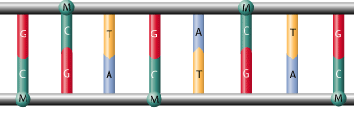
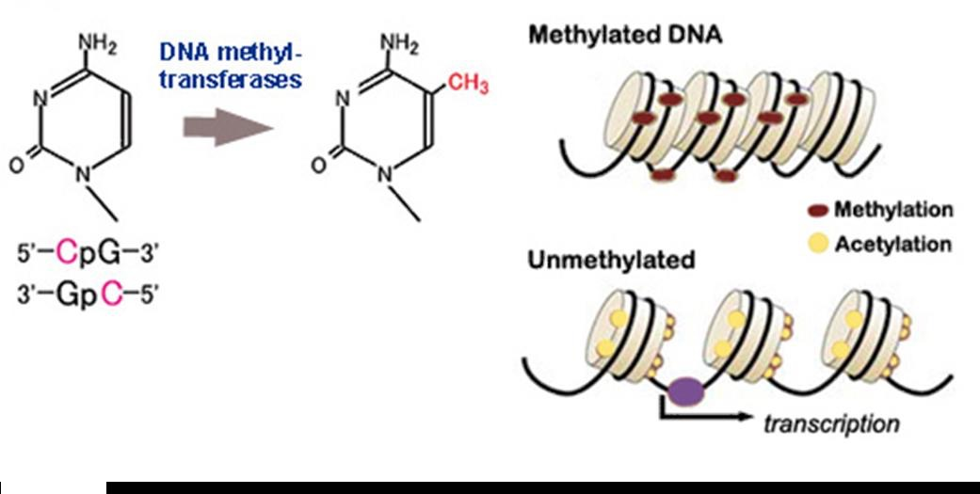
DNA methylation
Methylated bases, notably 5-methylcytosine, are an important feature of vertebrate genome and are related to a general repression of transcription
Methylation = chromatin becomes closed and transcriptionally inactive
Histone acetylation = chromatin becomes open and transcriptionally active

Slide 3
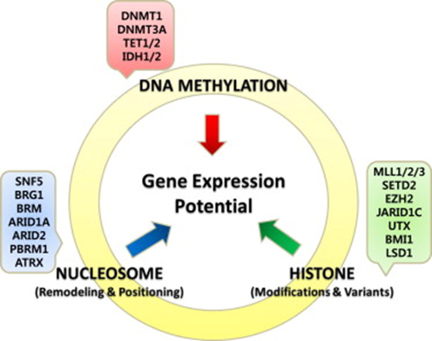
The zygote contains methylated DNA inherited from the contributing sperm and egg cells, but the methyl groups are removed during embryogenesis
Actively transcribed vertebrate genes are marked by CpG islands
Cytosine-methyltransferases are able to recognize CpG sites
CpGs are simmetric; after replication, the new sequences will maintain
the same CpG methylation pattern

Slide 4
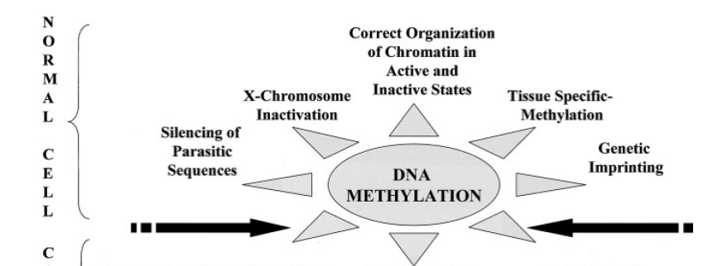
Epigenetic mechanisms are involved in the control of different gene expression patterns that in some cases can be inherited.....
for most of the genes the allelic expression is not inherited …
Non-methylated/methylated CpG islands
few mammalian autosomal genes are unusual since the allelic expression depends on its parental origin, the so-called “imprinted genes”
Methylated CpG islands
one of the female X chromosome is inactivated by methylation
“transposon” sequences are methylated
“repeated” sequences are methylated
J Pathol 2002; 196: 1–7

Slide 5
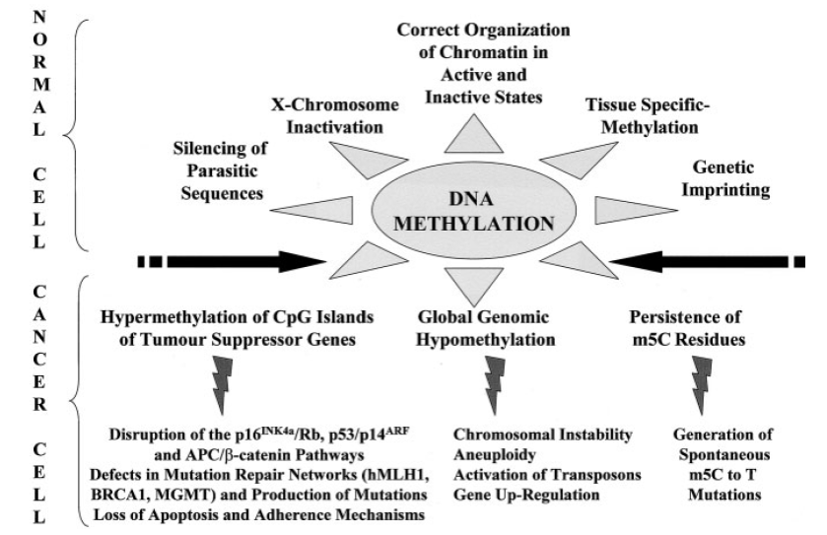
DNA hypo- and hypermethylation in cancer
J Pathol 2002; 196: 1–7

Slide 6
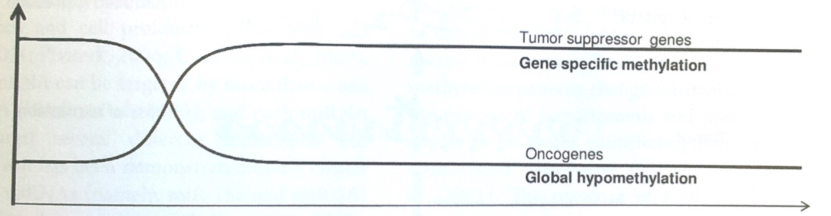
DNA Hypo- and hyper methylation in cancer progression
Met Levels
Tumor progression

Slide 7
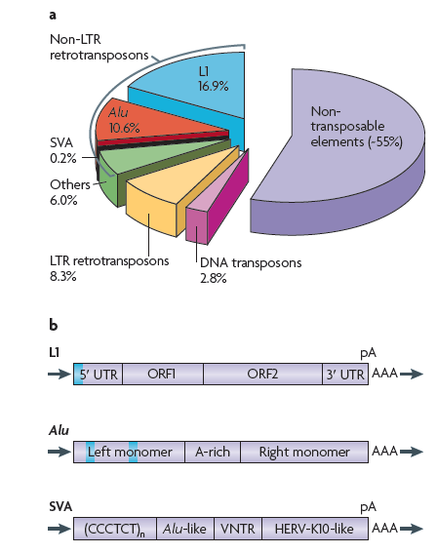
Members of the interspersed families of repeated sequences can be considered as transposable elements
Retrotransposon elements, unstable DNA elements that can migrate to different regions of the genome
Their RNA transcript can be converted into a complementary DNA that can be reinsert back into chromosomal DNA
NATURE REVIEWS | Genetics, 2009

Slide 8
DNA hypomethylation of repeated sequences is associated with retrotransposition activation
Hypomethylation of long interspersed nuclear element-1 (LINE-1) leads to activation of proto-oncogenes in human colorectal cancer metastasis. Hur K
Somatic expression of LINE-1 elements in human tissues Victoria P. Belancio
1988
2008
2010
2014
Unit-length line-1 transcripts in human teratocarcinoma cells.
J Skowronski
Activation and transposition of endogenous retroviral elements in hypomethylation induced tumors in mice. Howard G

Slide 9
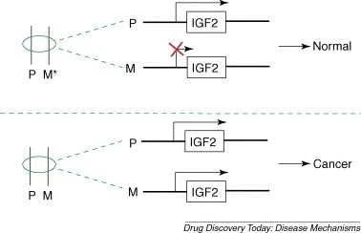
Gene imprinting loss as a cause of cancer
Hypomethylation of maternal allele
Wilms’ Tumour (Nature 1993; 362:747-9)
Colorectal cancer
Prostate cancer
Lung cancer
insulin-like growth factor type 2, IGF2

Slide 10
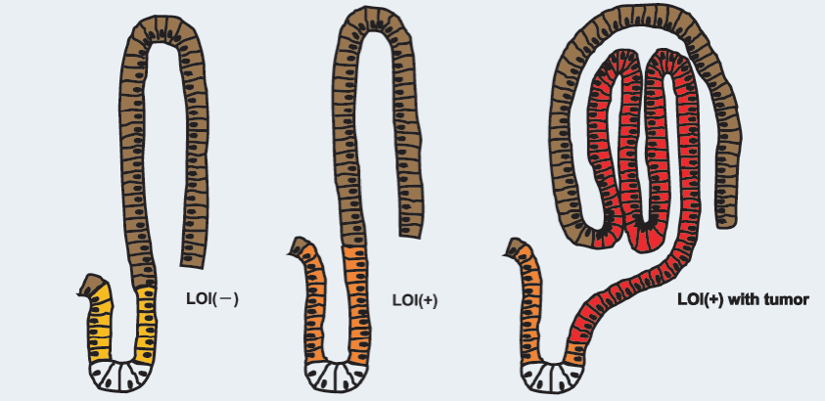
Notes:
Cartoon of the normal intestine: yellow progenitor compartment, brown differentiated compartment, white Paneth cells. Orange epigenetically modified progenitor cells, red adenoma cells

Slide 11
Colorectal cancer
Sporadic cases
(60–80%)
Familial cases (10%–30%)
Rare syndromes
Lynch Syndrome
(HNPCC) (2-5%)
Adenomatous polyposis syndromes (2%)

Slide 12
Colorectal cancer
Three main pathogenetic pathways:
Mutation in DNA mismatch repair genes
DNA microsatellite instability (MSI)
Mutation in APC and other Wnt pathways activating genes
chromosomal instability phenotype (CIN)
Global genome hypermethilation TS gene inactivation
CpG island methylator phenotype (CIMP)
Worthley and Leggett, 2010

Slide 13
DNA hypomethylation and colorectal cancer
1983 Goelz SE et al.
Hypomethylation of DNA from benign and malignant human colon neoplasms
Since the end of ‘80
DNA hypomethylation can be involved in CRC by different mechanisms:
Proto-oncogene activation
Chromosomal Instability
Retrotransposon activation
Gene imprinting loss
Ashktorab and Brim, 2014

Slide 14
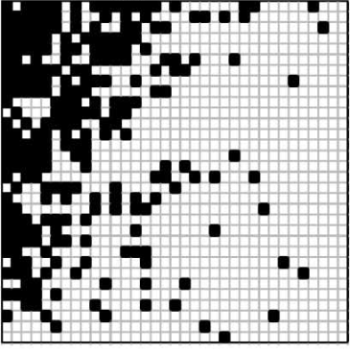
DNA hypermethylation : colorectal cancer and CIMP phenotype
genes
Simultaneous hypermethylation of several tumor-suppressor genes
cases
Mojarad et al , 2013
Notes:
Il grande interesse per lo studio dell’ipermetilazione genica nel CRC è nato in seguito alla scoperta nel 1998 dell’ipermetilazione de novo del gene hMLH1 nei CRC sporadici con MSI. Diversi studi hanno infatti dimostrato in modo chiaro che il pathway mutatore nei CRC sporadici è quasi esclusivamente innescato (in oltre il 90% dei casi) dalla presenza di ipermetilazione del promotore di hMLH1 con conseguente silenziamento genico.

Slide 15
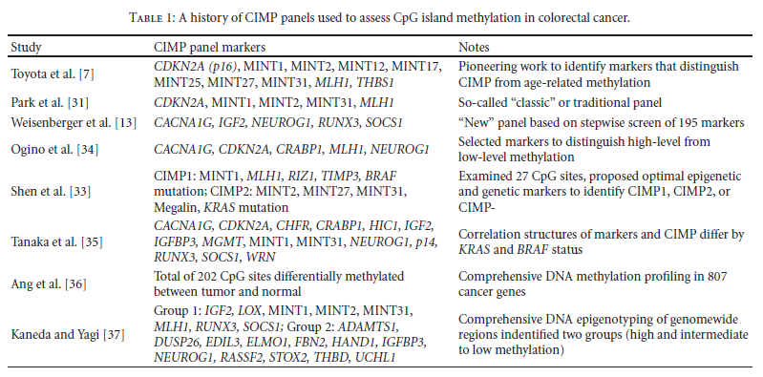
1999
2003
2006
2006
2007
2010
2010
2011

Slide 16
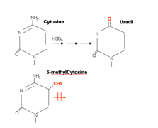
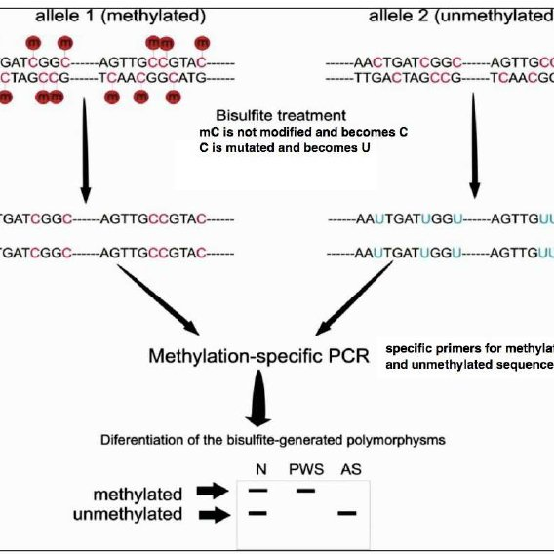
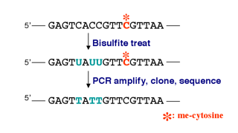
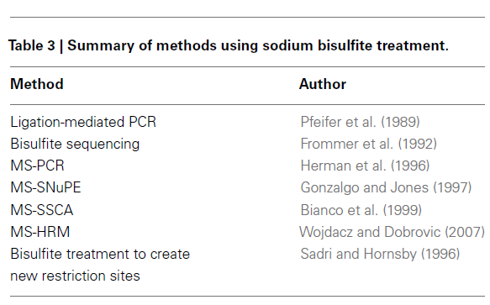
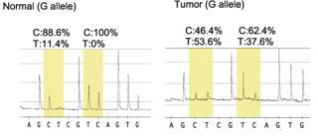
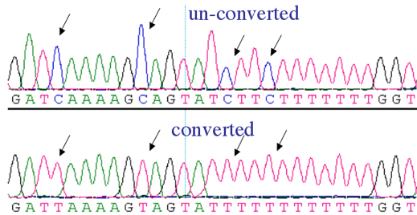
Bisulfite analysis for methylation studies
T1 T2

Slide 17
CRC hereditary syndromes as models of sporadic colorectal tumorigenesis
Familial
adenomatous polyposis
Adenoma-carcinoma sequence
Vogelstein’s model
MUTYH-associated
polyposis
DNA-oxidative pathway
Lynch syndrome or
HNPCC
Hypermutability pathway
Epigenetic germline
alterations ?
Hypermethylation pathway

Slide 18
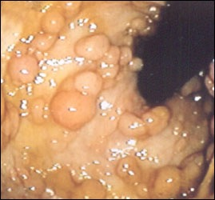
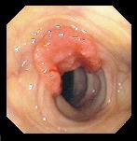
Familial
adenomatous
polyposis
autosomic dominant condition in linkage with mutations on APC tumour-suppressor gene
hundreds-thousands adenomas that confer a higher CRC risk at young age (about 40 aa)
variable phenotype
affected individuals develop:
retinic lesions, desmoids, osteomas
In addition to this “classical polyposis” there is:
Attenuated familial adenomatous polyposis (AFAP)
less < 100 adenomas, polyps and cancer can onset later and the expression of extra-colonic manifestations is limited

Slide 19
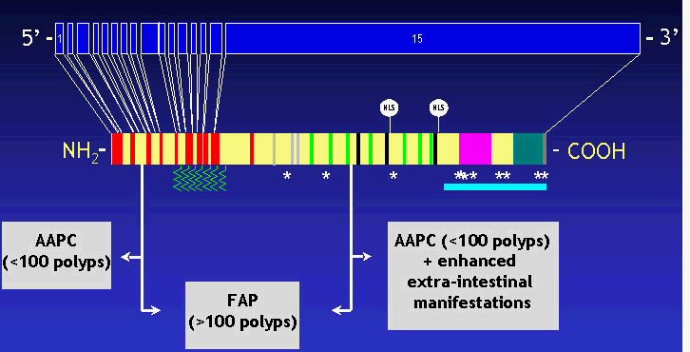
APC is a tumour-suppressor gene
identified with linkage analysis and positional cloning on 5q21
100 Kb, 15 exons, 2843 aa
Familial
adenomatous
polyposis
APC is a highly penetrant gene
Most (95%) of the alterations identified so far lead to a truncated protein
Mutations are identified
- in 70% of classical polyposis patients
in 10% of AFAP patients
there is genotype-phenotype correlation

Slide 20
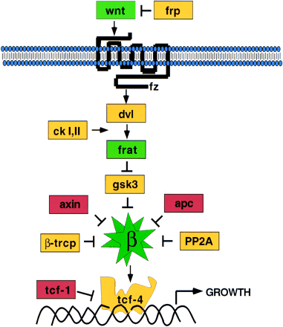
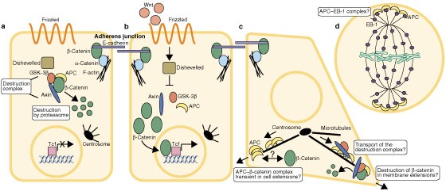
Familial
adenomatous
polyposis
APC is a multifunctional protein taking part to different cellular processes
The main role is to regulate the intracellular ß-catenin level in the Wnt pathway
adhesion
mitosis
apoptosis
migration

Slide 21
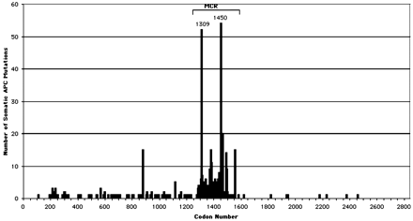
Familial
adenomatous
polyposis
APC role
APC is a tumour-suppressor genes
Most of APC somatic mutations lead to truncating proteins
60% of this mutations onset in the Mutation Cluster Region (MCR) between codons 1286 and 1513 in the binding domain to ß-catenin
Thierry Soussi APC database at hptt://perso.curie.fr.
MCR mutations confer a selective advantage to the transforming cells

Slide 22
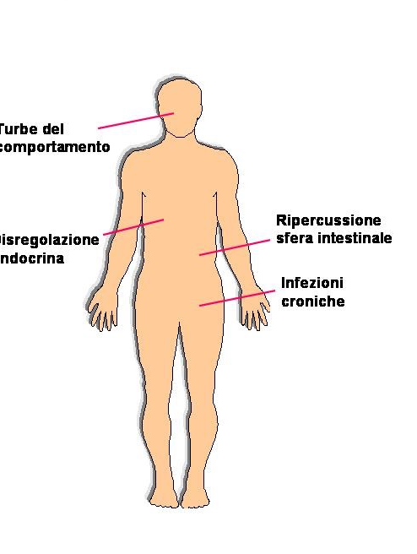
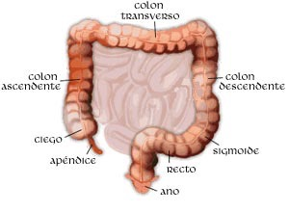
Familial
adenomatous
polyposis
FAP/AFAP:
two “hits” model,
the first constitutive,
the second somatic
TUMORIGENESIS
FIRST STEPS
PROGRESSION NEEDS
THE ACCUMULATION
OF OTHER GENETIC
SOMATIC MUTATIONS

Slide 23
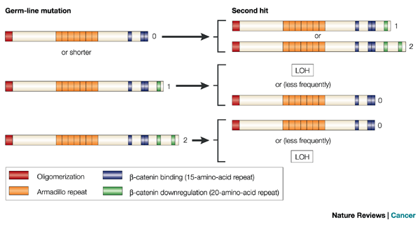
Familial
adenomatous
polyposis
APC is a characteristic tumour-suppressor gene
APC mutations are selected according to their proliferative advantage
This advantage is due to the cytoplasmatic β-catenin level
Two “hits” interdependence
APC gene
Just-right signaling model
Albuquerque et al., 2002

Slide 24
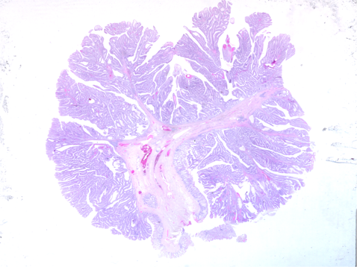
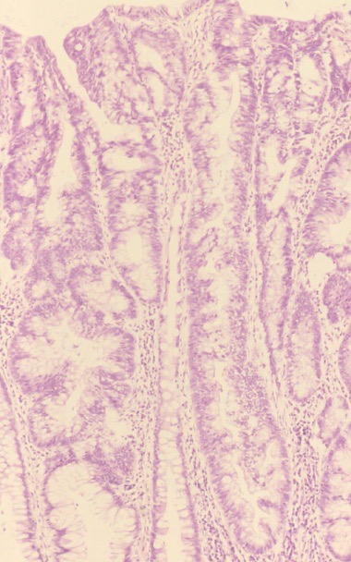
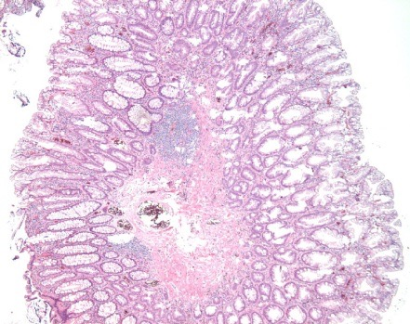
Familial
adenomatous
polyposis
Genotype-phenotype correlation
FAP patients show a considerable variable phenotype
variable number of adenomas
presence of carcinomas
extra-colonic manifestations
variable polyp histotype
Modifier genes ?
“Alternative genes“ to APC in linkage with the syndrome ?
hyperplastic polyps
serrated adenomas

Slide 25
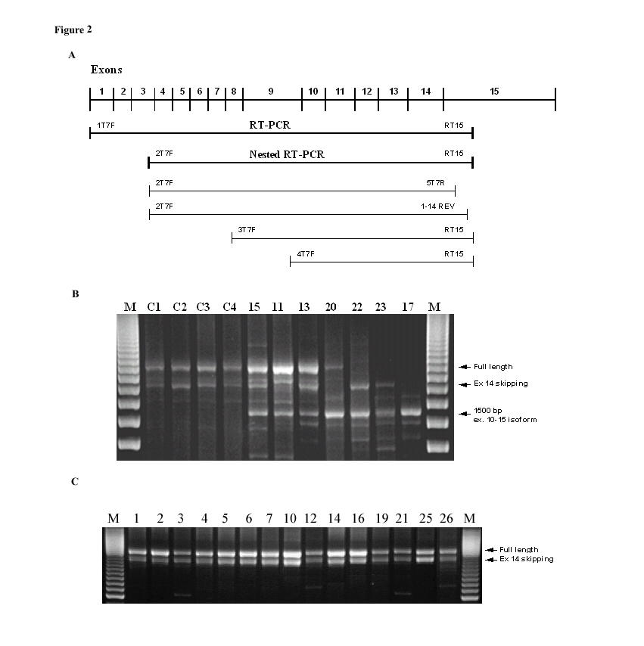
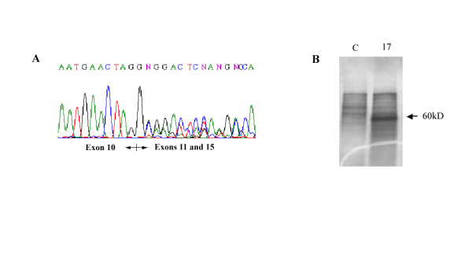
Familial
adenomatous
polyposis
Genotype-phenotype correlation
APC mutation type can play as modifier
Constitutional deletions are associated with a more aggressive phenotype
Venesio et al, Lab Invest 83: 1859-66 (2003)
Alternative splicing/isoforms in the first 14 exons associated with AFAP
Venesio at al, J Mol Med 85: 301-8 (2007)

Slide 26
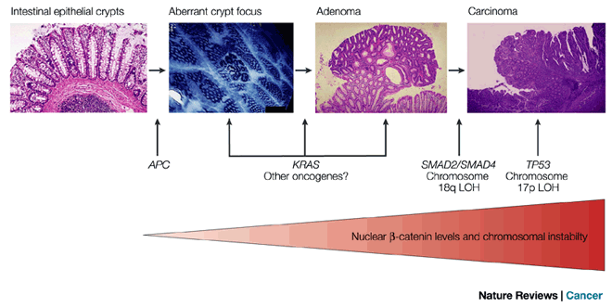
Familial
adenomatous
polyposis
Adenoma-carcinoma sequence
Vogelstein’s model
Histologic progression is related to the acquisition of genetic alterations
Most of sporadic colorectal tumours follow this model
A model also for other type of neoplasia
Tumour is due to alterations involving
4 genes
3 tumour-suppressor
genes and 1 oncogene
APC is the gatekeeper
of the colon

Slide 27
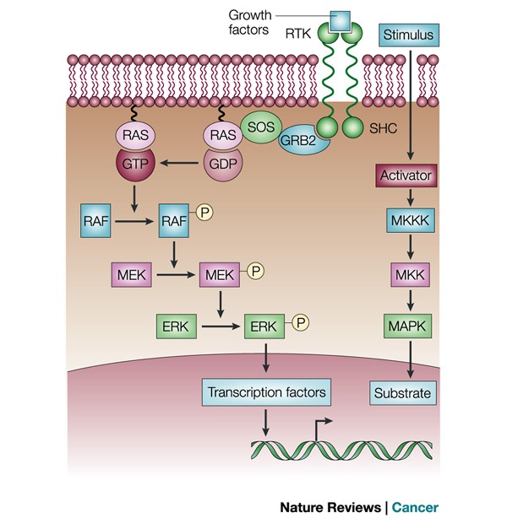
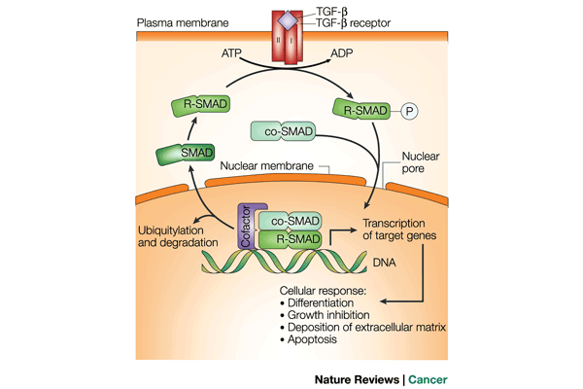
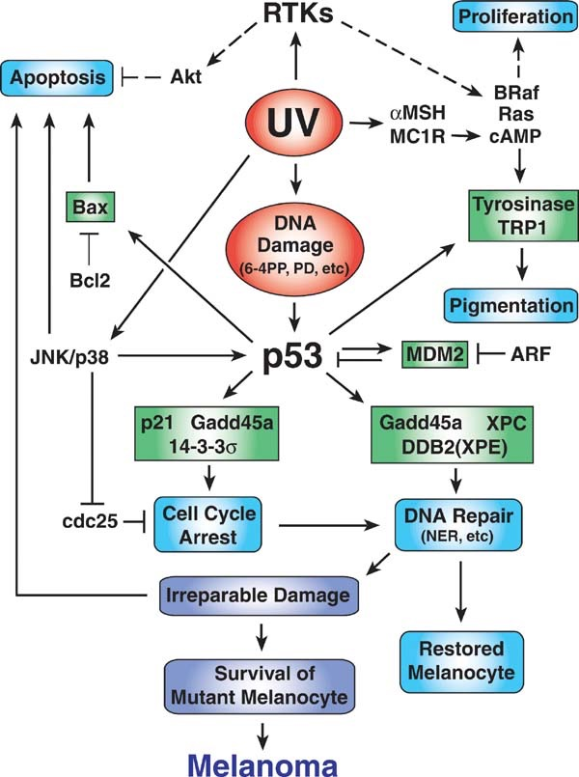
Adenoma-carcinoma sequence
Vogelstein’s model
Involved pathways
Wnt pathway
RAS pathway
TGF-ß pathway
p53 pathway

Slide 28
FAP is the model of
sporadic colorectal
tumorigenesis
In sporadic CRC there is accumulation of mutations
genetic alterations are all somatic and involve a specific tissue

Slide 29
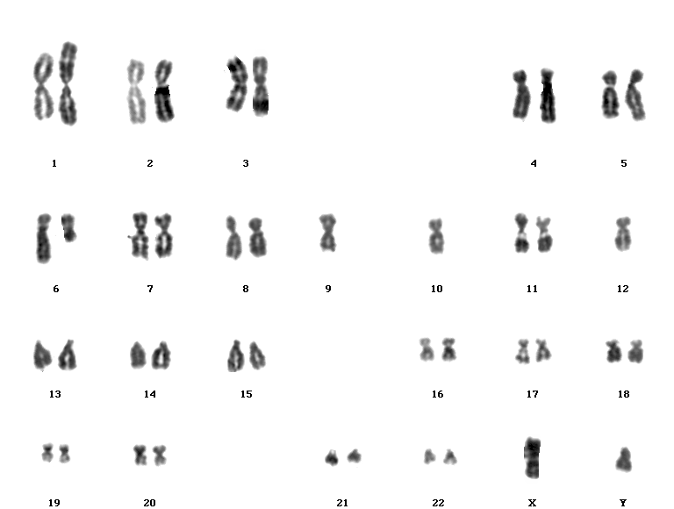
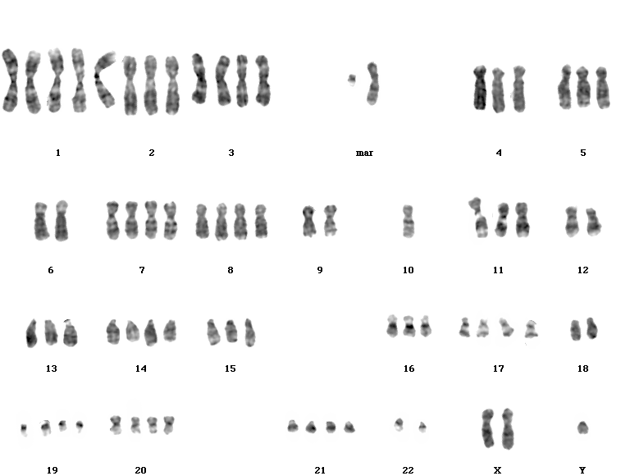
FAP is the model of
sporadic colorectal
tumourigenesis
Adenoma-carcinoma sequence
Vogelstein’s model
CRC following this model show a lot of
chromosomal alterations
Chromosomal instability
CIN
Giaretti et al, J Pathol, 2004

Slide 30
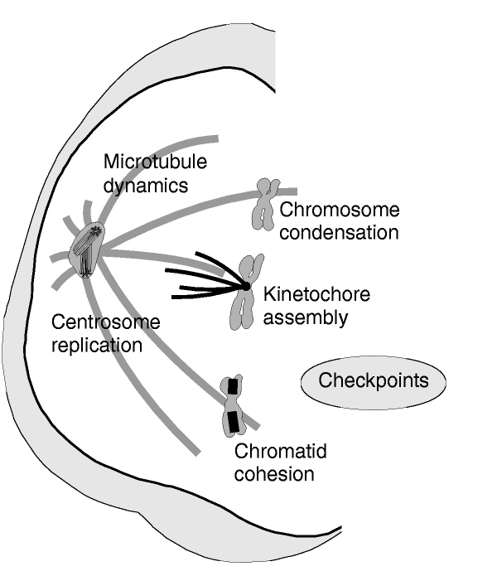
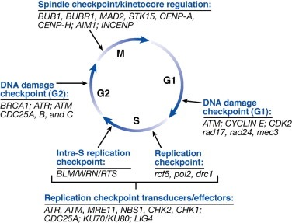
Chromosomal instability (CIN) is a feature of most of the sporadic CRC
What molecular mechanisms?
Qualitative and quantitative chromosomal alterations during mitosis segregation

