Slide 1
BIBLIOGRAPHIC TUTORIAL Dr. Elisa Anedda (elisa.anedda@unito.it)
Lesson 4
Master Cellular and molecular biology A.A. 2019/2020

Slide 2
Registering a paper
Whenever you need a paper that you’ve read, but you don’t remember which one and what were the major results, you can make an archive.
It chould contain brief descriptions of every single paper or book you’ve read, together with a short abstract with authors and journal/book.
The bibliography citation would be faster and easier.
Negative note: it needs a great amount of work!

Slide 3
BIBLIOGRAPHY CREATION
In the next slides you’ll find the most common bibliography tools and after that, an extensive tutorial on how to write the perfect bibliography for your thesis or for a paper.

Slide 4
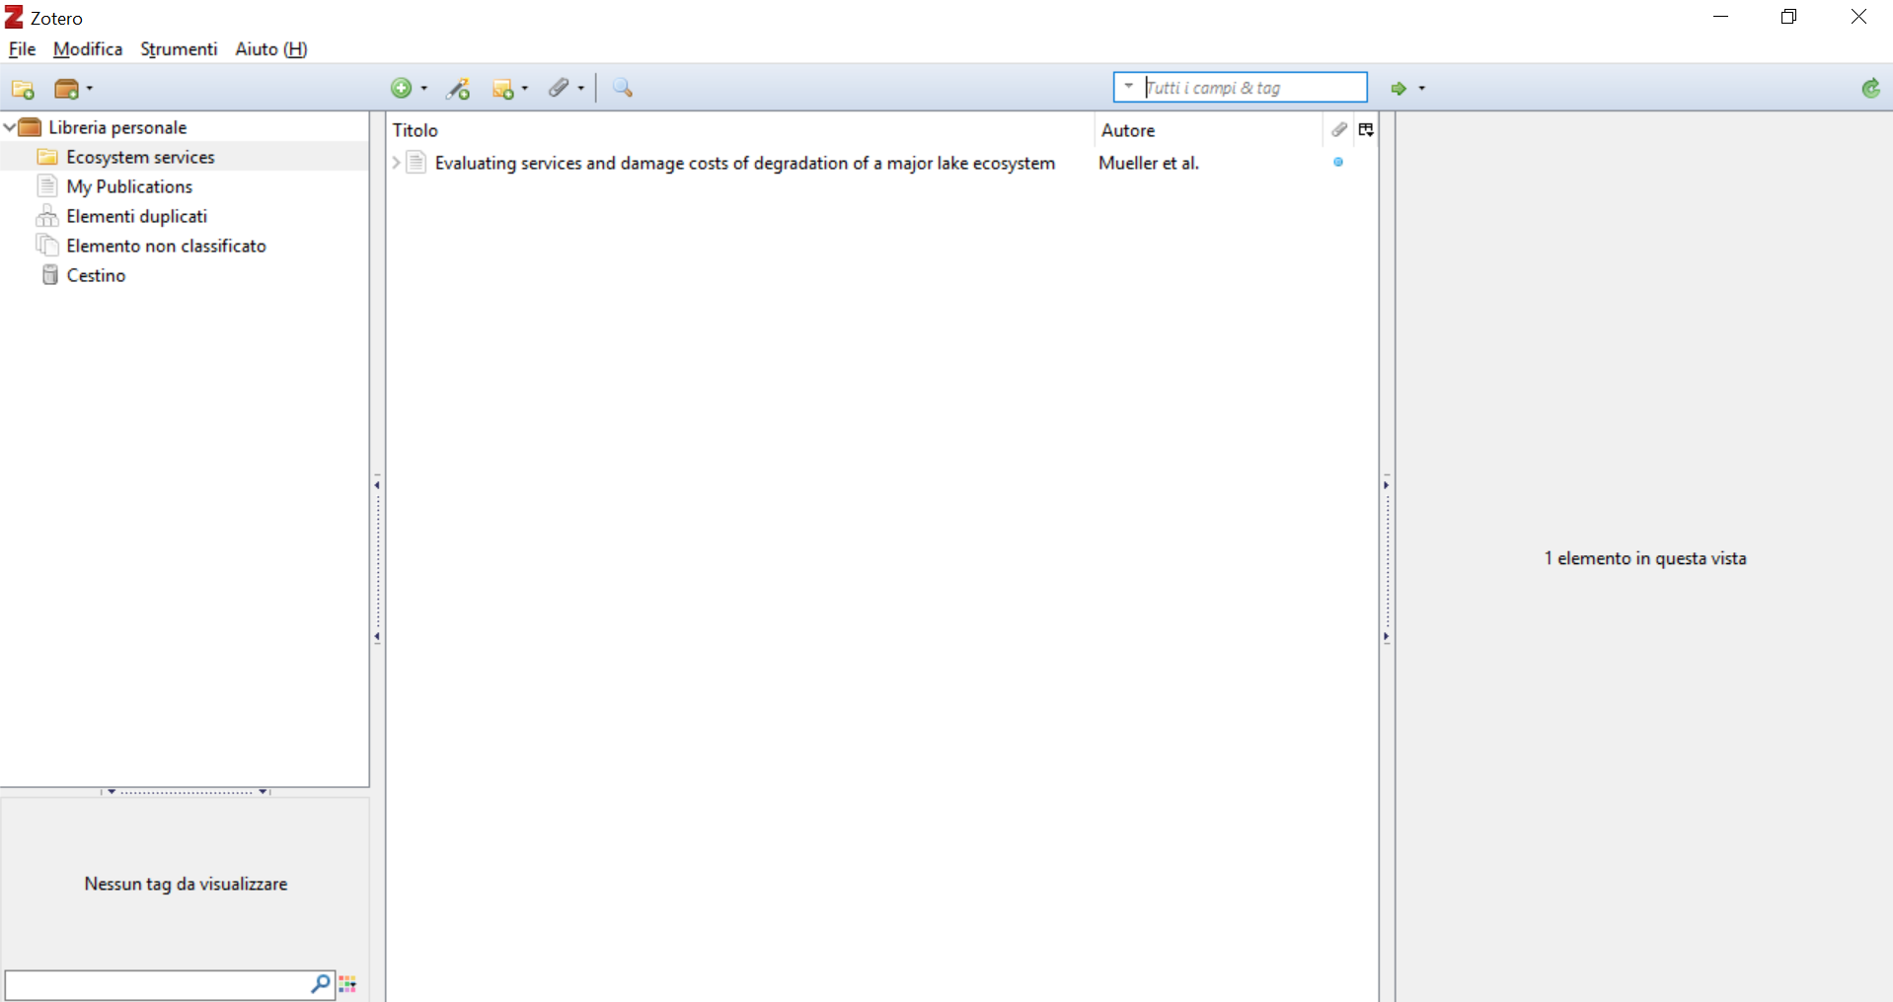
Open-source software
https://www.zotero.org/

Slide 5
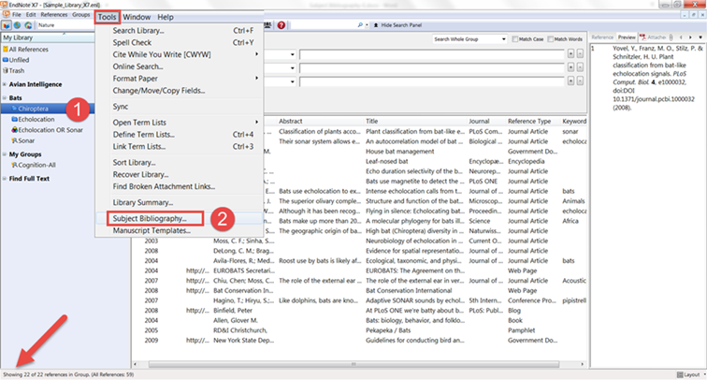
EndNote basic is opensource
EndNote X9 needs a subscription
https://www.endnote.com/

Slide 6
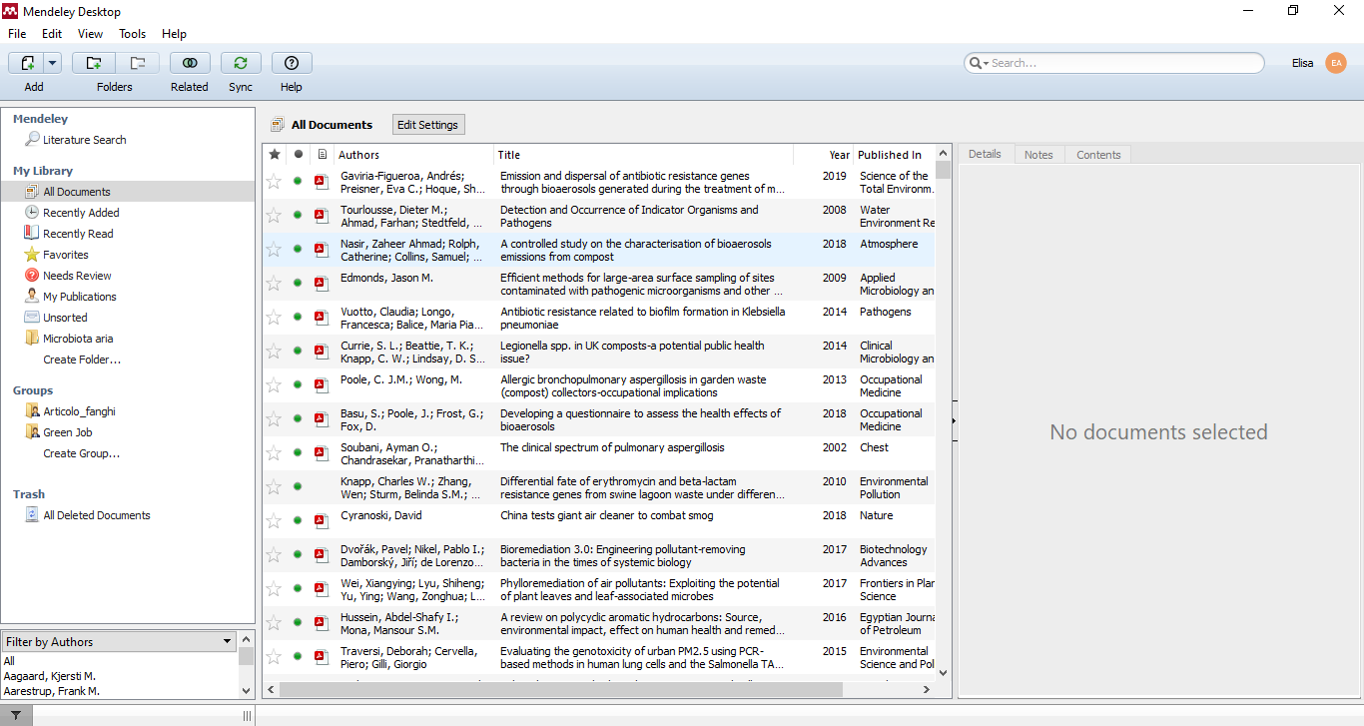
Open-source software
http://www.mendeley.com

Slide 7
Bibliography writing
The bibliography is a list of all the consulted and utilized texts during the bibliography research, identified through bibliographic references.
What to add?
YES
NO
ALL cited texts in thesis or paper and the consulted texts
Do not cite the texts that hasn’t truly been consulted

Slide 8
Bibliography for thesis
Bibliography should be ordered in alphabetical order using the surname of the first author.
First indicate the surname of the author, then the first letter of the name.
If there are more than one paper/book from the same author, those papers/books should be written in chronological order starting from the less recent.
Always better citing the first edition of the consulted text

Slide 9
Bibliography – how to?
If there are more papers from the same author, write them from the older to the most recent and if there are more papers from the same author in the same year, do as follows:
Mbareche, H., Veillette, M., Bilodeau, G.J., Duchaine, C., 2018a. Bioaerosol sampler choice should consider efficiency and ability of samplers to cover microbial diversity. Appl. Environ. Microbiol. 84, 1–22.
Mbareche, H., Veillette, M., Dubuis, M.È., Bakhiyi, B., Marchand, G., Zayed, J., Lavoie, J., Bilodeau, G.J., Duchaine, C., 2018b. Fungal bioaerosols in biomethanization facilities. J. Air Waste Manag. Assoc. 68, 1198–1210.

Slide 10
Bibliography - Papers
Author’s surname and first letter of the name
Year of pubblication
Paper title
Journal name
Magazine number
Consulted pages
DOI (Digital Object Identifier) if available
Example:
Wick, E.C., Sears, C.L., 2010. Bacteroides spp. and diarrhea. Curr. Opin. Infect. Dis. 23, 470–4. doi:10.1097/QCO.0b013e32833da1eb

Slide 11
Bibliography - Books
Author’s surname and first letter of the name
Title and subtitle of the book separeted by a full stop
Pubblication city
Pubblisher
Year of publication
Edition number (if more than one)
Page number and volume number (if more than one)
Traslation if the title is in a foreign language and exists an italian translation. Specify traslator name, italian title, pubblication location, pubblisher, year of pubblication and number of pages (if possible).

Slide 12
Bibliography - Chapters
To cite a book chapter where the chapters are written by different authors you should indicate the chapter author, the editors, followed by Ed. (singular) or Eds. (plural, if more than one
Chapter → specify the title and the number of the chapter
Es. Schmid S. (1997) - The tectonic evolution of the European Alps and foreland. In: B. van der Pluijm & S. Marshak (Eds.), Earth Structure: An Introduction to Structural Geology and Tectonics, pp. 510–524. W.W.Norton & Co.

Slide 13
Bibliography - Conference
Name and Surname of the author, Year, Title of the presented work, location and date of the conference, edited by «name and surname of the editor, pubblication location, publisher, year of publication and pages».
If more than 3 editors, indicate first editor followed by «et al.»
Es. Schiavone E.B., 2000, Il viaggio in Europa nel Siècle des lumières. Da categoria dello spirito a categoria politica, in Atti della giornata interuniversitaria organizzata dall'Università di Siviglia e dall'Università di Roma Tre, Roma Facoltà di scienze politiche, 18 dicembre 2000, a cura di Bruna Consarelli. Padova, Cedam, 2012, pp. 61-76

Slide 14
Bibliography - Others
Webliography
Surname and name of the author, Webpage’s title and subtitle, date of access
OECD, 2018. Wastewater treatment (indicator 2016) [WWW Document]. OECD data. Date accessed: 08/01/2020
Laws and statutes
European Commission, 1991. Council directive of 12 December 1991 concerning the protection of waters against pollution caused by nitrates from agricultural sources, 91/676/EEC, Official Journal of the European Communities.

Slide 15
There are different styles to be adopted, but YOU MUST ALWAYS USE THE SAME STYLE FOR THE SAME THESIS/PAPER.
If I always cite the magazine name in shorten, you always have to cite the magazine name in shorten throughout the bibliography
Bik, E.M., Long, C.D., Armitage, G.C., Loomer, P., Emerson, J., Mongodin, E.F., Nelson, K.E., Gill, S.R., Fraser-Liggett, C.M., Relman, D.A., 2010. Bacterial diversity in the oral cavity of 10 healthy individuals. ISME J. 4, 962–974. doi:10.1038/ismej.2010.30
Yoo, K., Lee, T.K., Choi, E.J., Yang, J., Shukla, S.K., Hwang, S. il, Park, J., 2017. Molecular approaches for the detection and monitoring of microbial communities in bioaerosols: A review. J. Environ. Sci. (China) 51, 234–247. doi:10.1016/j.jes.2016.07.002

Slide 16
Research material
https://www2.le.ac.uk/offices/ld/resources/writing/writing-resources/ref-bib
https://hoavouu.com/images/file/4WSwgmAx0QgQAAZh/the-research-project-how-to-write-it-by-ralph-berry.pdf
https://intranet.birmingham.ac.uk/as/libraryservices/library/referencing/icite/harvard/referencelist.aspx

Slide 17
Presentation
Always use tables and figures, they help your speech flow
Always cite the references of images and data
DO NOT write too much, simple slides
DO NOT read the slides, they’re just a guide

Slide 18
Research material
https://www.birmingham.ac.uk/schools/metallurgy-materials/about/cases/tips-advice/presentation.aspx
For Italian students:
http://dse.univr.it/reno/files/consigli_tesi.pdf

