Slide 1
2201M21
-
CELLULAR AND MOLECULAR BIOLOGY COURSE
BIOLOGIA CELLULARE E MOLECOLARE
SVB0104 - CANCER GENETICS
LESSON #2a
2nd year / 2° Semester
Teacher: Antonella Roetto, PhD
antonella.roetto@unito.it

Slide 2
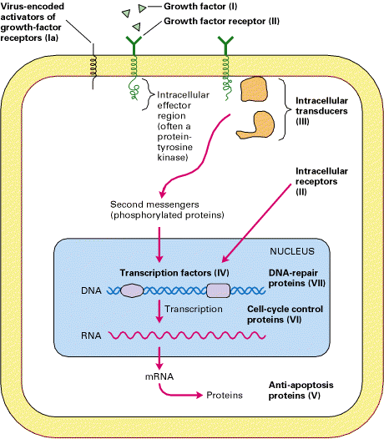
ONCOGENES
Oncogenes code for
Growth factor receptors
Transduction proteins
Transcription factors
Anti-apoptotic proteins
Cell-cycle proteins
DNA repair proteins

Slide 3
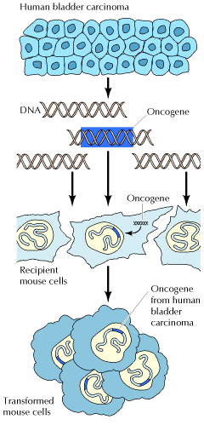
Genes promoting cell proliferation
The mutant versions are excessively or inappropriately active
Identified >100 oncogenes in human genome
Oncogenes were identified by gene transfer
DNA extracted from a human bladder carcinoma induced transformation of recipient mouse cells in culture.
Transformation resulted from integration and expression of an oncogene derived from the human tumor.

Slide 4
MECHANISMS OF ONCOGENIC ACTIVATION
Missense mutations
2. Chromosomal rearrangements- translocations
3. Amplification
4. Insertional mutations (“jumping” genes such as LINE1 or ALU sequence etc)

Slide 5
REPRESENTATIVE ONCOGENES OF HUMAN TUMORS
Oncogene | Type of cancer |  | Activation mechanism
ABL |  | Chronic myelogenous leukemia, acute lymphocytic leukemia | Translocation
AKT |  | Ovarian and pancreatic carcinomas | Amplification
BCL-2 |  | Follicular B-cell lymphoma | Translocation
E2A/pbx1 |  | Acute lymphocytic leukemia | Translocation
HER2 |  | Breast and ovarian carcinomas | Amplification
GIP |  | Adrenal cortical and ovarian carcinomas | Point mutation
GLI |  | Glioblastoma | Amplification
GSP |  | Pituitary and thyroid tumors | Point mutation
HOX-11 |  | Acute T-cell leukemia | Translocation
LYL |  | Acute T-cell leukemia | Translocation

Slide 6
Oncogene | Type of cancer |  | Activation mechanism
C-MYC |  | Burkitt's lymphoma | Translocation
 |  | Breast and lung carcinomas | Amplification
L-MYC |  | Lung carcinoma | Amplification
N-MYC |  | Neuroblastoma, lung carcinoma | Amplification
PDGFR |  | Chronic myelomonocytic leukemia | Translocation
PML/RARa |  | Acute promyelocytic leukemia | Translocation
RAS-H |  | Thyroid carcinoma | Point mutation
RAS-K |  | Colon, lung, pancreatic, and thyroid carcinomas | Point mutation
RAS-N |  | Acute myelogenous and lymphocytic leukemias, thyroid carcinoma | Point mutation
RET |  | Multiple endocrine neoplasia types 2A and 2B | Point mutation
 |  | Thyroid carcinoma | DNA rearrangement
SMO |  | Basal cell carcinoma | Point mutation

Slide 7
MISSENSE MUTATIONS
Amino acid substitutions in RAS family proteins
amino acid position
RAS gene 12 59 61
c-RAS (H, K, N) Gly Ala Gln normal cells
cancer cells
H-RAS Gly Ala Leu lung carcinoma
Val Ala Gln bladder carcinoma
K-RAS Cys Ala Gln lung carcinoma
Val Ala Gln lung carcinoma
Arg Ala Gln colon carcinoma
N-RAS Gly Ala Lys neuroblastoma
Gly Ala Arg lung carcinoma
Murine sarcoma virus
H-RAS Arg Thr Gln Harvey strain
K-RAS Ser Thr Gln Kirsten strain

Slide 8
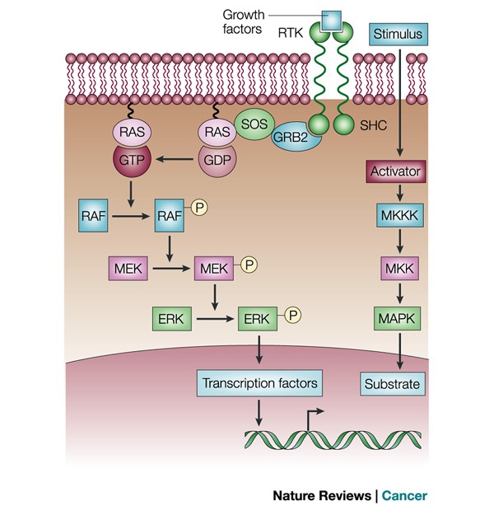
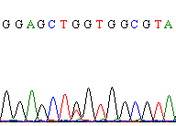
ERK/MAPK signal transduction pathway
KRAS mutations
Codon 12 G >T

Slide 9
2. CHROMOSOMAL TRANSLOCATIONS
Neoplasm Translocation Oncogene
Chronic myelogenous t(9;22) 90-95% of cases BCR-ABL¹
leukemia
Acute lymphocytic t(9;22) 10-15% of cases BCR-ABL¹
leukemia
Burkitt lymphoma t(8;14) 80% of cases c-MYC²
t(8;22) 15% of cases
t(2;8) 5% of cases
¹ BCR-ABL fusion protein is produced, which results in a constitutively active abl kinase
² c-MYC is translocated to the IgG locus, which results in its activated expression

Slide 10
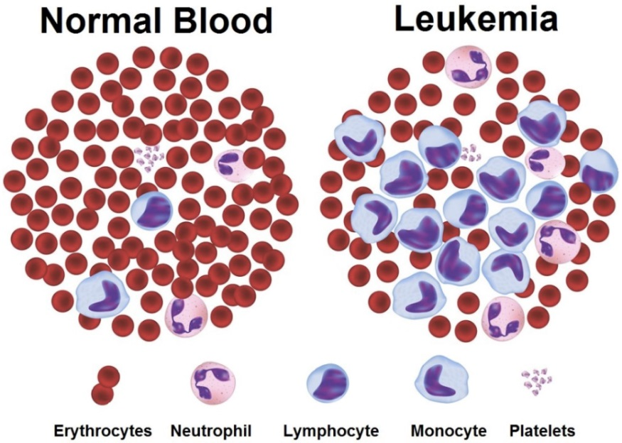
CHRONIC MYELOID LEUKEMIA
Peripheral blood smear

Slide 12
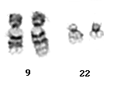
t(9;22)(q34;q11)
Ph
22
9
der(9)

Slide 13
Chronic myeloid leukemia (CML)
Philadelphia chromosome (small 22)
bcr-abl fusion protein is produced,
which results in a constitutively active abl kinase
bcr
bcr-abl
abl

Slide 14
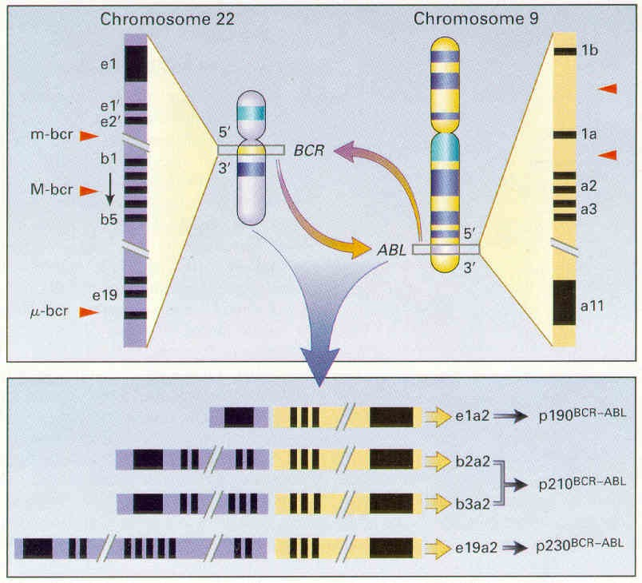
t(9;22)(q34;q11)
The ABL1 proto-oncogene encodes a cytoplasmic and nuclear protein tyrosine kinase that has been implicated in processes of cell differentiation, cell division, cell adhesion, and stress response. When it is translocated from chromosome 9 to chromosome 22 it become activated

Slide 15
Mechanisms responsible for t(9;22)
Random process
Hot spots particularly susceptible to DNA damage (fragile site : specific loci that exhibit gaps and breaks on metaphase chromosomes with partial inhibition of DNA synthesis)
Topographic arrangement of chromosomes 9 and 22 in the nucleus
Duplicated genomic sequences close to the BCR and ABL genes

Slide 16
BURKITT’S LYMPHOMA
Aggressive lymphoma
Endemic form in malarian regions (Equatorial Africa). Children 4-7 y are frequently affected.
Sporadic form (1-2% of all lymphomas)
Frequently associated with immunodeficiency (eg. HIV)
Associated with EBV infection

Slide 17
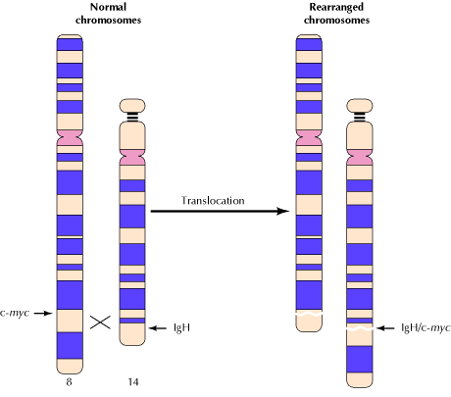
BURKITT LYMPHOMA (B cells)
TRANSLOCATION OF C-MYC
The c-MYC proto-oncogene is translocated from chromosome 8 to the immunoglobulin heavy-chain locus (IgH) on chromosome 14, resulting in abnormal c-myc expression.
c-MYC is translocated to the IgG locus,
which results in its activated expression
c-myc
IgG enhancer
IgG
In B lymphocytes
c-myc is activated by
the IgG enhancer

Slide 18
MYC/IGH
Endemic BL
Cen.
Tel.
MYC 5’
3’
>100 Kb
1
2
3
IGH
3’
5’
switch
Costant joining diversity variable
Increased expression of c-myc in B-lymphocytes
Proliferation is induced, even in the absence of growth factors.

Slide 19
MYC/IGH
Sporadic BL
Cen.
Tel.
MYC 5’
3’
1
2
3
IGH
3’
5’
switch
Costant joining diversity variable
t(8;14) 3’
5’
Costant 1 2 3
Boxer and Dang, 2001

Slide 20
3. GENE AMPLIFICATION
Very frequent event in oncogenes (1000x)
hyperexpression = proliferative selective advantage
Oncogene Amplification Source of tumor
MYC ~20-fold leukemia /lung carcinoma
MYC 5-1,000-fold neuroblastoma
MYC 10-20-fold small-cell lung cancer
ABL ~5-fold chronic myeloid leukemia
HER2 ~30-fold breast cancer
K-RAS 4-20-fold colon carcinoma
30-60-fold adrenocortical carcinoma

Slide 21
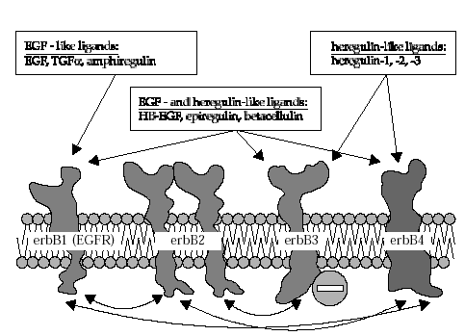
Epidermal Growth Factor Receptor (EGFR)
EGF-like ligands:
EGF, TGFα, amphiregulin,
beta-cellulin, ephrin
Heregulin-like ligands
heregulin-1,-2,-3, neuregulin
EGF-and Heregulin-like ligand
heparin-binding-EGF, epiregulin,
betacellulin
HER1- EGFR
HER2
HER3
HER4

Slide 22
HER-2 gene in Breast Cancer Dual Color FISH

