Slide 1
2201M21
-
CELLULAR AND MOLECULAR BIOLOGY COURSE
BIOLOGIA CELLULARE E MOLECOLARE
SVB0104 - CANCER GENETICS
LESSON #3
2nd year / 2° Semester
Teacher: Antonella Roetto, PhD
antonella.roetto@unito.it

Slide 2
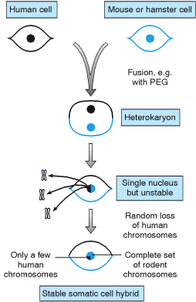
TUMOR SUPPRESSOR GENES
Cell fusion experiments showed that the transformed phenotype could be corrected in vitro by fusion of the transformed cell with normal cell (Stanbridge, 1982)
This provided evidences that tumorigenesis involves not only activated oncogenes but also loss of functions mutations in other genes
Tumor suppressor genes (TS) can have a variety of functions.
Their products mainly inhibit cell proliferation
Both alleles of a TS gene must be inactivated to change the behaviour of the cells

Slide 3
Tumor Suppressor Genes and Associated Protein Function
Gene | Associated inherited cancer syndrome | Cancers with somatic mutations | Presumed function of protein
RB1 | Familial retinoblastoma | Retinoblastoma, osteosarcoma, SCLC, breast, prostate, bladder, pancreas, esophageal, others | Transcriptional regulator; E2F binding
TP53 | Li-Fraumeni syndrome | Approximately50% of all cancers (rare in some types, such as prostate carcinoma and neuroblastoma) | Transcription factor; regulates cell cycle and apoptosis
p16 | Familial melanoma, Familial pancreatic carcinoma | Approximately 25-30% of many different cancer types (eg, breast, lung, pancreatic, bladder) | Cyclin-dependent kinase inhibitor (ie, Cdk4 and Cdk6)
p19 ^{ARF} | Familial melanoma | Approximately 15% of many different cancer types | Regulates Mdm-2 protein stability and hence p53 stability; alternative reading frame of p16/INK4a gene
APC | Familial adenomatous polyposis coli (FAP), Gardner syndrome, | Colorectal, desmoid tumors, thyroid cancers, stomach cancers | Regulates levels of β-catenin protein in the cytosol; binding to microtubules
BRCA1 | Inherited breast and ovarian cancer | Ovarian (~10%), rare in breast cancer | DNA repair; complexes with Rad 51 and BRCA2; transcriptional regulation
BRCA2 | Inherited breast (both female andmale), pancreatic cancer, ?others? | Rare mutations in pancreatic, ?others/ | DNA repair; complexes with Rad 51 and BRCA1
WT-1 | WAGR, Denys-Drash Syndrome | Wilms' tumor | Transcription factor

Slide 4
Table 7-1. Selected Tumor Suppressor Genes and Associated Protein Function
NF-1 | Neurofibromatosis type 1 | Melanoma, neuroblastoma | p21ras-GTPase
NF-2 | Neurofibromatosis type 2 | Schwannoma, meningioma, ependymoma | Juxtamembrane link to cytoskeleton
VHL | von-Hippel Lindau syndrome | Renal (clear cell type), hemangioblastoma | Regulator of protein stability
MEN-1 | Multiple endocrine neoplasia type 1 Endocrine tumors of the pancreas | Parathyroid adenoma, pituitary adenoma, enocrine tumors of the pancreas | Not known
PTCH | Gorlin syndrome, hereditary basal cell carcinoma syndrome | Basal cell skin carcinoma, medulloblastoma | Transmembrane receptor for sonic hedgehog factor; negative regulator of smoothened protein
PTEN/MMAC1 | Cowden syndrome; sporadic cases of juvenile polyposis syndrome | Glioma, breast, prostate, follicular thyroid carcinoma, head and neck squamous carcinoma | Phosphoinositide 3-phosphatase; protein tyrosine phosphatase
DPC4 | Familial juvenile polyposis syndrome | Pancreatic(~50%), approximately 10–15% of colorectal cancers, rare in others | Transcriptional factor in TGF-β signaling pathway
E-CAD | Familial diffuse-type gastric cancer; lobular breast cancer | Gastric (diffuse type), lobular breast carcinoma, rare in other types (eg, ovarian) | Cell-cell adhesion molecule
LKB1/STK1 | Peutz-Jeghers syndrome | Rare in colorectal, not known in others | Serine/threonine protein kinase
SNF5/INI1 | Rhabdoid predisposition syndrome renal or extra-renal malignant rhabdoid tumors), choroid plexus carcinoma medulloblastoma; central primitive neuroectodermal tumors) | Rare in rhabdoid tumors, choroid plexus carcinoma, medulloblastoma | Member of the SWI/SNF chromatin ATP-dependent remodeling complex
EXT1 / EXT2 | Hereditary multiple exostoses | Not known | Glycosyltransferase; heparan sulfate chain elongation
TSC1 / TSC2 | Tuberous sclerosis | Not known | Not known; cytoplasmic vesicle localization
MSH2, MLH1 PMS1, PMS2, MSH6 | Hereditary non-polyposis colorectal cancer | Colorectal, gastric, endometrial | DNA mismatch repair

Slide 5
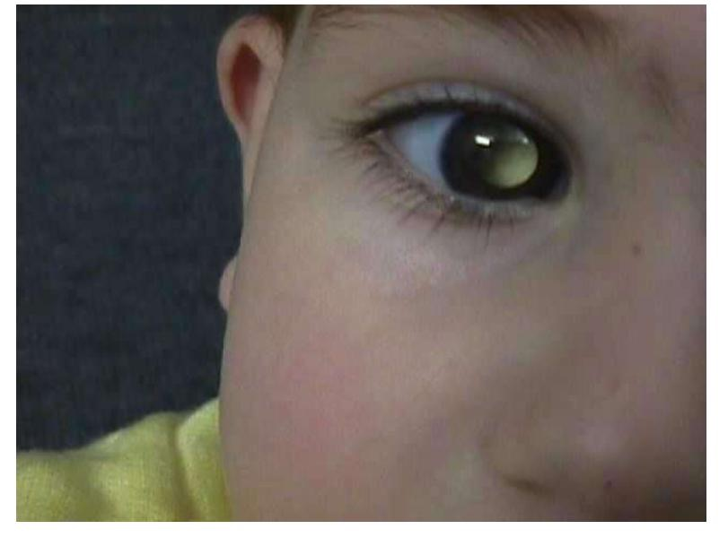
TUMOR SUPPRESSOR GENES
Knudson and the Retinoblastoma model
Retinoblastoma is a rare , aggressive childhood tumour of the retinal cells
60% of the cases are unilateral and onset by 30 months age
40% of the cases are bilateral and onset by 14 months and these children can develop other tumors during their lives (generally osteosarcoma)

Slide 6
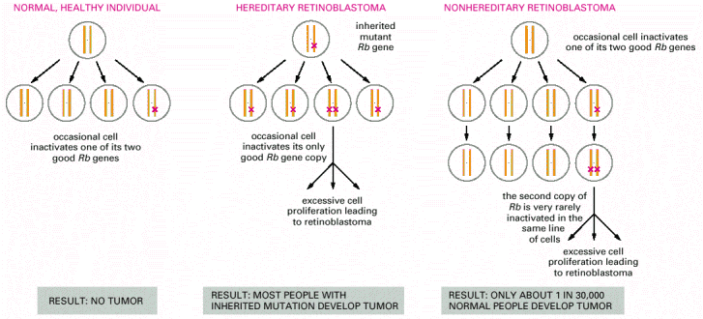
Knudson’s two «hits» hypothesis
Knudson suggested that two successive and independent alterations were necessary to turn a normal cell into a tumor cell
In RB bilateral form the first alteration is inherited whereas the second is acquired after birth (inherited form)
In RB unilateral form the alterations are both acquired by the cells after birth (sporadic form)

Slide 7
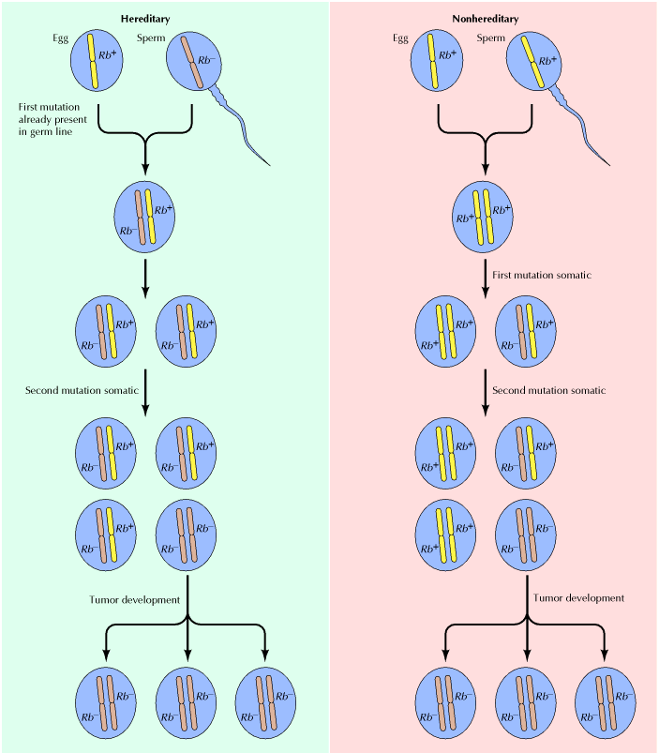
Hereditary retinoblastoma:
- a defective copy of the Rb gene (Rb⁻) is inherited from the affected parent
- a second somatic mutation, which inactivates the single normal Rb+ copy in a retinal cell, then leads to the development of retinoblastoma.
Non hereditary retinoblastoma: -
- two normal Rb+ genes are inherited, and retinoblastoma develops only if two somatic mutations inactivate both copies of Rb in the same cell
Autosomic dominant

Slide 8
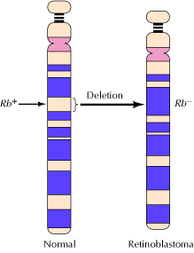
Investigations in Retinoblastoma families allowed to localize the gene on chromosome 13q14
Linkage analysis by using polymorphic markers mapping on chromosome 13q14
5-10% showed constitutional deletions involving part or the entire 13q14 band including RB1 locus
Cavenee and colleagues compared blood and tumour samples from the same patients: tumours cells were apparently homozygous for some markers because they have acquired a somatic deletion (the second hit)
Cavenee et al., 1983 proved Knudson’s hypothesis and established a paradigm for all the investigations on TSs

Slide 9
Retinoblastoma (OMIM 180200) is a model of human hereditary tumours
Susceptibility is in linkage with mutant allele (missense mutations, deletions etc) at high penetrance (80-90%)
So far identified 930 type of germline alterations

Slide 10
Inactivation of a tumor-suppressor genes
Both the alleles loss their function
Mechanisms: mutations, deletions, methylation
Loss of heterozygosity (LOH)
Loss of function of one allele of the gene when the other has been already inactivated by mutation/deletion/methylation
Heterozygosity is lost for the onset of a second mutation,deletion or methylation
Molecular analysis:
cytogenetics
DNA polymorphisms

Slide 11
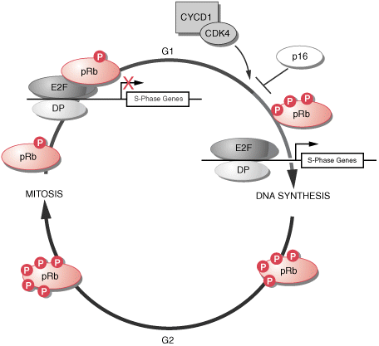
Rb
Nuclear phosphoprotein 105 kDa = p105Rb / pRb
The RB family: p105, p107, p130
Homologies among the RB family proteins.
Blue boxes, homologous regions among the three proteins
pRb is hypophosphorylated in G1
Suppression of transcription
Phosphorylation decreases in mitosis
Phosphorylation increases in S phase
Gene transcription is allowed

Slide 12
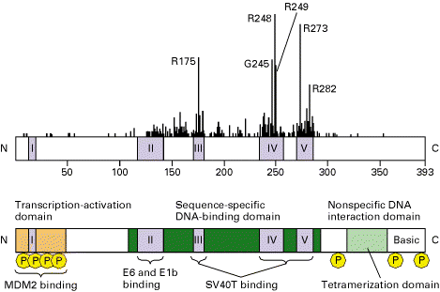
p53
somatic mutations very common in different types of human tumours
germline mutations associated with Li-Fraumeni syndrome
p53 is a transcription factor involved in DNA repair
it stops cell-cycle to repair DNA

Slide 13
The role of p53 in the cell cycle
“Guardian of the genome”
apoptosis (cell death)
DNA synthesis
UV irradiation leads
to cell cycle arrest
p53
S
phase
G0
G1
phase
quiescent cells
G2
phase
M
growth and
preparation for
cell division
phase
mitosis

Slide 14
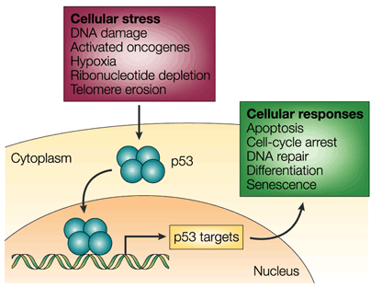
THE p53-MEDIATED RESPONSE
In non-stressed cells p53 exists at a very low concentration
Under stress conditions, the p53 protein accumulates in the cell
Binds in its tetrameric form to p53-response elements
Induces the transcription of genes involved in cell-cycle control, apoptosis, DNA repair, differentiation and senescence
The loss of p53 tumour-suppressor activity by mutation/deletion or inhibition allows the proliferation of the damaged cells under the stress conditions.
This uncontrolled proliferation can lead to tumour development.
Chène, Nat Rev Cancer 3: 102 (2003)

Slide 15
Li-Fraumeni syndrome
It is a very rare syndrome described by Li and Fraumeni (1969)
Families with frequent early onset sarcomas and osteosarcomas, breast cancers, brain tumours, and leukemias (SBLA)
In 1990 p53 germline mutations were associated with this syndrome
Transmission is autosomic dominant
KO Mice for p53 show Li-Fraumeni tumours

Slide 16
Li-Fraumeni syndrome - caused by mutations in the p53 gene
Breast cancer
Sarcoma
Other malignant neoplasms
There are multiple neoplasms (SBLA) in Li-Fraumeni families that are
inherited in an autosomal dominant fashion

Slide 17
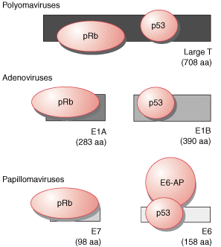
Interactions between tumor-suppressor gene products
and proteins encoded by DNA tumor viruses
SV-40
Large T antigen from polyomaviruses (such as simian virus 40 binds both the retinoblastoma (pRb) and p53 proteins.
For the adenoviruses and the high-risk human papillomaviruses (HPV types 16 and 18), different viral protein products complex with pRb and p53.
A cellular protein known as E6-associated protein (E6-AP) cooperates with the HPV E6 protein to complex and degrade p53.
adenovirus
papillomavirus
Levine , 2009

Slide 18
GENETIC MARKERS
A genetic marker is a known DNA sequence containing a variant (heterozygotes)
Genetic markers are helpful to identify an association between a hereditary disease and the genetic cause
Characteristics:
traceable,
associated with a specific locus,
highly polymorphic (no information in homozygous)

Slide 19
POINT MUTATIONS REPEATED SEQUENCES
1975- Restriction Fragment Length Polymorphisms (RFLP)
1995- Single Nucleotide Polymorphisms (SNPs)
1985- Variable Number of Tandem Repeats (VNTR)- MINISATELLITE
1990- Short Tandem Repeats-MICROSATELLITE

Slide 20
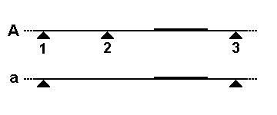
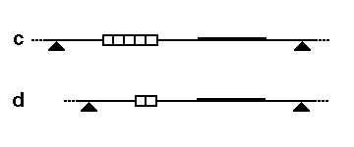
FIRST GENERATION GENETC MARKERS:
RFLP AND VNTR (MINISATELLITES)
DNA variations that can be identified with:
Restriction enzymes and gel-electrophoresis
RFLP (Restriction Fragment Length Polymorphism)
Single nucleotide variation in the two alleles
VNTR (Variable Number of Tandem Repeats)
Variation in the number of repeats in the two alleles
50-70 bp repeated sequences, very frequent in sub-telomeric regions

Slide 21
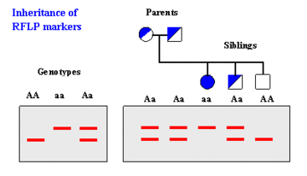
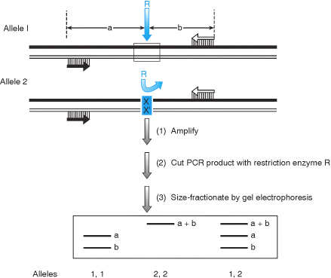
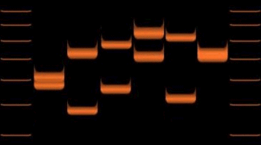
RFLP Analysis
Gel separation
Enzymatic Digestion
VNTR analysis
Max Informativity 50%
Gel separation
Enzymatic Digestion
Max Informativity 80%

Slide 22
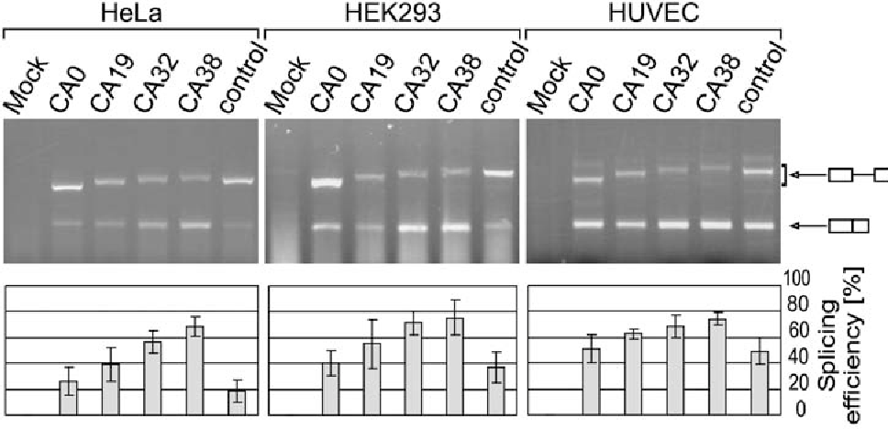
GENETIC MARKERS OF SECOND GENERATION:
MICROSATELLITEs
Can be used with PCR
1-6 bp short repeats frequently (CA)n
Max Informativity 90-95%

Slide 23
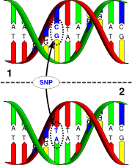
Human Genome Project results led to use Single Nucleotide Polymorphism (SNPs) instead of RFLP
SNP = is a single base DNA variant (A,T,C o G) among individuals of the same species
Genomic sequence variants in coding and non-coding sequence
SNPs Frequency= 1/1000 bp
Total genomic SNPs = 3 x 10⁶
A DNA variant can be considered a SNP when can be found in at least 1% of the individuals

Slide 24
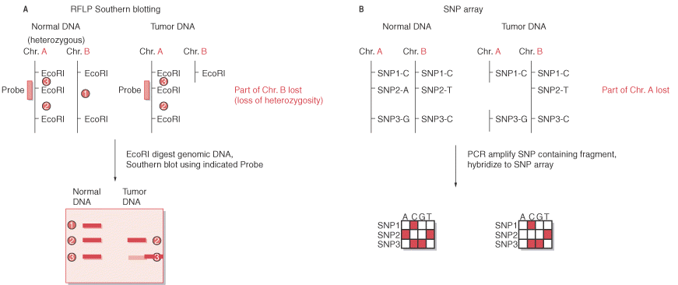
Loss of heterozygosity (LOH)

Slide 25
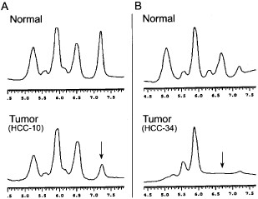
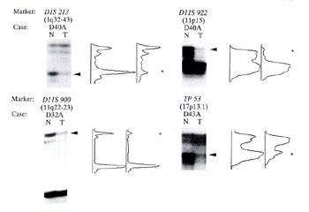
Loss of heterozygosity (LOH)
Germline DNA is compared with tumour DNA in heterozygote individuals:
LOH is found when in tumour DNA one band disappears
Axin1
Deletions detected with microsatellites
From Taniguchi et al , 2002

