Slide 1
BIBLIOGRAPHIC TUTORIAL Dr. Elisa Anedda (elisa.anedda@unito.it)
Lesson 3
Master Cellular and molecular biology A.A. 2019/2020

Slide 2
Grey Literature
Anything that hasn’t been published by the official scientific publishing industry, that hasn’t been submitted to peer review.
For example:
Licenses;
Interal pubblications of organizations;
Technical reports and research reports;
Research projects;
Acts or abstracts for conventions, conferences and seminars (included slides);
Degree thesis;
Lecture notes;
Guidelines for laboratory techniques and analytical methods;
pre-print of articles destined to pubblication.
MIND THAT in your thesis, the grey literature MUST be firmly less than white literature.

Slide 3
Text citing
Citing means recalling sources that support the subject or the sentence we are endorsing
Bibliographic research
Reading and rearrangement of the subject
Citing
PLAGIARISM
It DOES NOT mean that you have to cite directly what other authors say

Slide 4
RULES
(Author’s Surname, year of pubblication);
If there are two authors we cite both using an &;
If there are more authors we use et al. (in italic);
If we cite more papers, we must cite them in cronological order starting from the less recent.

Slide 5
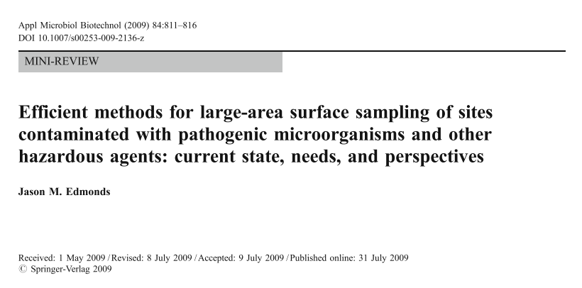
… efficient methods for Bacillus anthracis sampling in contaminated sites (Edmonds, 2009)

Slide 6
…. Metabolic syndrome could be a preventive tool for diabetes and cardiovascular pathologies (Ma and Zhu, 2013)

Slide 7
… respiratory microbiota is complex and act as a gatekeeper (Ho Man et al., 2017).

Slide 8
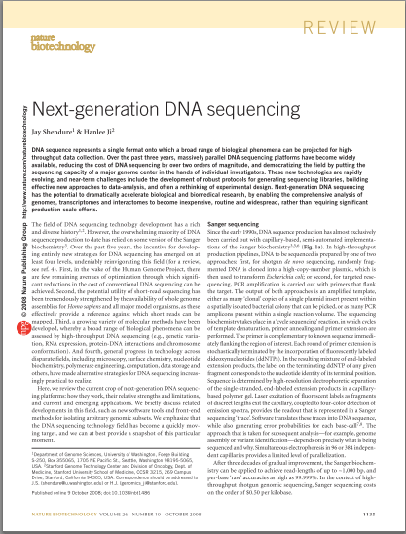
Academic paper
Title, authors, year of publication
Abstract
Introduction
Materials and methods
Results
Discussion
Conclusions
Bibliography

Slide 9
Selecting papers
Title, authors, year of pubblication
Abstract
Title and abstract give us an idea of the paper subject
The year of publication is extremely important
Keep in mind the authors name for another bibliography research

Slide 10
Introduction, Discussion and Conclusions
Those are crucial parts of a paper.
You need to read them right after the abstract.
Material and methods, Results
To read whenever something in discussion isn’t clear.
If you’re doing a methodological research, you MUST read those sections.
Bibliography
Crucial section to deepen your bibliography research

