Slide 1
2201M21
-
CELLULAR AND MOLECULAR BIOLOGY COURSE
BIOLOGIA CELLULARE E MOLECOLARE
SVB0104 - CANCER GENETICS
LESSON #7
2nd year / 2° Semester
Teacher: Antonella Roetto, PhD
antonella.roetto@unito.it

Slide 2
CRC hereditary syndromes as models of sporadic colorectal tumorigenesis
Familial
adenomatous polyposis
Adenoma-carcinoma sequence
Vogelstein’s model
MUTYH-associated
polyposis
DNA-oxidative pathway
Lynch syndrome or
HNPCC
Hypermutability pathway
Epigenetic germline
alterations ?
Hypermethylation pathway

Slide 3
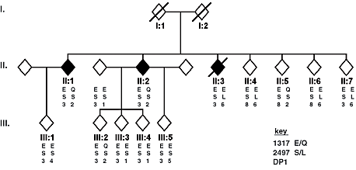
MUTYH-associated polyposis
MAP
The other player…
Al-Tassan et al.,Nature Genet, 2002
Family N
An alternative gene to APC is involved in the susceptibility to polyposis and CRC

Slide 4
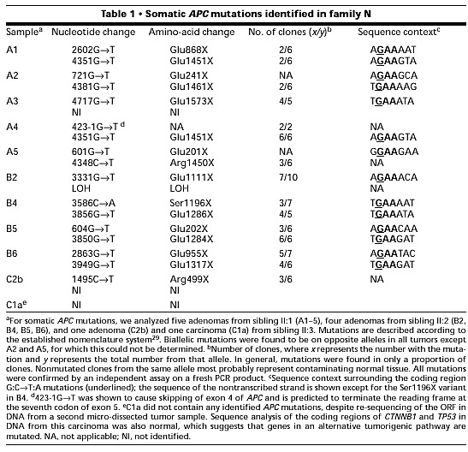
APC somatic analysis
APC ORF was sequenced in 11 adenomas and 1 carcinoma
15/18 G:C > T:A
Found more G>T transversions than sporadic CRC or FAP tumors
Alterations in genes involved in BER system ?
Al-Tassan et al., Nature Genet. 30, 227-232

Slide 5
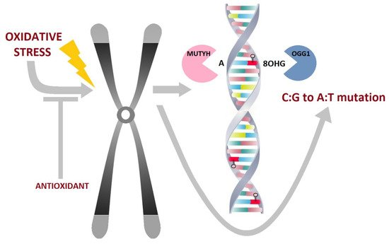
BER Base Excision Repair pathway
Vodicka et al, In J Mol Sci, 2020

Slide 6
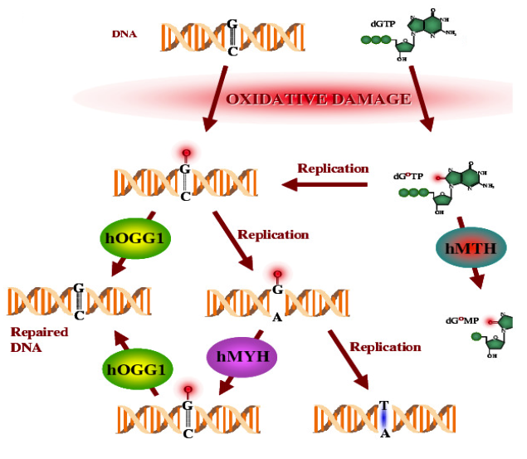
BER (Base Excision Repair)
Oxidative DNA damage repair
G 8-oxo-dG
A 8-oxo-Da
T, C
DNA nuclease
MTH (mutT)
DNA glycosylases
OGG1 (mutM)
MYH ≡ MUTYH (mutY)
9 more……

Slide 7
Glycosylase | Ref
MUTYH | Koger et al, 2019
OGG1 | Wang et al, 2018
MPG | Leitner-Dagan et al, 2012
MED4 | Sjolund et al, 2013
SMUG1 | Alexeeva et al, 2019
NTH1 | Shinmura et al, 2019
NEIL1 | Slyvka et al, 2017
NEIL2 | Minko et al, 2019
NEIL3 | Minko et al, 2019
TDG | Fu et al, 2019
UNG | Weiser et al, 2018
↑ expression in 20 cancer sites
Vodicka et al, In J Mol Sci, 2020

Slide 8
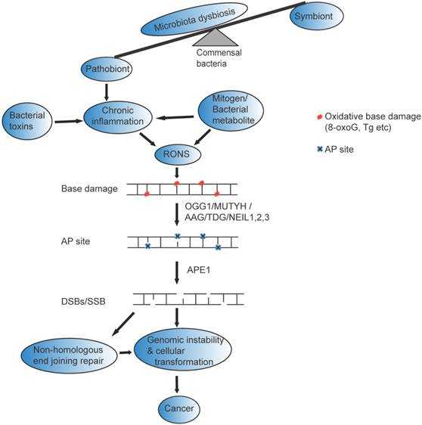
Microbioma and ROS and BER and Cancer
Ray and Kidane , 2016

Slide 9
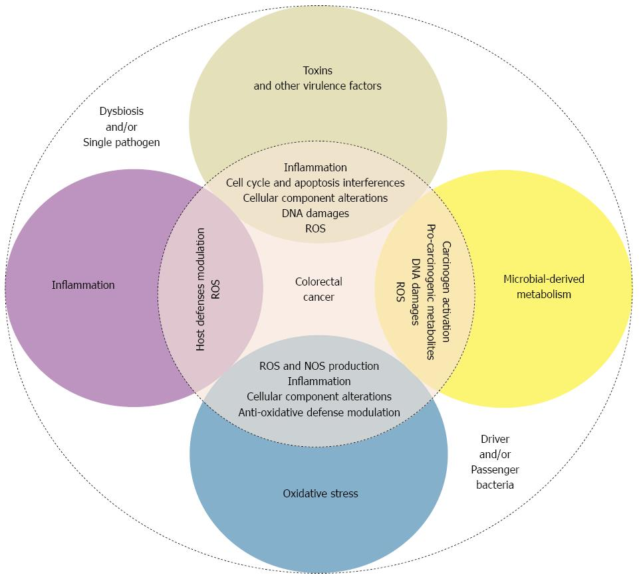
Microbioma and ROS and Colorectal Cancer
Gagniere et al, 2016

Slide 10
MUTYH-associated polyposis
MAP
Al-Tassan et al.,Nature Genet, 2002
Family N

Slide 11
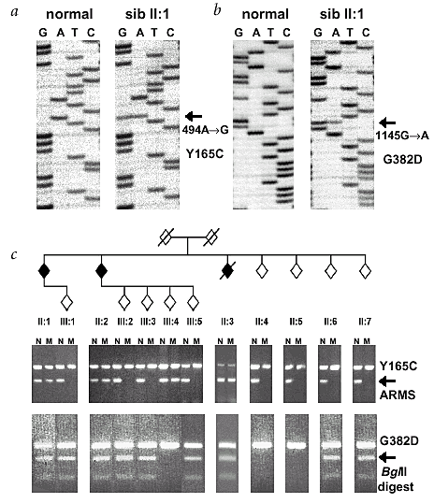
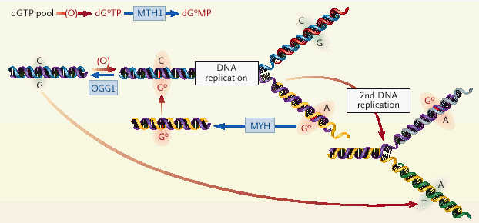
Constitutional analysis of BER genes in the affected individuals of N family
Identified biallelic mutations in MUTYH gene
exon 7 : Y165C
exon 13 : G382D
X
Oxidation causes the formation of 8-oxoG, which mispairs with adenine. At the division A is paired with G (G>T transversion)

Slide 12
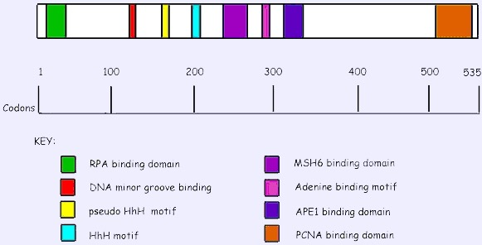
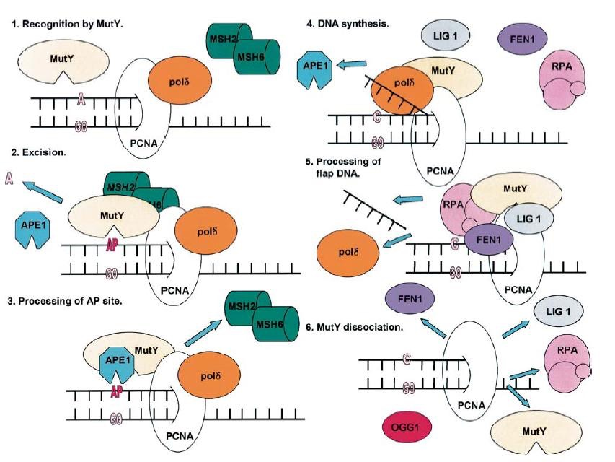
MUTYH is a 7.1 Kb gene, mapping on 1p34.3-1p32.1
It codes for a 535 aa protein
conserved domains involved in:
DNA binding
protein-protein interaction
nuclear and mitochondria signals
Involvement of other DNA repair systems by interacting with MSH6 (MMR), PCNA e APE1 (recombination)

Slide 13
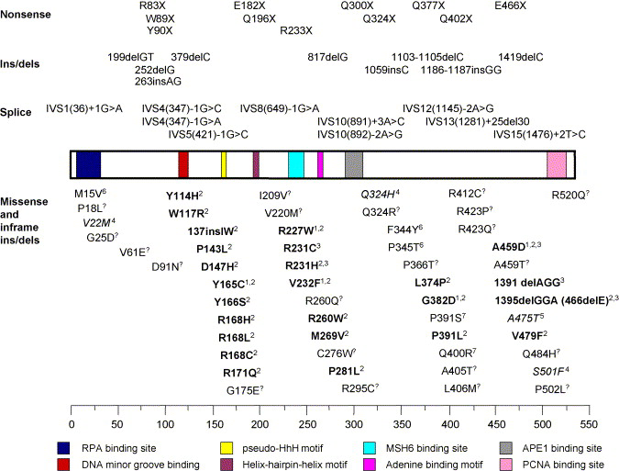
recessive autosomic inheritance
AFAP with >15 adenomas
most of the mutations are p.Y165C and p. G382D
Cheadle and Sampson,DNA repair, 2007
20% of patients carry other mutations involving most of the exons
mutations can involve also splicing and introns
No genotype-phenotype correlation

Slide 14
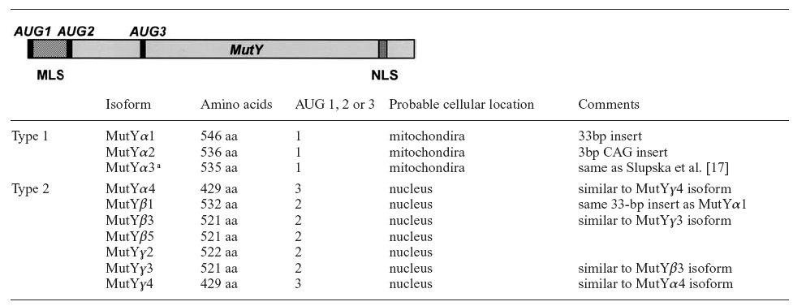
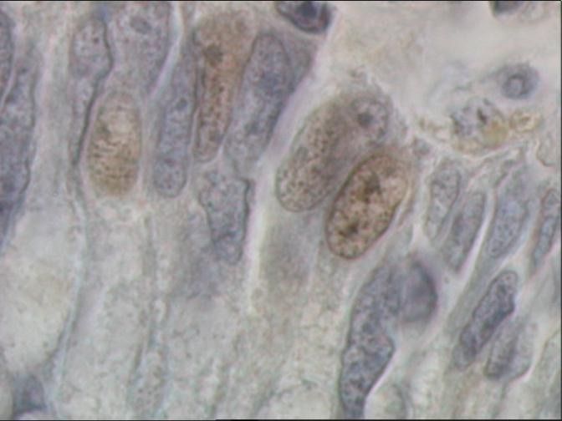
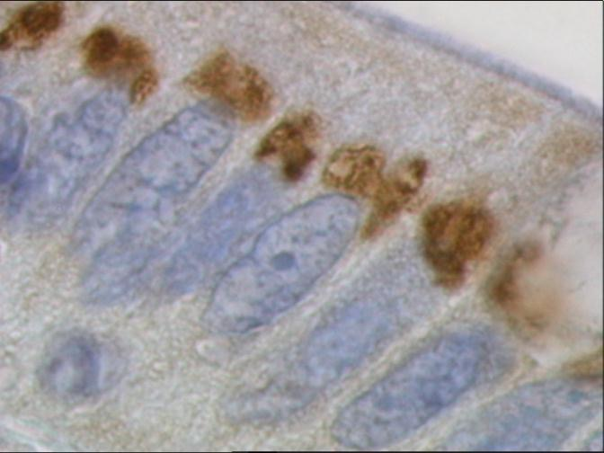
Parker and Eshleman,Cell Mol Life Sci, 2003
MUTYH gives rise to
10 alternative isoforms
MUTYH is present in
both nucleus and
mitochondria
MAP patients carrying biallelic germline MUTYH mutations show a characteristics perinuclear MUTYH expression in the colonic mucosa and adenomas cells
Control
MAP patient

Slide 15
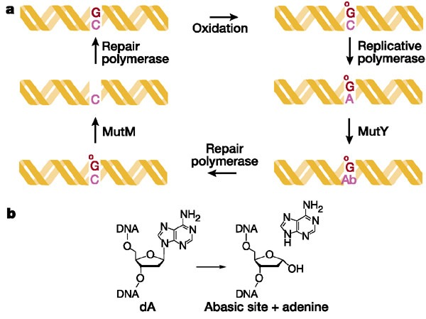
MUTYH carcinogenesis
Oxidative damage
constitutive impaired MUTYH
onset of 8-oxoG mispairing with adenine
G>T transversions
somatic G>T transversions in target genes
APC and KRAS
Few mutations in p53, BRAF, SMAD4, TGFßRII
MAP partly follows adenoma-carcinoma sequence
Progression can be rapid (carcinomas in 50% of patients at presentation)
Other factors ?

Slide 16
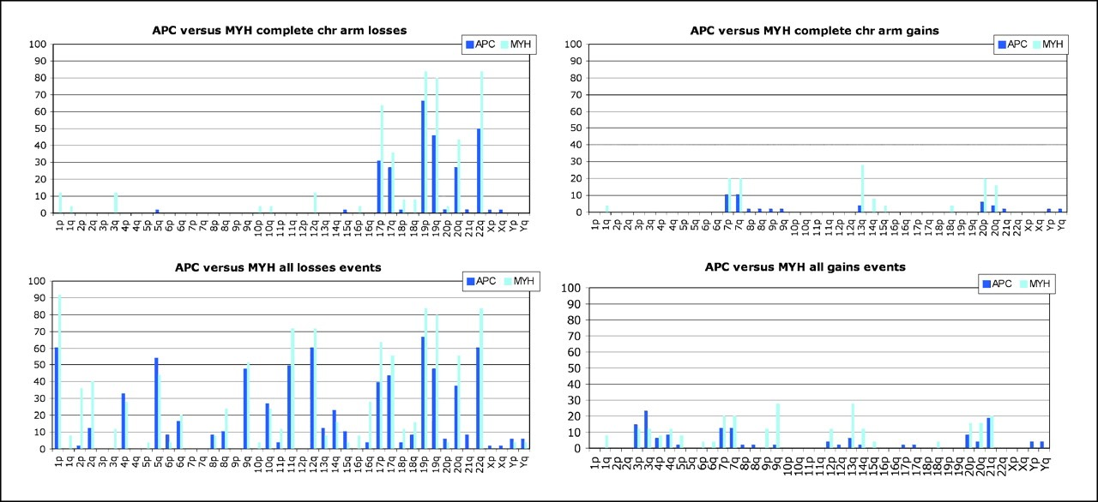
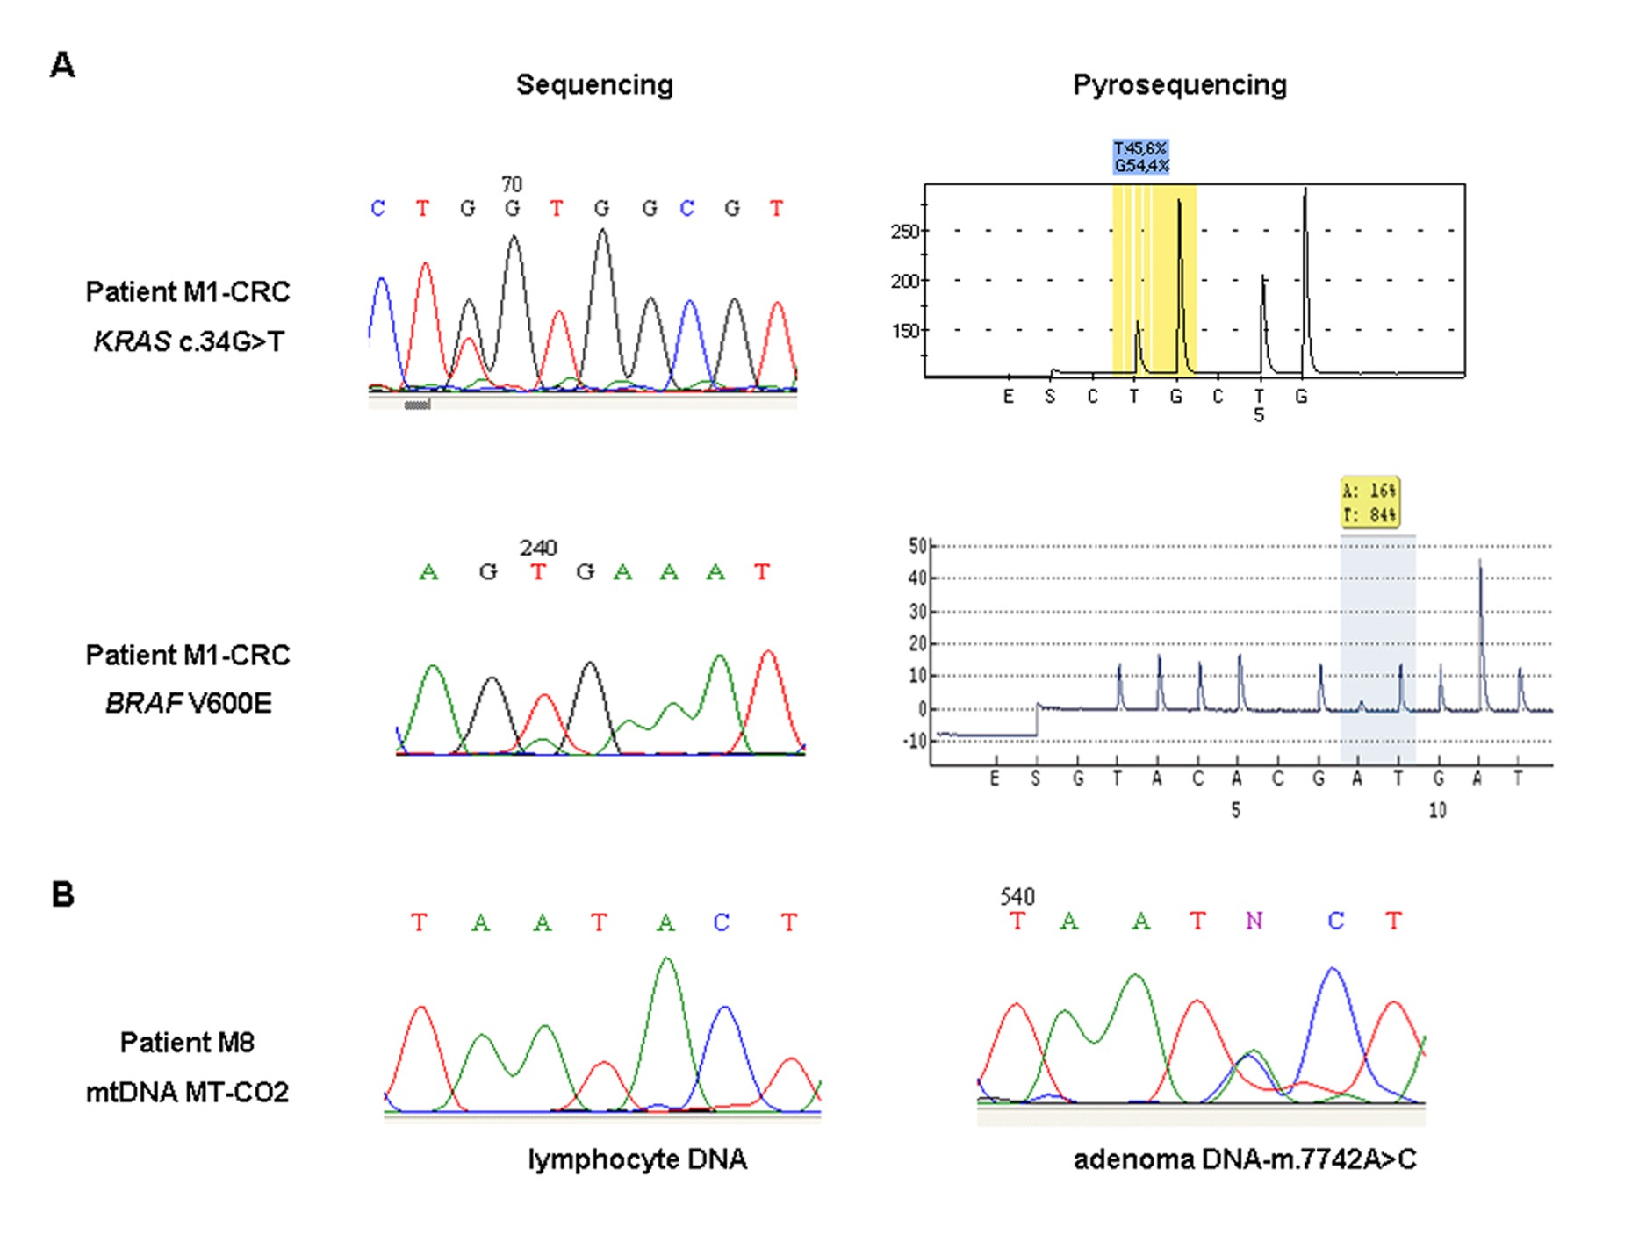
1. Aneuploidy: 80 % MAP vs 60% FAP
Cardoso et al, Cancer Res, 2006
Deletions of chromosome 1p, 17, 19 and 22;duplications of chromosomes 7 and 13
2. Somatic G>T transversions in “target” KRAS gene of MAP adenomas and carcinomas
Venesio et al., 2014

Slide 17
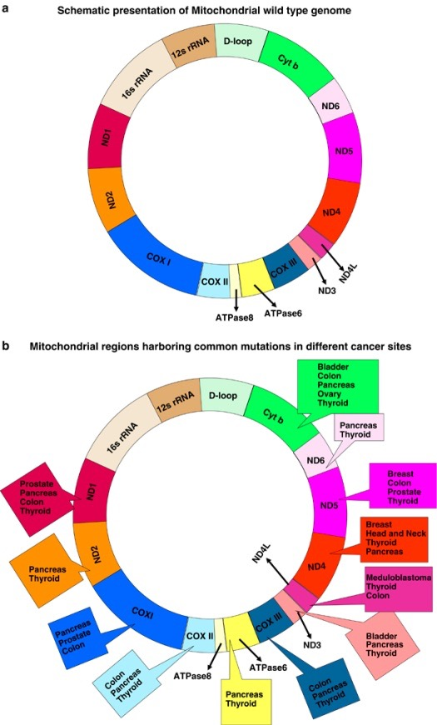
2. Specific mutations in “target” mitochondrial genes of MAP adenomas and carcinomas
Errichiello et al., 2015
…The sequence analysis revealed 17 different variants, in the MT-CO2 gene of MAP patients (P<0.0001) who frequently carried the hotspot m.7763 G>A mutation…D-loop instability was also significantly associated with variants grouped inside the MT-CO2 gene (P=0.006)…

Slide 18
CRC hereditary syndromes as models of sporadic colorectal tumorigenesis
Familial
adenomatous polyposis
Adenoma-carcinoma sequence
Vogelstein’s model
MUTYH-associated
polyposis
DNA-oxidative pathway
Lynch syndrome or
HNPCC
Hypermutability pathway
Epigenetic germline
alterations ?
Hypermethylation pathway

Slide 19
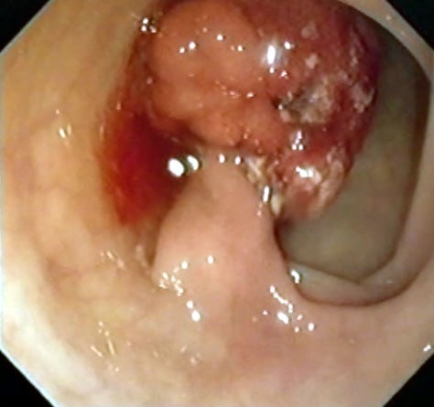
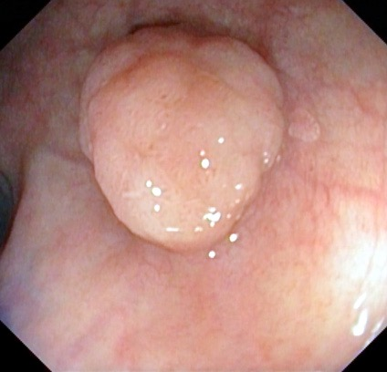
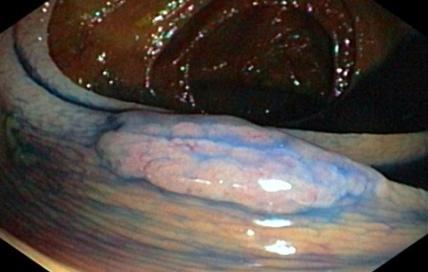
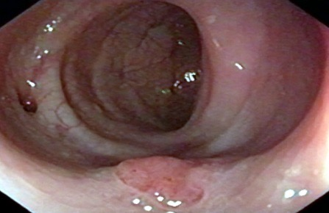
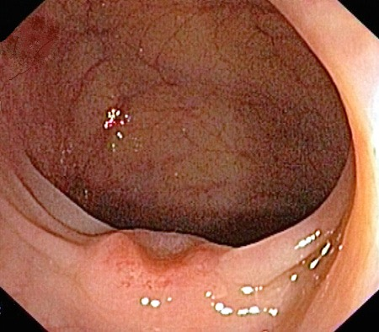
Lynch syndrome or
Hereditary Non Polypoid Cancer Colon
HNPCC
Most common form of hereditary CRC
Vertical transmission, CCR develops at a young age (<50 years), mainly in right colon
Several extra-colonic tumours (endometrial, gastric, urinary and biliopancreatic carcinomas)
Polypoid
Non Polypoid

Slide 20
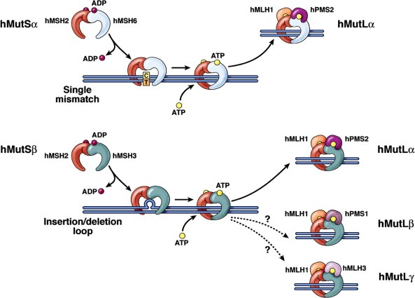
Lynch syndrome or
HNPCC
Autosomic dominant transmission
This syndrome is in likage with mutations in “DNA mismatch repair” (MMR) genes
MMR gene chrom. %.
MSH2 2p21 38%
MLH1 3p21-23 49%
PMS1 2q31-33 0.3%
PMS2 7p22 2%
MSH6 2p21 9%
MLH3 14q24.3 2%

Slide 21
during DNA replication….
base
misincorporation
Mismatches
purine-purine (G/G, A/A, G/A)
purine-pyrimidine (G/T, A/C)
pyrimidine-pyrimidine (C/C, T/T, T/C)

Slide 22
Fidelity in DNA replication
Single-base substitutions arise once in every 10⁴ - 10⁶ nucleotides incorporated
The proofreading activity of replicative DNA polymerases increases the fidelity to one error in 10⁷ to 10⁸
DNA Mismatch Repair (MMR) reduces the error rate to one error in 10⁹ to 10¹⁰

Slide 23
The Mismatch Repair (MMR) is an evolutionary well conserved pathway which greatly improve fidelity during DNA replication
by repairing errors of the DNA polymerase:
i) base-base mismatches due to insertion of an incorrect
nucleotide in the newly synthesized strand
ii) insertion/deletion loops (IDL) caused by strand slippage
during DNA replication
MMR also affects:
- Meiotic and mitotic recombination
- Processing and signaling of DNA-damage by methylating agents
- Processing of oxidative DNA damage
- Triplet Repeat stability
- Immunoglobulin diversity
- Bacterial adaptation and evasion of host immunity
- Genetic diversity in plants

Slide 24
DNA errors are detected by
MSH2/MSH6 and MSH2/MSH3 heterodimers
MutSα
MutSβ
MSH6
MSH2
MSH3
MSH2
base/base mismatches
1-2 nt loops
3-8 nt loops
MutLα
MLH1
PMS2
MLH1/PMS2 heterodimers
are recruited for excision and synthesis of the new repaired strand

Slide 25
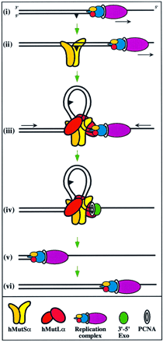
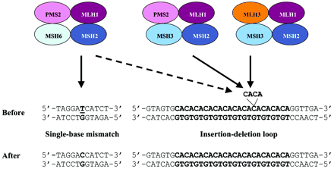
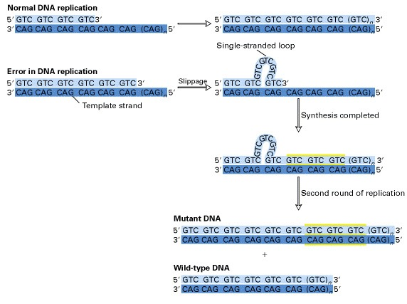
MMR genes form multiproteic complexes that jointly work to repair mispairing during DNA replication
When MMR is impaired, short repeated sequences (microsatellites) are prone to insert errors during replication
Microsatellite instability (MSI)

