Slide 1
2201M21
-
CELLULAR AND MOLECULAR BIOLOGY COURSE
BIOLOGIA CELLULARE E MOLECOLARE
SVB0104 - CANCER GENETICS
LESSON #9
2nd year / 2° Semester
Teacher: Antonella Roetto, PhD
antonella.roetto@unito.it

Slide 2
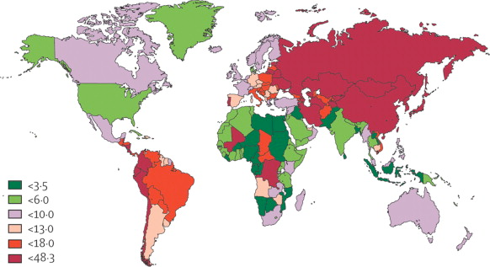
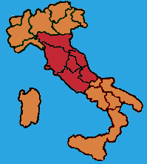
Gastric Cancer Incidence
G.C. is still the second most common cause of cancer-related death in the world
Incidence is decreasing in old patients and is stable in young patients and
cases with familial clustering
Italy: moderate to high risk area
Notes:
Il carcinoma gastrico rappresenta oggi la quarta forma più comune di cancro nel mondo, oltre che la seconda causa di morte per cancro. L’incidenza comunque è estremamente variabile: sono state individuate aree geografiche a basso rischio (come l’America settentrionale, l’Africa nord-orientale, l’Asia meridionale, l’Australia) e a rischio medio-alto (come il Sud America e l’Asia orientale (particolarmente colpiti Cina, Giappone)). In Europa è diffuso sopprattutto nei paesi dell’Est, ma anche l’Italia è considerato un paese ad alto rischio, pur con una notevole eterogeneitàtra regioni.

Slide 3
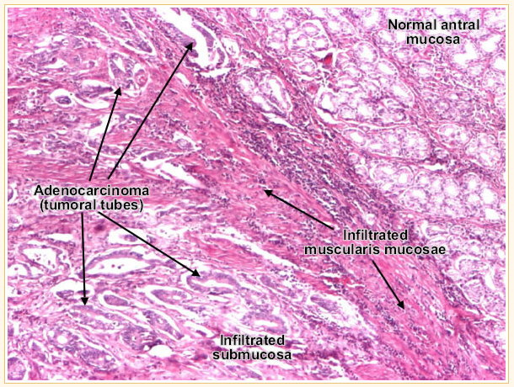
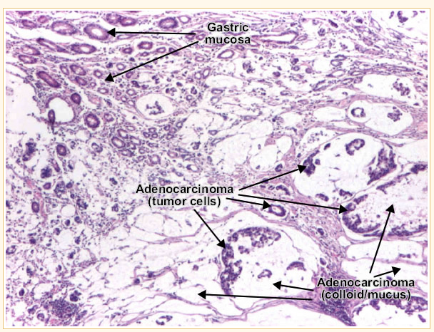
95% of G.C. are adenocarcinomas which can be classified into intestinal and diffuse types
Gastric adenocarcinoma, intestinal type.
Tumor cells describe irregular tubular structures, with stratification, multiple lumens surrounded by a reduced stroma ("back to back" aspect). The tumor invades the gastric wall, infiltrating the muscularis mucosae, the submucosa and thence the muscularis propria. Often it associates intestinal metaplasia in adjacent mucosa. Depending on glandular architecture, cellular pleomorphism and mucosecretion, adenocarcinoma may present 3 degrees of differentiation : well (photo), moderate and poorly differentiate.
Gastric adenocarcinoma, diffuse (infiltrative) type.
Tumor cells are discohesive and secrete mucus which is delivered in the interstitium producing large pools of mucus/colloid (optically "empty" spaces) - mucinous (colloid) adenocarcinoma, poorly differentiated (Lauren classification).
If the mucus remains inside the tumor cell, it pushes the nucleus against the cell membrane - "signet-ring cell".

Slide 4
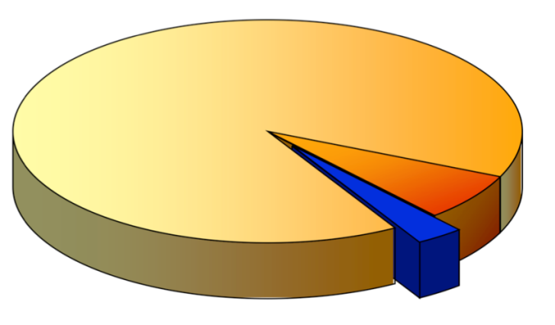
G.C. cases
Sporadic (90%)
ENVIRONMENT
Familial (10%)
GENES
Intestinal-type prevailing:
old patients
high risk areas
risk factors including
H. pylori, alcohol intake and smoking
Diffuse-type prevailing:
young patients
homogeneous geographic distribution
genetic factors
HDGC (1-3%): highly penetrant susceptibility to diffuse gastric cancer with an autosomal dominant pattern of inheritance
Notes:
La maggior parte dei casi di c.g. (il 90% circa) è di tipo sporadico, insorge cioè in pazienti senza evidente storia familiare. E’prevalentemente di istotipo intestinale (con formazioni simil-ghiandolari tipiche dell’epitelio intestinale), colpisce più frequentemente gli anziani, è particolarmente diffuso nelle aree geografiche definite ad alto rischio ed è spesso associato a fattori ambientali, quali infezioni da H. Pylori, fumo, alcool, stili di vita. Nel 10% dei casi si osserva clustering familiare, con due o più pazienti appartenenti alla stessa famiglia. In questi casi prevale l’istotipo diffuso, caratterizzato da cellule tumorali non coese tra loro. Il c.g. diffuso è più frequente tra i giovani, presenta una distribuzione geografica relativamente omogenea ed è spesso associato a fattori genetici. L’unica sindrome ereditaria finora riconosciuta e relativamente caratterizzata è l’Hereditary Diffuse Gastric Cancer (HDGC) che rappresenta l’1-3% di tutti i casi di c.g.

Slide 5
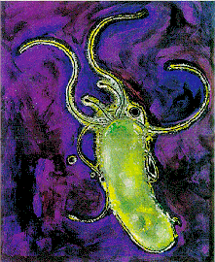
Sporadic GC
1. GC is the end result of a multifactorial, multigenetic and multistage process
2. arious environmental exposures such as Helicobacter pylori infection, high salt diet, inadequate vitamin C uptake and smoking, have been identified as risk factors
3. Genetic factors : CIN, MSI (hMLH1 mutations, methylation)

Slide 6
Sporadic GC
1. Gastric cancer (GC) remains a leading cause of cancer-related deaths worldwide, even though a decrease in its incidence and mortality rate has been observed in recent decades
2. Although the incidence of intestinal GC has declined gradually, the incidence of diffuse gastric cancer (DGC) has remained stable.

Slide 7
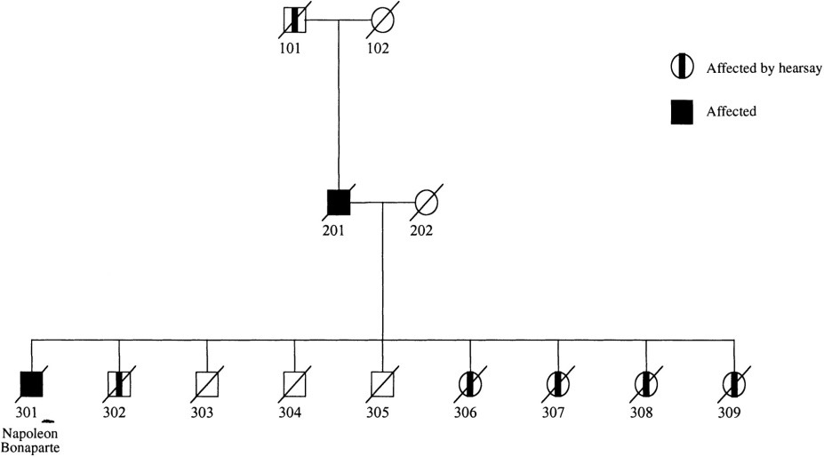
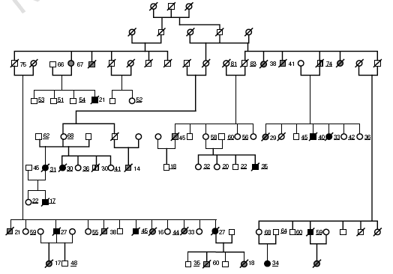
HDGC syndrome
early-onset diffuse-type gastric cancer
1964
XIX century

Slide 8
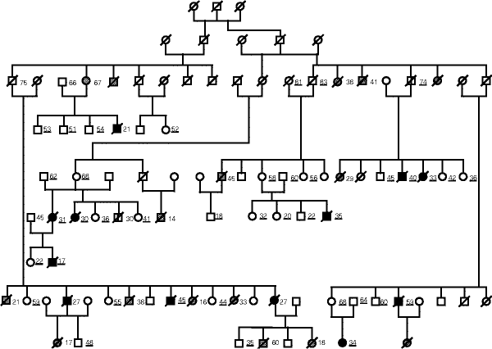
Autosomal dominant cancer-susceptibility syndrome
Gastric cancer of diffuse histotype (and Lobular Breast Cancer)
Average age of onset: 38 years
Associated with inactivating mutation of CDH1 gene
High penetrance (70%)
Notes:
L’Hereditary Diffuse Gastric Cancer (HDGC) è una malattia autosomica dominante, caratterizzata da un’elevata predisposizione allo sviluppo di cancro allo stomaco di istotipo diffuso e di cancro al seno di istotipo lobulare. La penetranza è incompleta, ma comunque elevata (circa il 70%) L’età media di insorgenza di c.g. nei pazienti con HDGC è di 38 anni. La sindrome è associata a mutazioni inattivanti del gene CDH1, come dimostrato da Guilford e colleghi nel 1998, mediante analisi di linkage svolta su famiglie Maori.

Slide 9
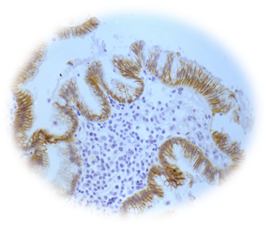
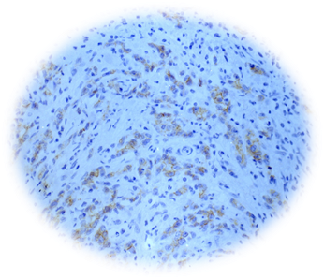
CDH1 loss of function and
E-cadherin expression
CDH1 is a t.s.g. and follows the “two hit” model
WT
WT
MUT
WT
MUT
MUT
Normal tissue
Normal tissue
Cancer tissue in both hereditary
and sporadic DGC and LBC cases
Notes:
Per tutti i motivi prima indicati, la perdita di funzione dell’E-caderina promuove la progressione tumorale.
CDH1 è un gene oncosoppressore e segue il modello dei “two hits”: a partire da un soggetto sano, privo di alterazioni in CDH1, affinchè si sviluppi una cancro gastrico sporadico non è sufficiente una singola mutazione inattivante in un allele di CDH1, ma è necessario che avvengano alterazioni somatiche in entrambi gli alleli di delle cellule bersaglio.

Slide 10
In hereditary diffuse gastric cancer one allele is constitutively mutated
The inherited wild-type allele is inactivated in tumor cells by a somatic event
Methylation of the CDH1 promoter is the second hit (somatic mutations, and intragenic deletions also found)
(Grady et al. Nat Genet 2000 ; Oliveira et al. Oncogene 2004)

Slide 11
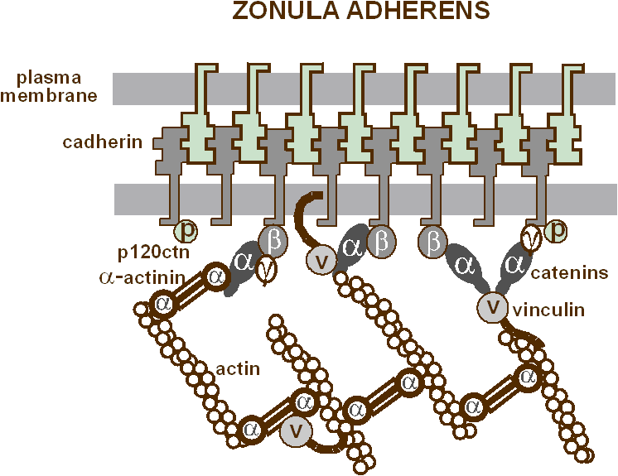

Slide 12
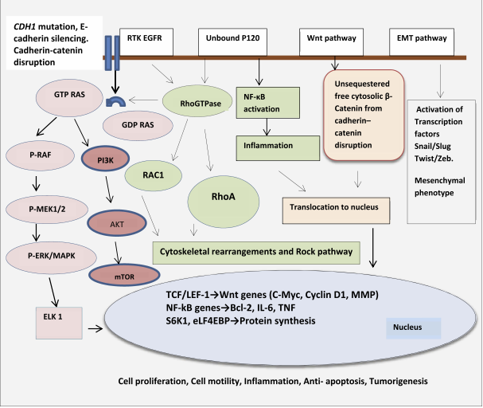
Shenoy, 2019

Slide 13
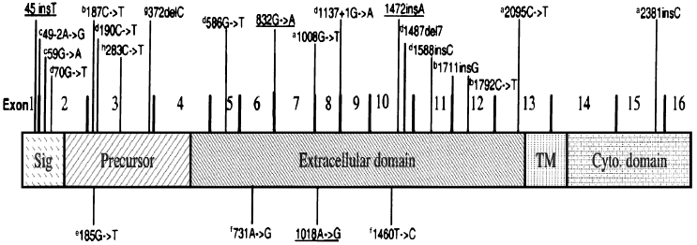
…CDH1 identified mutations
GENE SEQUENCING
the great majority (about 80%): truncating mutations (frameshift, nonsense, splicing)
about 20%: missense mutations

Slide 14
…CDH1 identified mutations
DELETIONS
6.5%: recently identified by MLPA in “mutation-negative” HDGC families
3.8%: overall freq. (only in countries with low incidence of G.C. accounting for 9% of all CDH1 alterations in HDGC families)
(Oliveira et al. Hum Mol Genet 2009)

Slide 15
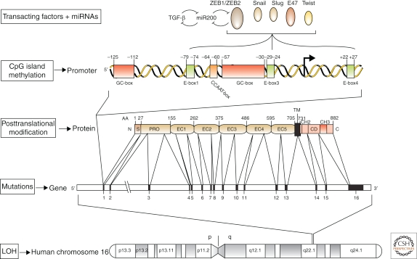
CDH1 gene

Slide 16
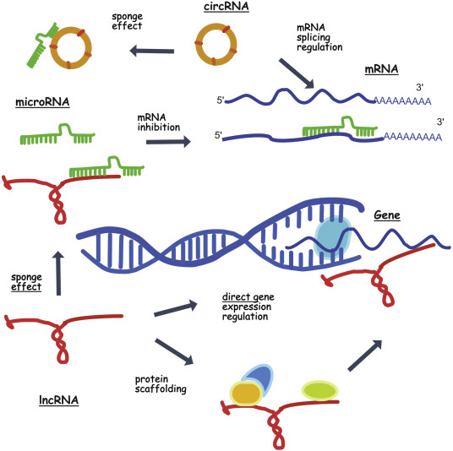
Non-coding RNAs (ncRNAs)
regulators of gene expression
two distinct subtype forms:
microRNAs (miRNAs) (19-25 nt)
long non-coding RNAs (lncRNAs) (> 200 nt)
Involved in epigenetics, splicing and gene
transcription, cell differentiation,
migration, cell cycle,
apoptosis, angiogenesis,
pluripotency and immune response
Ors-Kumoglu et al, 2019

Slide 17
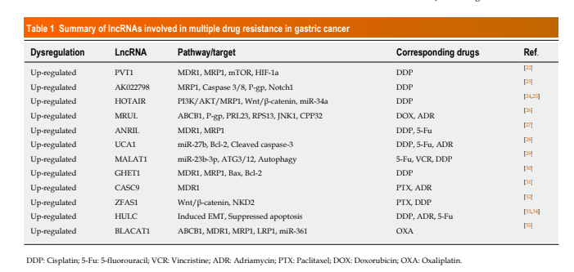
ncRNAs are up/down regulated in GC and are involved in
its sensitivity to chemotherapy
Luo Yj et al, 2019

Slide 18
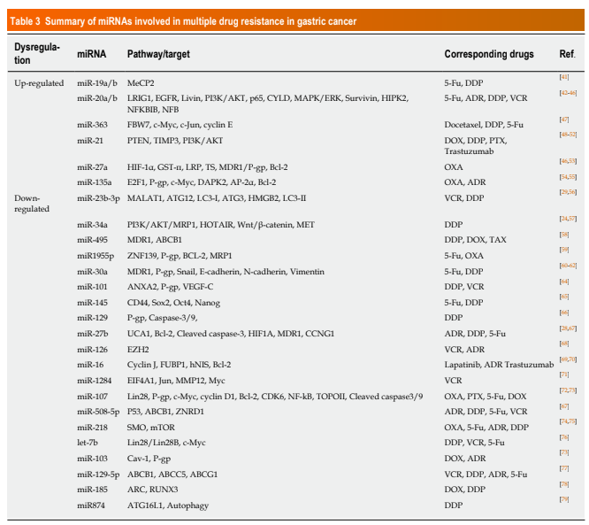
Luo YJ et al, 2019

Slide 19
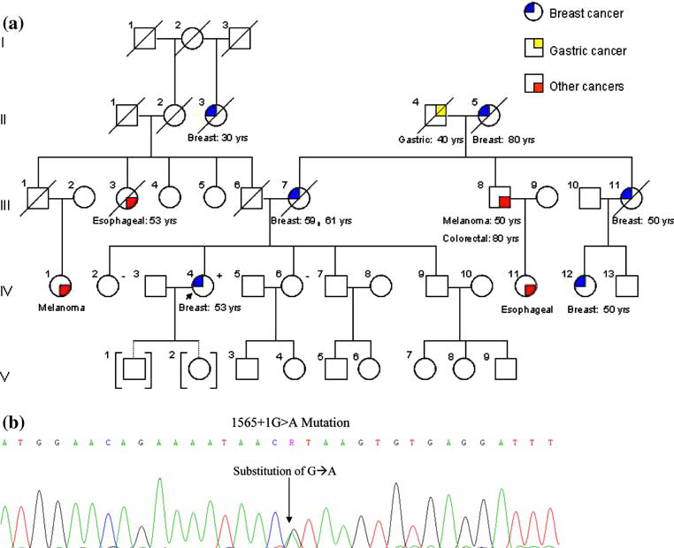
Additional or exclusive Lobular BC

Slide 20
CDH1 mutation carriers cumulative risk
estimated cumulative risk of gastric cancer by age 80 years:
67% for men
83% for women
for women:
cumulative risk of breast cancer 39%
combined risk of gastric cancer and breast cancer 90% by age 80 years
(Pharoah et al. Gastroenterology 2001)
HDGC could be asymptomatic for a long time , when first symptoms appear
the disease is already in advanced stages, poor prognosis
Genetic screening

Slide 21
HEREDITARY GC: a polygenic syndrome
CDH1
Lobular breast carcinomas, colorectal carcinomas, and prostatic carcinomas have been documented in mutant gene carriers
Phenotypic heterogeinity
Cancer gene
Other genes
MMR genes (gastric cancer belongs to the tumor spectrum of HNPCC)
p53 (mutations have been found in cancer families with different tumor types including gastric cancer)
Other candidates ???

Slide 22
Colorectal cancer
environment
genes
Gastric cancer
modifier genes

