Slide 1
2201M21
-
CELLULAR AND MOLECULAR BIOLOGY COURSE
BIOLOGIA CELLULARE E MOLECOLARE
SVB0104 - CANCER GENETICS
LESSON #13b
2nd year / 2° Semester
Teacher: Antonella Roetto, PhD
antonella.roetto@unito.it

Slide 2
CSC Plasticity
able to have phenotypic changes under specific stimuli (breast cancer cell lines)
Microenvironment
Colorectal cancer cells + inflammation non stem cells dedifferentiantion
EMT process
Some carcinomas metastasis have epithelial traits
Breast cancer xenograft changes from EMT to epiythelial in the metastatic site
CSC metabolism
Glycolysis vs OxPhos fatty acids
Metastatic breast cancer cells use different metabolic pathways in the different colonizing site
Batlle and Clevers, Nat Med, 2017

Slide 3
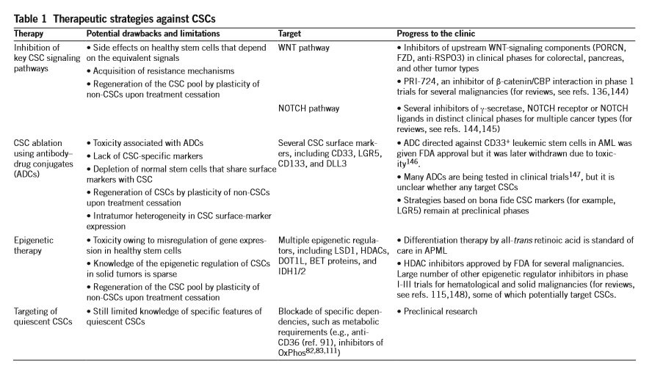
CSC and therapeutic resistance and targeting
Batlle and Clevers, Nat Med, 2017

Slide 4
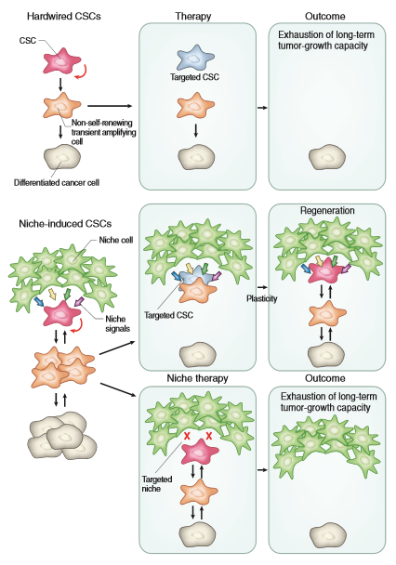
CSC niche targeting
Batlle and Clevers, Nat Med, 2017

Slide 5
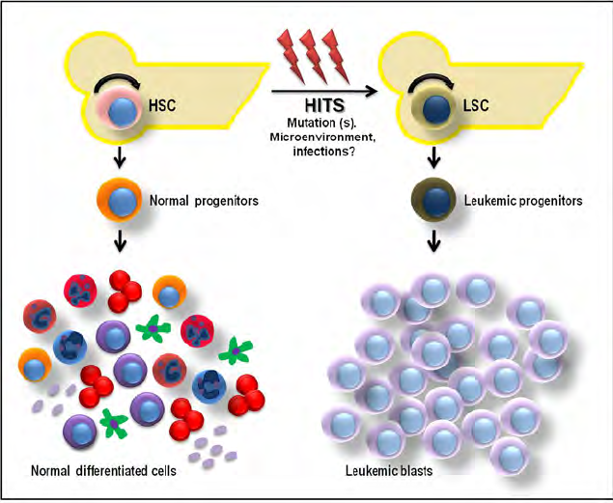

Slide 6
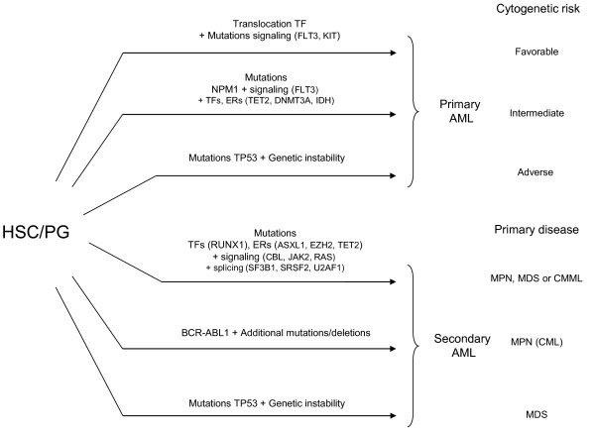
STEM CELLS AND HEMATOPOIETIC CANCER

Slide 7
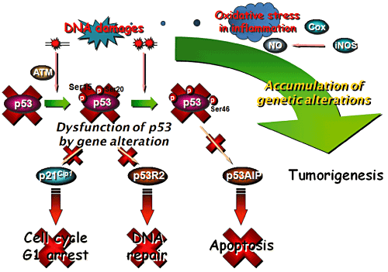
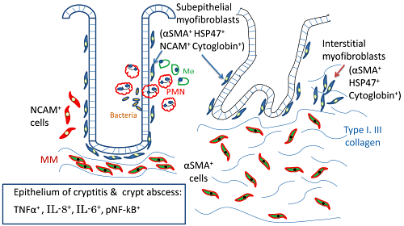
STEM CELLS AND GASTRIC CANCER

Slide 8
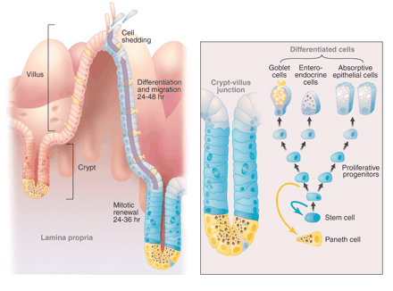
STEM CELLS AND COLORECTAL CANCER
Human colon is composed of 5 x 10 ⁶
1/6- 1/3 of these cells fell into intestinal lumen every 24 hours
Genes involved in this regulation are important in the first steps of tumorigenesis
Stem cells are located in the stem cell niche at the bottom of the crypt, among Paneth cells, and are responsible for the maintenance of crypt homeostasis.
They were first investigated by Cheng and Leblond, who called them “crypt base columnar cells.”

Slide 9
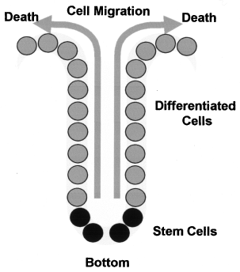
The complete life cycle of these cells takes about 5 days, and the entire epithelial lining of the gut is replaced once a week
The number of stem cells must be maintained since they are the only cells capable of preserving the population and producing an offspring of differentiated cells
The Paneth cells produce factors such as epidermal growth factor (EGF), transforming growth factor α (TGF-alpha), and Wnt3, all essential for activation of the Wnt pathway and stem cell maintenance
Stress condition induce symmetric division of the SCs

Slide 10
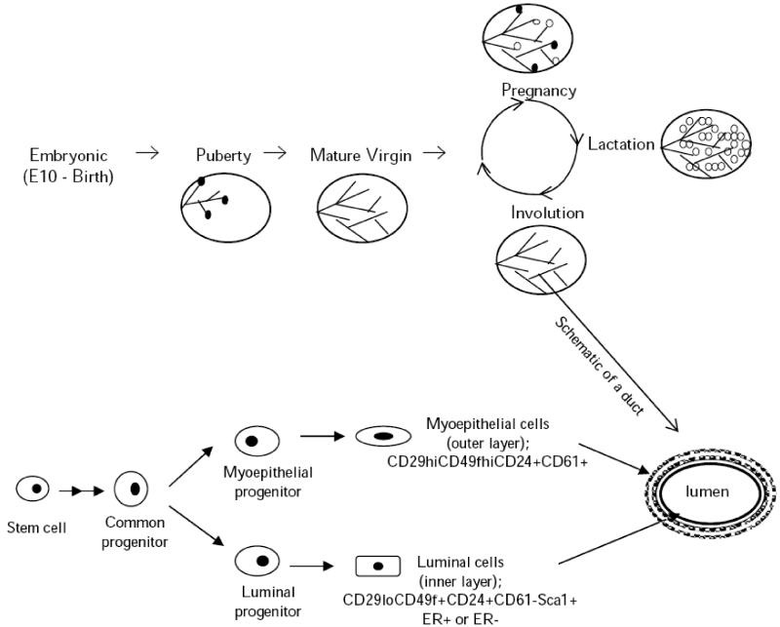
STEM CELLS AND MAMMARY GLAND

Slide 11
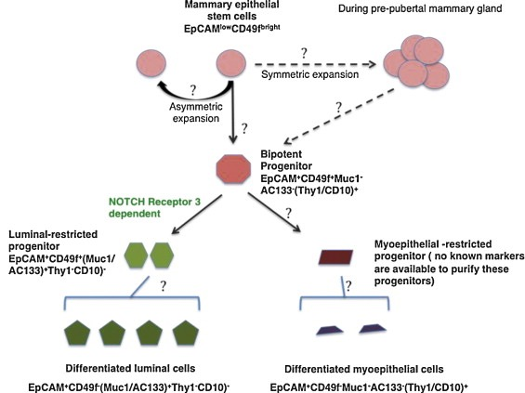
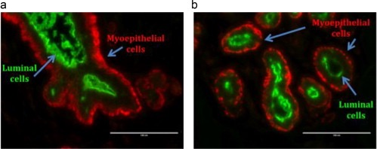
STEM CELLS AND MAMMARY GLAND
Cell surface markers CD44+/CD24- have been established as biomarkers for BCSCs
Upregulation of CD44 expression has been linked to breast tumor formation
The deregulation of Notch, Wnt/Frizzled/β-catenin, Hippo, and Hedgehog signaling pathways is believed to be involved in the formation of CSCs

