Slide 1
Paper discussion
Jeroen Pasterkamp

Slide 2
microRNA BIOGENESIS
Winter et al., Nat Cell Biol 2009

Slide 3
HIGH CONTENT miRNome SCREEN
InteRNA Technologies BV

Slide 4
NOVEL REGULATORS OF NEURITE GROWTH
Embryonic brain tissue
135a-1 is prominent form
Primary neuron cultures

Slide 5
miR-135 EXPRESSION IN THE EMBRYONIC BRAIN

Slide 6
miR-135: INTRINSIC REGULATION OF AXON GROWTH
Notes:
miRIDIAN miRNA mimics: Negative control #1 (Thermoscientific/Dharmacon), with biotin tag for bioIps and without for neuronal transfections.
For in vivo, the 3’ cholesterol modified Scramble mimic from Exiqon (same as in the Nat. Med paper from Henshall lab).

Slide 7
IN UTERO ELECTROPORATION
Notes:
miRIDIAN miRNA mimics: Negative control #1 (Thermoscientific/Dharmacon), with biotin tag for bioIps and without for neuronal transfections.
For in vivo, the 3’ cholesterol modified Scramble mimic from Exiqon (same as in the Nat. Med paper from Henshall lab).

Slide 8
miR-135s PROMOTE NEURONAL MIGRATION

Slide 9
miR-135s TARGETS KLF-4
Kruppel-Like Factor 4 – transcription factor
Knockdown leads to:
Enhanced axon growth
Longer leading process length on migrating neurons
Enhanced cortical neuron migration

Slide 10
miR-135s TARGETS KLF-4

Slide 11
miR-135s ACT THROUGH KLF-4 IN NEURONS

Slide 12
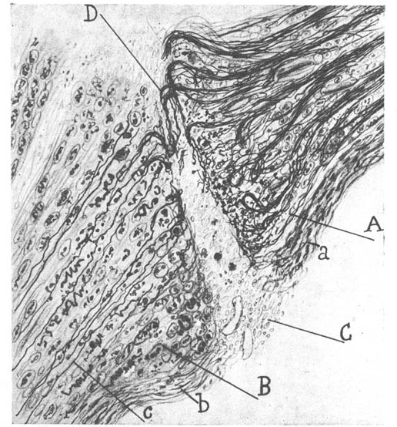
ADULT CNS AXONS DO NOT REGENERATE
Scar tissue (reactive glia, fibroblasts)
Neurite growth inhibitors
Cell death
Reduced intrinisic growth potential
Knockdown of KLF-4 is one of the few experimental treatments that enhances CNS axon regeneration

Slide 13
miR-135s PROMOTE CNS AXON REGENERATION
Toshihide Yamashita, Yuki Fijita
(Osaka University, Japan)
Optic nerve crush model (ONI)

Slide 14
miR-135s PROMOTE CNS AXON REGENERATION

Slide 15
miR-135s PROMOTE CNS AXON REGENERATION

Slide 16
miR-135s DEPLETION INHIBITS CNS AXON REGENERATION

Slide 17
CONCLUSIONS
Image-based high-throughput screening identifies novel regulators of neurite growth
miR-135a and miR-135b regulate axon growth and neuronal migration by repressing KLF-4
Exogenous application of miR-135s enhances CNS regeneration in part by reducing KLF-4 expression, while removal of endogenous miR-135s inhibits regeneration
First example of the ability of neuronal miRNA application in promotion of mammalian CNS axon regeneration

