Slide 1
2201M21
-
CELLULAR AND MOLECULAR BIOLOGY COURSE
BIOLOGIA CELLULARE E MOLECOLARE
SVB0104 - CANCER GENETICS
LESSON #4
2nd year / 2° Semester
Teacher: Antonella Roetto, PhD
antonella.roetto@unito.it

Slide 2
Positional cloning: statistical approaches to gene mapping, i.e. locating genes on the genome
Linkage analysis
Association studies (Linkage disequilibrium)

Slide 3
Linkage analysis
Uses a genetic marker map (a map of polymorphic loci)
Looks for co-segregation with a marker (polymorphic locus)
Simple Idea:
To determine if marker allele at a known location travels with the disease in a family

Slide 4
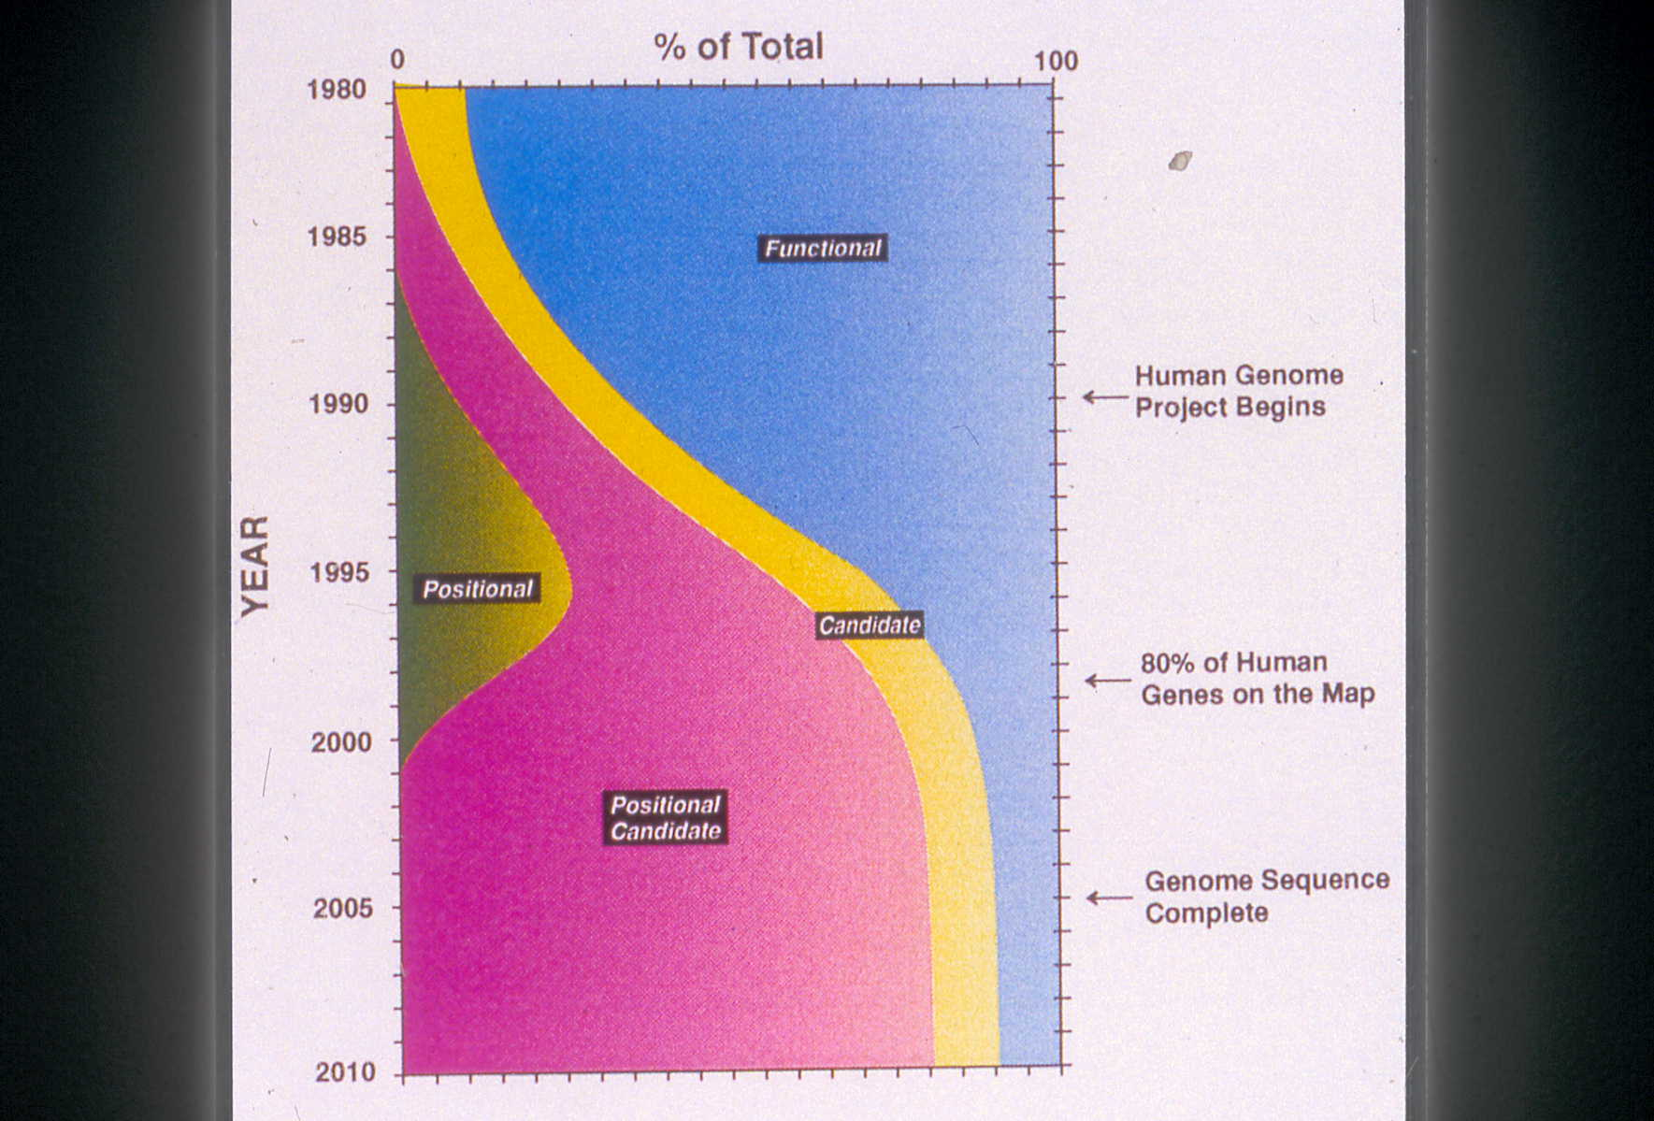
Linkage Analysis
To identify the chromosomal region in which the disease-gene is located without knowing its function

Slide 5
MARKERS and ALLELES
5’ACGTGGTCAGGG 3’
3’ACGTGGACAGGG 5’
5’ACGTGGCACAGG 3’
5 ACGTGGCACACAGG 3’
133
202
160
244
183
170
217
164
228
127
169
135
194
150
250
179
170
219
164
234
120
157
133
202
154
252
185
170
217
164
224
120
167
133
204
156
244
195
170
229
164
234
114
153
SNP
CA repeat
D15S210
D15S128
D15S122
D15S11
GABR3
D15S97
D15S156
D15S219
D15S165
D15S98
D15S87
133
202
160
244
183
170
217
164
228
127
169
133
202
154
252
185
170
217
164
224
120
167
133
202
160
244
183
170
217
164
228
127
169
133
164
224
120
167
More than one consecutive allele
HAPLOTYPE

Slide 6
Chromosomal region non in-linkage with the disease
Chromosomal region in-linkage with the disease
Meiotic recombination is exploited to define the small region
in-linkage with the disease

Slide 7
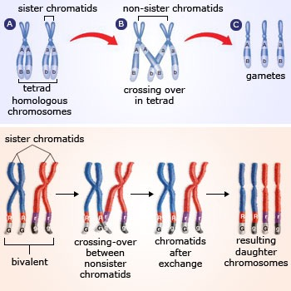
Linkage Analysis is based on RECOMBINATION
Genetic mapping
the aim is to discover how often two loci are separated by meiotic recombination
If two loci are on different chromosome they will segregate independently
Children will have 50% chance to receive each of these loci.
Recombination fraction is ⍬ = 0.5
If loci are on the same chromosome they are expected to segregate together (⍬= 0)
but due to meiotic recombination this does not always happen (0 <⍬ < 0.5 )
The further two loci are on the chromosome the more they recombinate
The ⍬ is a measure of the distance between two loci

Slide 8
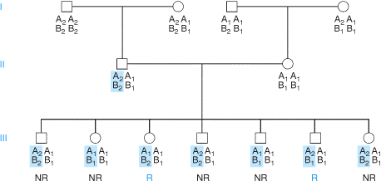
Recombination will rarely separate loci which lie very close (⍬=0)
Alleles on the same small chromosome segment tend to be transmitted as a block through a pedigree - called haplotype -that can be tracked in families and populations
How can we calculate the ⍬ ?
⍬ = 2/7= 0,28
The proportion of children who are recombinant is the recombination fraction between the two loci A and B during meiosis

Slide 9
Recombination fraction defines genetic distance
Two loci which show 1% of recombination = 1 centimorgan distance (cM)
The mathematical relationship between
recombination fraction and genetic map distance is described by the mapping function
Haldane function d= 0.5ln (1- 2⍬)
However there is interference during crossing-over
since one chiasma can inhibit another…
Kosambi function d=0.25ln[(1+2⍬)/(1-2⍬)

Slide 10
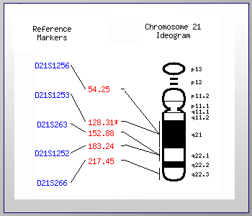
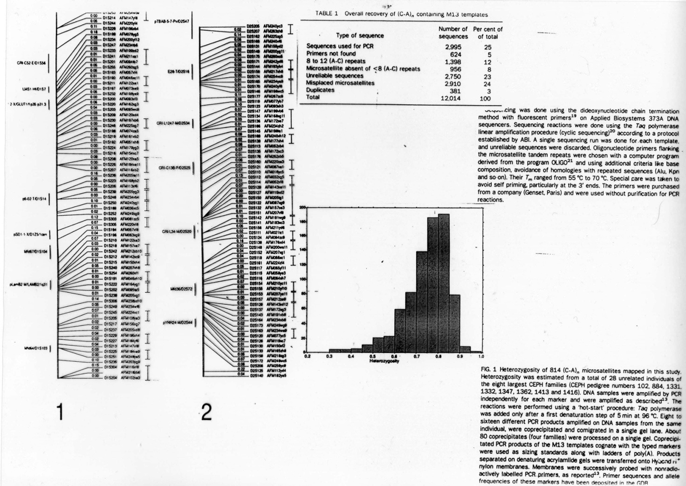
To perform linkage analysis you need genetic markers…
Characteristics:
highly polymorphic
the rarest allele with a frequency of at least 1%
feasible and stable in the pedigree
well-known position in the genome
genetic map of markers
Genetic map of markers in 1980…
Human complete genetic map of microsatellite markers in 1992 by Cohen and colleagues

Slide 11
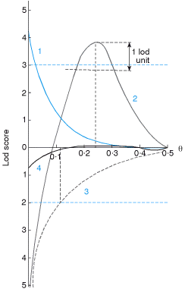
Genetic linkage and disease
Suitable large families are collected and segregation of the disease is compared with the segregation of the markers
By using statistics it is tested the probability that the two loci (markers) are not in linkage (null hypothesis; threshold is p=0.05) in one family (LOD SCORE)
Data from different families are collected and combined
LOD SCORE = is the logarithm of the odds that the loci are linked rather than unliked
It is a function of recombination fraction and is the product of the probabilities in each individual family
When ⍬ is 0.5, lod score is 0
Z =3 is the threshold to accept linkage

Slide 12
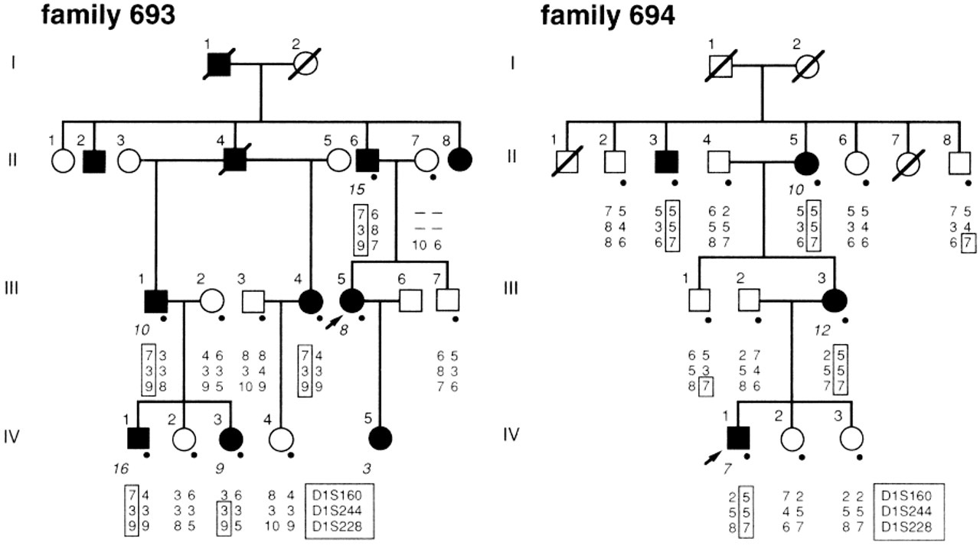
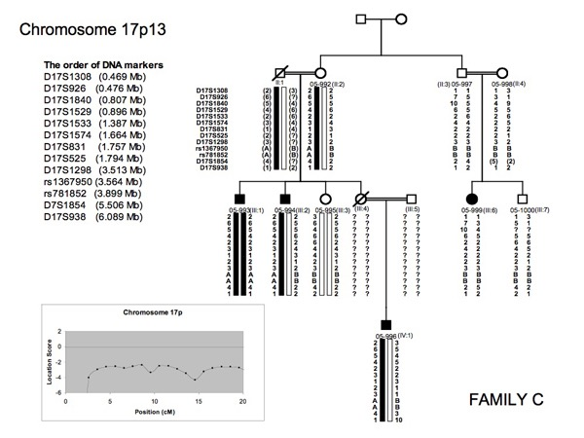
The overall probability of linkage in a set of families is the addition of LOD scores in each family
Linkage analysis can be more efficient if data for more than two loci are analyzed simultaneously
Multipoint mapping

Slide 13
cM Mb
Human Genome Project
June,20th,2003

Slide 14
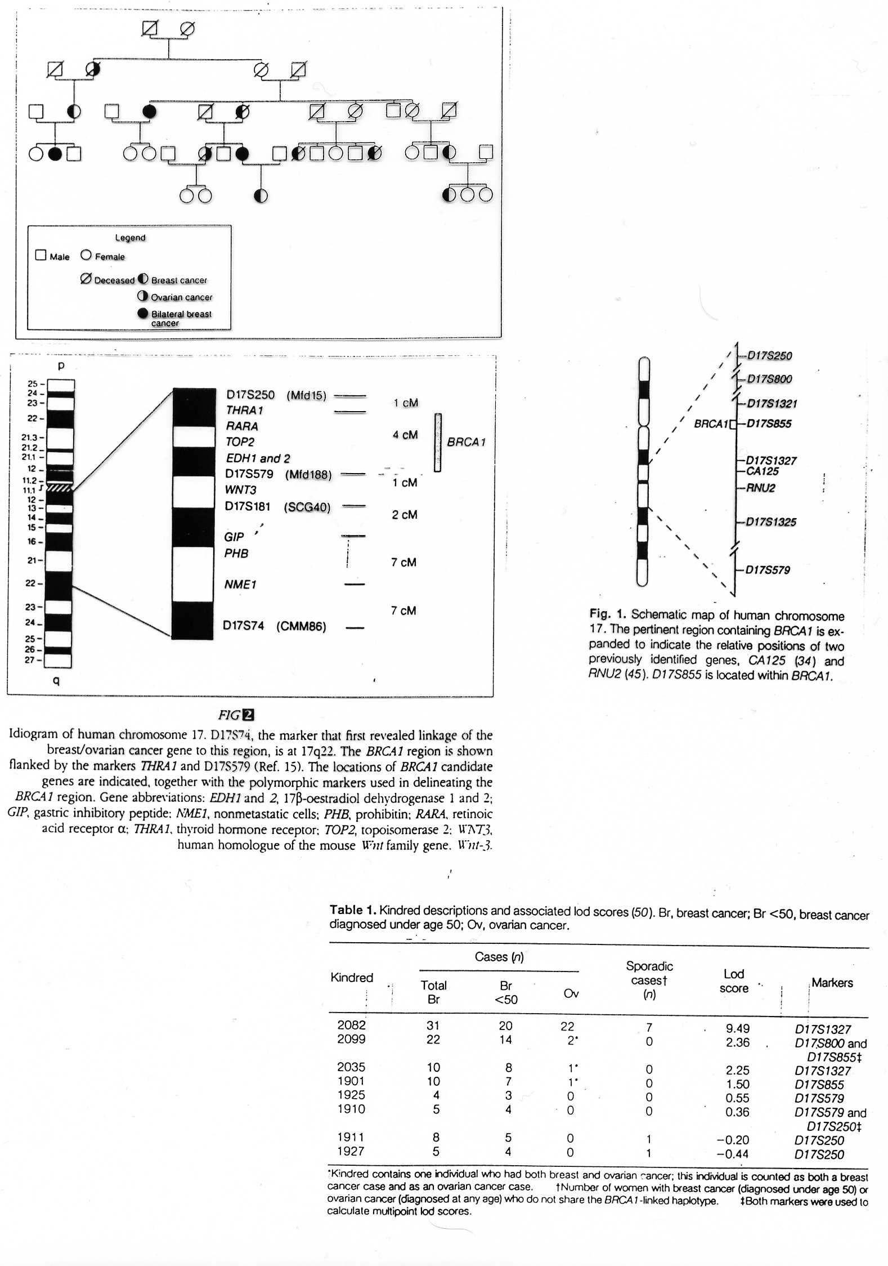
Linkage analysis and positional cloning: BRCA1
“The existence of BRCA1 was proven in 1990 by mapping predisposition to young-onset breast cancer in families to chromosome 17q21. (Hall et al, Science,1990)
Knowing that such a gene existed and approximately where it lays triggered efforts by public and private groups to clone and sequence it….
BRCA1 was positionally cloned in September 1994…”
Mary Claire King
identification of the more informative families
identification of the locus for the susceptibility
Lod score 5,98 to D17S74

Slide 15
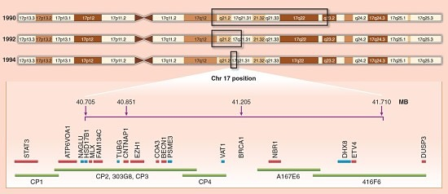
Linkage analysis and positional cloning:BRCA1
Families were analyzed with microsatellites spanning the region
lod scores were calculated for each family and add up for all the families
from genetic (cM) to physical map (Mb)
characterization of an open reading frame

Slide 16
Parametric Linkage Analysis
Parametric linkage analysis can be applied when there is a probability that a gene important for a disease is linked to a genetic marker
It is studied using the LOD score, which assesses the probability that the disease and the marker are cosegregating.
It can be used when we have a pedigree with a clear type of inheritance and genotype-phenotype correlation
Non-Parametric Linkage Analysis
Non-parametric linkage analysis studies the probability
of an allele being identical by descent with itself
It is used when the type of inheritance is not known
Less powerful, but you can apply it to a lot of families
3
-
1
1
+
2
2
-
3
2
+
4
3
-
1
2
-
3
3
-
1
2
-
3
1
+
2
2
+
4

Slide 17
Linkage analysis
Great success in identifying genes for simple Mendelian diseases
Few success in identifying genes contributing to complex disease
Unsuccessful in identifying genes contributing to common complex disease

Slide 18
Linkage
Markers association due
to their proximity
in the families
Association
preferential recurrence of
some alleles compared
to general population
Linkage disequilibrium
preferential association of
one disease allele with one
or more
alleles compared to
population

Slide 19
Linkage disequilibrium (LD)
The nonrandom association of alleles in the population
Alleles at neighboring loci tend to cosegregate
Linkage disequilibrium implies population allelic association

Slide 20
Linkage Disequilibrium
after n generations the haplotypes distribution will be differrent
in the two groups ONLY for the markers close to the mutation
mutation
t=0
Patients Controls
mutation spreads associated with
a particular haplotype
ricombinations interrrupt the association
with the farther markers alleles
Linkage disequilibrium: cystic fibrosis
Allelic combination CF chromosomes normal chromosomes
X1 K1 3 49
X1 K2 147 19
X2 K1 8 70
X2 K2 8 25
Ivinson AJ et al, 1989.

Slide 21
Linkage Disequilibrium Mapping
Population based
Look for variant allele in LD with disease
If most affected individuals in a population share the same mutant allele, then LD can be used to locate the chromosomal region harboring the disease

Slide 22
Case-Control Studies
Association studies: which allele of which gene is associated with the disease?
Common method in epidemiology
Cases
Controls from the same population
this implies that cases and controls should have similar genetic backgrounds

Slide 23
Linkage and association are different phenomena
- Association is a statistical statement about the co-occurrence of alleles or phenotypes (e.i. allele A is associated with disease D if people who have D also have more A). The association can have many possible causes (not all genetics).
- Linkage is a relationship between loci and does not of itself produce any association in the general population.
Linkage creates association within families, but not among unrelated people.
However, if two supposedly unrelated people with disease D have inherited it from a distant common ancestor, they may well also tend to share particular ancestral alleles at loci closely linked to D (Linkage disequilibrium )
Statistical association can develop for different reason:
direct cause-effect
natural selection
stratification of the population
linkage disequilibrium
Association studies are based on the use of haplotypes

