Slide 1
2201M21
-
CELLULAR AND MOLECULAR BIOLOGY COURSE
BIOLOGIA CELLULARE E MOLECOLARE
SVB0104 - CANCER GENETICS
LESSON #13a
2nd year / 2° Semester
Teacher: Antonella Roetto, PhD
antonella.roetto@unito.it

Slide 2
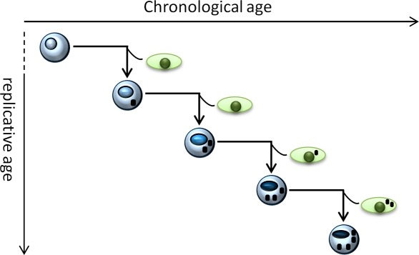
STEM CELLS AND CANCER
Adult stem cells (SCs) maintain tissue homeostasis throughout life and are rare, largely quiescent cells capable of :
self-renewal
maintaining the stem cell pool
differentiating to produce all mature cells within a tissue

Slide 3
STEM CELLS AND CANCER
Asymmetric cell division allows SCs to 1) self-renew and 2) produce another cell that undergoes differentiation, providing tissue homeostasis.
The SC daughter(s) of a stem cell retain all stem cell characteristics:
1) proliferation capacity,
2) undifferentiated state,
3) the capability to produce daughter cells that undergo differentiation.
A failure to maintain the correct stem cell number leads to tissue degeneration/aging or tumorigenesis/tissue hyperplasia by stem cell hyperproliferation

Slide 4
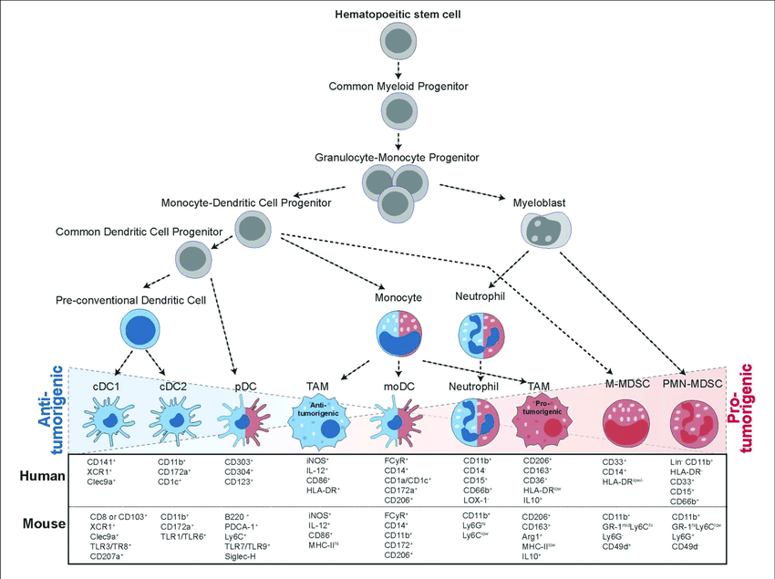

Slide 5
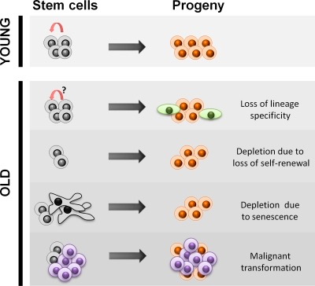
STEM CELLS AND CANCER
Wnt, Notch and Hedgehog pathways are the controllers of the balance between self-renewal and differentiation in neural, epidermal, intestinal, breast and haematopoietic SCs.
Cell survival and cell-cycle-regulating pathways, such as p53, Bmi-1, p21 and cyclin-dependent kinase inhibitors (CDKI), represent an additional intrinsic regulatory mode of SC self-renewal.
Also SCs are subjected to aging by accumulating DNA or protein damages
Aging induces the lost of specificity and and functionality with the onset of symmetric divisions.

Slide 6
CANCER STEM CELL MODEL
SCs have the ability to self-renew and differentiate to give rise to mixed cellular populations.
These features suggested that tumour-initiating cells might in fact be cancer stem cells.
Cancer stem cells (CSC) could explain the heterogeneity of most tumours, the tumor dormancy and the relapse occurring in patients considered tumour-free for many years.
The existence of CSCs, and whether they are sufficient to maintain tumour growth in humans, has not yet been definitively confirmed.
It is still unclear whether tumour initiation is driven by :
genomically advantaged stem cells or
more differentiated cells that reacquire stem cell properties
both events are possible

Slide 7
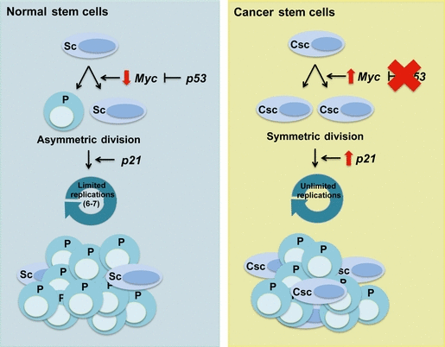
STEM CELLS AND CANCER
Verga Falzacappa FEBS Journal 279 (2012) 3559–3572
Normal SCs divide mainly asymmetrically giving rise to stem (Sc) and progenitor (P) cells
Their self-renewal potential is intrinsically restricted, exhausting when they reach the limit of six to seven divisions
In normal SCs, p53-dependent regulation of c-Myc imposes an asymmetric mode of division and p21 maintains self- renewal
In cancer stem cells (Csc), self-renewal capability is deregulated.
Loss of p53 results in a switch to the symmetric mode of cell division, and upregulation of p21 extends the self-renewal ability of CSCs.
The CSCs undergo an indefinite number of rounds of cell division, which results in the expansion of the stem cell pool.

Slide 8
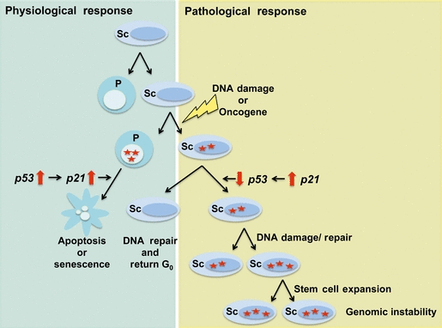
STEM CELLS AND CANCER
The DNA-damage response is different between stem (Sc) and progenitor (P) cells.
Progenitor cells respond to damage via p53-dependent upregulation of p21 that induces apoptosis or senescence
SCs upregulate p21, resulting in downregulation of p53 activity, which inactivates apoptotic responses and increases cell cycle entry and expansion of the SC pool, increasing the rounds of symmetric divisions.
Continuous DNA damage and repair suppresses apoptosis⁄senescence favouring the survival of SCs that harbour DNA mutations.
This could generate an actively expanding pool of immortal and genomically unstable SCs increasing the risk of cancer.

Slide 9
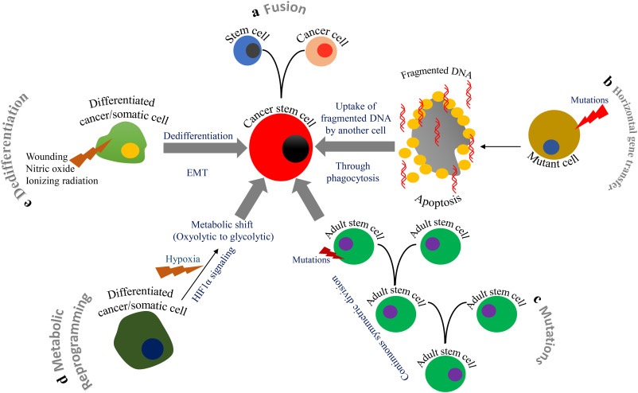

Slide 10
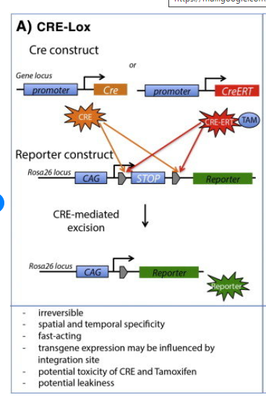
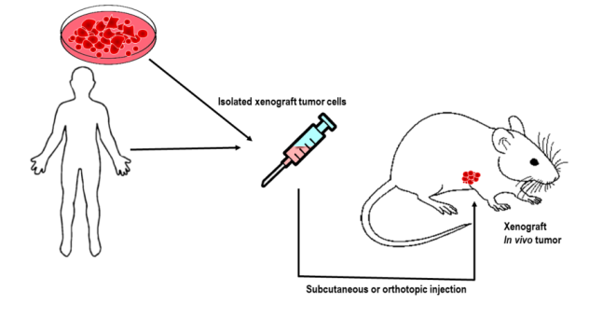
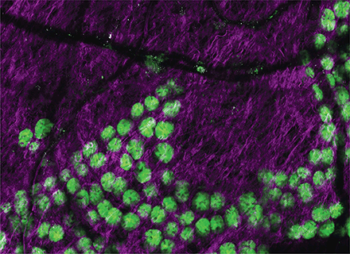
Approaches
Xenograft Lineage tracing
Tumor cell sorting
Cells inoculation in
Immunodeficient mice
Useful for leukemias
well characherized cells, few genetic changes,
low intra-tumor genetic heterogeneity
Solid tumors?
Dissociation of the tumor mass, tumor rely on cell-cell contact,
extracellular matrix, microenviroments
Kretzschmar and Watts, 2012

Slide 11
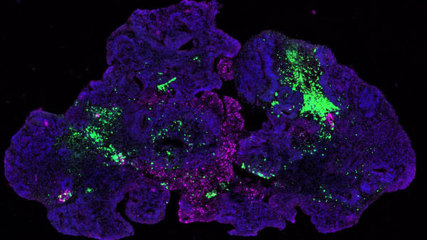
Organoids
3D culture technologies, 3D matrix
tissue-derived adult stem cells can grown and form self-organizing organotypic structures
human healthy tissue and cancer models.
cryopreserved and stored in living organoid biobanks
can be genetically characterized and used for drug screening
A single LGR5+ intestinal stem cell epithelial organoids (Sato et al, 2009)

Slide 12
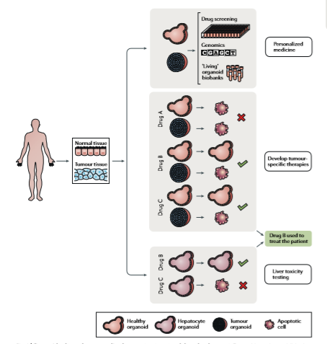
Drost and Clevers, 2018

Slide 13
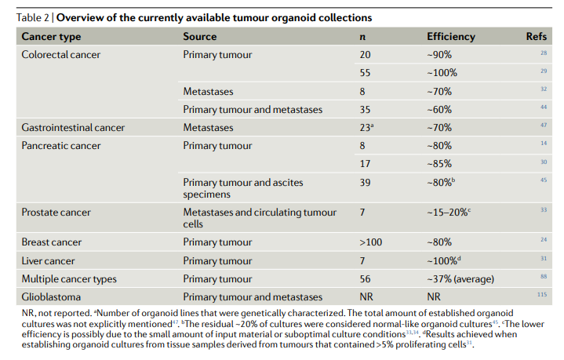
Drost and Clevers, 2018

Slide 14
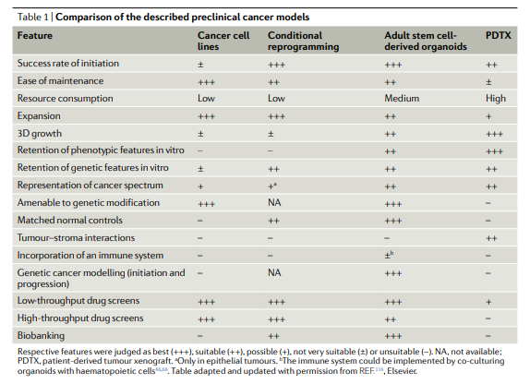
Drost and Clevers, 2018

Slide 15
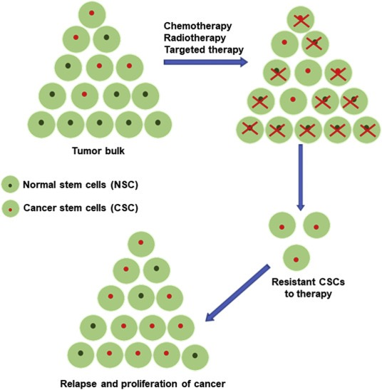
CSCs are generally resistant to chemotherapy and radiotherapy
A subset of remaining CSCs after therapy can survive and promote cancer relapse and resistance to therapies
CSCs role in drug resistance is crucial for establishing novel tumor diagnostic and therapeutic strategies.

Slide 16
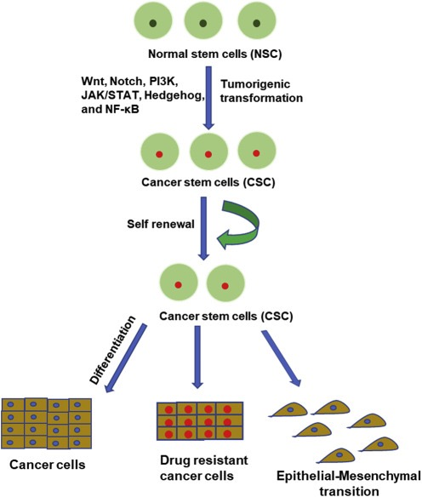

Slide 17
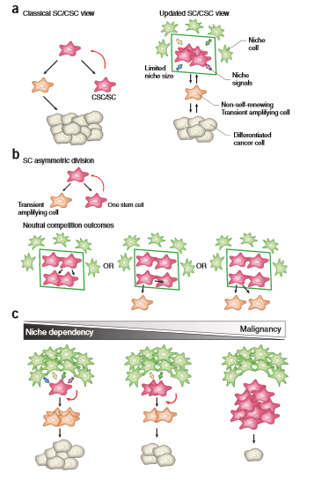
SC Plasticity
Role of the niche
Batlle and Clevers, Nat Med, 2017

Slide 18
SC Plasticity
Role of the niche
Batlle and Clevers, Nat Med, 2017

