Slide 1
2201M21
-
CELLULAR AND MOLECULAR BIOLOGY COURSE
BIOLOGIA CELLULARE E MOLECOLARE
SVB0104 - CANCER GENETICS
LESSON #1
2nd year / 2° Semester
Teacher: Antonella Roetto, PhD
antonella.roetto@unito.it

Slide 2
THE SPECTRUM OF HUMAN CHARACTERS
few characters are purely mendelian, purely polygenic or purely environmental
single gene
mendelian
genetic
reduced penetrance
multifactorial with single major locus
multifactorial
polygenic
environmental
Notes:
This first slide summarizes the main factors that could contribute to the onset of a huma disease. At the top corner of the triangle you can see the role of a single gene, down left corner more than one gene, down right corner the environment. These three factors rarely work alone and can differntly contibute to the onset of the disease giving origin to different types of disease: pure mendelina disease, mendelian disease with reduced penetrance, multif w sml
Multi.

Slide 3
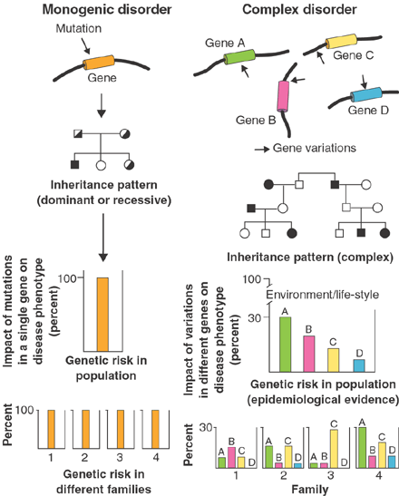
MONOGENIC DISEASES
In monogenic diseases, mutations in a single gene
are both necessary and sufficient
to produce the clinical phenotype
and to cause the disease.
The impact of the gene on genetic risk for the
disease is the same in all families.
From Leena Peltonen and Victor A. McKusick; Science 2001

Slide 4
COMPLEX DISEASES
In complex disorders with multiple causes,
variations in a number of genes result in a
genetic predisposition to a clinical phenotype.
Pedigrees reveal no Mendelian inheritance,
and gene mutations are
often neither sufficient nor necessary
to explain the disease phenotype.
From Leena Peltonen and Victor A. McKusick; Science 2001

Slide 5
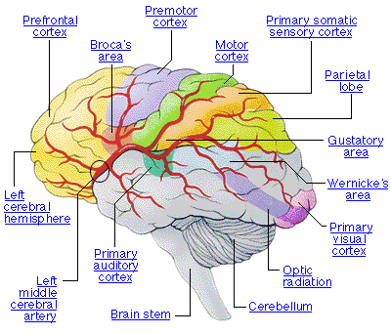
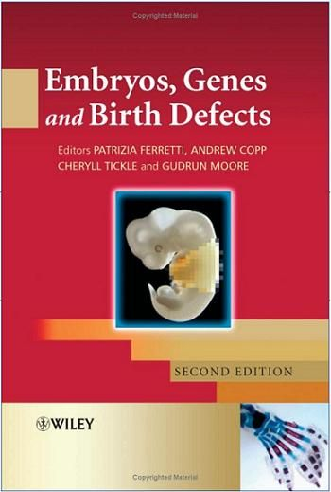
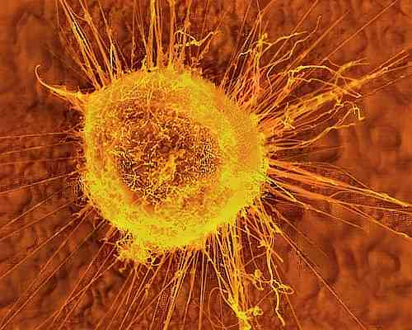
Complex Diseases
Psychiatric and
degenerative
disease of brain
Cardio-vascular diseases
Cancer
Non-syndromic birth defects

Slide 6
Complex Diseases
Selected Characteristics
Can aggregate in families but do not segregate in mendelian fashion
Multigenic
Multiple environmental factors
Phenotypic and Genetic heterogeneity
Incomplete (variable) penetrance
Complex interplay between genetic and environmental factors
Notes:
Multifactorial – Genetic, environmental, s with varying genetic contributions
Multigenic - Multiple genes with varying genetic contributions
Phenotypic heterogeneity
Phenocopies
Variable penetrance
Multiple genes with varying genetic contributions
Multiple environmental factors
Complex interplay between genetic and environmental factors
Highly context dependent
Susceptibility as opposed to determinism
Requires integrated approach (not reductionism)
Examples: hypertension, diabetes and cancer

Slide 7
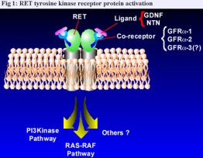
Genetic and phenotypic heterogeneity
More genes one disease
One gene more diseases
HFE
RET
Notes:
Multifactorial – Genetic, environmental, s with varying genetic contributions
Multigenic - Multiple genes with varying genetic contributions
Phenotypic heterogeneity
Phenocopies
Variable penetrance
Multiple genes with varying genetic contributions
Multiple environmental factors
Complex interplay between genetic and environmental factors
Highly context dependent
Susceptibility as opposed to determinism
Requires integrated approach (not reductionism)
Examples: hypertension, diabetes and cancer

Slide 8
Penetrance
Probability of disease given the genotype
penetrance = p(D=1|genotype)
Examples: assume 3 possible genotypes at a locus: (AA,Aa,aa)
p(D|AA) = 1, p(D|Aa) = 1, p(D|aa) = 0 AD
p(D|AA) = 1, p(D|Aa) = 0, p(D|aa) = 0 AR
p(D|AA) < 1, p(D|Aa) <1, p(D|aa) = 0 AD IP
Incomplete penetrance: penetrance < 1

Slide 9
Complex Diseases
Complex diseases tend to have low λ
Large λ suggest a major disease gene
Small λ may indicate many genes, each contributing a small effect
λ_{s} = 500 Cystic Fibrosis
λ_{s} = 15 Type I Diabetes
λ_{s} = 1 – 4 Hypertension
Notes:
Relative risk (λ) = risk for a relative of an affected person divided by the risk to the general population

Slide 10
Cancer = 2.3 millions deaths/year in industrial countries;
500.000 in the United States
Cancer is a genetic disease
One pathogenic variant in one gene in all cells (germinal mutations)
Hereditary Tumors
Accumulation of a high number of tissue-specific mutations (progression)
Familial Tumors
Some variants in some genes in all cells (germinal variants)
Sporadic Tumors
Some pathogenic variants in some genes in some cells (specific tissues)
Genes/environment interplay is necessary for the progression

Slide 11
Genes associated with cancers…
Cell-cycle and proliferation control, differentiation and apoptosis
“gatekeepers”
Tumor-suppressor genes
“caretakers”
DNA repair control
“landscape”
Microenvironment control
Oncogenes
Code for growth factors, growth factor receptors, signal transduction proteins
High penetrant genes
Low penetrant genes
“Strong” pathogenic phenotype
Variants with functional effect
“Mild or non evident” pathogenic phenotype
Variants with mild or non evident effect

Slide 12
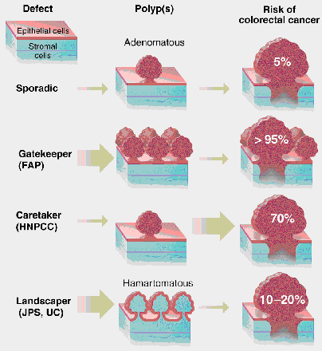
“Landscape” tumor suppressor genes
Landscaping genes are genes that have an indirect effect on the tissue that will eventually become cancerous acting on the stromal cells creating an aiding microenvironment for the cells to their transformation/progression.
Landscaper defects. juvenile polyposis syndrome (JPS) and ulcerative colitis (UC)
from Kenneth W. Kinzler, Bert Vogelstein
Science 15 May 1998:

Slide 13
Hereditary tumors
5%
Familial Tumors
10-20%
Sporadic tumors
80-85%
Familial cases
Sporadic cases
Hereditary syndromes
environment
genes
Modifier genes

Slide 14
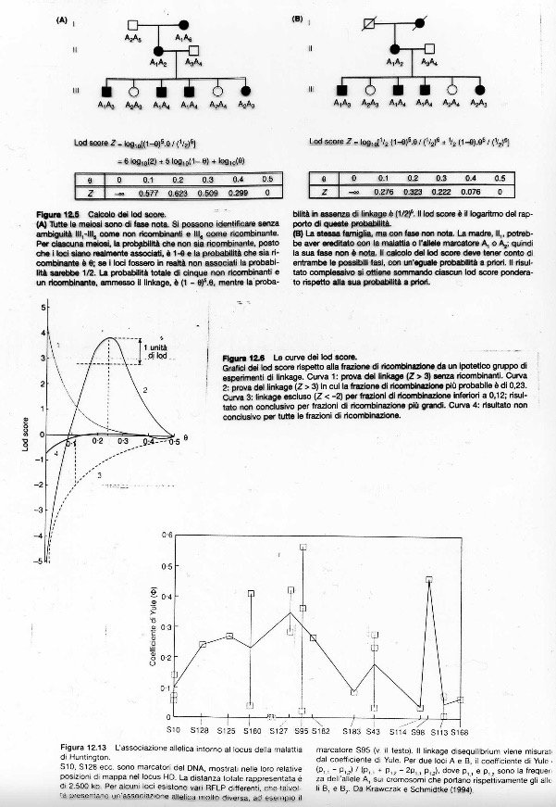
Cancer recognized as hereditary disease (end of the 19th century)
Hereditary tumors
High penetrant monogenic
syndromes
High penetrant genes
APC VHL WT1 RB1 NF1 NF2 p53 p16 BRCA1 BRCA2
hMSH2 hMLH1 hPMS1 hPMS2 ATM XPA BLM MUTYH
RET MET
Identified by:
Linkage analysis
positional cloning
Most of the susceptibility cancer syndromes are dominant in the families
Most of them follow Knudsen’s “two hits” hypothesis

Slide 15
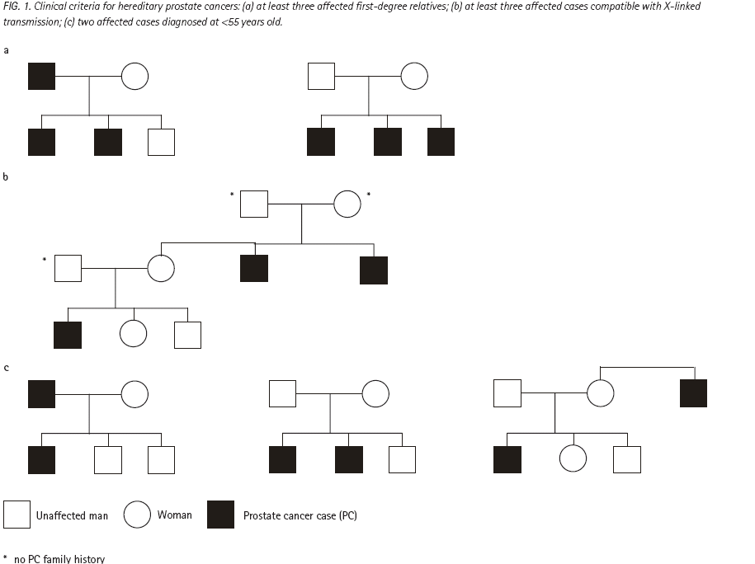
Hereditary tumors
High penetrant monogenic
syndromes
Families with several individuals affected by the same type of cancers
Recessive autosomic transmission
Both affected alleles are necessary to develop the disease
Some syndromes associated with DNA repair genes, such as the recessive polyposis
Dominant autosomic transmission
One affected allele is sufficient to acquire the susceptibility to develop the disease
FAP, HNPCC, breast and ovarian susceptibility genes,etc

Slide 16
Familial tumors
Polygenic syndromes
Predisposition associated with the interaction of different genes with the environment
High penetrant genes
Low penetrant genes
Most variants are single nucleotide polymorphisms (SNPs)
Genomic sequence variants in coding and non-coding sequence
SNPs Frequency= 1/1000 bp
Total genomic SNPs = 3 x 10⁶

Slide 17
Familial tumors
Polygenic syndromes
Families in which there is no evidence of a clear mendeleian inheritance
Polygenic risk
Low penetrant genes
To identify these genes linkage analysis is not useful
Use of inbred mice
Studies of homozygous mice in controlled environment
So far identified about 50 low penetrant genes in different tumor types
Homo sapiens ?
Identified only very few genes :
- DNA repair (XRCC1, XPD)
- detoxification (cyt. P450, GSST1)
- Inflammation response (PLA2, COX1/2, TNF-a)
Use of association studies
Case-control studies

Slide 18
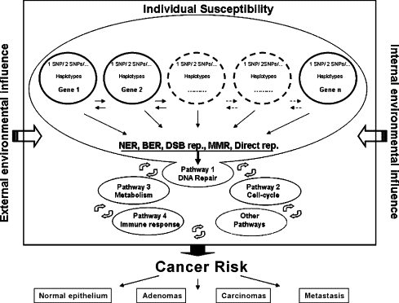
Sporadic Tumors
Interaction of the genetic background with environment
Relatives of cancer patients show 2/4 times higher risk of developing the same tumors
In industrial countries is difficult to point out the genetic background because enviroment background is high and confouding
Complex association studies
Genome wide association studies with nanotechnologies (DNA chips, etc)

Slide 19
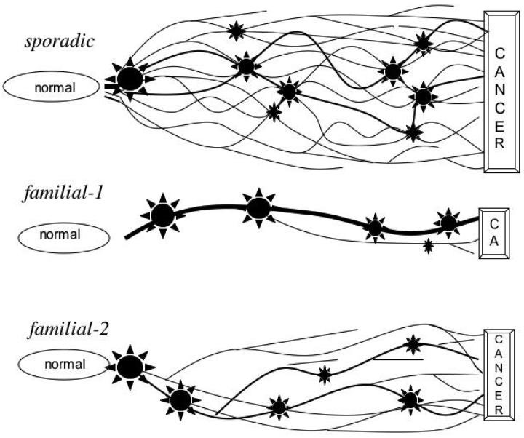
Growing debate over the nature of the genetic contribution to individual susceptibility to common complex diseases such as cancer
‘Common Disease, Common Variant (CDCV)’
Genetic variations with appreciable frequency in the population, but relatively low penetrance, are the major contributors to genetic susceptibility to common diseases
‘Common Disease, Rare Variant (CDRV)’
Multiple rare DNA sequence variations, each with relatively high penetrance, are the major contributors to genetic susceptibility to common diseases.
More than 90–95% of the heritable component of a disease has been left unexplained after extensive GWAS interrogation.
This suggests that individual common inherited variations are not likely to explain the majority of common chronic disease prevalence
GWA studies have reached their limits in the identification of common variations contributing to common diseases
This opens the door for the discovery of multiple rare variations that contribute to common diseases (or possibly other forms of genetic and epigenetic variation).

