Slide 1
Colorectal cancer
Melanoma
Breast cancer
environment
genes
Gastric cancer
modifier genes

Slide 2
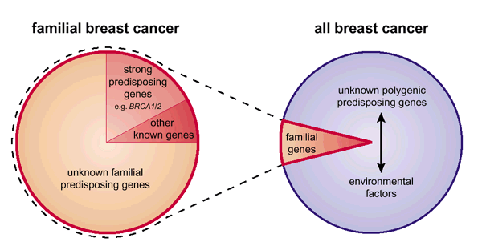
Breast cancer
Breast cancer risk is 1/12 women
Hereditary cases are 5% of the total breast tumours

Slide 3
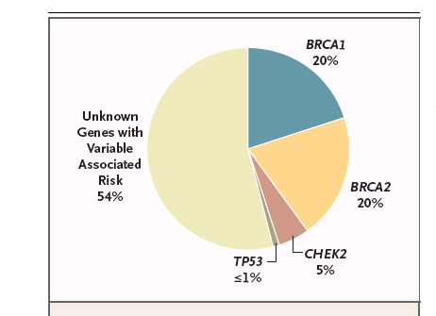
High penetrant genes:
BRCA1, BRCA2
PTEN
P53
LKB1/STK11
CDH1
BRCA1/2 genes account for only a subset of the hereditary breast cancers
High, but variable penetrance
Polygenic syndrome
Low penetrant alleles: CHECK2

Slide 4
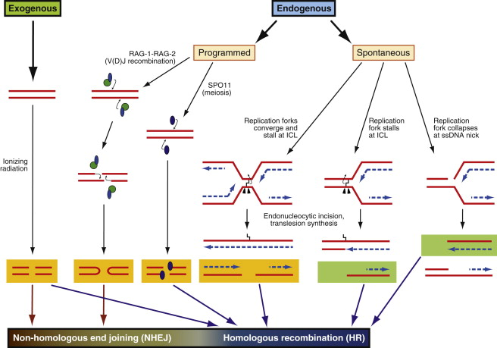
BRCA-1/2 proteins and Double Strand Breaks (DSB)
DNA damage that can block progression of replication
irradiation, chemical agents, reactive oxygen species (ROS)
ultraviolet light (UV) mobile genetic elements integration

Slide 5
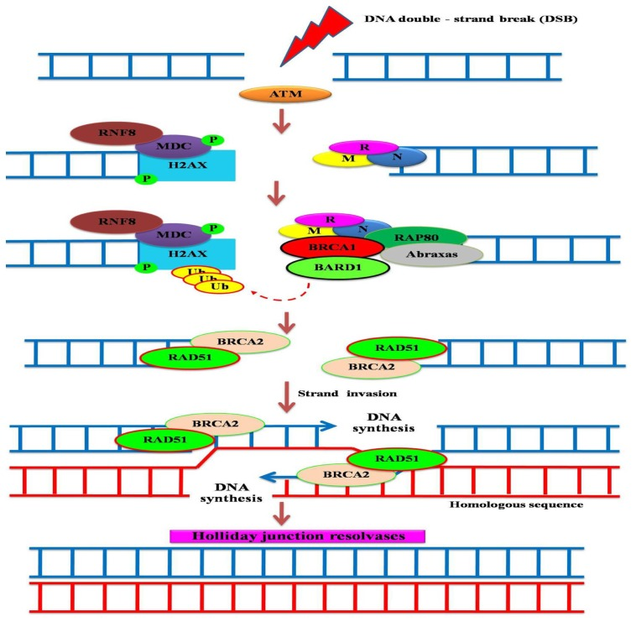
BRCA1: DNA repair, chromatic remodelling and cell cycle check control
BRCA2 : DNA repair (DSB) during homologous recombination

Slide 6
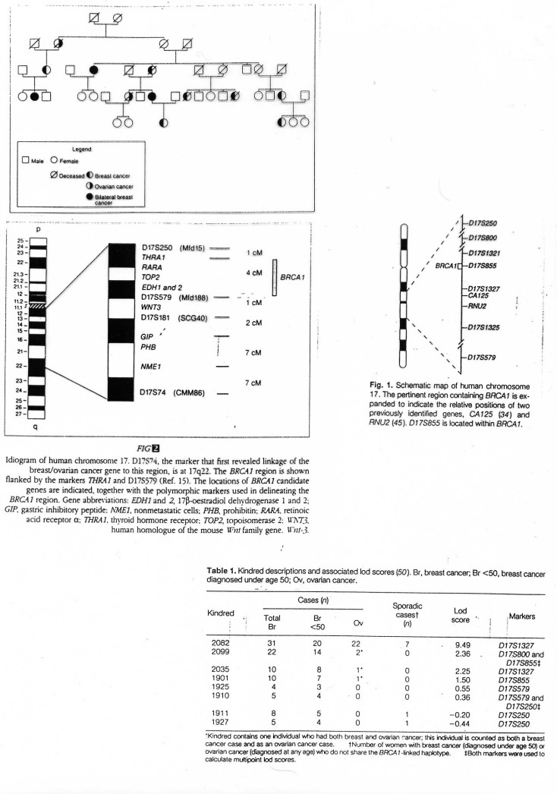
Breast cancer
BRCA1/BRCA2
2-3% of all breast/ovarian cases
both identified with linkage analysis
BRCA1 : 17q21, 100Kb, 22 exons
BRCA2 : 13q12, 70Kb, 27 exons
BRCA2 also in linkage with male breast cancer
cancer risk at 70 years
BRCA1 : 55% breast ; 39% ovarian
BRCA2 : 43% breast ; 27% ovarian
BRCA2 homozygous mutations caused Fanconi anemia
CARETAKERS
Genotype-phenotype : mutations in the central domain are associated with a more aggressive phenotype
Very frequent SNPs; in addition to a major variant, SNPs may influence the phenotype

Slide 7
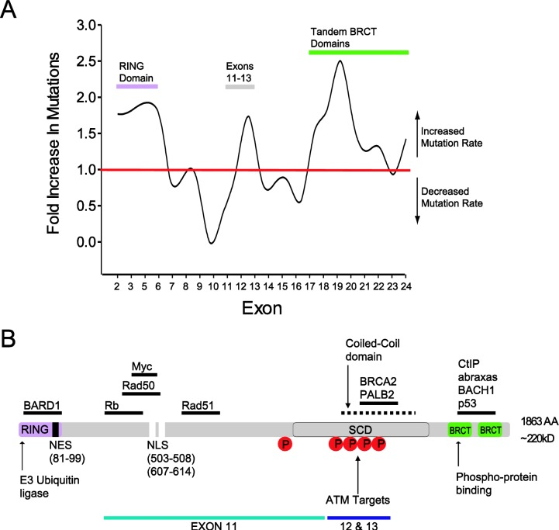
BRCA1 structure and function
Clark et al.2012

Slide 8
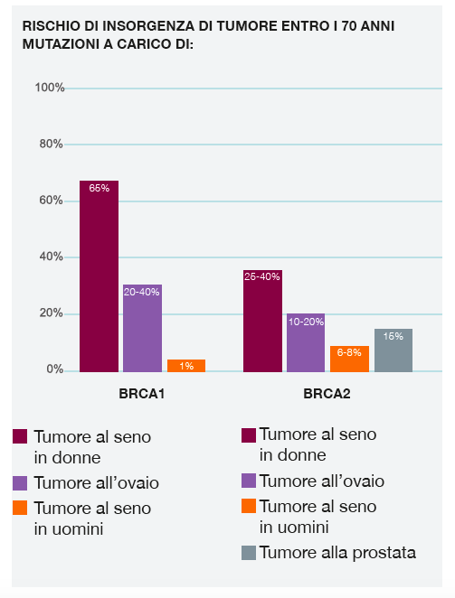
Cancer onset risk at age 70 years
Breast cancer in women
Ovarian cancer
Breast cancer in men
Breast cancer in women
Ovarian cancer
Breast cancer in men
Prostate cancer

Slide 9
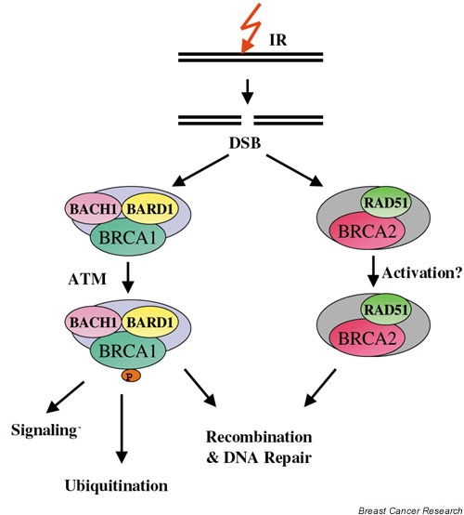
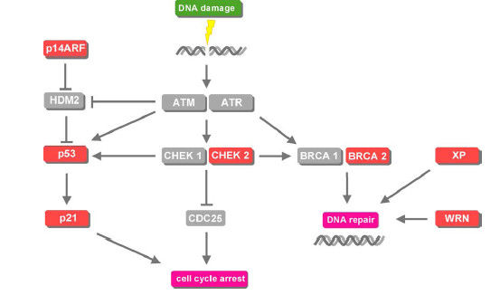
Breast cancer
Low penetrant alleles
CHECK2 , ATM, TGFB1, CASP8
CHECK2 : 22q12.1; it is a G2 checkpoint kinase, activated by ultraviolet radiation through ATM phosphorylation
Variants can modulate BRCA 1 mutated phenotype
CHECK2 and ATM are on the BRCA1 pathway

Slide 10
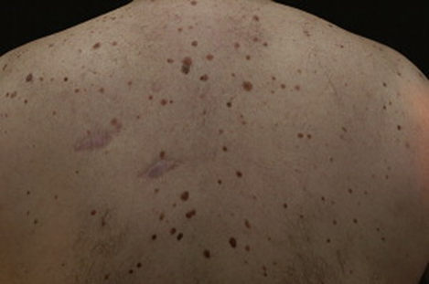
Melanoma
Melanoma are hereditary in 10% of cases:
a) several melanomas in different generations,
b) multiple primary melanomas in one subject,
c) early onset of the disease
Autosomic dominant condition in linkage with loci on 9p21
Linkage analysis identified CDKN2A mutations (9p21) in association with hereditary melanoma in 1997
CDKN2A is composed
of 4 exons and codes for 2 proteins :
p16/INK4a and p14/ARF

Slide 11
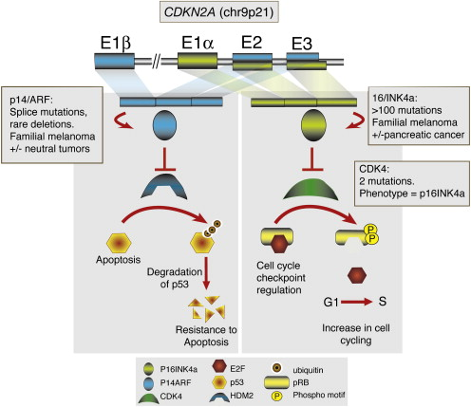
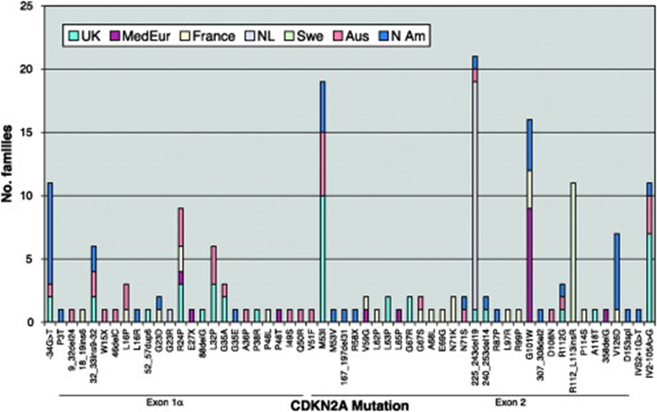
p16 loss induces the G1/S transition (by Rb1 phosphorylation)
p14 loss makes p53 unstable
Germline mutations of these two genes affect 39% of the families.
CDKN2A germline mutations are frequently found in geographical region with low incidence of sporadic melanoma

Slide 12
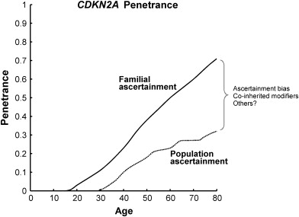
CDKN2A germline mutations show a penetrance of 30% at 50 years and 67% at 80 years depending on the geographical region
Relevance of modifier factors (ex. UV exposition)
High penetrant alleles:
CDKN2A, ARF, CDK4
Low penetrant alleles:
MC1R , vitamin D receptor
Phenotype is correlated with pigmentation, skin type, sun sensibility etc…

Slide 13
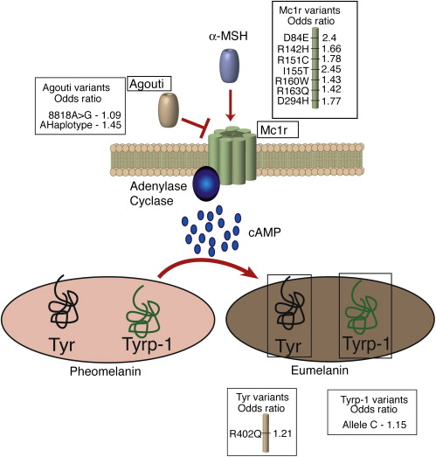
More than 120 genes are involved in pigmentation and skin colour...
MC1R codifies for a transmembrane protein which activates the eumelanin production by adenylase cyclase
These genetic variants are found in 80% of individuals with red hair and clear skin, but in only 20% of those with black hair
They are associated with a 3.9 higher risk of melanoma
MC1R plays a role as a phenotype modifier in association with CDKN2A
Somatic BRAF mutations (50% of cutanea melanoma) are associated with MC1R variant

Slide 14
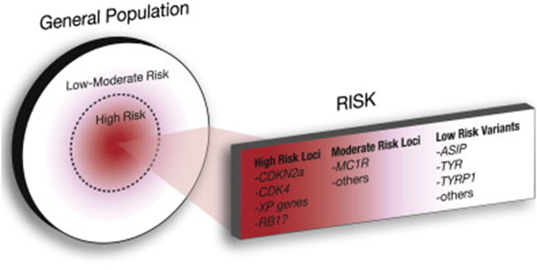
MELANOMA: A POLYGENIC DISORDER

Slide 15
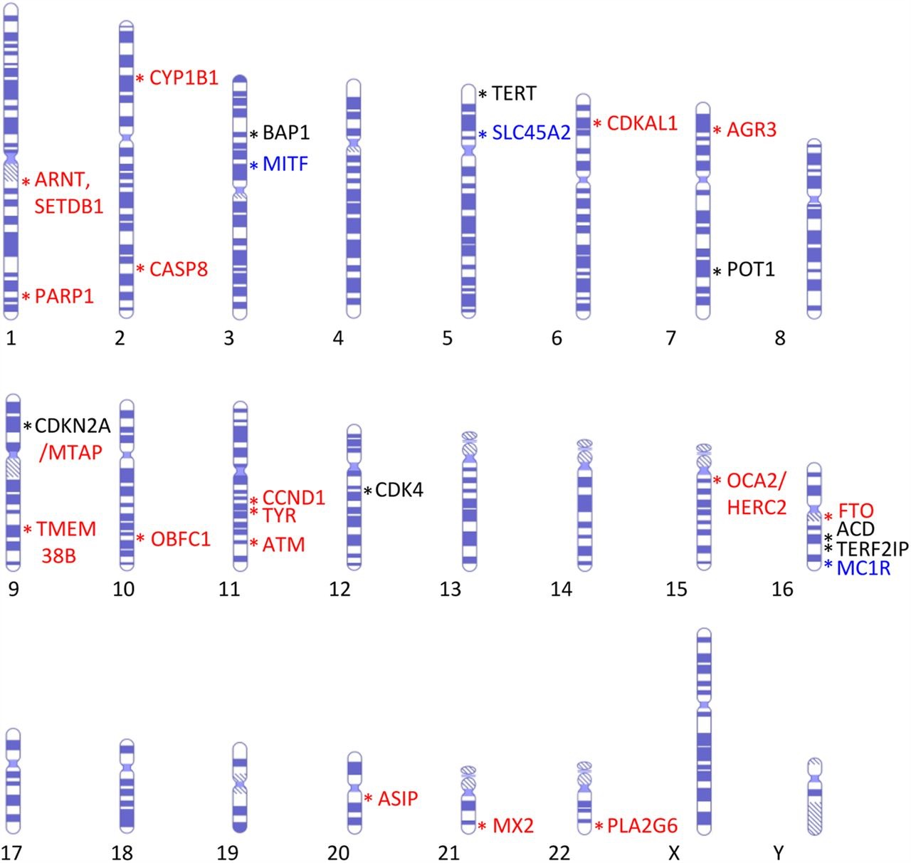
Melanoma as an example of polygenic disorder
High, medium and low penetrance genes and their chromosome band locations.
Jazlyn Read et al. J Med Genet 2016;53:1-14

Slide 16
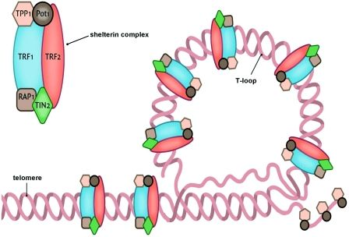
PROTECTION OF TELOMERES 1 (POT1)
Sheltherin complex
Involved in the regulation of telomere replication in mammalian cells, together
with the condensed telomeric chromatin structure to protect telomeres from
exposing free DNA ends which are subject to both telomere shortening and
chromosome end fusion.
Involved in telomerase function

Slide 18
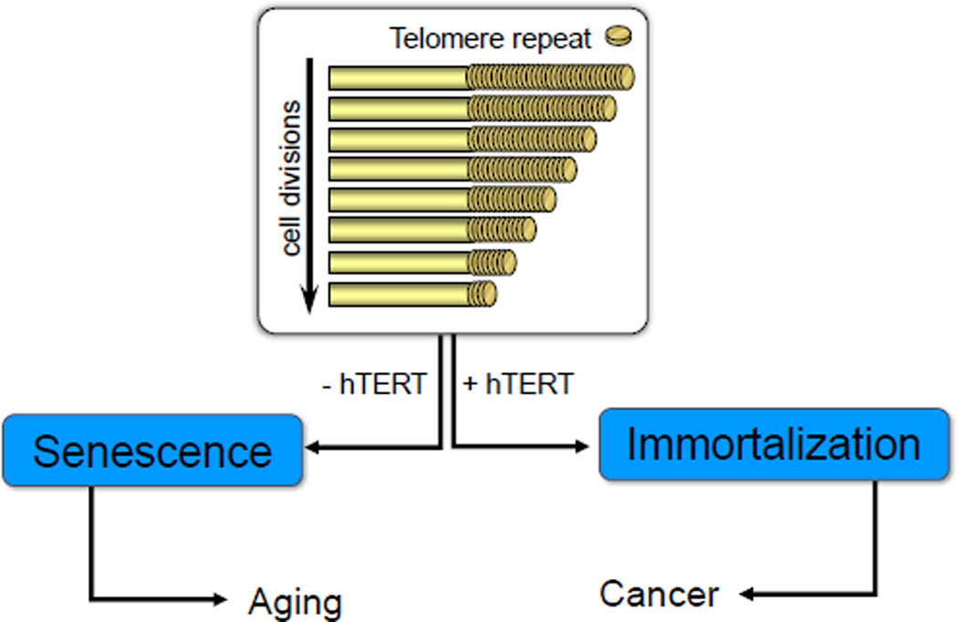
Say JW, 2016
Somatic mutations in the proximal promoter of the human telomerase reverse transcriptase gene (TERT) is now considered the most common noncoding mutation in cancer.

Slide 19
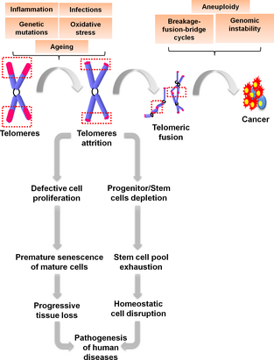
Defects in telomere- and telomerase-associated proteins lead to progressive telomere shortening
Telomere attrition coupled with deficiency in telomerase activity culminates in replicative senescence in adult stem cells, leading to a depletion in the stem cell reserve.
Collectively, these eventually manifest as hematological (i.e. anaplastic anemia, pancytopenia, bone marrow failure) or non hematological (i.e. skin abnormalities, pulmonary diseases, liver diseases) clinical features.
In adult cells short dysfunctional telomeres inevitably result in telomeric fusions, leading to genome instability, the cornerstone for carcinogenesis.

Slide 20
GENE-GENE
Epistasis: the effect of a particular gene depends
on the presence of another modiﬁer gene.
CDKN2A
MC1R
VDR
SLC45A2
BRAF

Slide 21
GENE -PHENOTYPE
GENE-ENVIRONMENT
CDKN2A mutation penetrance by age 80 years
0.76
0.58
0.91
Modifiers?

Slide 22
FAMILIAL MELANOMA NEGATIVE FAMILIES
Although the majority of genetic alterations associated with melanoma development are somatic, the underlying presence of heritable melanoma risk genes is an important component of disease occurrence.
Susceptibility for some families due to mutation in one of the known high penetrance melanoma predisposition genes: CDKN2A, CDK4, BAP1, POT1, ACD, TERF2IP and TERT accounts for approximately 50% of familial melanoma cases
Genetic basis is unexplained for the remainder of high-density melanoma families.
rare mutations in a few additional high penetrance genes yet to be discovered
polygenic component to susceptibility, multiple low-risk alleles and genetic modifiers.

Slide 23
FAMILIAL MELANOMA MUTATIONS AND RISK OF OTHER CANCERS…
some 'melanoma' predisposition genes have been linked to other cancers, with cancer clustering observed in melanoma families at rates greater than expected by chance.
The most extensively documented association is between:
CDKN2A germ line mutations and pancreatic cancer
BAP1 (BRCA1-associated protein-1) germ line mutations and cutaneous melanoma, uveal melanoma and mesothelioma
MITF, BAP1 and renal cell carcinoma
POT1 and glioma

Slide 24
…AND VICEVERSA
Xeroderma pigmentosum
Li-Fraumeni syndrome
Melanoma
Familial breast cancer
Werner syndrome

