Slide 1
2201M21
-
CELLULAR AND MOLECULAR BIOLOGY COURSE
BIOLOGIA CELLULARE E MOLECOLARE
SVB0104 - CANCER GENETICS
LESSON #11
2nd year / 2° Semester
Teacher: Antonella Roetto, PhD
antonella.roetto@unito.it

Slide 2
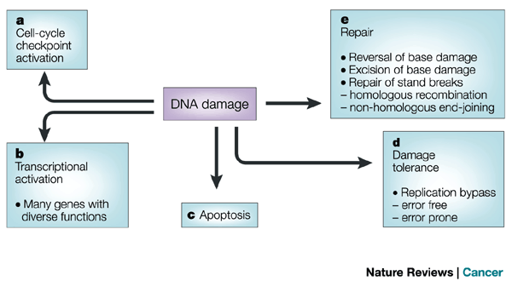
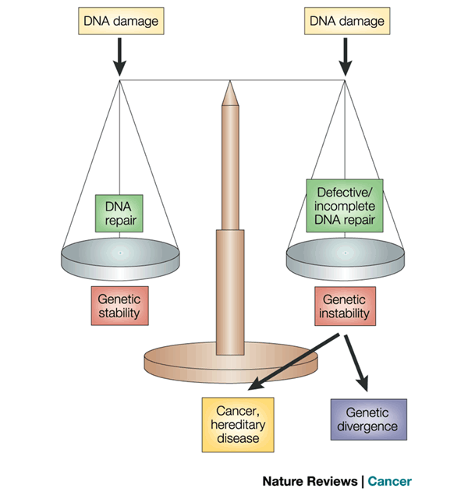
Mutational load at any given time in both germ line and somatic cells is the outcome of a dynamic equilibrium between the extent of DNA damage, the efficiency of DNA repair

Slide 3
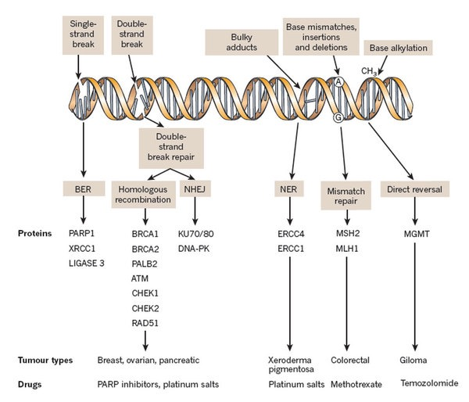
DNA repair pathways and cancers

Slide 4
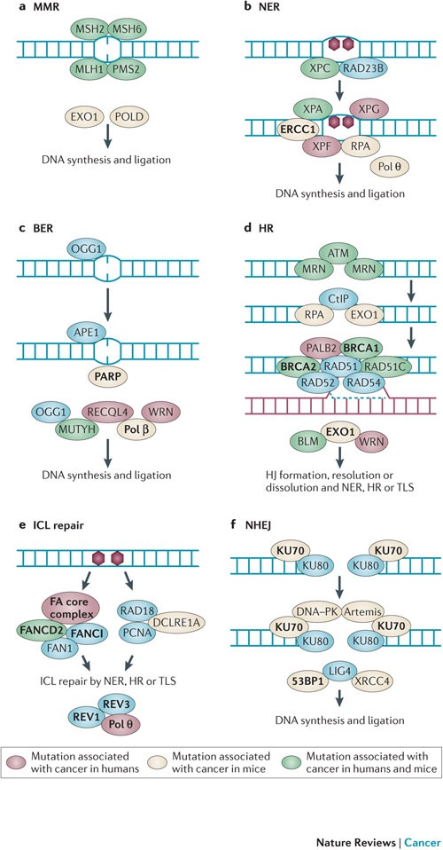
DNA REPAIR SYSTEMS
The nucleotide excision repair or NER pathways repairs bulky helix distorting adducts such as thymine dimers induced by UV
Base excision repair or BER removes DNA bases that are damaged by oxidation
DNA double strand break (DSB) repair by homologous recombination HR is active in late S or G2 phases of the cell cycle
Interstrand crosslinks (ICL) repair is a combination of different pathways, including NER, HR and translation synthesis polymerases
Non homologous end-joining (NHEJ) is active throughout the cell-cycle and is the only DSB pathway that is available in G1 phase when there are no templates for HR

Slide 5
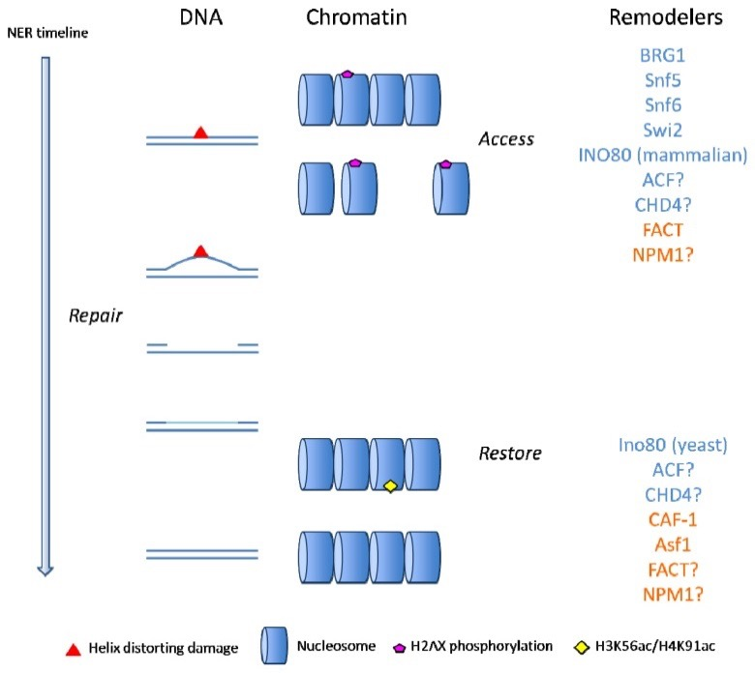
NER pathways
‘cut and patch’-type reaction
Short stretch of damage DNA removed
Undamaged DNA used as primer to re-synthetise the stretch (DNA pol)
Newly synthetised fragment ligation (DNA ligase)
Lesions not only has to activate the NER pathway but also a preliminary chromatin remodeling to access DNA
Cooperating mechanisms enhance the efficiency of NER by altering chromatin structure.
Many of the players were identified as regulators of transcription (ATP-dependent chromatin remodelers, histone modifying enzymes and several transcription factors)

Slide 6
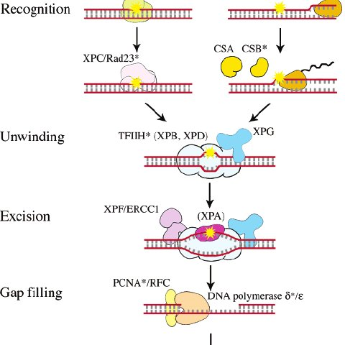
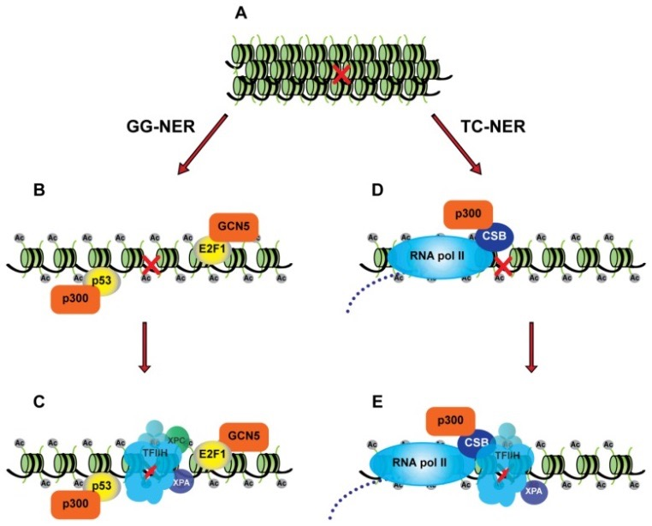
The global genome NER (GG-NER or GGR) pathway prevents mutagenesis by detecting the genome for helix-distorting lesions
The transcription-coupled NER (TC-NER or TCR) preferential repair of transcribed strands of active genes to allow gene expression
The p53 and E2F1 transcription factors are well known to regulate gene expression in response to DNA damage by contributing to modifying chromatin structure in response to DNA damage to promote GGR

Slide 7
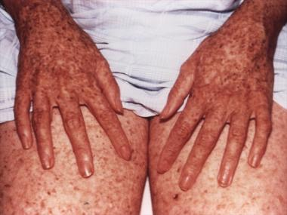
Defects in GG-NER result in cancer predisposition
Defects in TC-NER cause a variety of diseases (i.e. from ultraviolet radiation-sensitive syndrome to severe premature ageing conditions)
Humans with a hereditary defect in NER suffer from Xeroderma pigmentosum
They have a marked predisposition to skin cancer caused by sunlight exposure.
The balance between GG­R and TCR is crucial for protection from cancer as well as from premature ageing
In TCR deficiency this balance is disturbed, and cells with a low DNA damage load die from transcriptional stress, resulting in accelerated ageing and strong pro­tection from cancer.
In GGR deficiency, the still­ functional TCR promotes cell survival and delays ageing leading to the accumulation of DNA damage in non­ transcribed sequences, including the non­transcribed strand of actively expressed genes

Slide 8
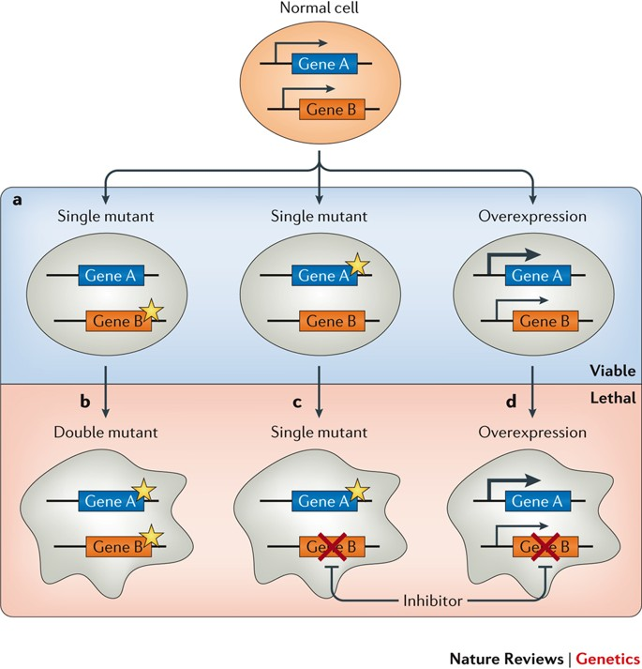
Tumors with specific DNA repair defects can be completely dependent on these pathways
This dependence can be exploited therapeutically to induce synthetic lethality in tumors
O’Neil et al , 2017
Tumors cells derived from patients carrying germline defects in key regulator genes of DNA repair pathways could be a useful model to understand responsiveness to synthetic lethality therapies
(eg. BRCA1/BRCA2 with PARP inhibitors)

Slide 9
Syntethic lethality
SL
Occurs between two genes
A genetics/epigentics alteration on one of the two genes is viable for the cell
but the second gene alteration is lethal for the cell
Characterized in model organnism (yeast, fruit fly)
Cell lines
Important therapeutical implications
CANCER
Many SL are dependent from specific
conditions / different cellular background
Quite rare/ unknown
O’Neil et al , 2017

Slide 10
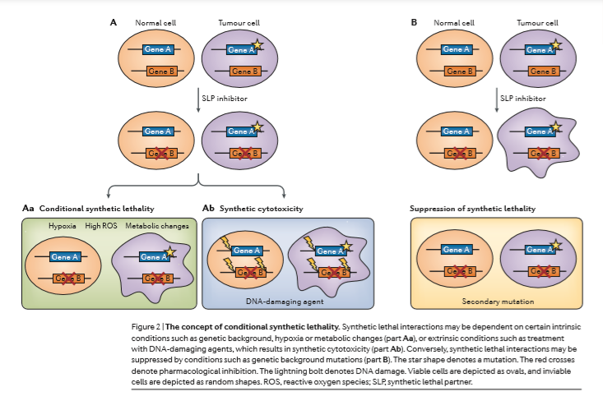
O’Neil et al , 2017

Slide 11
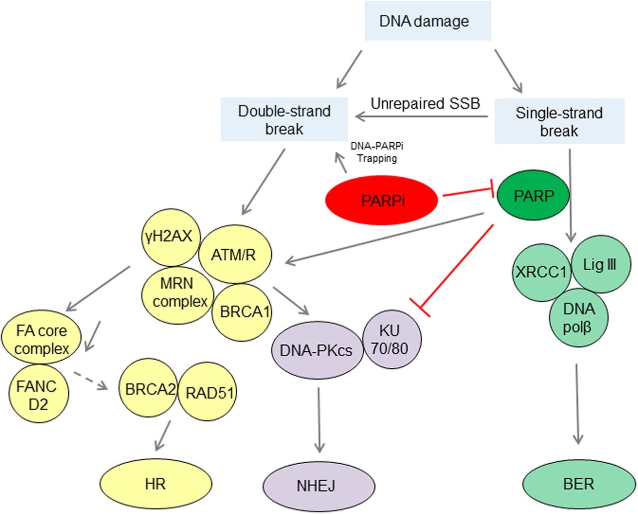
PARP1 binds to DNA single-strand break and catalyzes poly(ADP)ribosylation of itself and acceptor proteins, facilitating the recruitment of DNA repair proteins
Diana Lim, and Joanne Ngeow Endocr Relat Cancer 2016;23:R267-R285
PARP Inhibitors
They can be used to block the recruitment of DNA repair proteins

Slide 12
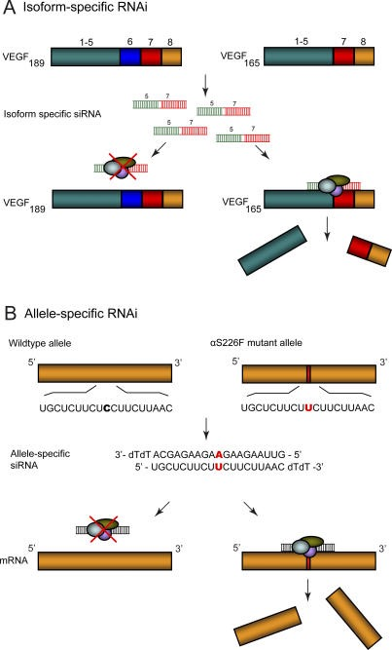
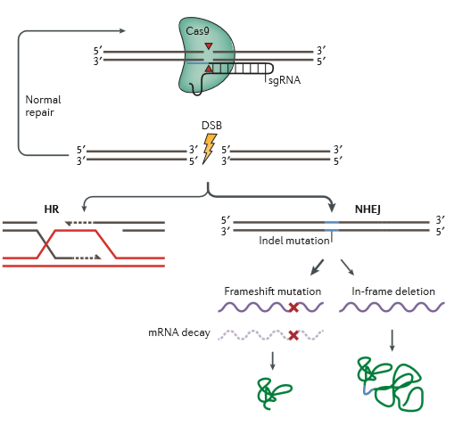
Genes inactivation strategies
RNA interference CRISP-Cas 9 technology
https://www.youtube.com/watch?v=2pp17E4E-O8

Slide 13
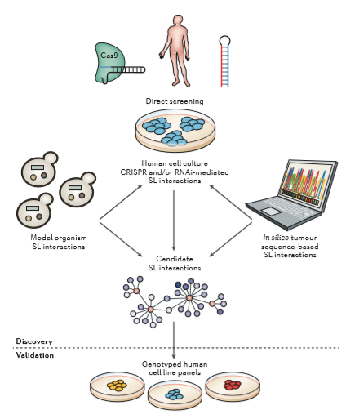

Slide 14
From synthetic lethality to cancer theraphy……
SL selective to cancer cells specific mutations responders
Can be apply to to any type of cancer mutations
Many therapeutic options low drug doses/adverse effects
Synthetic lethality databases, such as SynLethDB, contains tens of thousands
of interactions from the published literature;
The problems of irreproducibility in cell culture,
need to be confirmed across multiple cell
culture contexts and in vivo.
It should be worth to evaluate potential synthetic lethal interactions
that can be applied to cancer prevention
PARP1 inhibitors use to prevent breast cancer
in BRCA1 /2 mutated women

Slide 15
on the basis of the data obtained until now we can say the SL therapeutical approach will have significant impact on cancer research even if we are at the beginning of the story

Slide 16
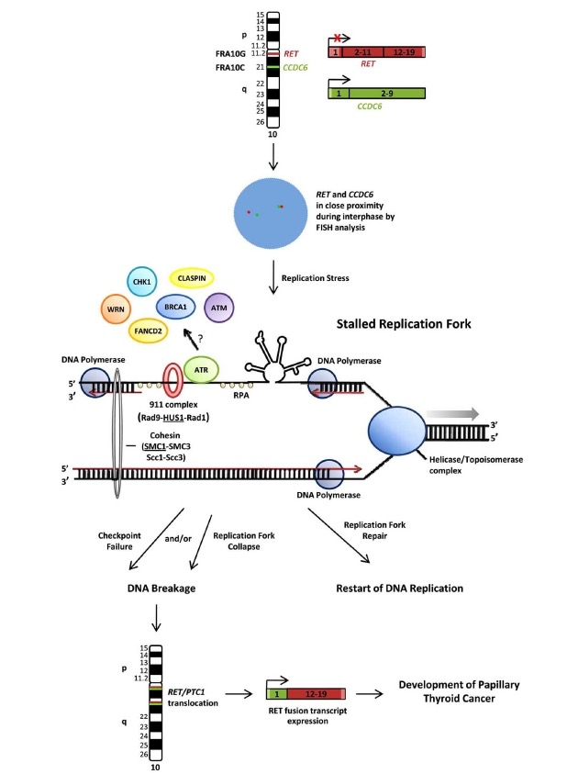
FRAGILE SITES AND CANCER
Fragile sites are specific genomic regions, mendelian inherited, exhibiting gaps or breaks on metaphase chromosomes following conditions of partial replication stress.
Fragile sites often coincide with genes that are frequently rearranged or deleted in human cancers (examples : formation of RET/PTC rearrangements, and deletions within the FHIT gene)
It is hypothesized that under replication stress, stable secondary structures form at fragile sites and stall replication fork progress, ultimately resulting in DNA breaks.
The ATR DNA damage checkpoint pathway plays a critical role in maintaining stability at fragile sites.

Slide 17
Human CFS | Location | Frequency | Associated genes | CACG
FRA2G | 2q31 | modest | IGRP, RDHL, LRP2 and others | not validated
FRA2H | 2q32 | modest | non-coding RNA gene | not validated
FRA3B | 3p14.2 | high | FHIT | FHIT
FRA4F | 4q22 | modest | GRID2 | not validated
FRA6E | 6q26 | modest | PARK2, PLG, LPA and others | PARK2
FRA6F | 6q21 | Modest | REV3L, DIF13, FKHRL and others | not validated
FRA7B | 7p22 | low | THSD7A, SDK1, MAD1L1 | not validated
FRA7G | 7q31.2 | modest | MET, TESTIN, CAV, and others | MET, TESTIN
FRA7I | 7q36 | modest | PIP | not validated
FRA7K | 7q31 | modest | IMMP2L | not validated
FRA8C | 8q24 | modest | MYC | MYC
FRA9E | 9q32 | low | PAPPA and others | PAPPA
FRA10F | 10q26 | low | FATS and others | FATS
FRA10G | 10q11 | low | RET, NCOA4 | RET
FRA16D | 16q23.2 | high | WWOX/FOR | WWOX
FRAXB | Xp22.3 | modest | STS, GS1 | not validated
FRAXC | Xq22.1 | modest | DMD, IL1RAPL1 | DMD
Genomic instability occurs preferentially at fragile sites (FS), evolutionarily conserved and late replicating regions with AT-rich sequences.
Identifying a cancer-associated FS gene (CACG) remains a challenge and little is known about the function of CACGs at most FS loci.
Recent studies of FATS (for Fragile-site Associated Tumor Suppressor), reveal an active role of these genes in regulating DNA damage checkpoints and suppressing tumorigenesis.

Slide 18
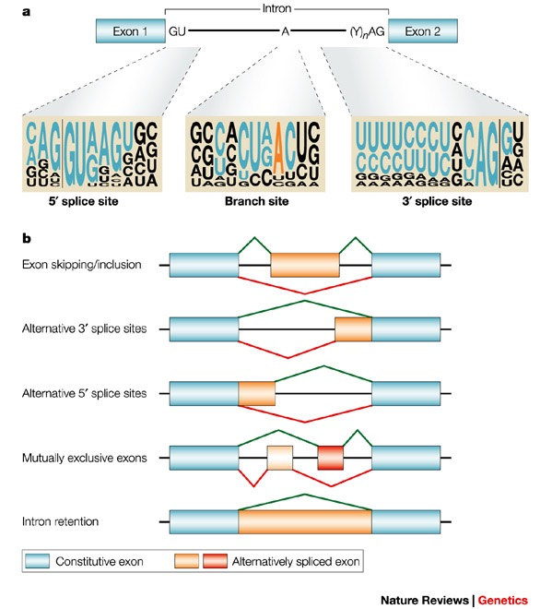
ALTERNATIVE SPLICING
The production of several isoforms from the same transcriptional unit
Conserved motives near or flanking introns :
GU, AG, polypirimidine tract preceding 3’AG and A residues using as a branchpoint
Cartegni et al., 2002

Slide 19
Alternative spicing isoforms can modulate the phenotype of several genes
The percentage of mammalian genes affected by alternative splicing can vary between 22 and 74%
A subset of these isoforms are degraded as nonsense mediated mRNA decay (NMD)
Most gives rise to functional protein isoforms
Alternative transcripts are less subjected to deleterious mutations and are hotspots for the evolution of proteins
Genomic variant can influence the quality and quantity of the alternative splicing
Alternative splicings can act as low penetrant alleles

Slide 20
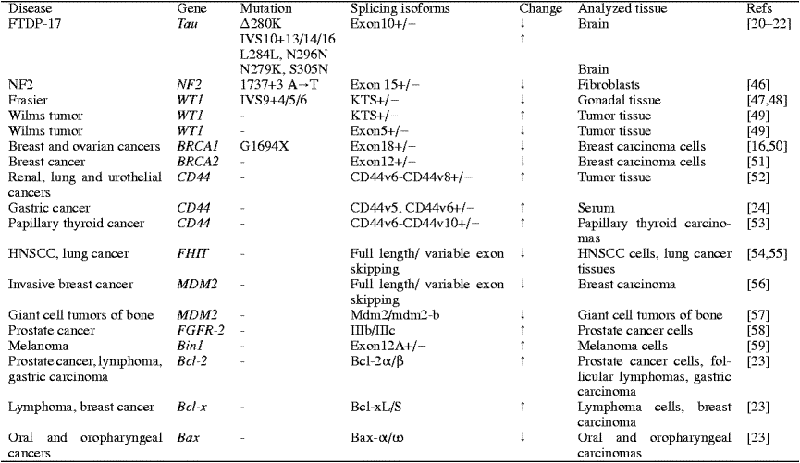
Splicing alterations can be germline - associated with monogenic syndromes- and somatic –associated with poligenic diseases

Slide 21
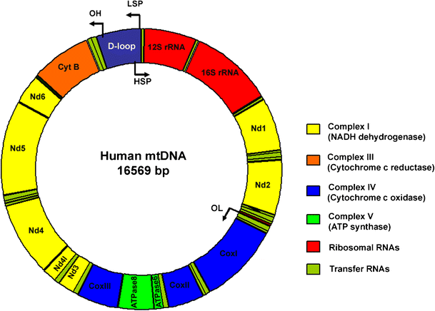
Mitochondria and mitochondrial DNA (mtDNA)
The mitochondrion is a highly specialized organelle, present in almost all eukaryotic cells and principally charged with the production of cellular energy through oxidative phosphorylation (OXPHOS).
Mitochondria are also involved in calcium signalling, regulation of cellular metabolism, haem synthesis, steroid synthesis and, perhaps most importantly, programmed cell death (apoptosis).
Mitochondria have their own DNA, known as mitochondrial DNA or mtDNA.
In humans, mitochondrial DNA spans about 16,500 DNA base pairs, representing a small fraction of the total DNA in cells.

Slide 22
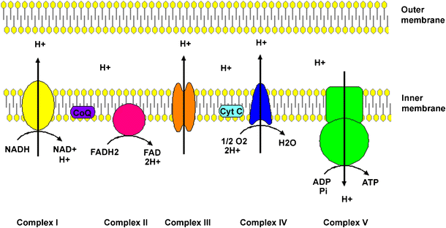
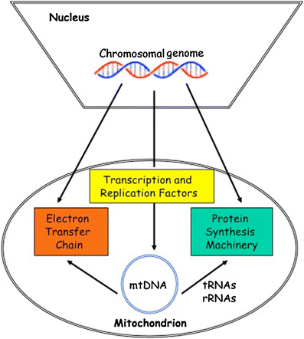
Mitochondria and mitochondrial DNA (mtDNA)
MtDNA consists in a heavy (H) and a light (L) strand, which encodes 13 of the more than 90 subunits of the electron-transfer chain and 22 tRNAs and two rRNAs.
Mitochondria divide by binary fission, similar to bacterial cell
In mammals mitochondria may replicate their DNA and divide mainly in response to the energy needs of the cell, rather than in phase with the cell cycle

Slide 23
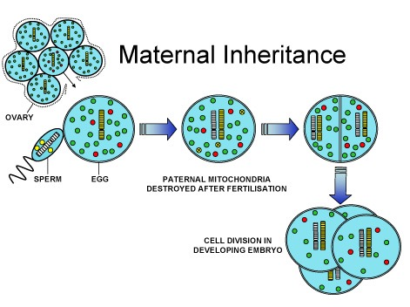
Mammals normally inherit their mtDNA from the population present in the oocyte, just prior to fertilization when mtDNA replication has been completed (matrilinear inheritance)
Uniparental inheritance leads to little opportunity for genetic recombination between different lineages of mitochondria
These copies tend to be identical and thus the mtDNA transmitted to the offspring is homoplasmic.
Following natural fertilization, sperm mtDNA tends to be eliminated thus ensuring the maintenance of homoplasmy

Slide 24
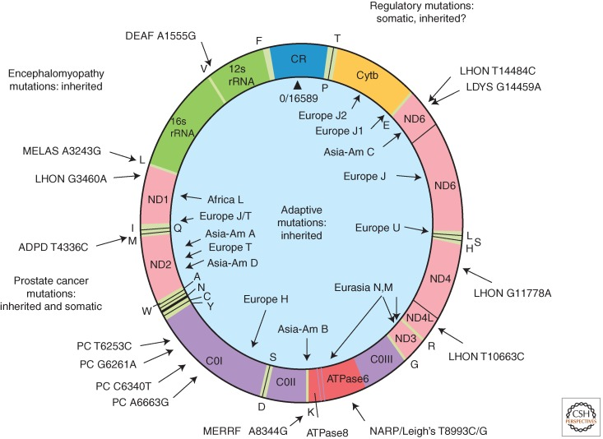
The near-absence of genetic recombination in mitochondrial DNA makes it a useful source of information for population genetics and evolutionary biology.
Mitochondrial DNA is inherited as a single unit, or haplotype that can be used to infer the evolutionary history of populations.
The segregation of mtDNA molecules tends to follow a pattern of random genetic drift since variants can be fixed (heteroplasmic condition)

Slide 25
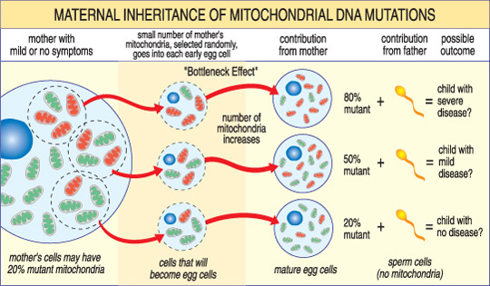
Normally, all of the thousands of copies of mtDNA within an individual are wild-type (WT) and identical, i.e. homoplasmic.
However, mutant and WT mtDNA molecules can coexist in a state described as heteroplasmy.
Over 100 point mutations and large-scale deletions have been identified so far
1 in 10,000 of the population are affected by mtDNA disease and another 1 in 6000 are at risk

Slide 26
Mitochondria, undergoing uniparental inheritance and with little to no recombination should accumulate deleterious mutations until functionality is lost.
Mitochondria avoid this buildup through a developmental process known as the mtDNA bottleneck: a single egg cell with some proportion of mutant mtDNA produces an embryo where different cells have different mutant loads
Cell-level selection may then remove those cells with more mutant mtDNA, leading to a
stabilisation or reduction in mutant load between generations.

Slide 27
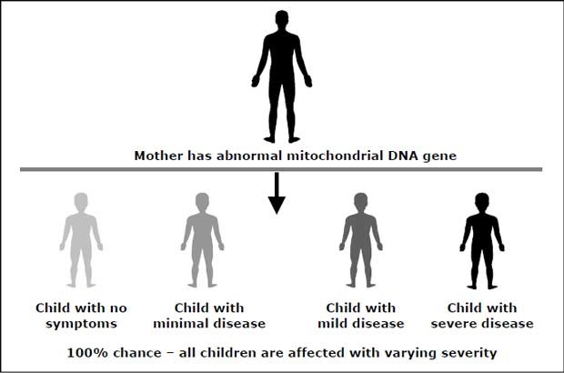
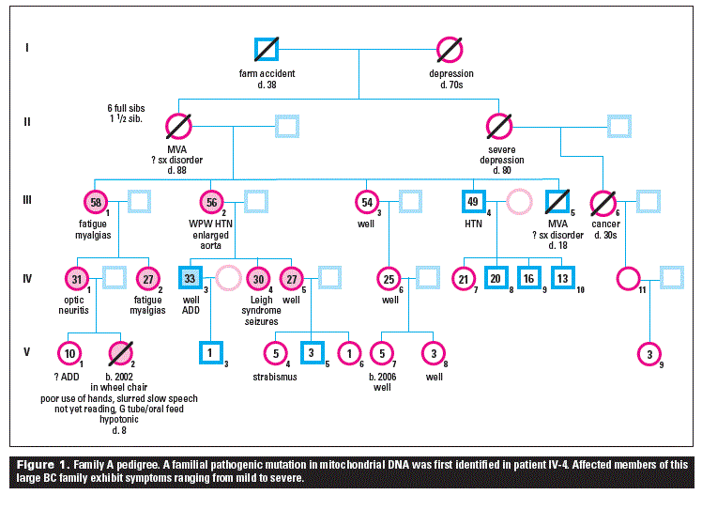
Mitochondrial disease is an inherited chronic illness that can be present at birth or develop later in life.
It causes debilitating physical and cognitive disabilities, loss of muscle coordination; muscle weakness and pain; seizures; vision and/or hearing loss; learning disabilities
mtDNA inherited diseases affect many tissues with variable features.
there are hundreds of different mitochondrial diseases with a spectrum of abnormalities
identical mtDNA mutations may not produce identical diseases.
Inherited mitochondrial diseases show complex patterns of inheritance

Slide 28
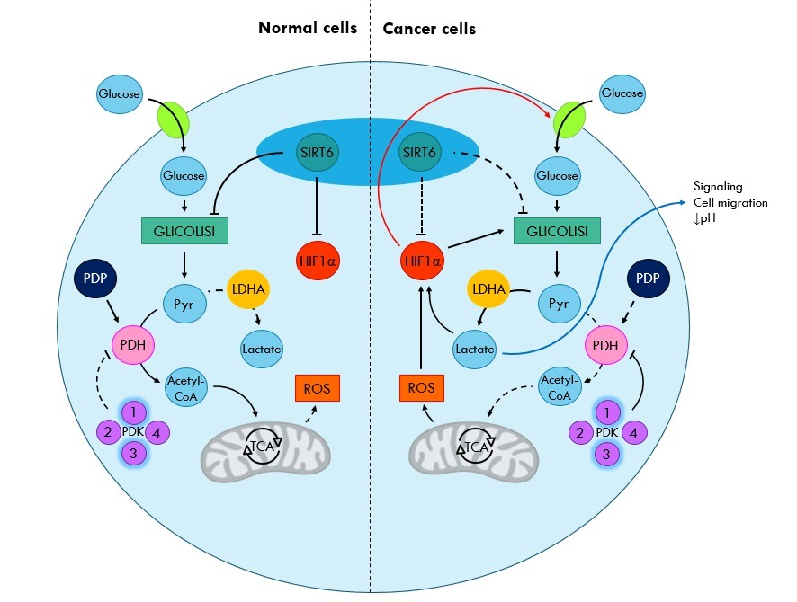
Mitochondria and cancer
Cancer cells are metabolically adapted for rapid growth and proliferation under hypoxic conditions, a condition in which normal cells would not grow at all or only poorly
Metabolic switch : glycolysis increase
Notes:
This is a Descriptive Observational Study, that that wants to measure the correlation between some colon pathologies and the expression of specific genes.

Slide 29
Altered metabolism in cancer cells has been directly or indirectly linked to mitochondria
Differences in the ultra structure of mitochondria and depletion cellular mitochondrial numbers have been reported in cancer cells
Differences in content and composition of all oxidative phosphorylation complexes, respiratory chain activity, expression of oxidative phosphorylation genes and levels of mitochondrial DNA were reported in tumoral samples vs relative to normal controls.

Slide 30
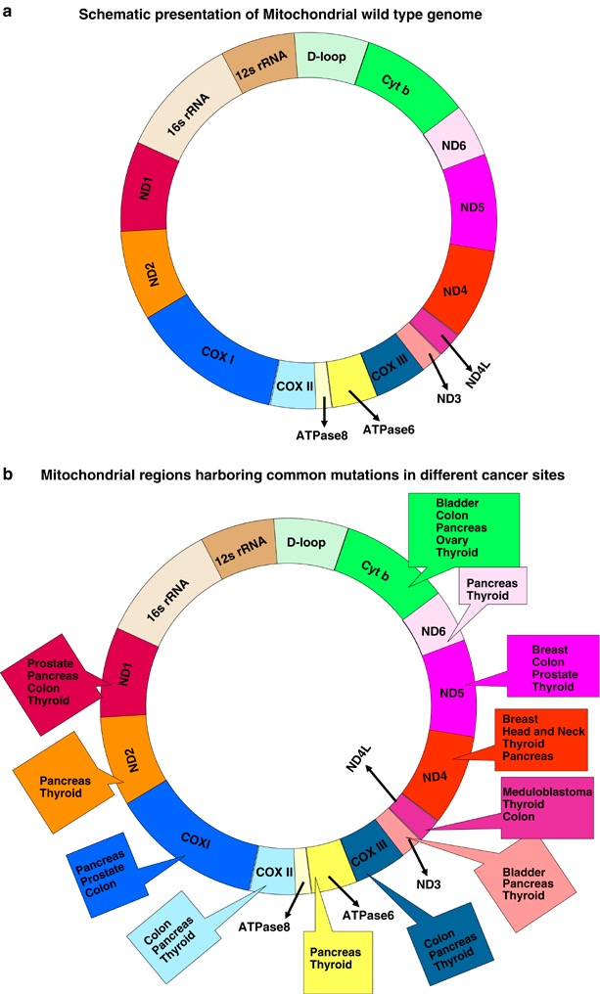
High level of ROS
Several mtDNA mutations have been identified in various types of human cancer.
Mutations have been found in both the non-coding region and coding regions of the mtDNA
The majority of the mutations appeared to be homoplasmic in nature

Slide 31
Specific mutations in “target” mitochondrial genes of MAP adenomas and carcinomas
Errichiello et al., 2015
…The sequence analysis revealed 17 different variants, in the MT-CO2 gene of MAP patients (P<0.0001) who frequently carried the hotspot m.7763 G>A mutation…D-loop instability was also significantly associated with variants grouped inside the MT-CO2 gene (P=0.006)…

Slide 32
