Slide 1
2201M21
-
CELLULAR AND MOLECULAR BIOLOGY COURSE
BIOLOGIA CELLULARE E MOLECOLARE
SVB0104 - CANCER GENETICS
LESSON #11
2nd year / 2° Semester
Teacher: Antonella Roetto, PhD
antonella.roetto@unito.it

Slide 2
Colorectal cancer
Melanoma
Breast cancer
environment
genes
Gastric cancer
modifier genes
Lung cancer

Slide 3
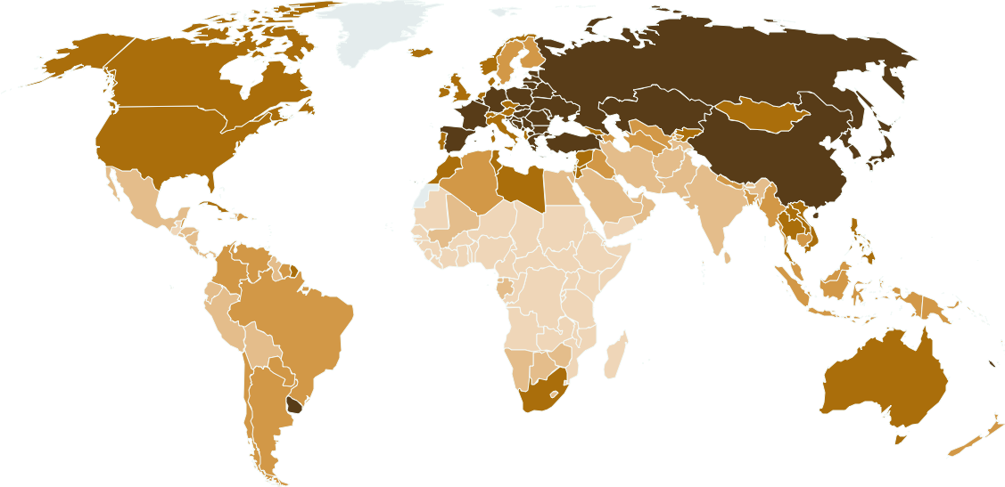
LUNG CANCER
Heterogeneous disease
Is the leading cause of cancer deaths worldwide
Frequent metastatization
It is often diagnosed at an advanced stage
Chemotherapy

Slide 4
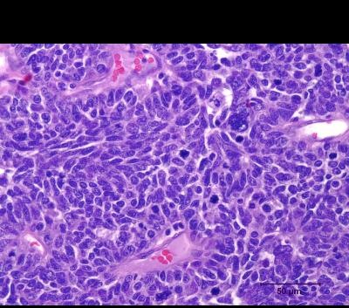
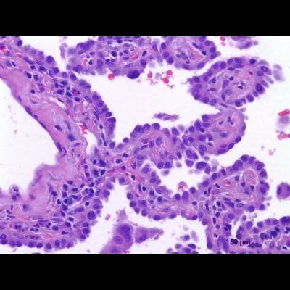
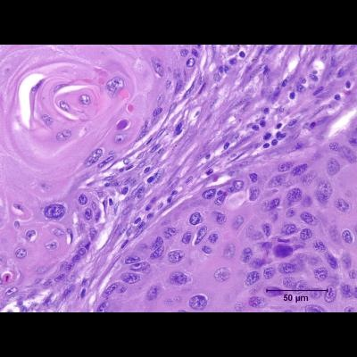
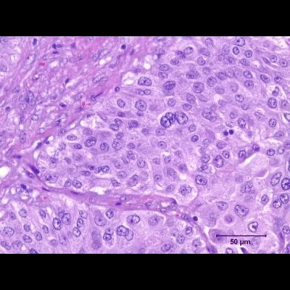
Lung Cancer
Small cells
Small Cell Lung Carcinoma – SCLC
15%
“Neuroendocrine”
Non Small Cell Lung Carcinoma – NSCLC
Lung epithelial cells
85%
Bronchioloalveolar
Squamous
Large cells
Adenocarcinoma
Squamous cell
Large cell
…..

Slide 5
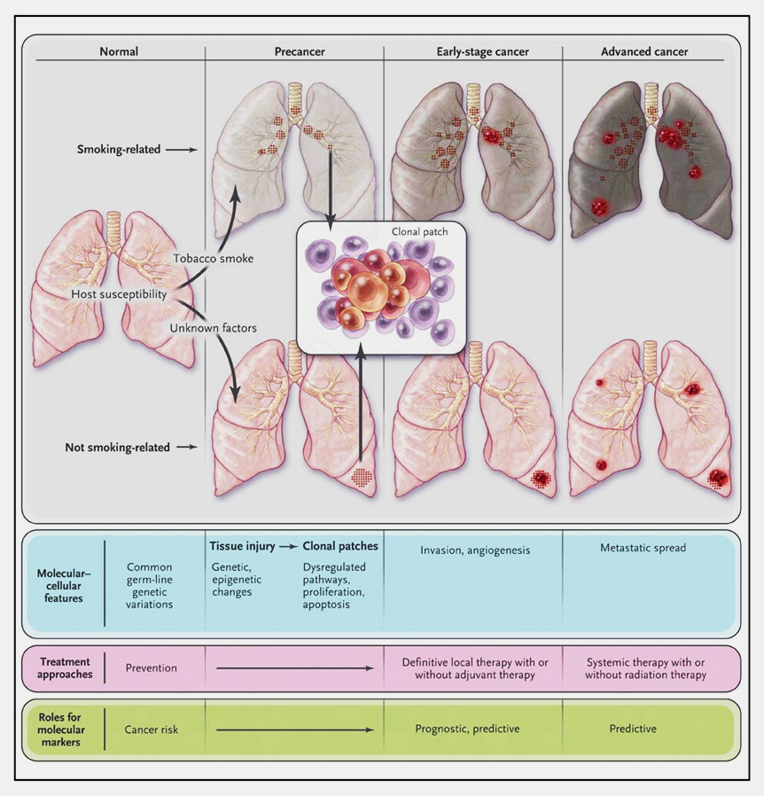
Enviromental factors (tobacco, hormonal, and viral) and genetic susceptibility interact to influence lung carcinogenesis
Tissue injury initially causes genetic and epigenetic changes
Dysregulated proliferation and apoptosis lead to dysplasia and clonal patches
Additional changes result in early-stage cancer, and metastasis
Herbst et al., N Engl J Med, 2008

Slide 6
Genetic susceptibility : some low penetrant alleles have been proposed
6 SNPS in the nicotinic acethylcoline receptor gene cluster on chromosome 15q
A region on chromosome 5p which includes the human telomerase reverse transcriptase gene hTERT

Slide 7
Non Small Cell Lung Cancer
Bronchioloalveolar
Adenocarcinoma is the most common type of NSCLC
Large cells
Squamous
Smoking causes all types of lung cancer but it is more related to SCLC and squamous-cell carcinoma
In NSCLC molecular origins and progression are still debated

Slide 8
Allelotype of NSCLC
1.0
0.9
0.8
0.7
0.6
0.5
0.4
0.3
0.2
0.1
0.0
1
2
3
4
5
6
7
8
9
10
11
12
13
14
15
16
17
18
19
20
21
22
Chromosome
FHIT = 80%
P16 = 70%
Rb = 80%
P53 = 50%
Tumor suppressor
Fragile histidine triad protein ,
involved in purine metabolism,
fragile site on chromosome 3

Slide 9
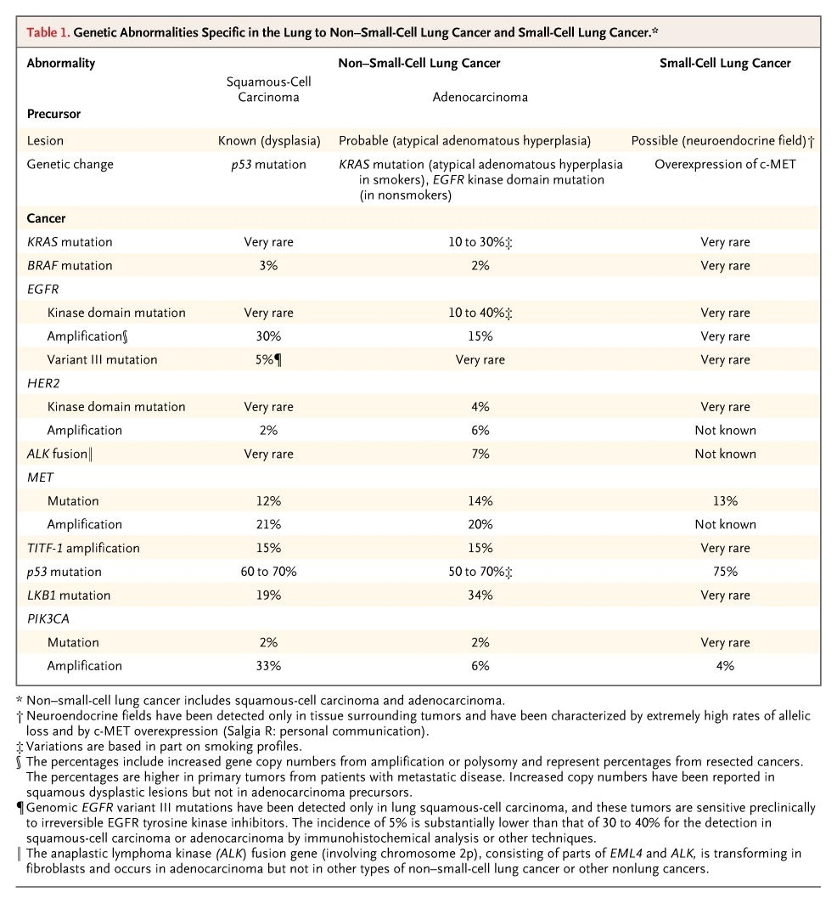
NSCLCs can exhibit a strikingly different molecular profiles....
smoking
other causes
Herbst et al., N Engl J Med, 2008

Slide 10
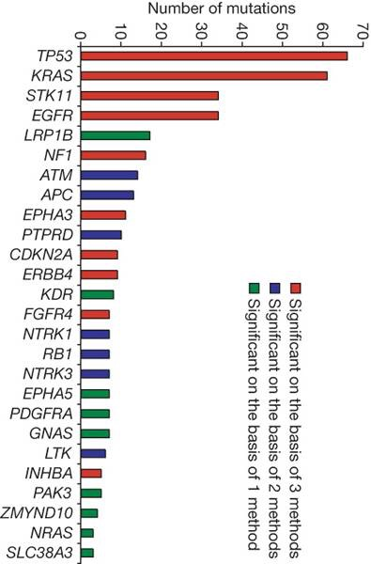
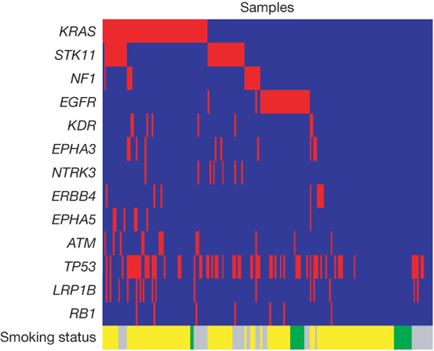
The genomic approach…
L Ding et al. Nature 455, 1069-1075 (2008)
188 primaries screened for 623 candidate genes
26 significantly mutated genes in lung adenocarcinomas
Concurrent and mutual exclusion of mutations observed across genes in lung adenocarcinomas.

Slide 11
Concurrent and mutual exclusion of mutations observed across
genes in lung adenocarcinomas
Ding et al., Nature, 2008

Slide 12
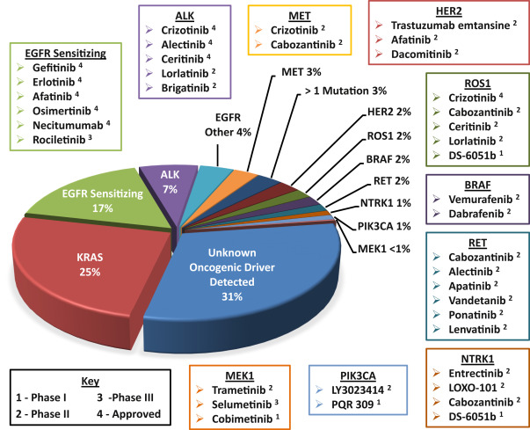
Lung adenocarcinoma
Tsao et al, 2016

Slide 13
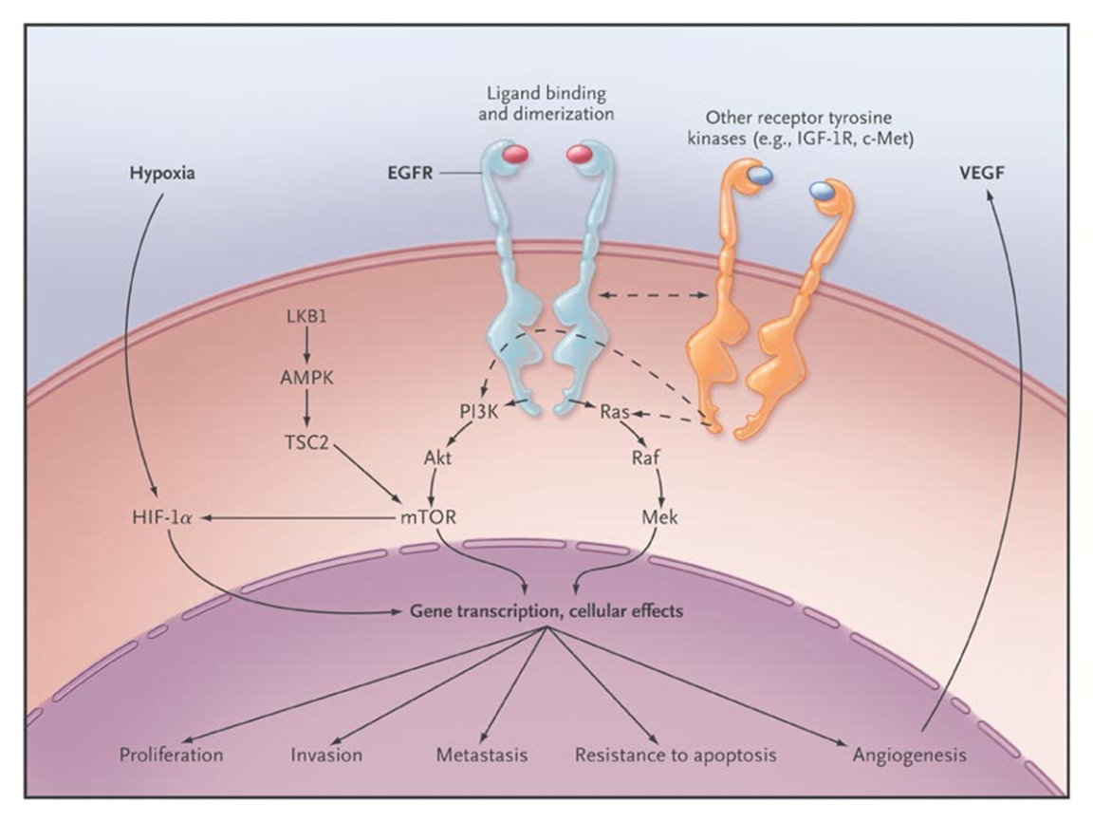
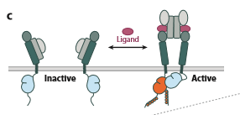
EGFR pathway and “target therapy” in lung cancer
EGFR was identified as a target of drug inhibitors in ‘90
Reversible inhibitors
Gefitinib (Iressa)
Erlotinib (Tarceva)
were approved by FDA in 2003 and 2004

Slide 14
Responsiveness to TKIs was associated with the presence of mutations in tyrosine kinase domain of EGFR
Oncogene addiction theory
A tumor dependence of a particular genomic alteration
to maintain the malignant phenotype
EGFR pathway must be activated to be useful as TKIs target
Responsive patients were only a subset of NSCLC (15%):
adenocarcinomas, women, non-smoking

Slide 15
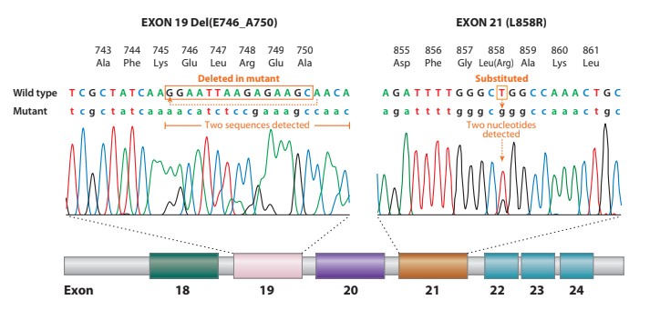
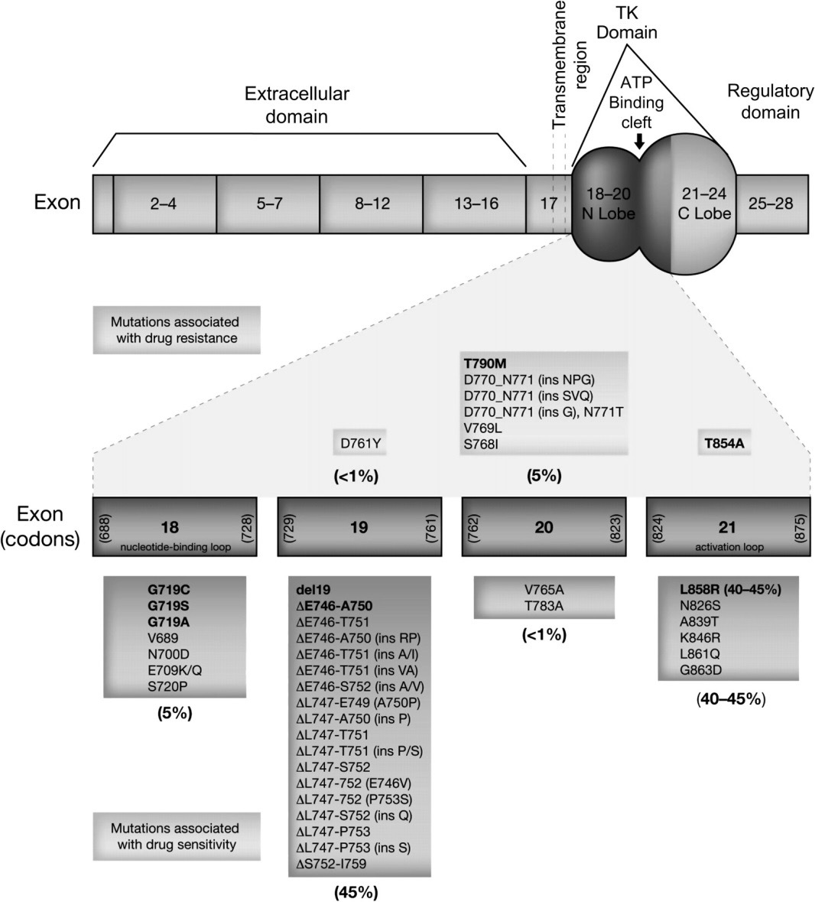
EGFR mutations in NSCLC (2004-2014)
Most responsive mutations are (90%):
in-frame deletions in exon 19
missense mutations L858R in exon 21
Da Cunha Santos et al ,2011
Rare mutations in exons 18-21 are also associated with TKI responsiveness
Gately K et al., J Clin Pathol 2012;65:1-7

Slide 16
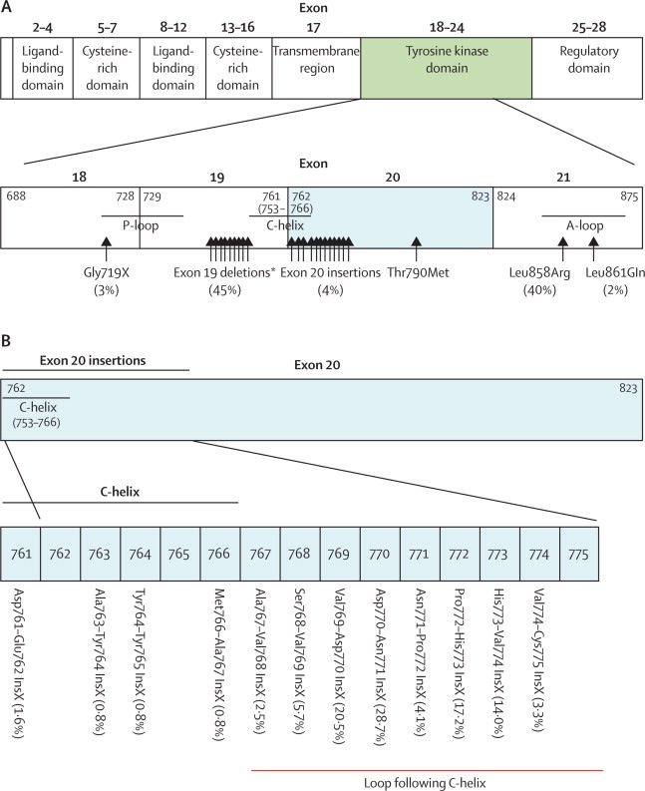
EGFR mutations in NSCLC (2004-2014)
New mutations…
Yasuda et al., Lancet Oncol.,2012
Insertions in exon 20 account for 4%
Mutations in exon 20 confer resistance to TKIs treatment

Slide 17
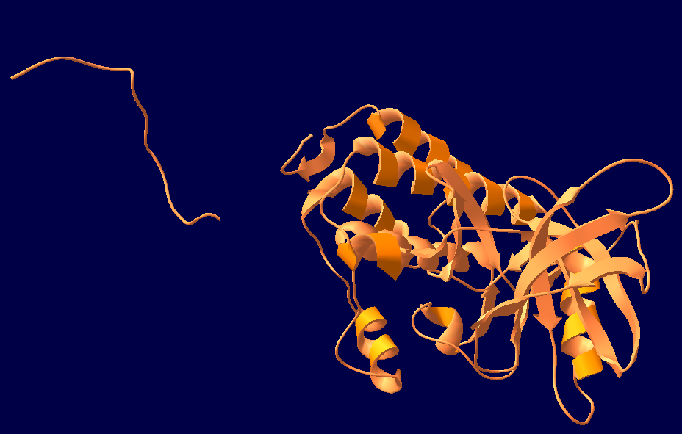
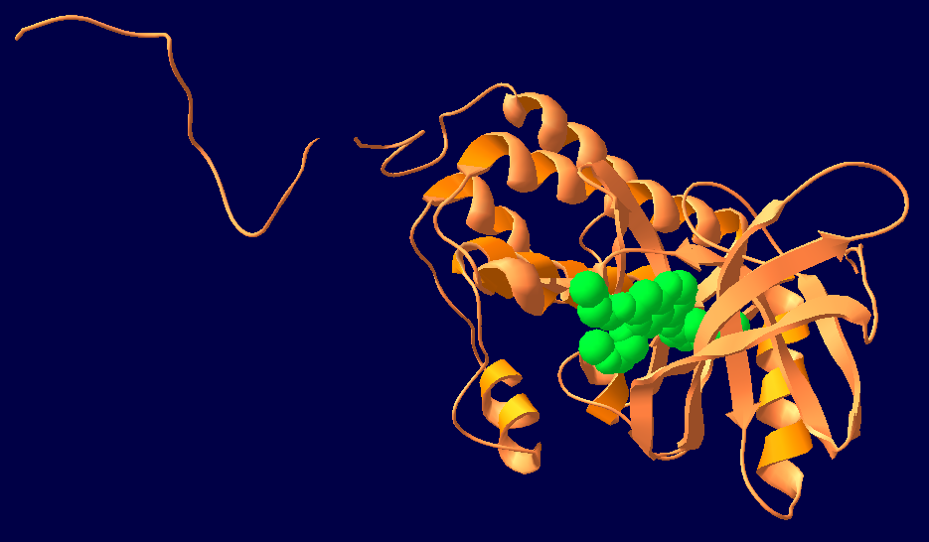
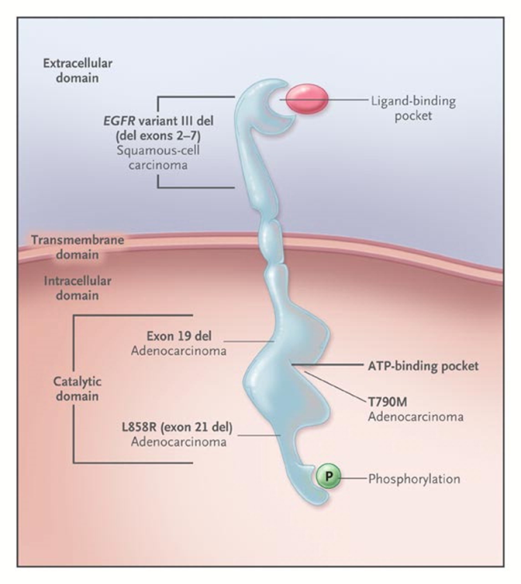
Why only some mutations confer TKI sensitivity ?
EGFR
TKIs
Gefitinib/erlotinib compete with ATP for the same site in the ATP-binding pocket.
Exon 19 del and L858R are located near this site

Slide 18
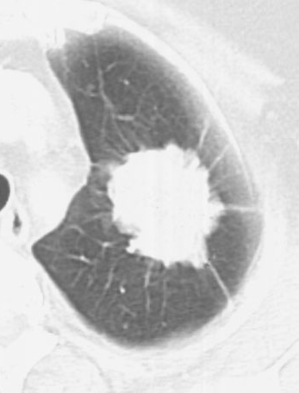
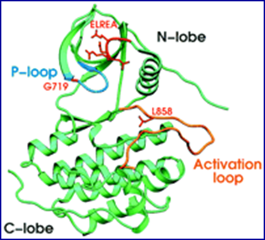
TKIs treatment causes a shrinkage of the primary lesions and metastasis
Day 1
adenocarcinoma with exon 19 Δ in 77 years old woman
Day 53
Responsiveness to TKIs depends on the type of the EGFR mutation
Disease-free survival (DFS)
exon 19 Δ 12 months
L858R 5 months
Overall-survival (OS):
Exon 19 Δ 36 months
L858R 8 months
This difference depends on the ability of the drugs to inhibit the downstream phosphorylation of mutated EGFR

Slide 19
EGFR and TKi treatment
EGFR increased copy number (ICN) in addition to EGFR mutations
Cappuzzo et al., J Natl Cancer Inst 2005
EGFR amplification and chromosome 7p polysomy may be associated with TKIs responsiveness

Slide 20
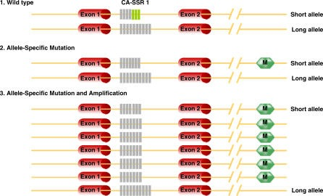
What mechanisms underlying the association of mutation and amplification in the same EGFR allele ?
Three polymorphisms have been found associated with increased EGFR protein production -shorter CA-SSR1 length, in intron 1, and the variant forms of SNPs - 216 and – 191 in the promoter-
EGFR mutations were found to favor the shorter allele of CA-SSR1, and selective amplification of the shorter allele of CA-SSR1 occurred frequently in tumors harboring a mutation.
Nomura et al., Plos Med, 2007
Similar associations have been reported in other oncogenes - cKIT or KRAS

Slide 21
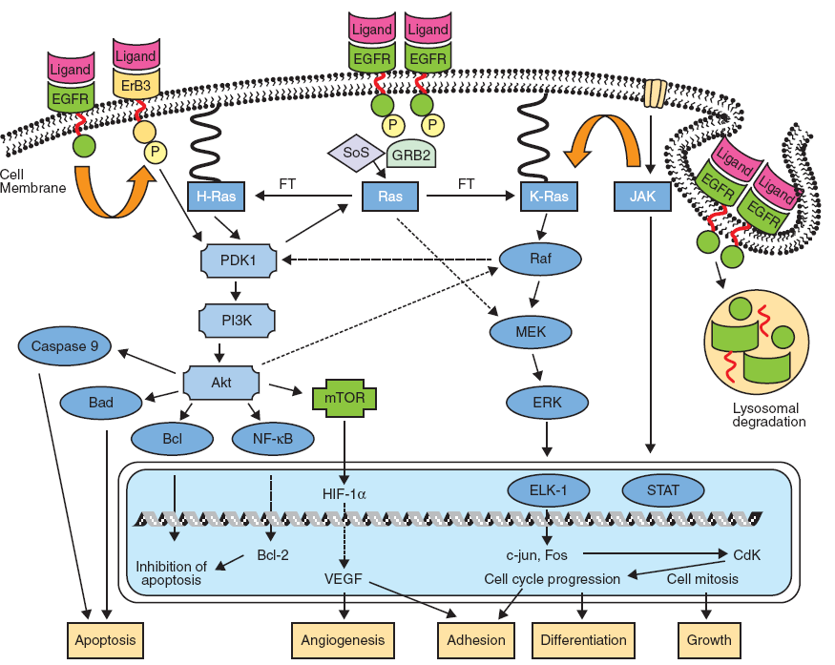
Primary resistance to TKIs treatment
TKi responsiveness is abrogated by the acquisition of genetic alterations affecting genes involved in other pathways
MAPK pathway gene mutations
MET gene amplifications
HER2 mutations
Alternative drugs targeting
pathway P13K-mTOR-AKT
pathway RAS-RAF-MEK-ERK-ERK
LKB1
AMPK
TSC1/2
Secondary resistance to TKIs treatment
Second EGFR mutations on exon 20, particularly T790M
(Rocha-Lima et al., 2007)

Slide 22
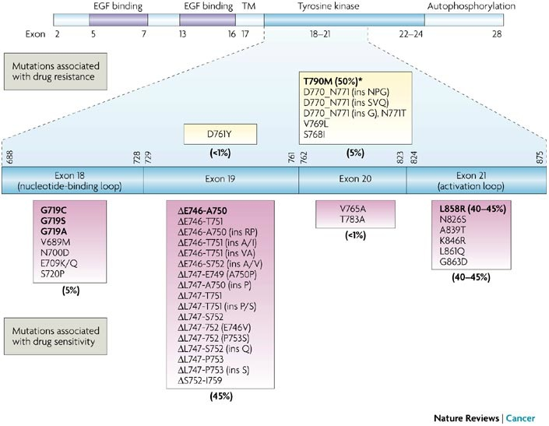
Responsiveness to TKIs can be abrogated by secondary mutations in EGFR kinase domain
the story of T790M
T790M is selected by TKI treatment

Slide 23
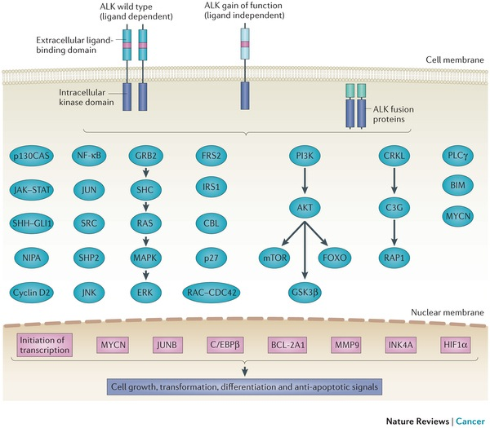
Other genetic abnormalities with «driver» characteristics in NSCLC : anaplastic lymphoma kinase (ALK) gene rearrangements
chromosome 2p inversion leading to a fusion with echinoderm microtubule–associated protein like 4 (EML4) gene
Hallberg and Palmer, Nat Rev Cancer, 2013
This rearrangement occurs in 2-5% NSCLC, 50 years or younger, never or former smokers with adenocarcinoma, independently from EGFR or KRAS gene mutations

Slide 24
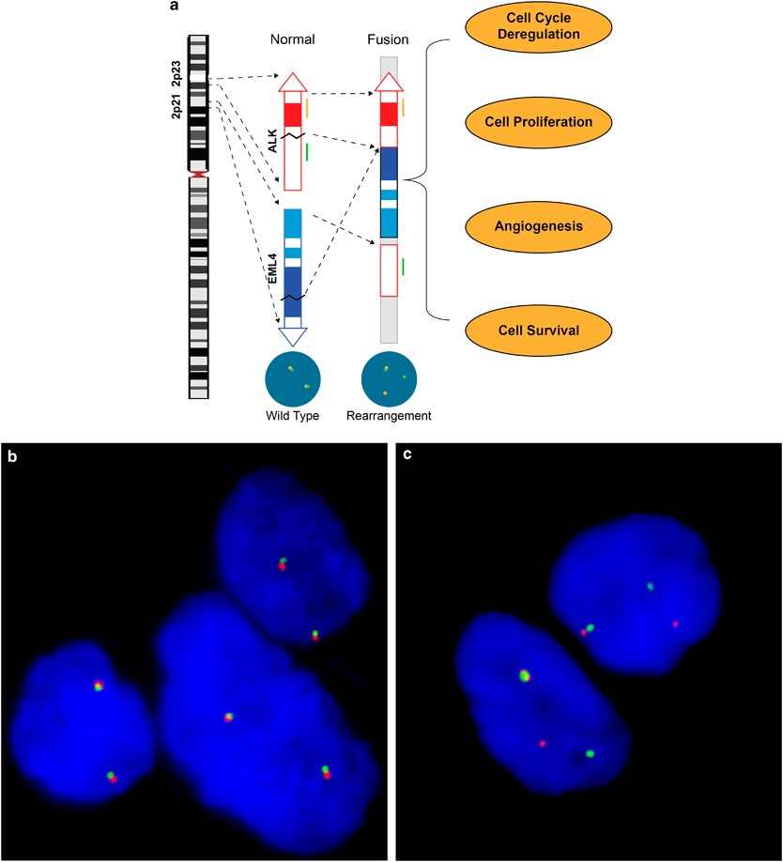
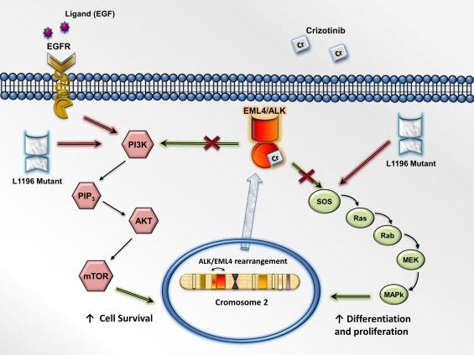
A fluorescent in situ hybridization assay was approved by the US Food and Drug Administration (FDA) as the standard method for the detection of ALK gene rearrangement
Crizotinib, a first-in-class dual ALK and c-MET inhibitor, has been shown to be particularly effective against ALK positive NSCLC

Slide 25
Mutations detection
PCR
Sequencing
SSCP
DHPLC
FISH
IHC
WT cell ‘contamination’
FFPE samples
Molecular profiling
High sensitivity
High specificy
High thoughput
Cost effectiveness
Mass spectrometry
OncoCartaTM MassARRAY ® chip (Sequenom, CA)
238 mutations in 19 oncogenes

